Slide 1
Experiment instruction
On each trial, a cross sign will appear at the center of the screen to tell you that a new trial will start. Then a dot appears, which indicates the tones will be played soon.
On each trial, you will hear a series of tones followed by a gap and two pairs of tones. There will be a delay between the pairs. After listening to the second pair of tones, please respond whether the duration of the second pair is shorter or longer than the duration of the first pair. Please press F key on the keyboard by your left index finger if the second one is longer than the first one. Please press J key by your right index finger if the second one is shorter.
Please ignore the series of tones before the gap and focus on the two pairs after the gap.

Slide 2
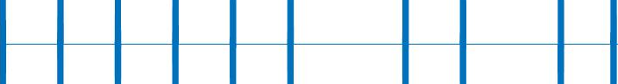
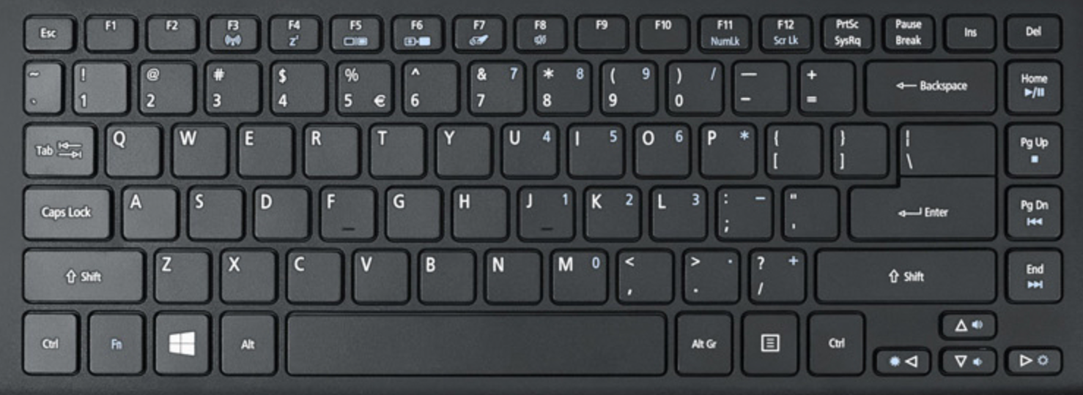
First pair
Second pair
Gap
Delay

Slide 3
First pair
Second pair
Delay

Slide 4
First pair
Second pair
Gap
Delay

Slide 5
First pair
Second pair
Gap
Delay

Slide 6
Experiment instruction
You will have a chance to take a break in each 54 trials. It’s up to you to take a break or keep doing the experiment. It’s also up to you for how long you want to rest. If you want to continue without taking a rest, just press space key on the keyboard to go on. The whole experiment will be three sessions, including practice, session 1 and session 2. There will be a 10 mins break between session 1 and session 2. The duration may depend on how long your breaks and reaction times are.

