Slide 1



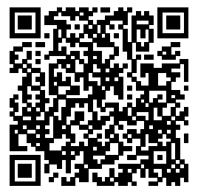

Let's Build:
Product Intelligence Engine with AI
Tze'ela Melzer, Product Manager, Microsoft MDO
Join the PM WhatsApp group!

Slide 2
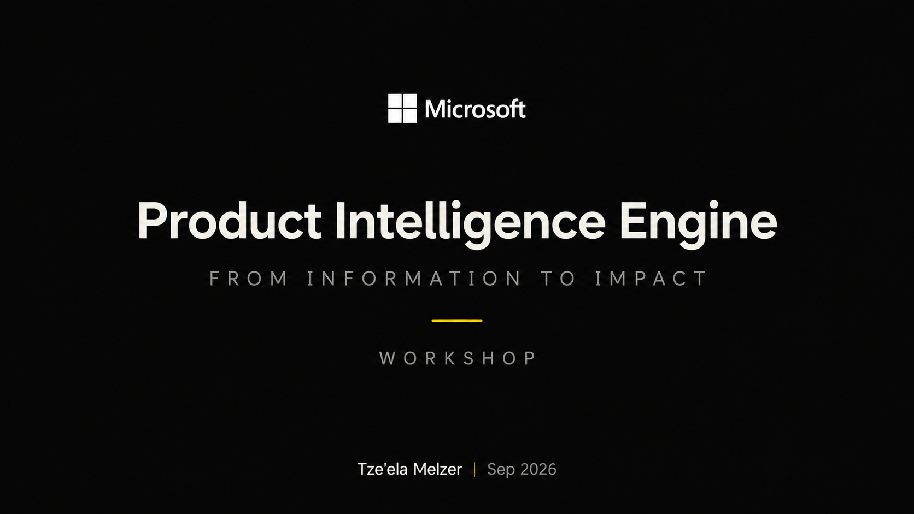

Slide 3
PLAN
• PLAN • THEORY • BUILD • TEST • AUTOMATE • SHARE
How we'll work today.
A simple plan: understand the pattern, build together, and leave with a working signal.
01
Why this matters
Turn information overload into a repeatable signal.
02
See the target outcome
Look at the kind of brief we want to create.
03
Build the Skill in Scout
Define the job, sources, scoring, output, and guardrails.
04
Test and automate
Refine the result and put it on a schedule.
05
Share and improve
Leave with something useful that you can keep running.
You leave with a working Skill, a tested result, and an Automation.

Slide 4
THEORY · WHY
• PLAN • THEORY • BUILD • TEST • AUTOMATE • SHARE
A. Competitor launches an AI assistant
B. An API your product depends on will be deprecated
C. AI adoption grew 42%
D. Customer complaint gets 1,200 reactions
Notes:
“The annoying answer is: I don’t know.”
“Because a signal isn’t defined by the information. It’s defined by the decision it can change.”
The problem isn’t finding information. It’s deciding what matters.

Slide 5
THEORY · WHY
• PLAN • THEORY • BUILD • TEST • AUTOMATE • SHARE
The problem isn't finding information.
It's deciding what matters.
DOCS · BLOGS · ROADMAPS · GITHUB · COMPETITORS · CUSTOMER SIGNALS
One update can change your roadmap.
The right ones create momentum.
The workshop helps you encode that judgment once - then reuse it every day.
Notes:
“Competitors. Customer complaints. Roadmap changes. APIs. AI updates. Anything you keep checking because you’re afraid that if you don’t — you’ll miss something important.”
“Keep that thing in your head. Because by the end of this workshop, I want it to be running without you.”

Slide 6
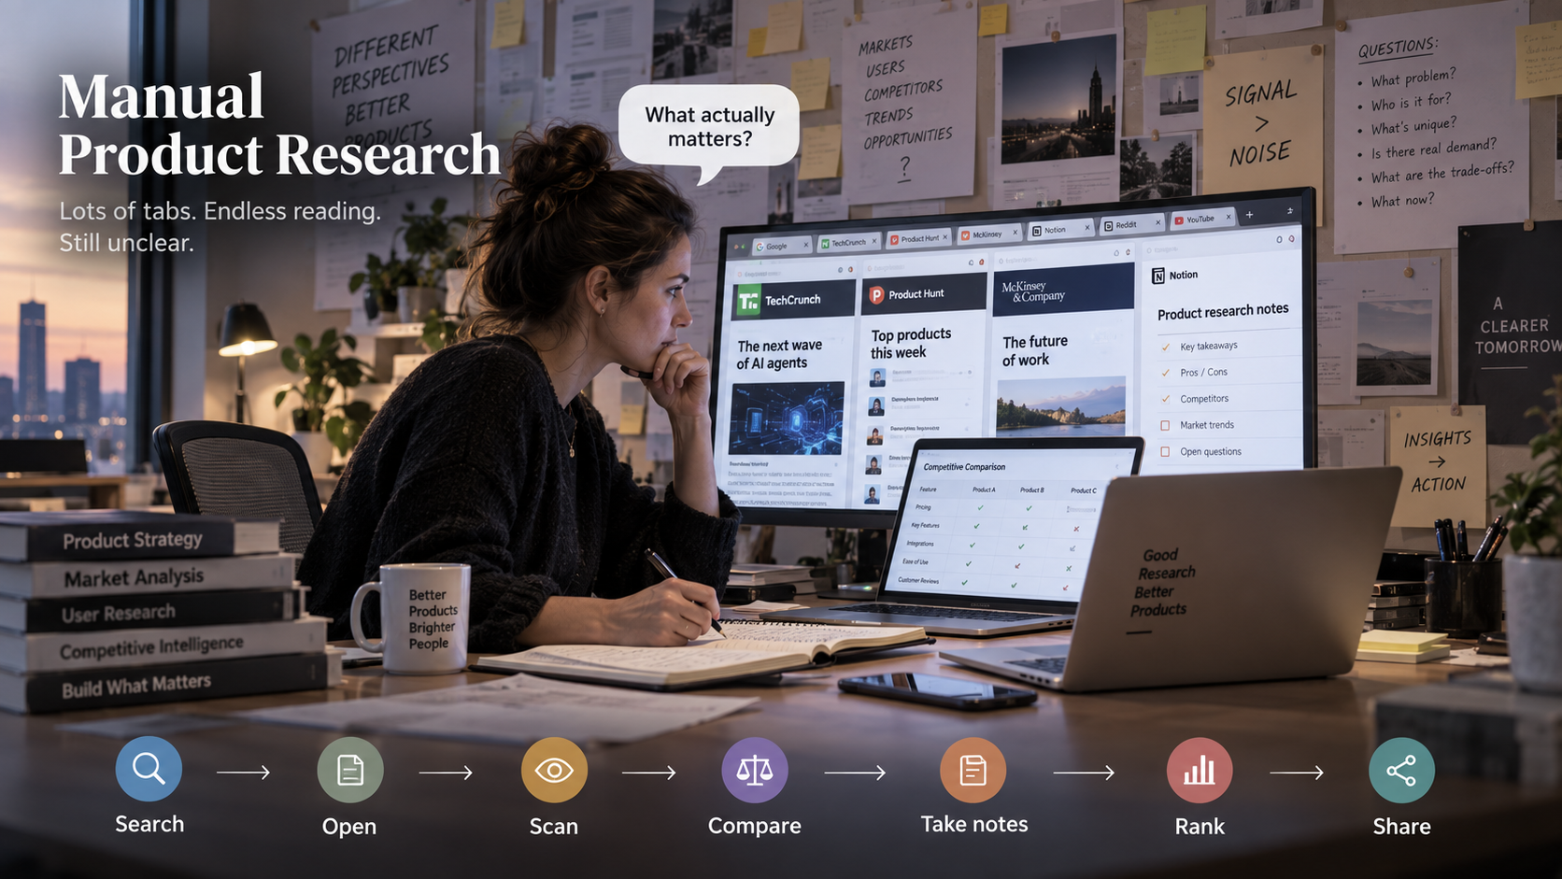

Slide 7
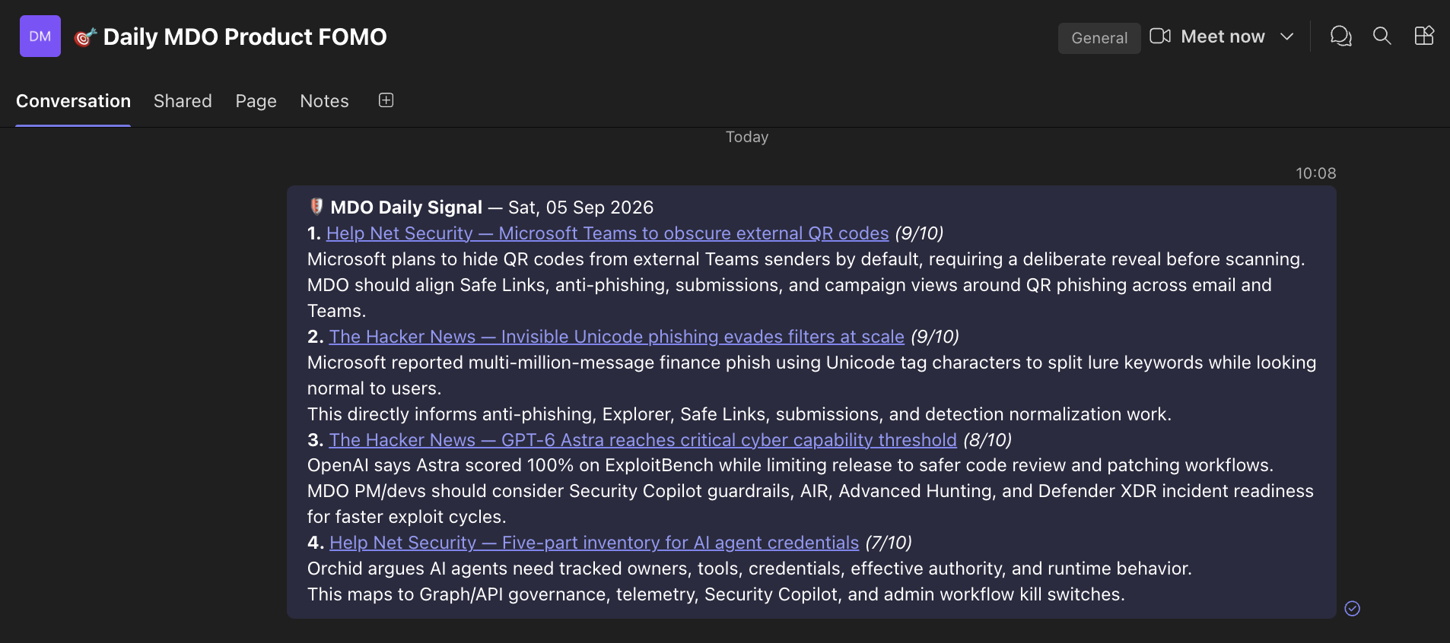
THEORY · OUTCOME
• PLAN • THEORY • BUILD • TEST • AUTOMATE • SHARE
This is the outcome.
A tiny daily brief: ranked, explained, and actionable.
3-5 signals · what changed · why it matters · linked source
Notes:
7–12 min. Show the MDO example you already run.,Do not explain the implementation yet. Ask the room what they notice: small number of items, scoring, why-it-matters, source links.

Slide 8
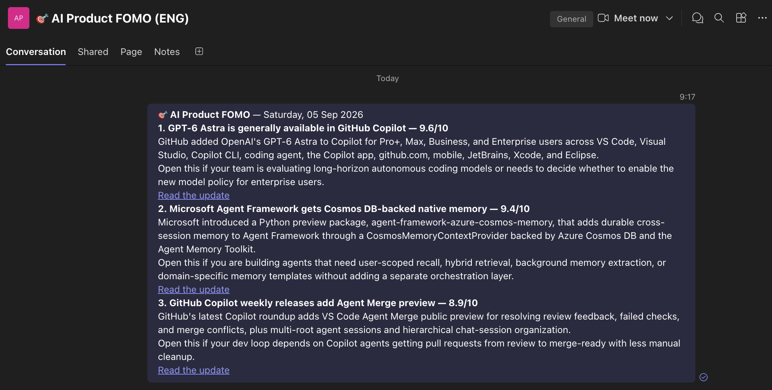
THEORY · REUSABILITY
• PLAN • THEORY • BUILD • TEST • AUTOMATE • SHARE
Same engine. Different job.
The rules change. The workflow doesn’t.
DOMAIN → SOURCES → SCORING → OUTPUT → SCHEDULE

Slide 9
THEORY · MENTAL MODEL
• PLAN • THEORY • BUILD • TEST • AUTOMATE • SHARE
A Skill is a reusable decision system.
Five layers. Automation puts them on a cadence.
01
Job
What decision should this help me make?
PURPOSE
02
Scope
Where should it look - and how fresh?
RESEARCH
03
Signal
What deserves a 9/10 - and what gets ignored?
RANKING
04
Output
Exactly what should land in my inbox or channel?
FORMAT
05
Guardrails
What must never leak or happen automatically?
SAFETY
AUTOMATION = skill + cadence + destination + duplicate protection

Slide 10
BUILD TOGETHER
• PLAN • THEORY • BUILD • TEST • AUTOMATE • SHARE
Build it.
We build it together.
Open Scout. Start a new chat. We move together.
RULE FOR THIS WORKSHOP
Start simple. We build the rules one layer at a time.

Slide 11
HANDS-ON · STEP 0
• PLAN • THEORY • BUILD • TEST • AUTOMATE • SHARE
Pick one thing you repeatedly hunt for.
Narrow beats impressive.
competitors · dependency changes · customer friction · AI/platform updates · security signals
I want to build a daily Product Intelligence Engine for my area.
Help me turn one recurring research problem into a reusable Skill + Automation.
Ask me one question at a time. Do not create the Skill yet.
Checkpoint: you can describe the problem in one sentence.

Slide 12
HANDS-ON · STEP 1
• PLAN • THEORY • BUILD • TEST • AUTOMATE • SHARE
Give Scout the job.
Domain + audience + decision impact.
My domain is [DOMAIN].
The audience is [PM / dev / team].
The job is to surface only updates that could change a roadmap decision, implementation plan, customer communication, or priority.
Help me sharpen this into one sentence.
GOOD JOB STATEMENT
“Only surface things that could change what we decide or do.”

Slide 13
HANDS-ON · STEP 2
• PLAN • THEORY • BUILD • TEST • AUTOMATE • SHARE
Define the hunting ground.
Choose where to look - and when to stop looking.
Research the last 24 hours first.
Prioritize: [official docs / roadmap / GitHub / competitors / research / public customer friction].
Prefer primary sources.
If fewer than 3 strong items exist, use a 7-day fallback and label it.
Avoid duplicates.
3-6
source categories
a focused source set
Freshness first. Use fallback only when it adds value.

Slide 14
HANDS-ON · STEP 3
• PLAN • THEORY • BUILD • TEST • AUTOMATE • SHARE
Teach it what ‘important’ means.
This is where your judgment becomes reusable.
10
Influence work now
Direct product / API / competitor / threat shift
Score each candidate 1-10 for usefulness to [AUDIENCE].
Tie-break by direct impact, actionability, freshness, and source confidence.
Reject generic, old, duplicate, or weakly connected items.
8-9
Strong signal
Clear roadmap, UX, platform, customer or dev implication
6-7
Useful context
Use when it adds helpful context
1-5
Lower priority
Generic, old, duplicate or weakly connected
Your score is the product.
With clear selection rules, automation scales signal.

Slide 15
HANDS-ON · STEP 4
• PLAN • THEORY • BUILD • TEST • AUTOMATE • SHARE
Lock the output.
Make the result easy to scan - every single day.
1. Linked headline (9/10)
Return 3-5 ranked items.
For each: linked headline + score, one sentence on what changed, one sentence on why I should care.
Keep the final message under 220 words.
No source footer when the headline is already linked.
Also show a local-only research progress block.
What changed - one sentence.
Why it matters to my domain - one sentence.
The output contract is a UX decision.
Checkpoint: the answer should fit on one screen.

Slide 16
HANDS-ON · STEP 5
• PLAN • THEORY • BUILD • TEST • AUTOMATE • SHARE
Add guardrails before autonomy.
Safe defaults make automation usable.
01
Public by default
Team-postable output uses public sources only.
PRIVACY
02
No private leakage
Internal/customer/tenant data requires explicit approval.
SAFETY
03
No surprise actions
Testing must not post, change, or remediate anything.
CONTROL
Public/team-postable output must use public sources only.
Do not include private email, Teams, calendar, customer, tenant, or internal document content unless I explicitly approve the exact content.
While testing, never post or change anything automatically.

Slide 17
HANDS-ON · STEP 6
• PLAN • THEORY • BUILD • TEST • AUTOMATE • SHARE
Turn the conversation into a Skill.
Now Scout packages the rules so you can reuse them.
Turn everything we defined into a reusable Skill called [NAME].
Make it self-contained with:
Purpose · Research scope · Selection rubric · Required output format · Guardrails · Automation pattern · Quality bar.
Show me the Skill before saving it.
SKILL ANATOMY
01
Purpose
02
Scope
03
Selection
04
Output
05
Guardrails
06
Automation
07
Quality bar
Review the rules.
Keep the structure clear.

Slide 18
TEST
• PLAN • THEORY • BUILD • TEST • AUTOMATE • SHARE
Test the system once - before scheduling it.
Refine the rule based on today's answer.
Run [SKILL NAME] now.
Show me the final message and research progress.
THEN
Critique the result. What is too generic, missing, noisy, or hard to act on?
Propose only the 3 highest-impact rule changes.
A weak item means the selection rule can improve. A long digest means the output contract can be tighter.

Slide 19
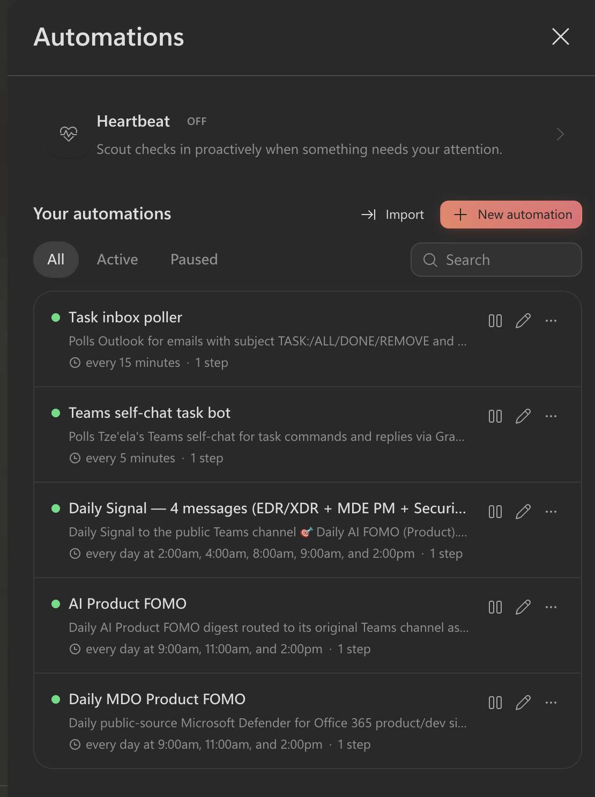
AUTOMATE
• PLAN • THEORY • BUILD • TEST • AUTOMATE • SHARE
Now put it on a clock.
NEW AUTOMATION →
Skill + cadence + destination + duplicate protection.
01
Open Automations → New automation
02
Use the Skill as the task
03
Set cadence + destination
04
Add duplicate protection + success/skip status
Create an automation that runs [SKILL NAME] every weekday at 9:00 Israel time and sends/posts it to [DESTINATION].
Before sending, check whether today’s digest already exists and skip duplicates.
Use public sources only. Return only success/skip status after the run.

Slide 20
SHARE
• PLAN • THEORY • BUILD • TEST • AUTOMATE • SHARE
A signal that works
while you don’t.
01
Skill
The rules are clear enough to reuse tomorrow.
READY
02
Test
The result is useful - not merely interesting.
USEFUL
03
Automation
It is scheduled, safe, and duplicate-aware.
RUNNING
SHARE
What signal did you build - and what did you deliberately exclude?

