Slide 1
Rohm,bd71847 driver Porting on imx8mm platform of Linux 5.10.72 (NXP release)
2020/08/30 Hung

Slide 2
Linux Support Version compare
Porting Step of u-boot
(Linux version 5.10.72)
Porting Step of Linux kernel
(Linux version 5.10.72)
Booting Log
Verify and testing
Note
Appendix

Slide 3
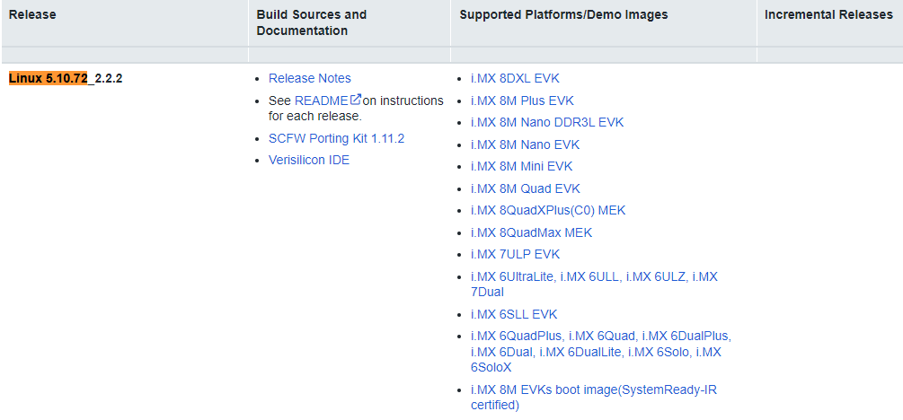
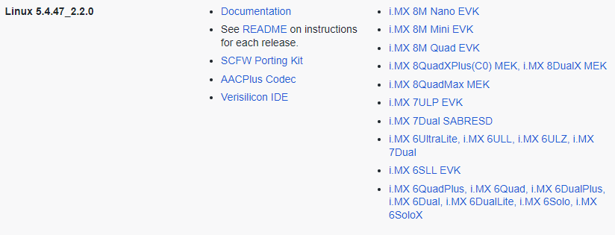
Linux Support Version compare
https://www.nxp.com/design/software/embedded-software/i-mx-software/embedded-linux-for-i-mx-applications-processors:IMXLINUX
Default is not “bd71847”
Default is “bd71847”

Slide 4
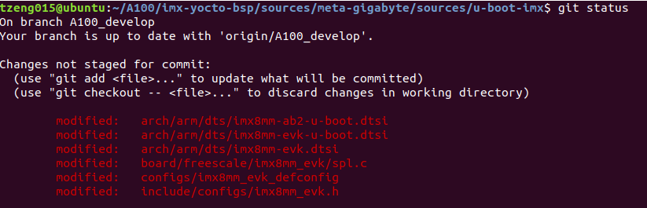
Porting Step of u-boot (Linux version 5.10.72)

Slide 5
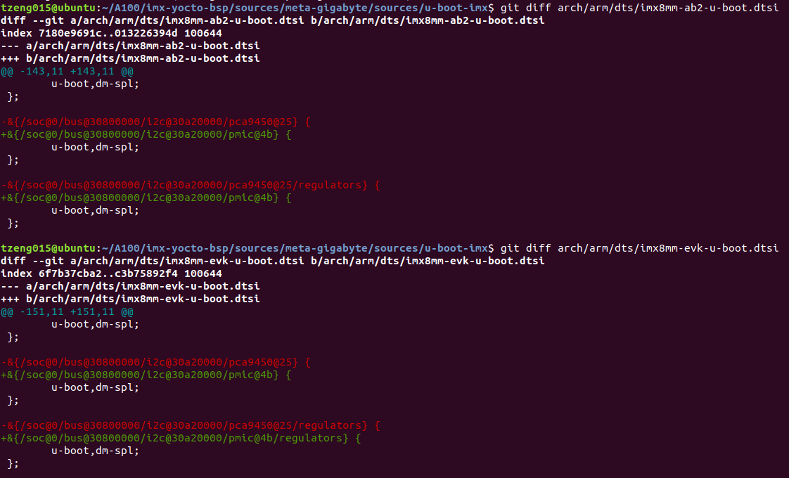
Modify Compiler error
Modify Compiler error

Slide 6
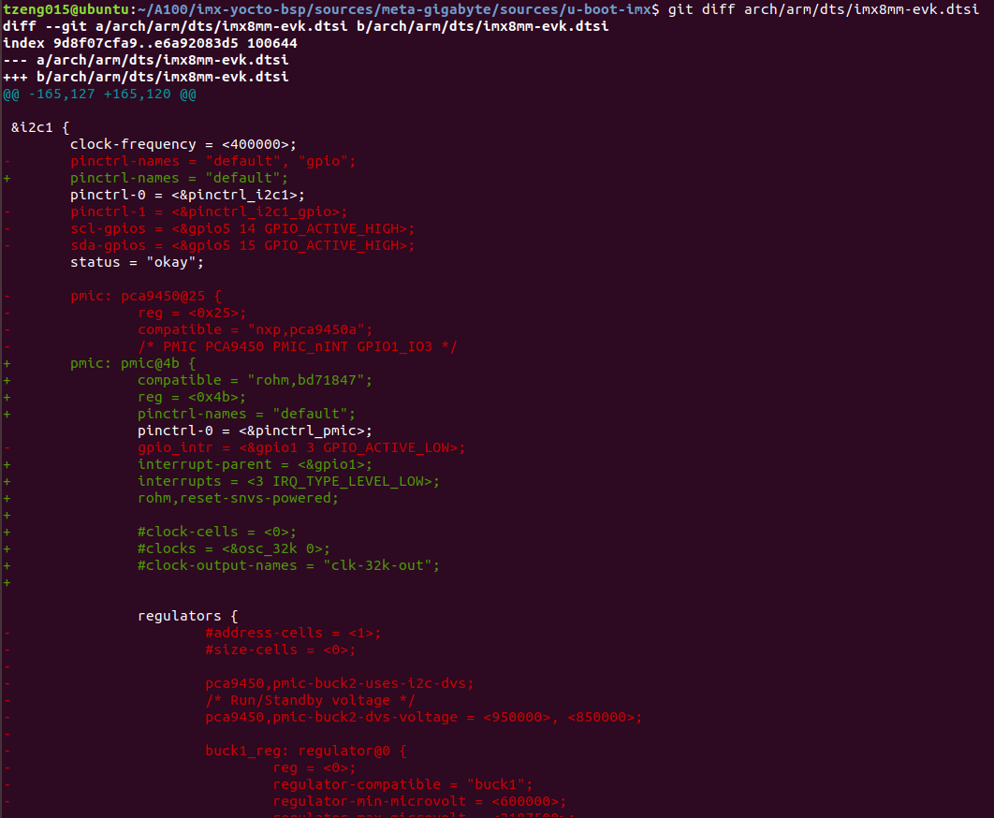
Check the last item ➔ Note 1
It has mask .

Slide 7
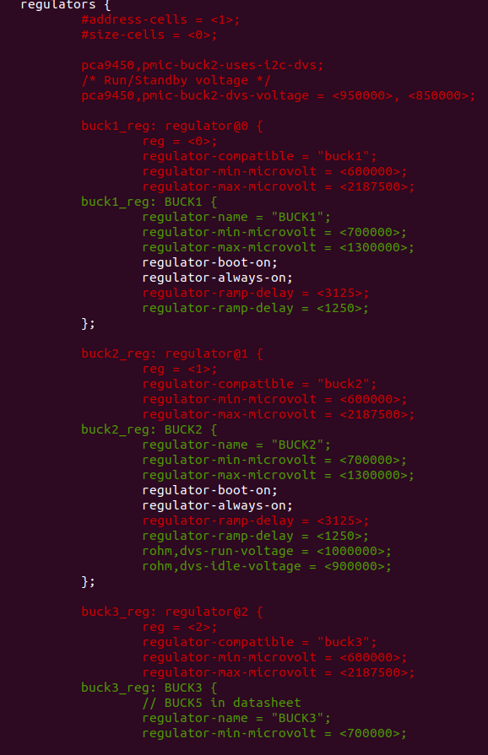
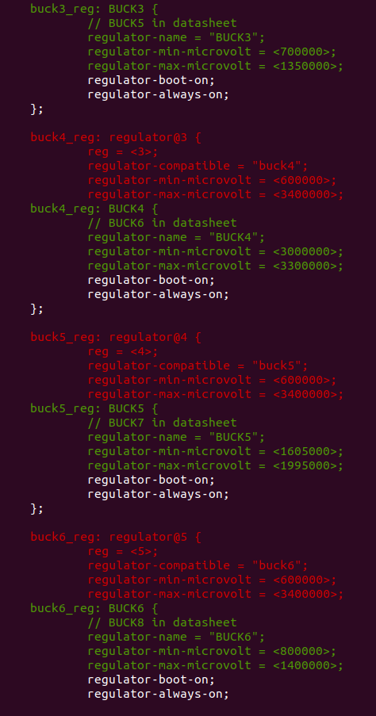

Slide 8
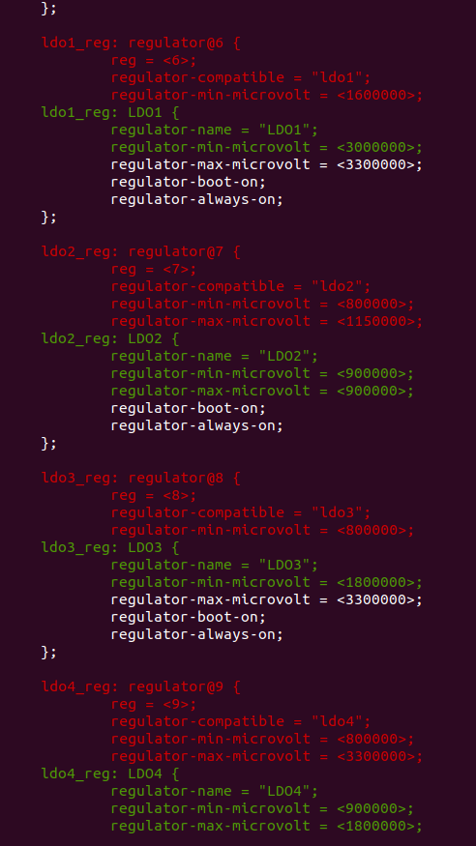
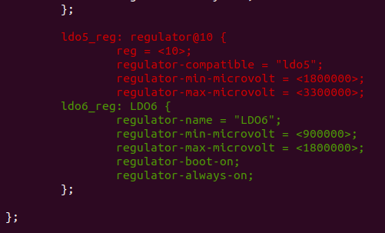

Slide 9
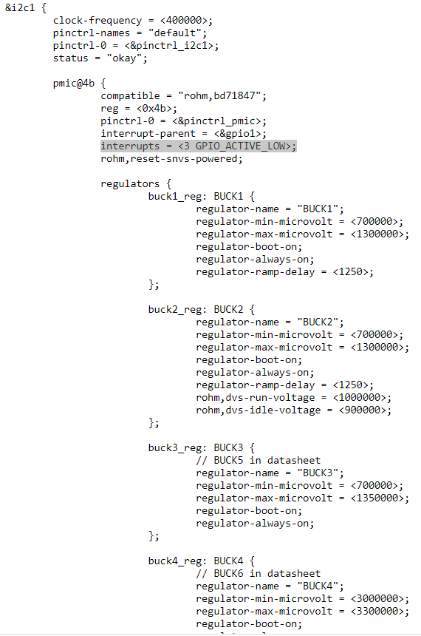
DST reference here
https://source.codeaurora.org/external/imx/linux-imx/tree/arch/arm64/boot/dts/freescale/imx8mm-evk.dts?h=imx_5.4.47_2.2.0
Check the last item ➔ Note 1

Slide 10
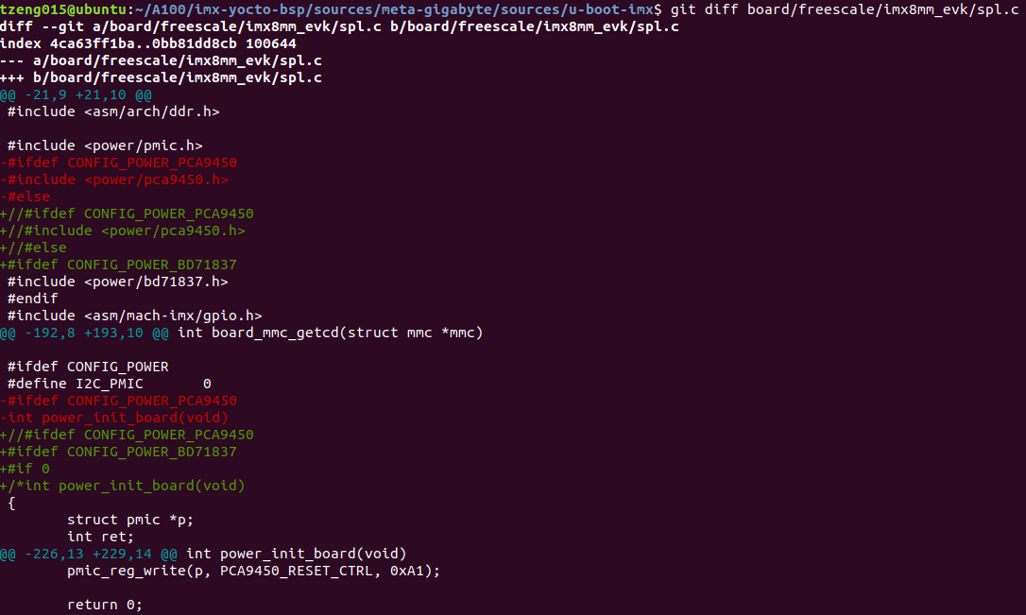
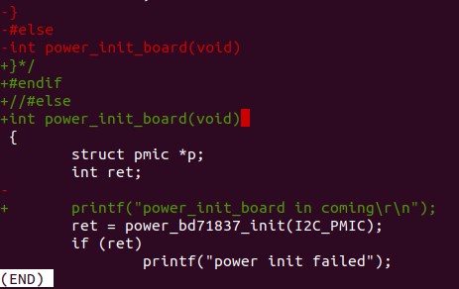

Slide 11
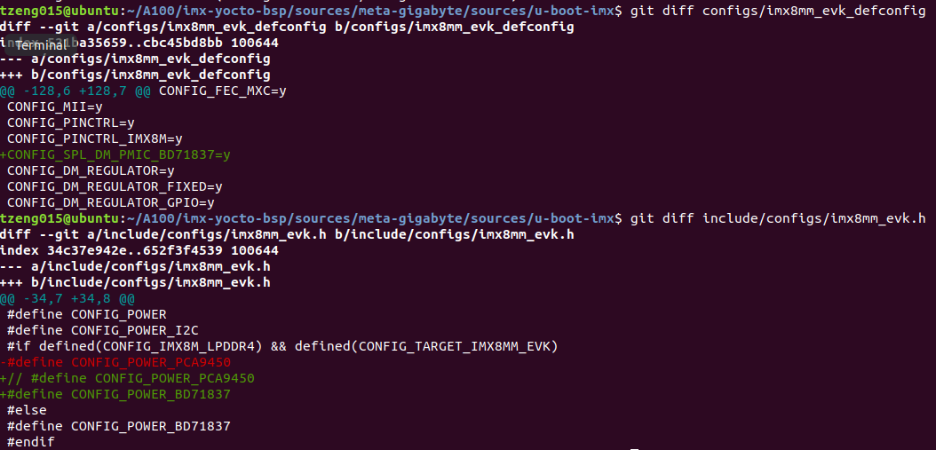

Slide 12
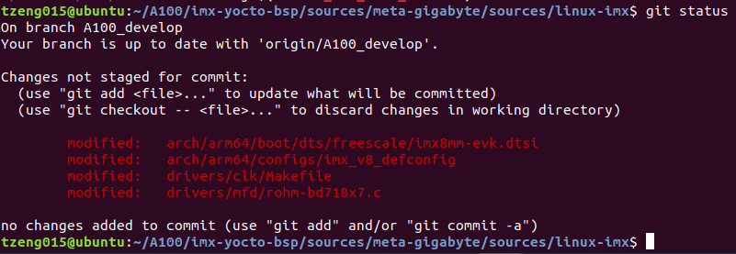
Porting Step of Linux (Linux version 5.10.72)

Slide 13
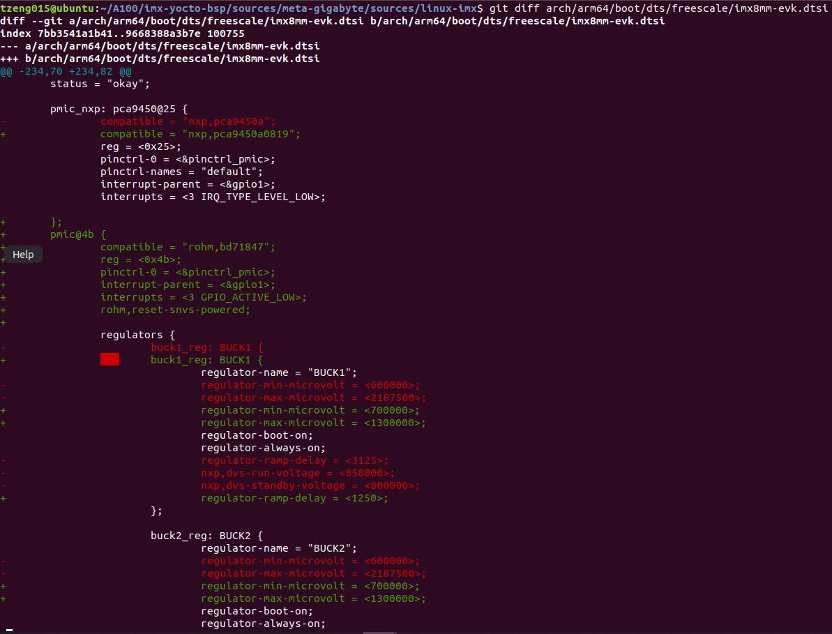
Check the last item ➔ Note 2
Check the last item ➔ Note 3

Slide 14
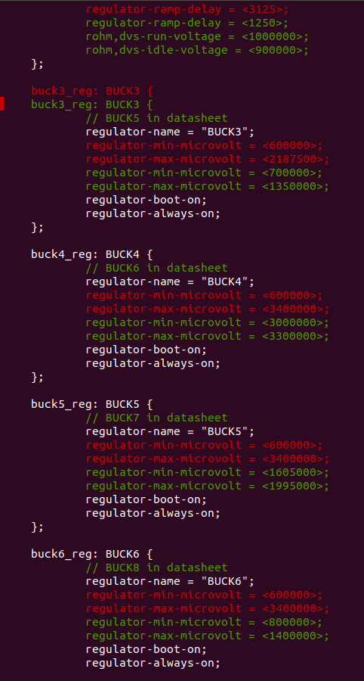
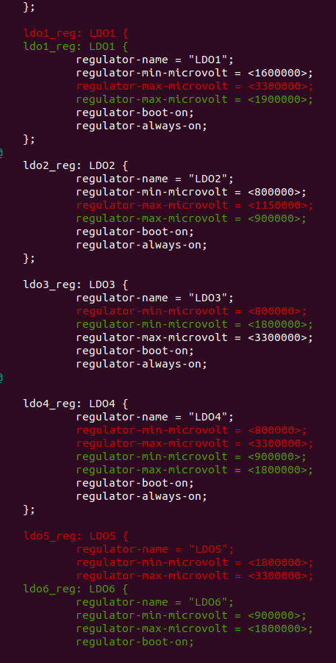

Slide 15
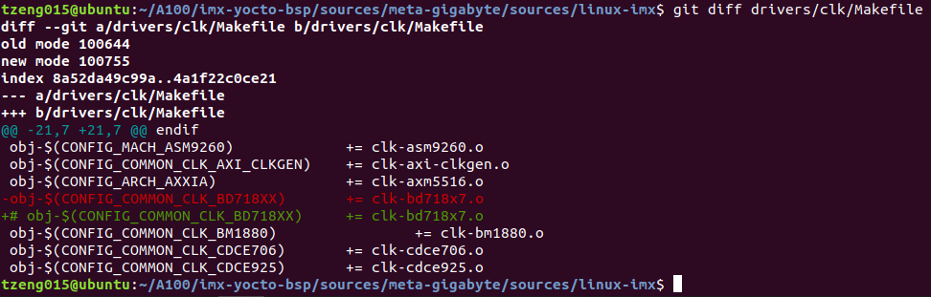
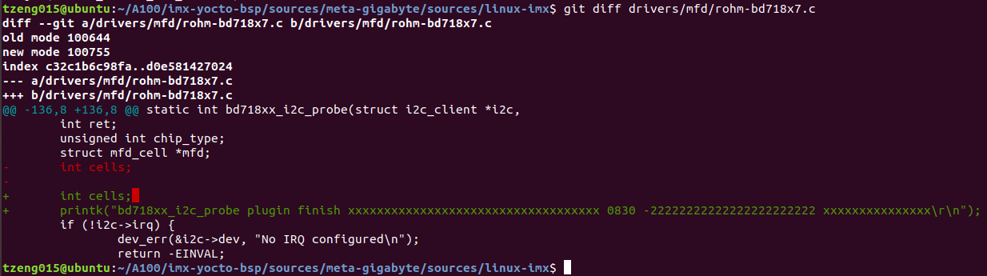
This is check by myself

Slide 16
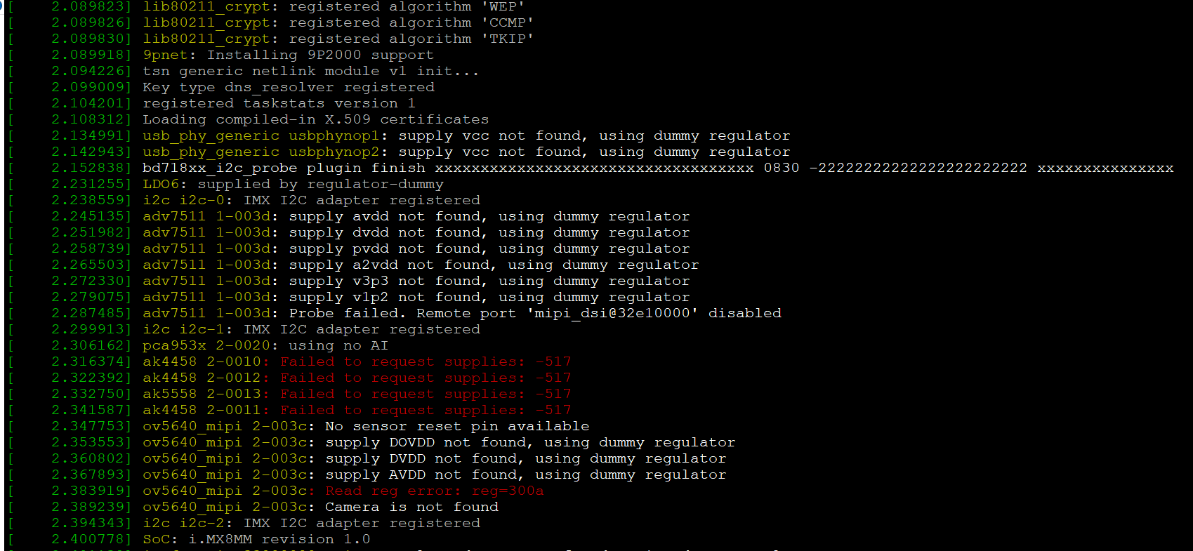
Booting Log

Slide 17
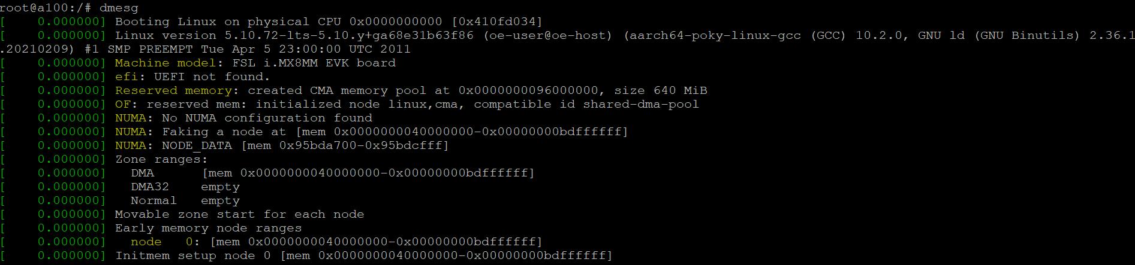
Verify and testing

Slide 18
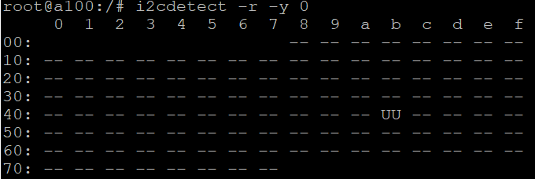

Slide 19
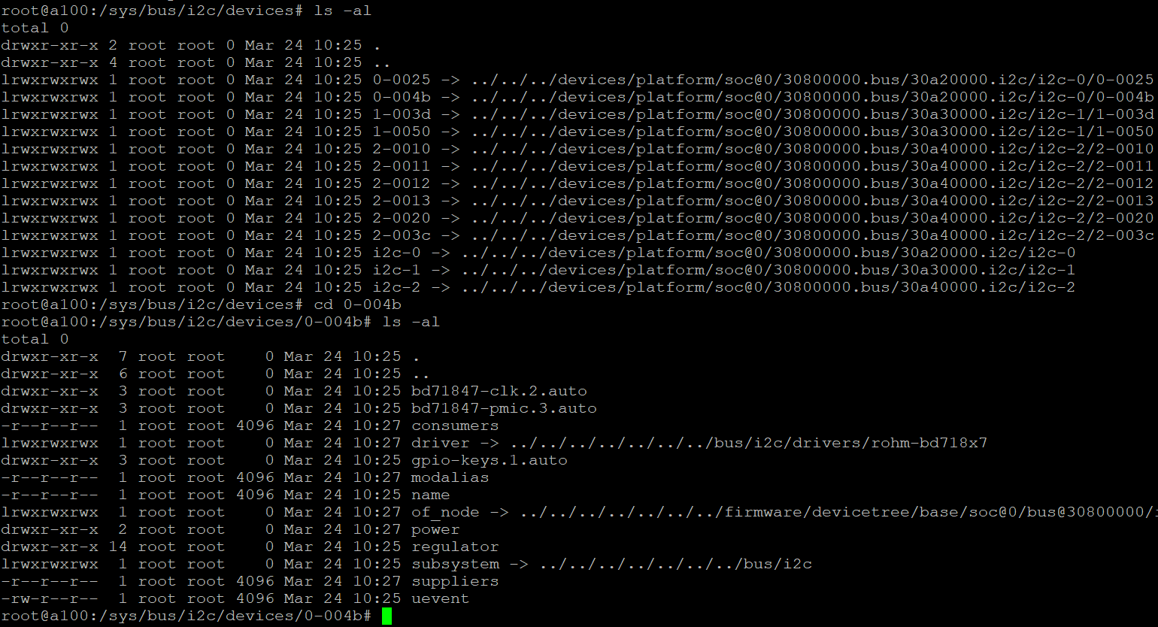

Slide 20
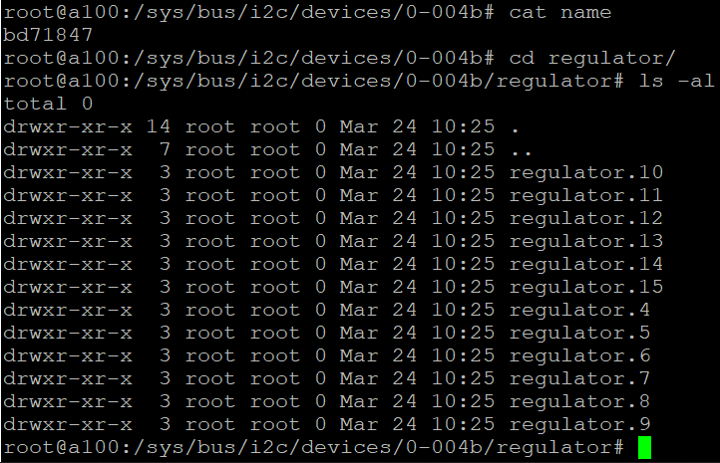

Slide 21
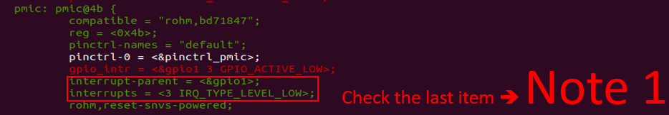
Note
Note 1
Interrupt 3 of GPIO1 . This is PMIC_n_INT . It shall configured according your board

Slide 22
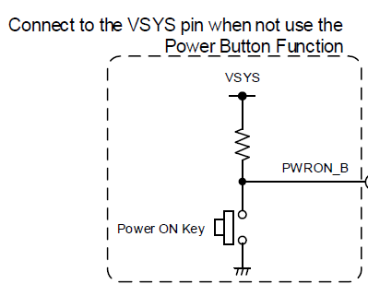

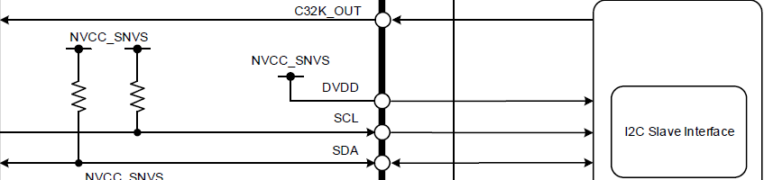
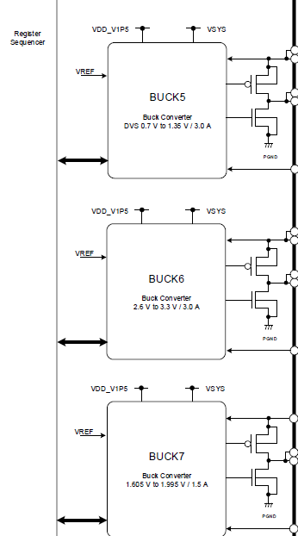
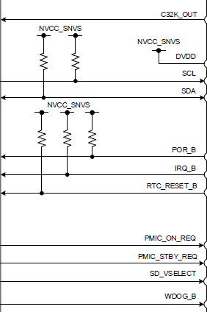
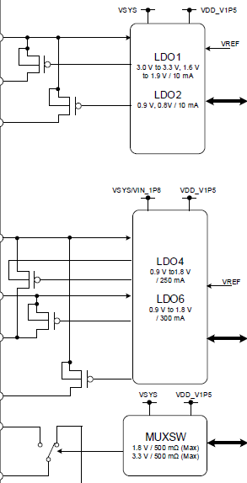
BD71847AMWV
/drivers/input/keyboard/gpio_keys.c
./drivers/regulator/bd718x7-regulator.c
/drivers/clk/clk-bd718x7.c
I2c
SOC
./drivers/mfd/rohm-bd718x7.c

Slide 23
BD71847AMWV
SOC

Slide 24
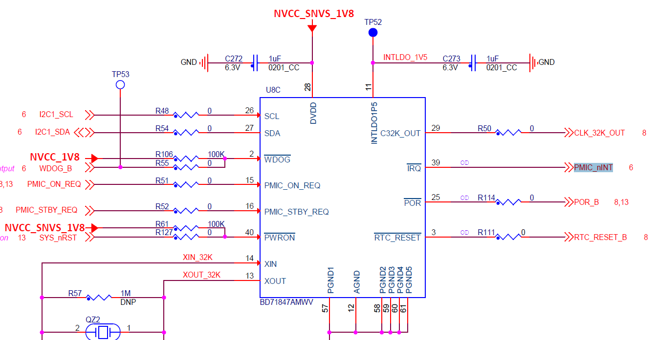
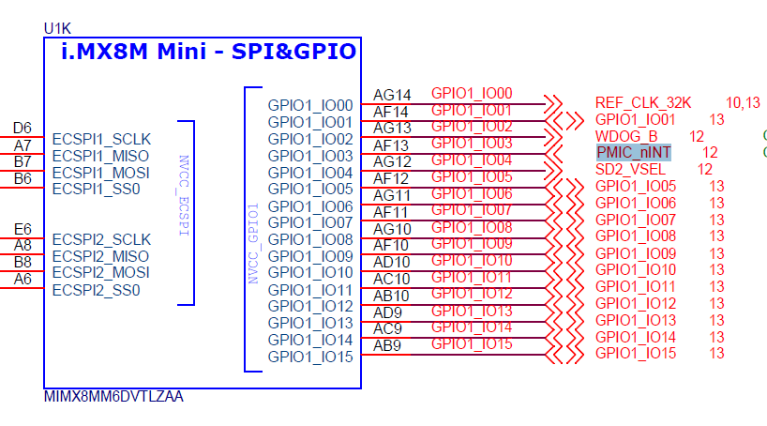

Slide 25
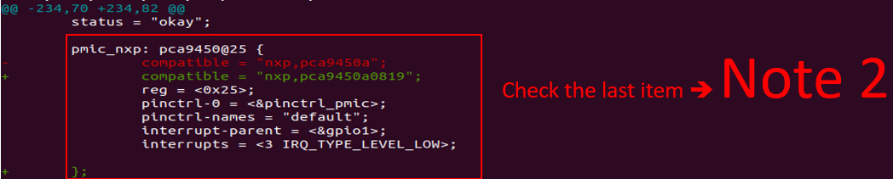
Note 2
It shall keep it because of compiler error. Other files will delete-note so let we keep there.

Slide 26
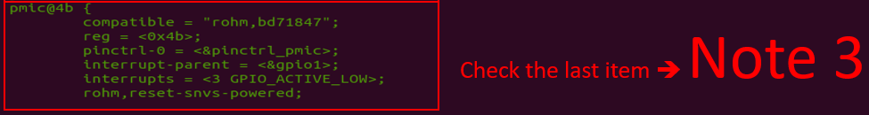
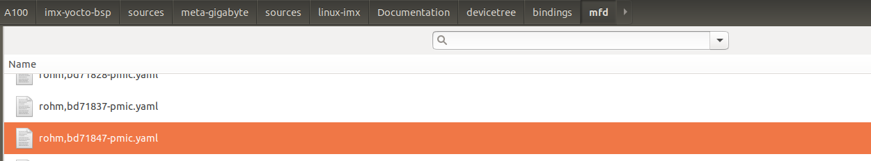
Note 3
Reference the Document inside yocto project

Slide 27
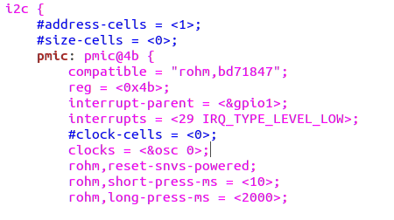
This one is OK
(1)
(1)
(2)
It shall configured according you board map to which interrupt
Clocks configured shall mask it and no use or it will hang during booting.
According the Linux 5.4.47, it only use these two items at imx_v8_defconfig
CONFIG_MFD_ROHM_BD718XX ➔ for BD71837/BD71847 core
CONFIG_REGULATOR_BD718XX ➔ for regulator control
CONFIG_COMMON_CLK_BD718XX ➔ for clock gate control
CONFIG_KEYBOARD_GPIO ➔ for reset induced by short press of power button.

Slide 28
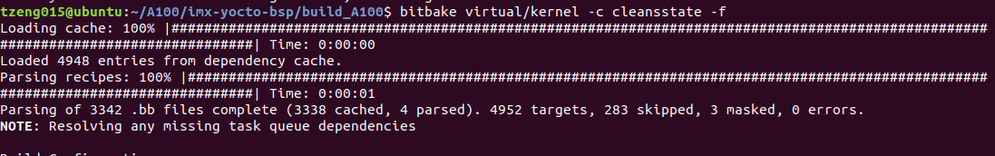
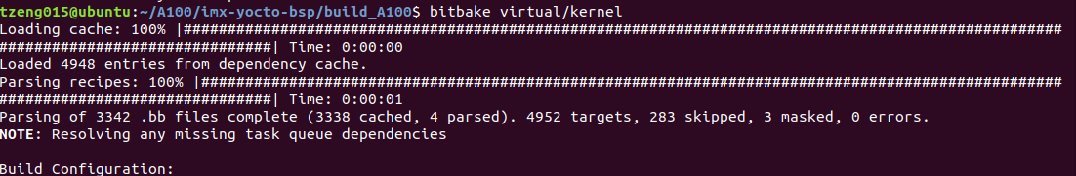
Note 4
When you put these codes to build in you project you have to clean build kernel / u-boot . Then you
can build your image smooth.

Slide 29
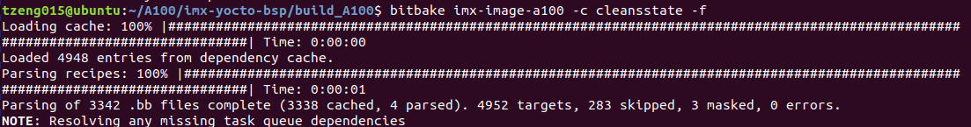
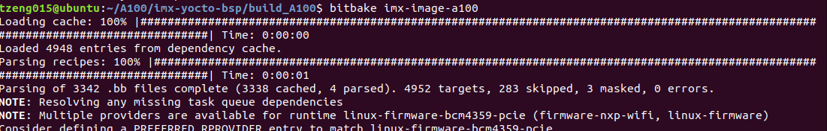

Slide 30
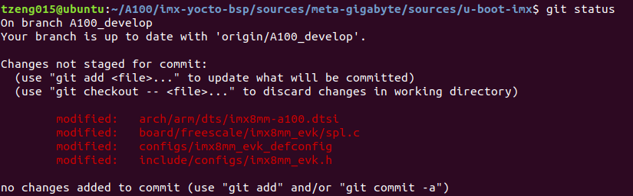
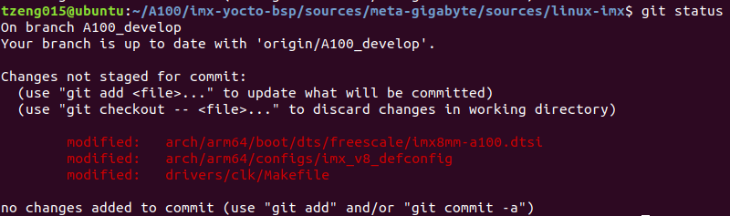
Appendix
A100 Porting state

Slide 31
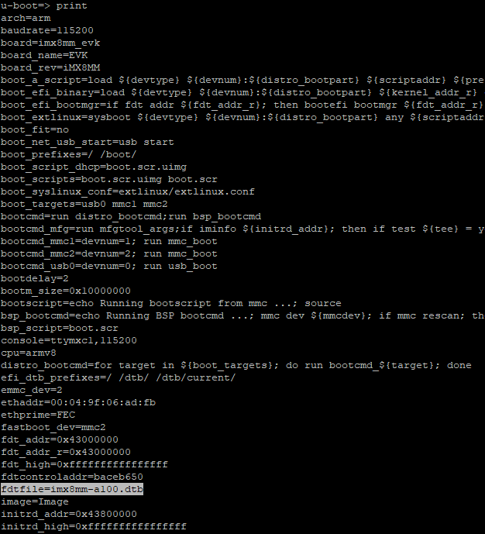

Slide 32
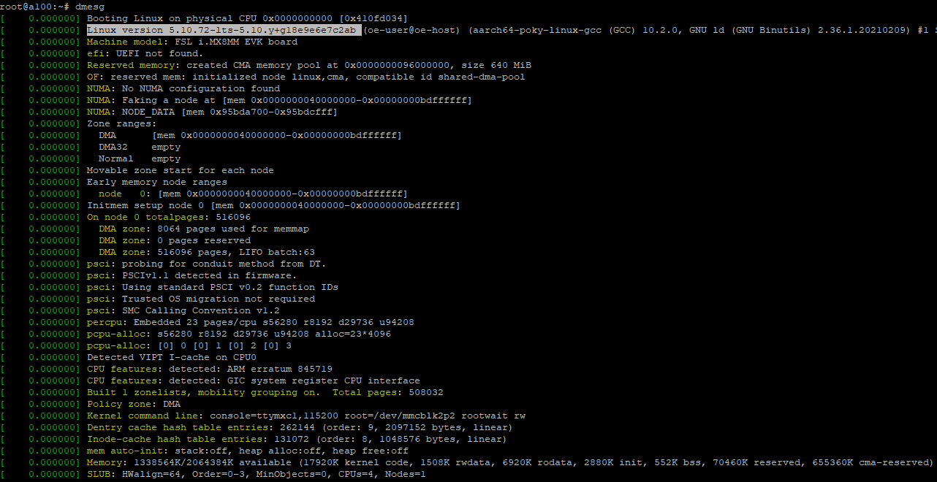

Slide 33
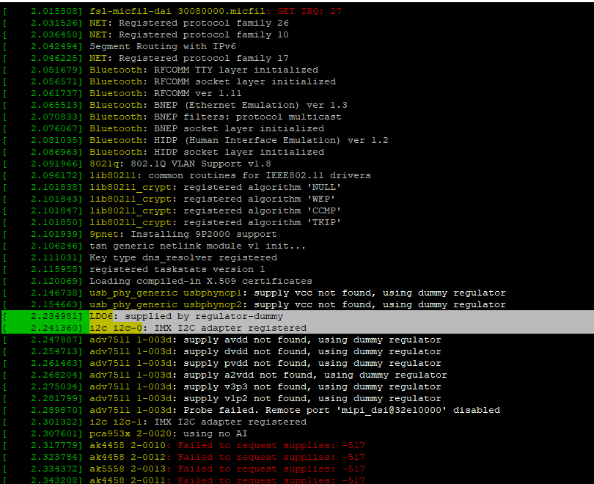

Slide 34
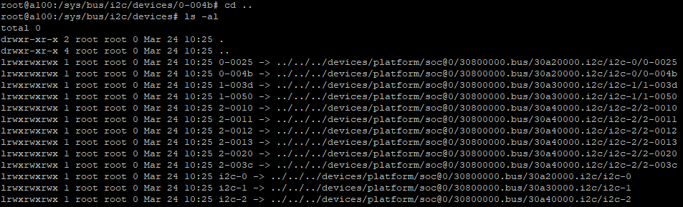
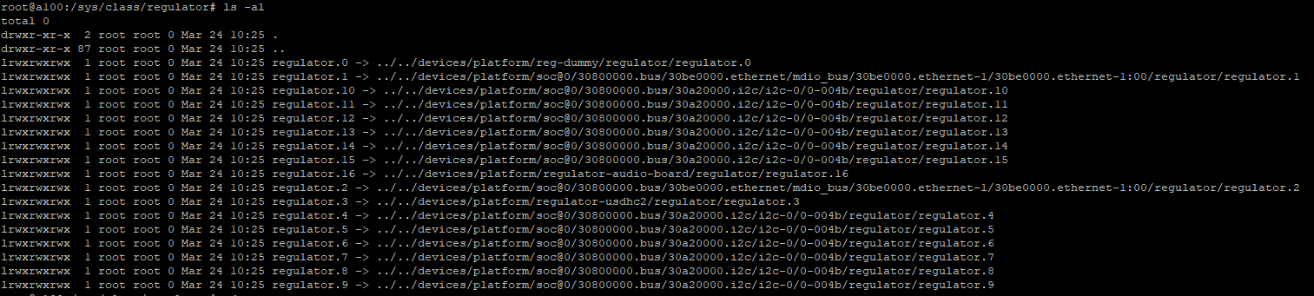

Slide 35
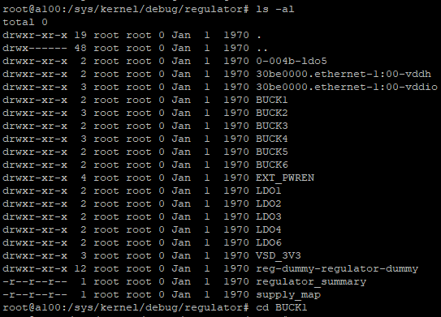

Slide 36
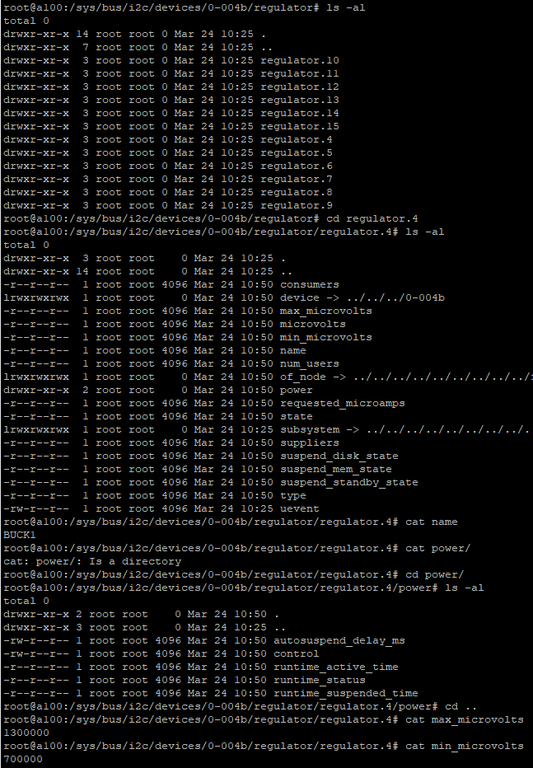
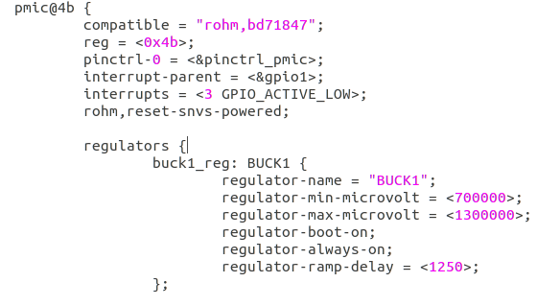

Slide 37



