Slide 1

DA 623 - Course Project
Health Disorder Prediction Using Cough Audio
Bhadra Tendulkar (210103111)

Slide 2
Motivation
Why Cough Audio?
Cough sound analysis has emerged as a promising frontier in non-invasive disease detection, offering significant potential for early diagnosis of respiratory conditions.
Standard tests for diseases are often slow, expensive, or inaccessible, especially in rural areas where these conditions are most -prevalent
Clinical assessments typically require specialized medical knowledge and equipment, creating barriers to timely diagnosis
Resource-intensive diagnostics like chest X-rays have limited availability in many settings.
Coughs originating from specific infections or diseases have sufficient distinguishing characteristics that machine learning models can leverage for classification
Research has demonstrated that pathological coughs, including those from COVID-19, asthma, and TB patients, contain unique acoustic features distinguishable from healthy coughs.

Slide 3
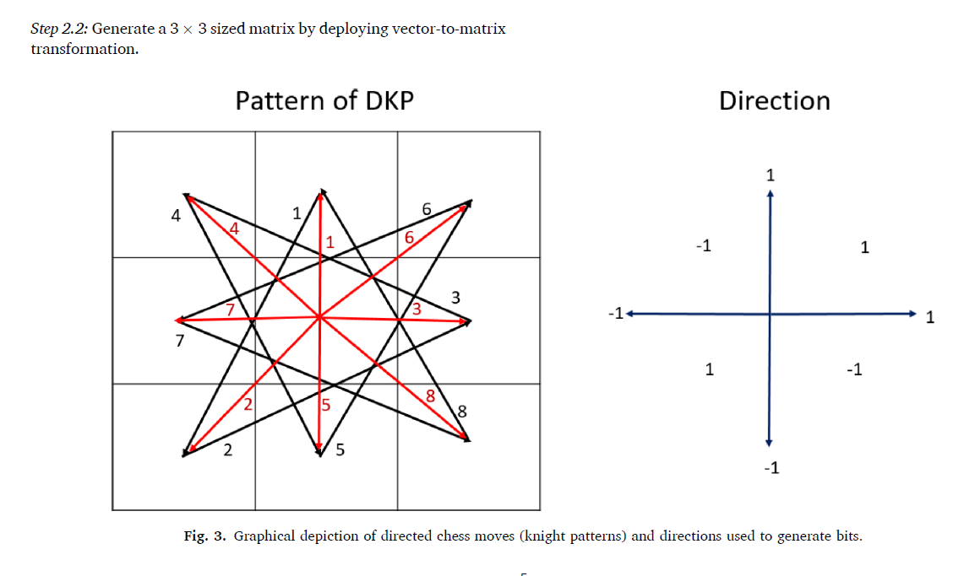
Literature Review & Dataset Properties
Specific to cough sound analysis and related areas, previous work has employed a range of techniques such as Mel-frequency cepstral coefficients (MFCC), Constant Q cepstral coefficients (CQCC), Wigner distribution, Wavelet transform, focus on a single disease.
Many proposed methods described in the literature for multiclass classification had high computational complexity, which can be a barrier to practical deployment.
The DKPNet41 model was designed to achieve high accuracy, and achieved a superior accuracy rate for multiclass classification compared to other methods in the literature, such as the 90.80% reported by Pal and Sankarasubbu.
The dataset comprised of audio of:
i) Acute Asthma - 110 subjects
ii) Heart Failure - 247 subjects
iii) Covid-19 - 241 subjects
iv) Healthy - 244 subjects
I have used 110 audio samples of each type as the data.

Slide 4
Proposed Architecture using the DKP Method
Audio file read and resampled
Subbands for the audio file
Dividing Signal into 9 Overlapping Blocks
Signal Padded if length not sufficient
Transforming 9 sized vector into 3*3
Initialize Map Signals vectors
Calculate threshold value ‘d’
Signal Padded if length not sufficient
Apply DKP to generate bit values using Kernels
Calculating Map Signals, convert binary to decimal.
Extract & Merge Histogram from signals.
PCA for dimensionality Reduction
Classifier using ANN/LR/SVM/etc.

Slide 5
Kernels and their application
The DKPNet41 method uses three directed kernels for feature generation:
i) Directed Signum (∂1): ∂1 (a, b)= { 0, (a − b < 0 and dir = 1) or (a − b ≥ 0 and dir = − 1) 1, (a − b ≥ 0 and dir = 1) or (a − b ≥ 0 and dir = − 1) }
ii)Directed Upper Ternary (∂2): ∂2 (a, b)= { 0, (a − b ≤ d and dir = 1) or (a − b > d and dir = − 1) 1, (a − b > d and dir = 1) or (a − b ≤ d and dir = − 1) }
iii) Directed Lower Ternary (∂3): ∂3 (a, b)= { 0, (a − b ≥ − d and dir = 1) or (a − b < − d and dir = − 1) 1, (a − b < − d and dir = 1) or (a − b ≥ − d and dir = − 1) }
a and b are the input values being compared.
dir is the direction, which is calculated using the specific "edge" or connection being evaluated (based on the directed graph patterns derived from knight moves).
d is a threshold value, calculated using the standard deviation of the one-dimensional input signal, and is calculated as half of Standard deviation of the signal.
DKP Patterns: Use 2 directed graph patterns (knight-move-like) on a 3×3 matrix to select point pairs (𝑎,𝑏).
Apply 3 directed kernels (∂1,∂2,∂3∂1, ∂2, ∂3∂1,∂2,∂3) to each pair, guided by the pattern's direction.
Each kernel outputs a binary bit (0 or 1), forming 6 groups of 8 bits per matrix.
Convert each 8-bit group into a decimal "map signal."
Extract & merge histograms from the 6 map signals.

Slide 6
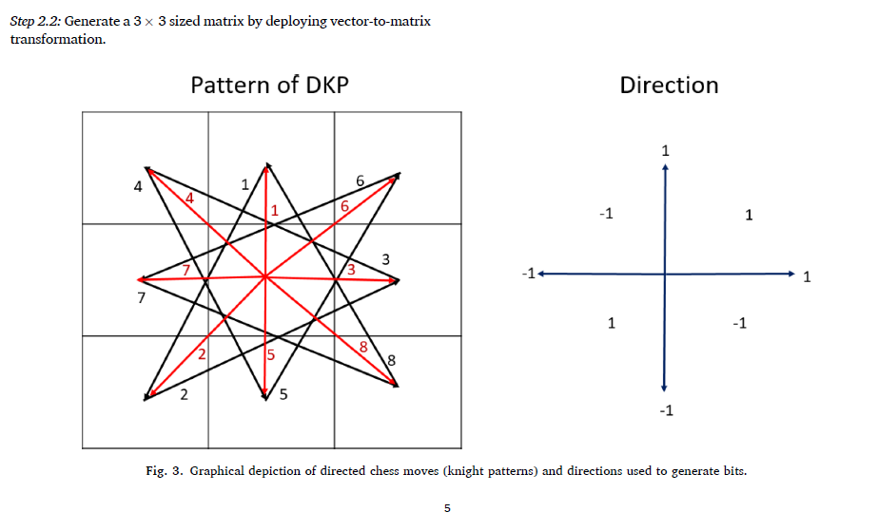
Kernels and their application (contin.)

Slide 7
Approach Implemented
For generation of the CSV of features, 110 audio files of each label (1,2,3,4) were chosen randomly. This was done to ensure that the time required for processing of audio files is not very high, given the hardware constraints.
The paper used INCA, an advanced feature selection technique based on the original Neighborhood Component Analysis (NCA) algorithm, which is designed for supervised dimensionality reduction and feature selection to improve classification performance. However for easier implementation, I used PCA for dimensionality reduction of the features.
The key difference between INCA and PCA is:
INCA | PCA
Selects features that maximize classification accuracy (usually with kNN) | Finds directions (principal components) that maximize variance in data
Selects a subset of original features; may learn a transformation | Transforms data into new orthogonal axes (principal components)
Reduced set of original features most relevant for classification | New set of features (principal components); often fewer than original

Slide 8

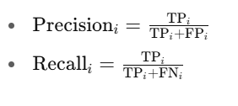
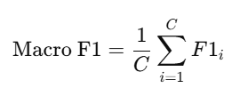
Result & Conclusion
4 Classifiers were used - Multinomial Logistic Regression, Random Forest, Support Vector Classifier, custom made Artificial Neural Network.
Performance Metric used - Macro F1 Score (takes value 0-1)
Macro Score Values were as follows:
ANN: 0.4344
SVC: 0.4155
Random Forest = 0.4344
Multinomial Logistic Regression: 0.4855
4) In order to improve the model’s performance, INCA can be used instead of PCA as done in the research paper.
5) By using Optuna for hyperparameter tuning, model performance as gauged by Macro F1 Score improved. (for 10 iterations, the ANN Macro F1 Score increased to about 0.48).

Slide 9
References & Tools Used:
Kuluozturk M, Kobat MA, Barua PD, Dogan S, Tuncer T, Tan RS, Ciaccio EJ, Acharya UR. DKPNet41: Directed knight pattern network-based cough sound classification model for automatic disease diagnosis. Med Eng Phys. 2022 Dec;110:103870. doi: 10.1016/j.medengphy.2022.103870. Epub 2022 Aug 6. PMID: 35989223; PMCID: PMC9356574.
NotebookLM
Perplexity.ai

