Slide 1


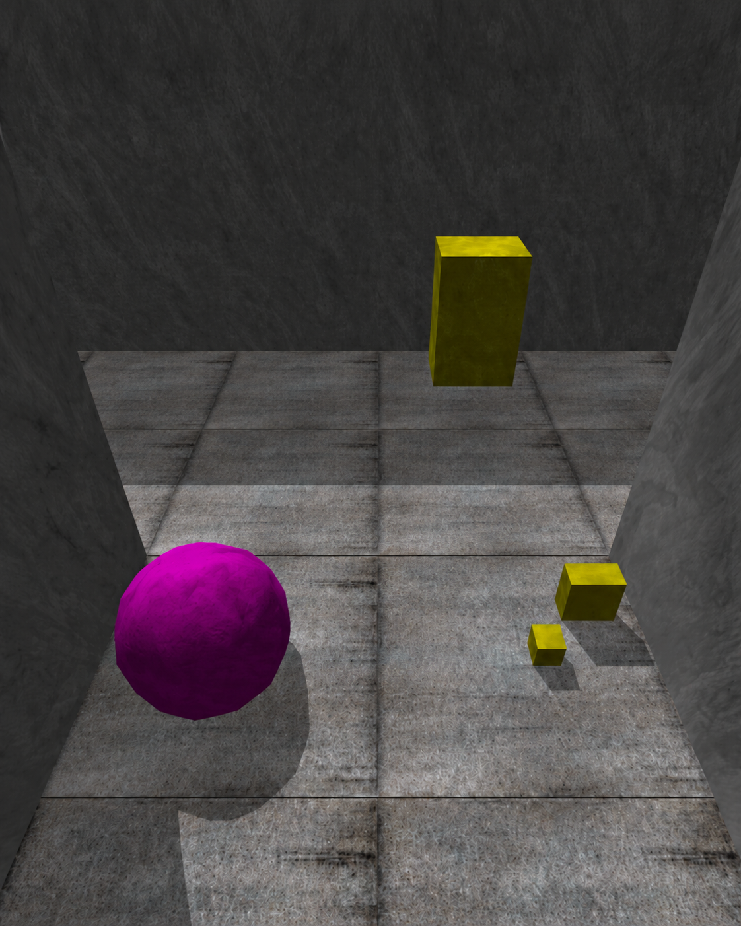
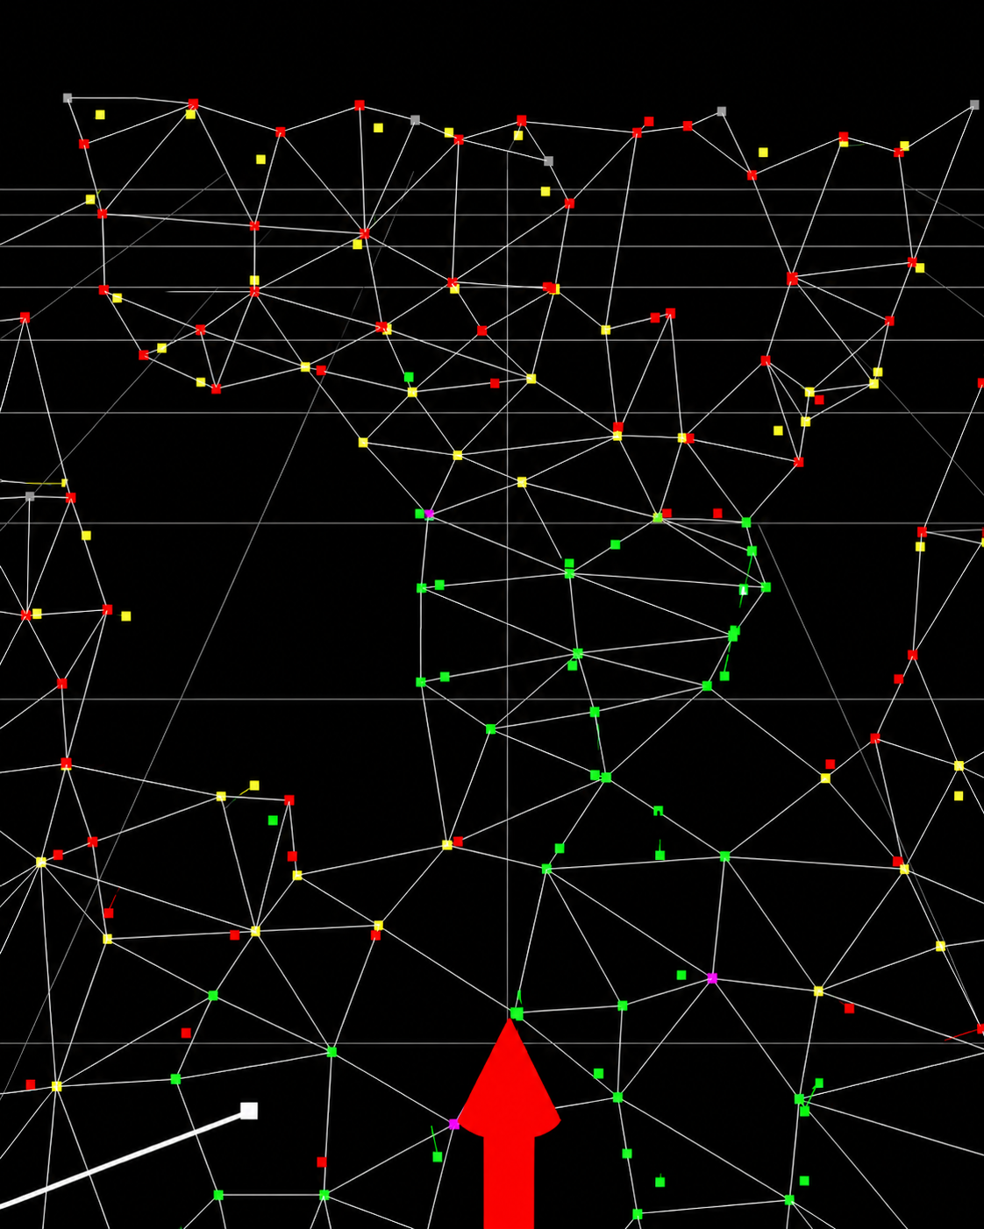
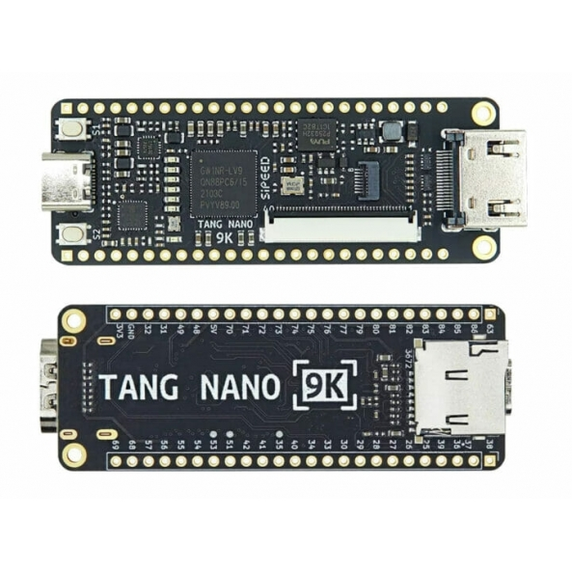
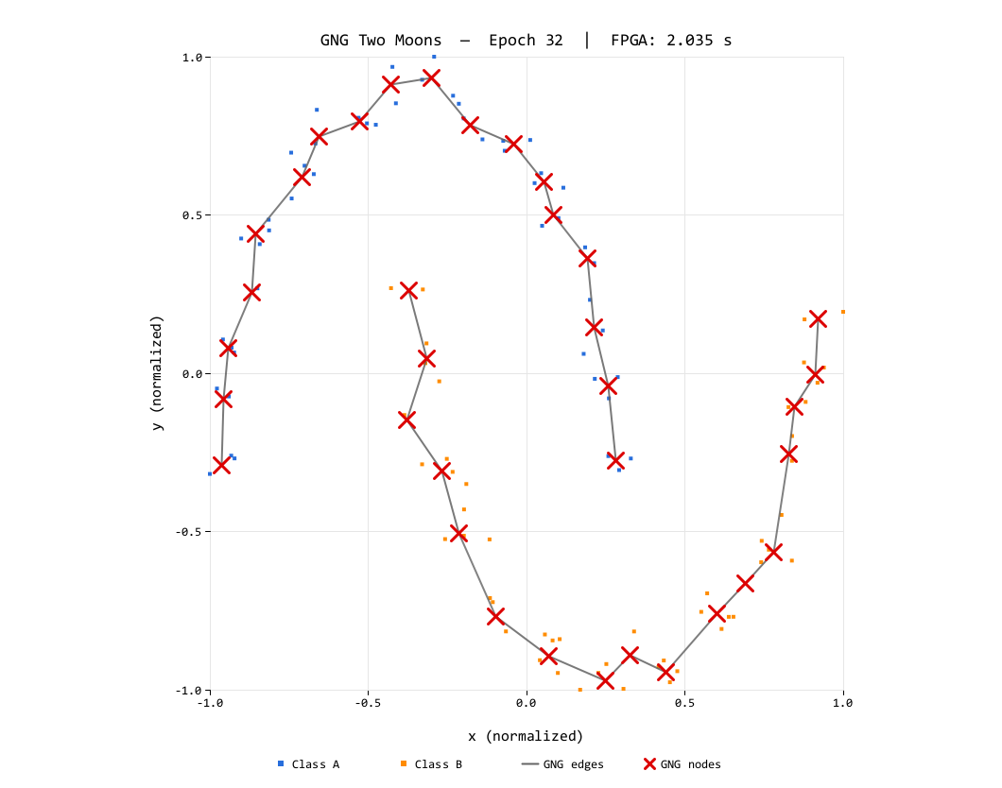
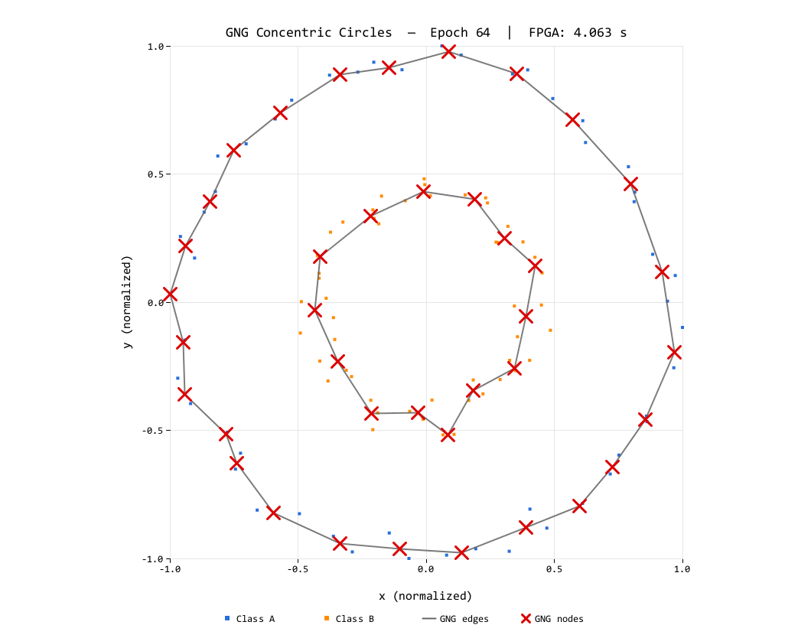
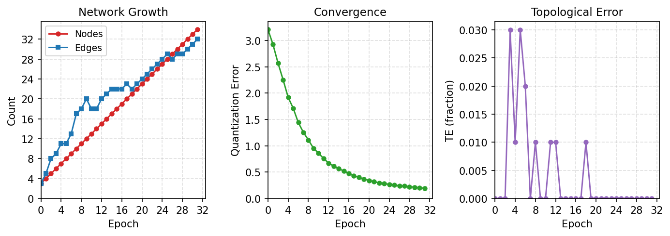
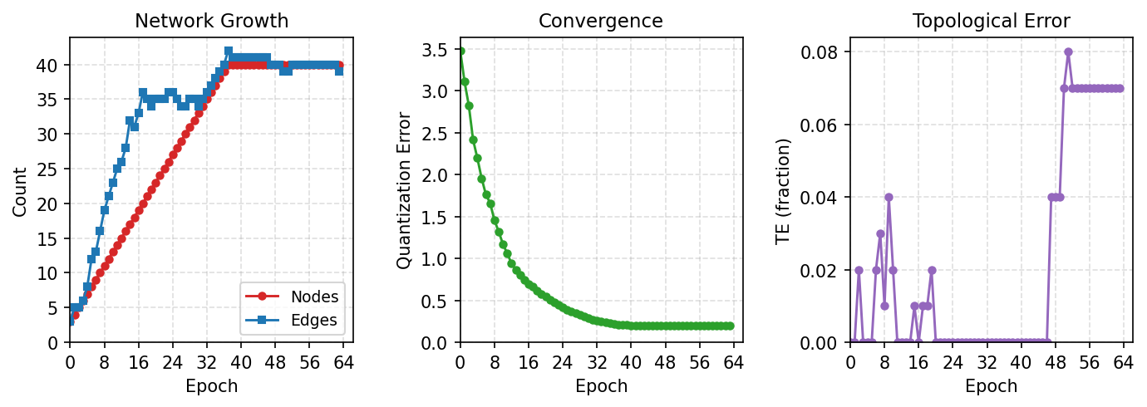

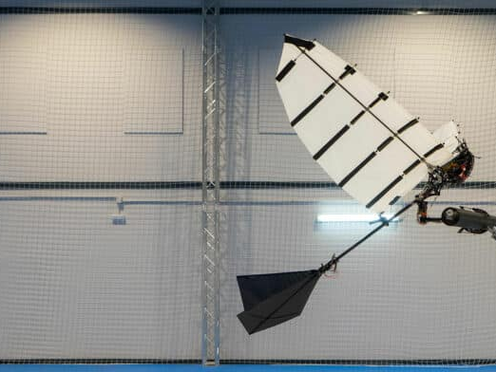
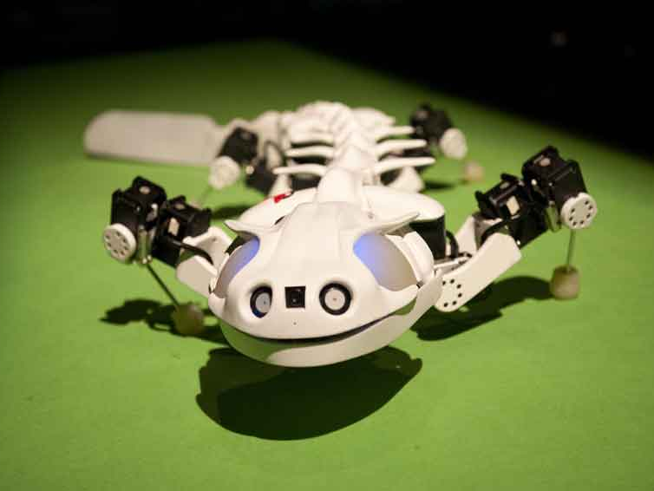
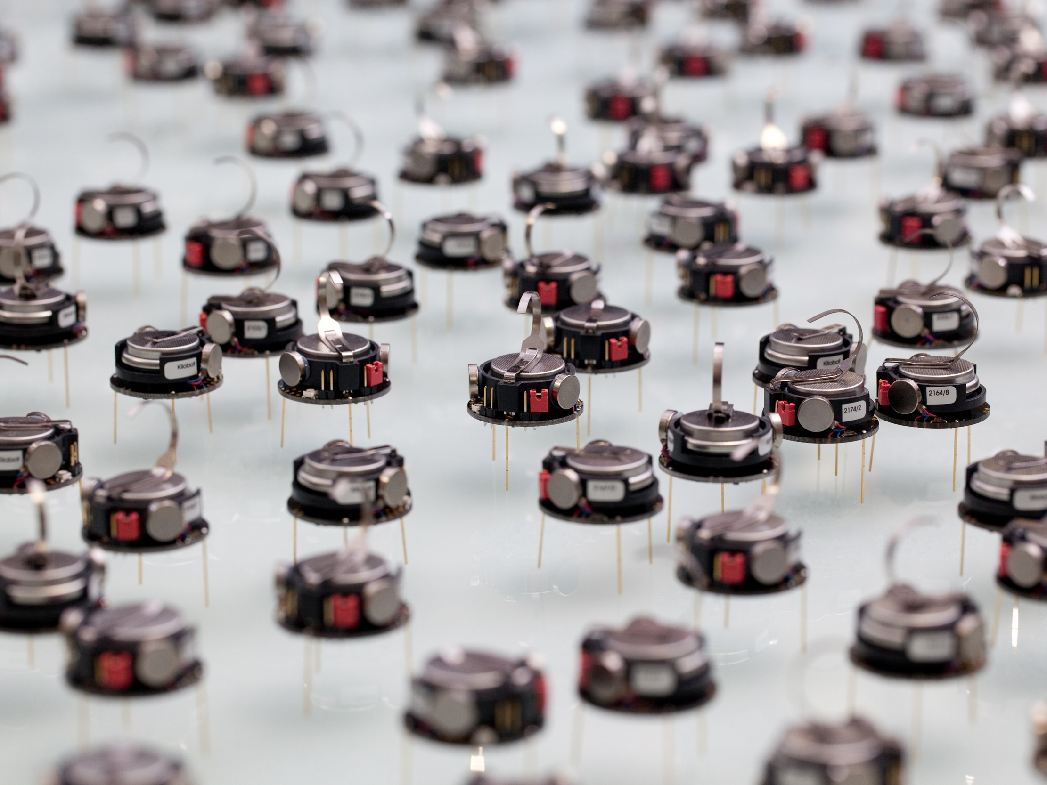
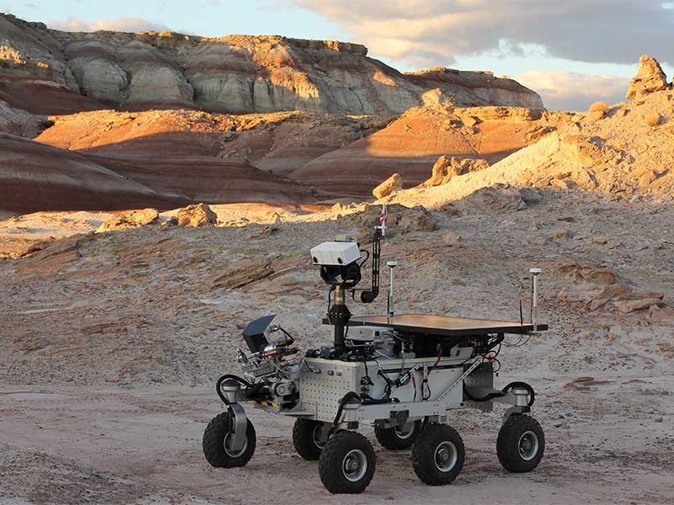


Edge-Cell Graph Encoding and Fixed-Point Arithmetic for FPGA Growing Neural Gas
Bringing Online Topology Learning Down to Embedded FPGA
Teuku Zikri Fatahillah¹ · Raditya Artha Rochmanto^{1,2} · Achmad Fahrul Aji^{1,2} · Anhar Risnumawan^{1,3} · Chyan Zheng Siow^{1,4} · Naoyuki Kubota¹
June 21–26, 2026
¹ Tokyo Metropolitan University, Japan ² Politeknik Negeri Semarang, Indonesia ³ Politeknik Elektronika Negeri Surabaya, Indonesia ⁴ Changsha CCAVC, China
−41%
~625 µs
38%
~1,600
Graph-State Memory
Latency per Sample
LUT Utilization
Samples / Second
1 · MOTIVATION & PROBLEM
4 · MEMORY COMPARISON
(2,000 B → 1,180 B)
(@ 27 MHz)
(of 8,640 LUTs)
(Throughput)
Many deep-learning systems rely on labels, pre-training, or task-specific priors .
NO LABELS. NO CLOUD. STILL LEARNING.
Component
Baseline
Proposed
Saving
In unseen or changing environments, robots must discover structure directly from streaming sensory data.
Node array
400
400
—
Edge Memory
1,600
780
−51.25
Unsupervised topology learners like SOM and GNG learn online without labels.
Total graph state
2,000
1,180
−41.0
⚠ But deploying GNG on tiny FPGAs is challenging:
Small FPGAs can learn topology online.
5 · FPGA RESOURCE UTILIZATION
① Dynamic topology on static hardware
Resource
Used
Avail.
Util.
GNG continually creates, ages, and removes edges — creating irregular memory access and control-flow pressure on a small FPGA.
LUT
3,205
8,640
38%
② Dense adjacency wastes graph memory
FF
1,408
6,693
22%
An N×N adjacency matrix at N_{max} =40 alone consumes 1,600 B before any node coordinate is stored.
BSRAM
6
26
24%
③ Floating-point units are too costly
DSP
5
10
50%
Per-sample distance and learning-rate updates increase area and latency, limiting usefulness on a sub-10K-LUT FPGA.
Streaming Sensory Data
Learned Topology (Growing Graph)
6 · LEARNING PERFORMANCE (QE / TE)
Design target
Integer FPGA Engine
Two Moons
A bounded-memory, integer-only GNG accelerator that preserves dynamic topology while fitting the Tang Nano 9K resource envelope.
Epoch
Nodes
Edges
QE
TE
2 · METHOD OVERVIEW
→
→
16
19
22
0.4750
0.00
32
35
33
0.1832
0.00
What is GNG? Growing Neural Gas is a self-organizing clustering algorithm that incrementally learns a graph approximating the data distribution — discovering both prototype nodes and their topology online, without labels.
48
40
37
0.1461
0.00
64
40
34
0.1455
0.01
Concentric Circles
Epoch
Nodes
Edges
QE
TE
① Fused Update Pass
16
19
33
0.6964
0.00
Error decay, edge aging, neighbor movement, and pruning combined in one NB_SCAN sweep — eliminating a separate full-array decay pass.
32
35
36
0.2592
0.00
• While stepping node n: decay error, probe edge_cell[idx(s1,n)]
48
40
40
0.2000
0.04
• If active edge: age it, move neighbor, prune if over-age
64
40
39
0.1960
0.07
• Per-node degree counters enable isolated-node detection with no extra scan
FSM PIPELINE — PER INPUT SAMPLE
7 · LEARNED TOPOLOGIES & TRAINING DYNAMICS
SAMPLE
fetch input ξ
Two Moons — Epoch 32
Concentric Circles — Epoch 64
↓
WIN_SCAN
find nearest s₁, s₂
Unsupervised Topology Learning (GNG)
Integer-Only Fixed-Point (Q8 / Q16)
Memory-Efficient Edge-Cell Encoding
↓
UPDATE
winner error + Q8 move
↓
NB_SCAN — FUSED
decay error · probe edge_cell · age / prune · move neighbor
one N_{max} scan replaces the separate decay + neighbor passes
↓
Two Moons — Training Dynamics (32 epochs)
CONNECT
reset edge (s₁, s₂) age = 0
Online structure discovery, without labels, without cloud, on a tiny FPGA.
↓
INSERT
every λ — split max-error edge
② Edge-Cell Encoding
One byte per node pair stores age+1 (0 = no edge). At N_{max} =40: edge storage 1,600 B → 780 B (−51%).
③ Fixed-Point Arithmetic
Concentric Circles — Training Dynamics (64 epochs)
Integer-only datapath — no FPU. Coordinates: 16-bit signed integers in [−1000, 1000] after min-max normalization.
EDGE-CELL ENCODING — HALVES GRAPH STORAGE
Squared distance (17-bit → 35-bit, DSP 9×9):
Dense Adjacency O(N²)
Edge-Cell Half-Adj. O(E)
Δx = ξx − xn, Δy = ξy − yn
1
1
1
1
1
1
1
1
0
2
0
0
0
0
0
d² = Δx² + Δy² (overflow-free)
1
1
1
1
1
1
1
1
0
3
0
0
1
0
Winner adaptation (Q8, ε_{w} ≈ 0.301):
1
1
1
1
1
1
1
1
−51%
0
1
0
0
0
Δx_{s1} = ⌊EPS_WIN_Q8 × (ξx − x_{s1}) » 8⌋
1
1
1
1
1
1
1
1
0
2
0
0
EPS_WIN_Q8 = 77 → ε_{w} = 77/256 ≈ 0.301
1
1
1
1
1
1
1
1
edge storage
0
1
0
Neighbor adaptation (Q16, ε_{n} ≈ 0.001):
1
1
1
1
1
1
1
1
→
0
3
Δx_{n} = ⌊EPS_N_Q16 × (ξx − x_{n}) » 16⌋
1
1
1
1
1
1
1
1
0
EPS_N_Q16 = 66 → ε_{n} = 66/65536 ≈ 0.001
1
1
1
1
1
1
1
1
8 · REAL-TIME THROUGHPUT
Error decay (no multiplier, β ≈ 0.9961):
1,600 B
780 B
err_{n} -= err_{n} » ERR_DECAY_SHIFT
ERR_DECAY_SHIFT = 8 → β = 1 − 2⁻⁸ ≈ 0.9961
full N×N matrix (baseline)
upper triangle, age+1 (proposed)
Param
Value
HW mapping
Total graph state
2,000 B → 1,180 B
−41%
Nₘₐₓ
40
node BRAM depth
Aₘₐₓ
50
A_MAX_STORED = 51
λ
100
lambda_cnt counter
εw
≈ 0.301
EPS_WIN_Q8 = 77, ≫ 8
εn
≈ 0.001
EPS_N_Q16 = 66, ≫ 16
α
0.5
INS_ALPHA_SHIFT = 1
β
≈ 0.9961
ERR_DECAY_SHIFT = 8
SCAN FOR EVERYTHING
3 · FPGA ARCHITECTURE
GNG Engine — Single FSM
Nearest-Node Search
Per-sample latency ~625 µs, measured from the on-chip 32-bit cycle counter
Weight Update
Dataset
Cycles
µs
Samp/s
Total s
Edge Update & Aging
Sipeed Tang Nano 9K Gowin GW1NR-9C · 27 MHz
Two Moons
16,852
624.1
1,602
5.40
Node Insertion / Deletion
Paper · Poster · Slides · Source Code
Concentric Circles
16,931
627.1
1,595
5.72
Fixed-Point Arithmetic (Q8 / Q16)
github.com/tzf230201/fpga_gng
Node, edge & dataset BRAMs · UART 1 Mbit/s host link · deterministic ≥ 3-cycle BRAM access.
PROSPECT APPLICATIONS
Aerial robot
Bio-inspired robot
Swarm robots
Exploration robot
Infrastructure inspection
Supported by the Japan Science and Technology Agency (JST), Moonshot R&D Program, grant JPMJMS2034.
[email protected]

