Slide 1


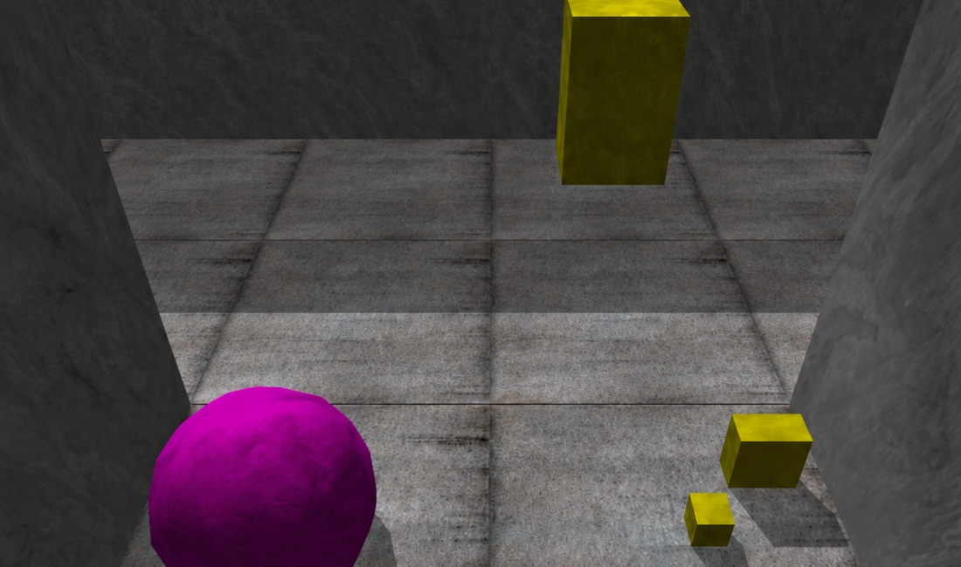
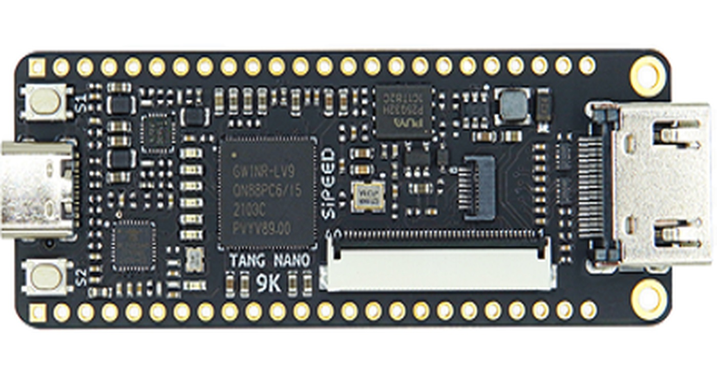
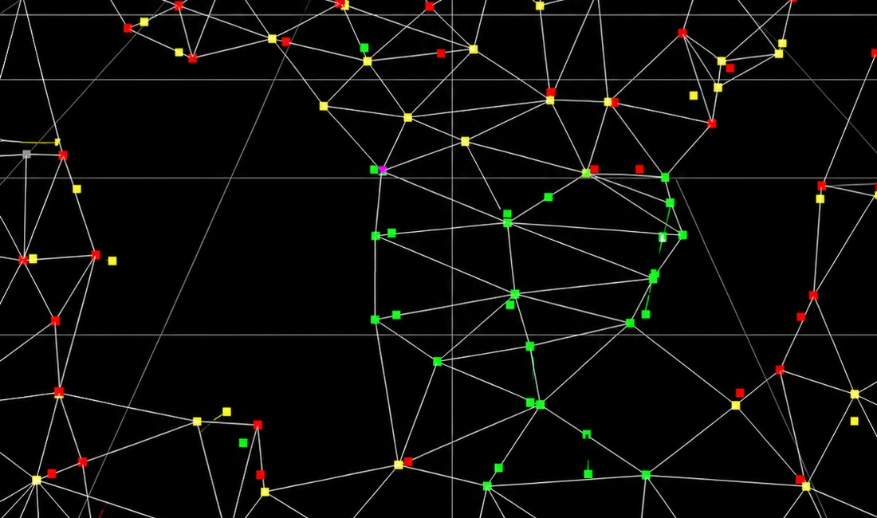
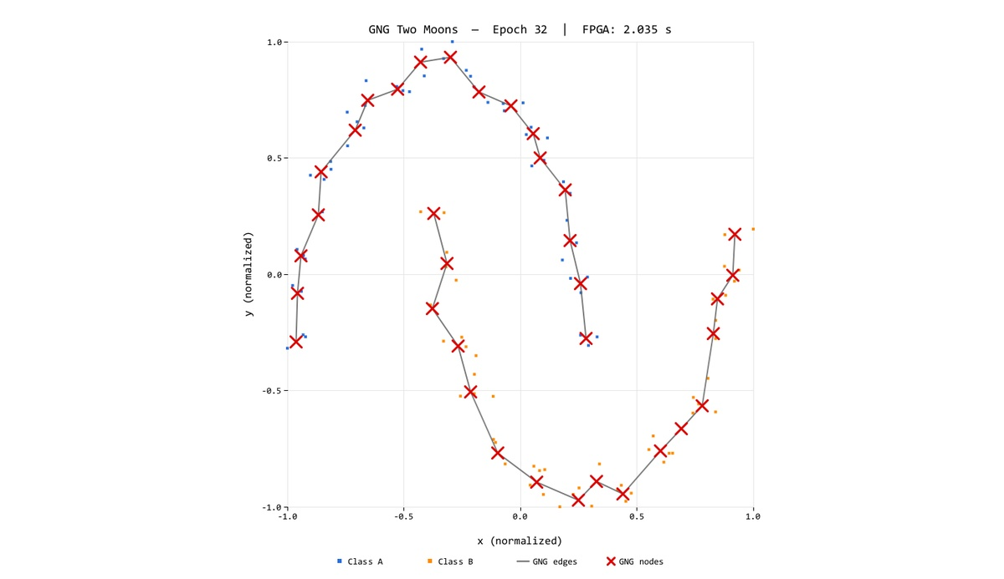
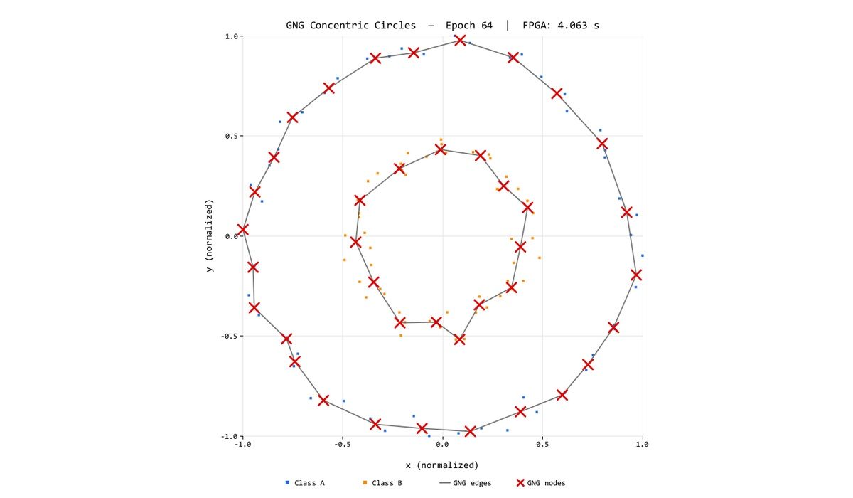
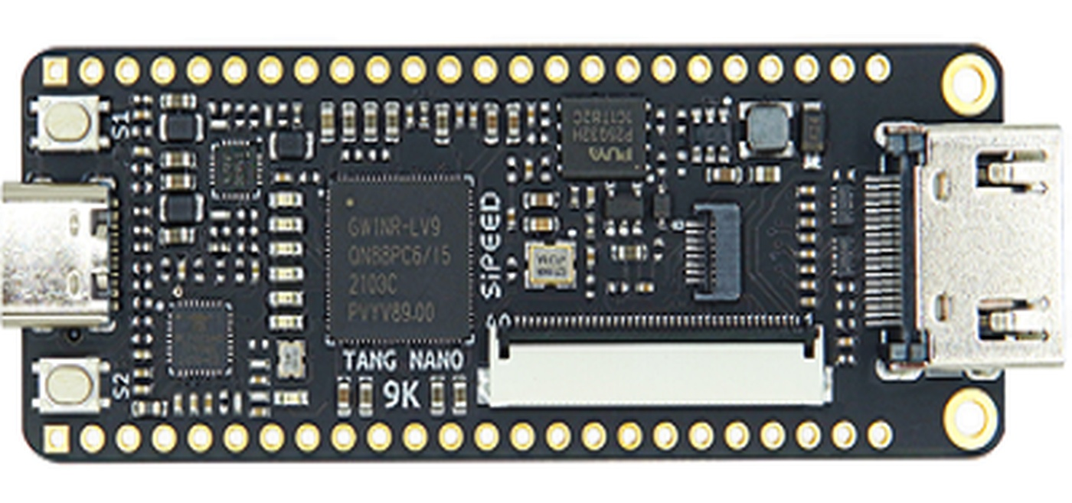
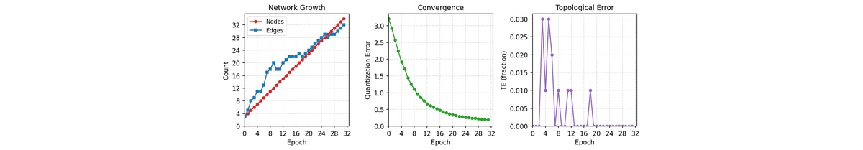
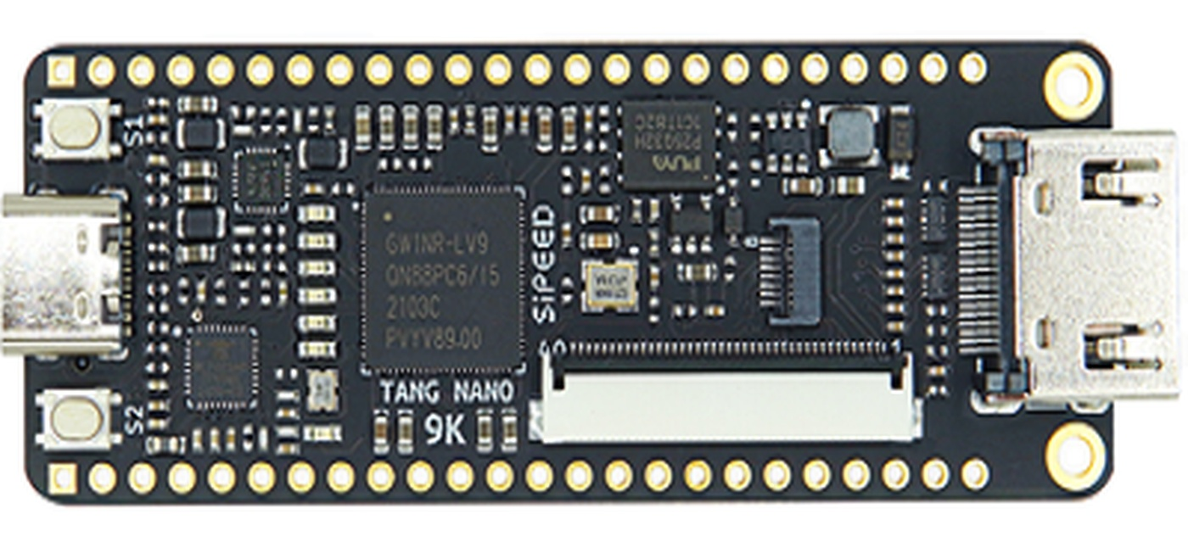
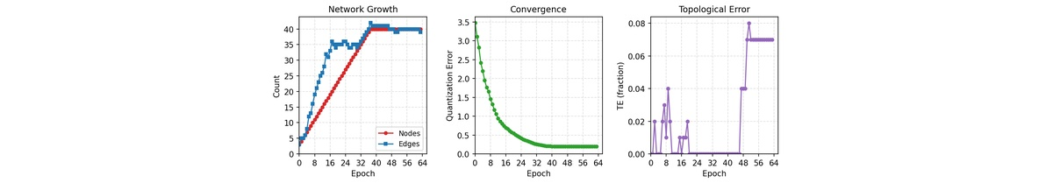

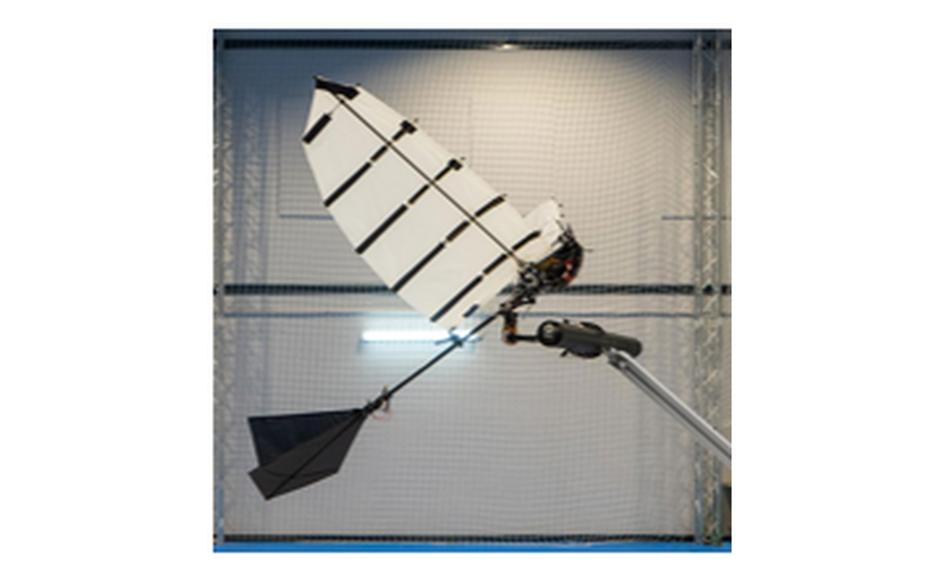
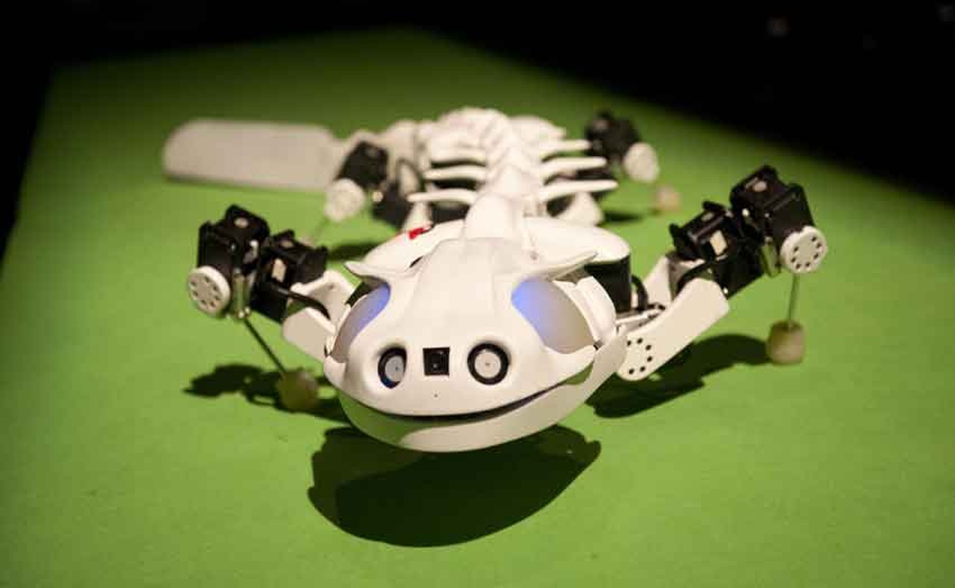
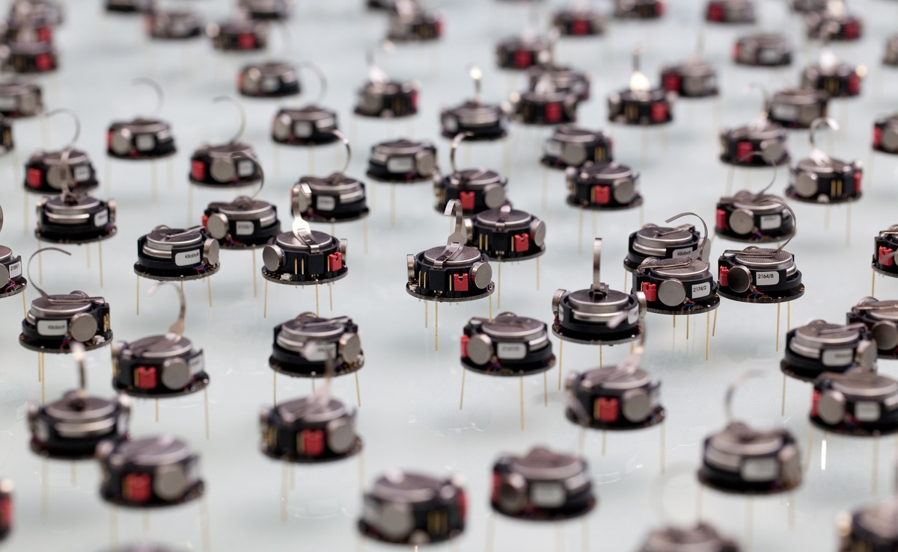
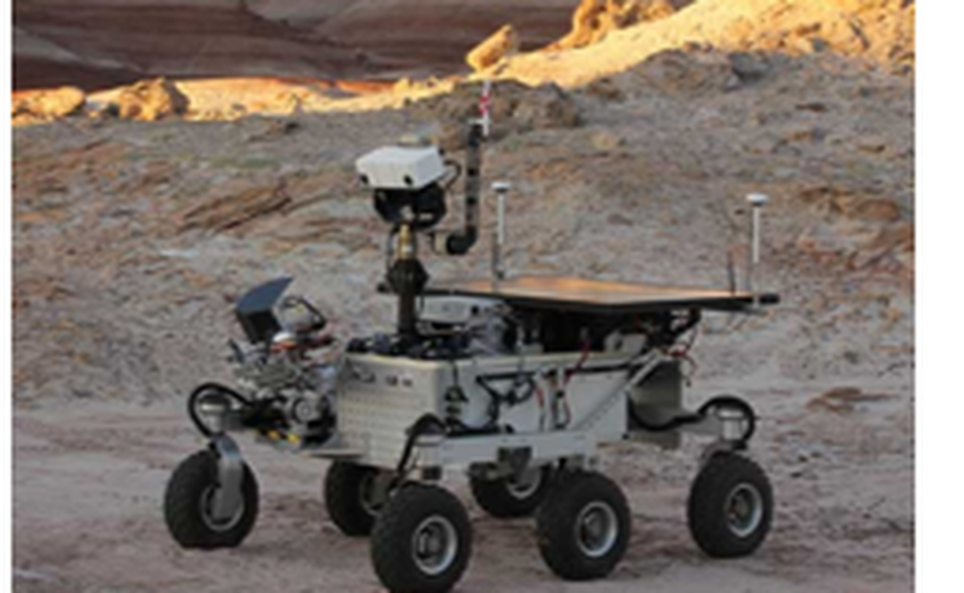
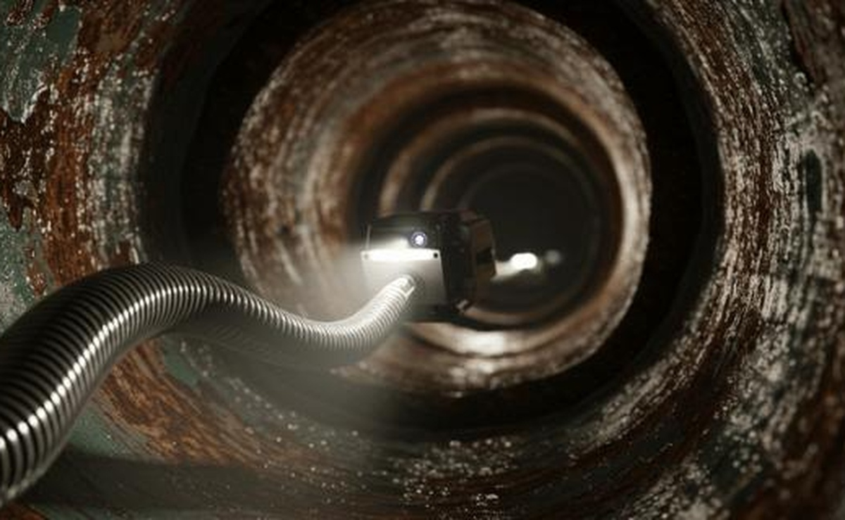

Edge-Cell Graph Encoding and Fixed-Point Arithmetic for FPGA Growing Neural Gas
Integer-only online topology learning on a sub-10K-LUT FPGA
Teuku Zikri Fatahillah1 · Raditya Artha Rochmanto1,2 · Achmad Fahrul Aji1,2 · Anhar Risnumawan1,3 · Chyan Zheng Siow1,4 · Naoyuki Kubota1
IEEE WCCI 2026
Maastricht
1 Tokyo Metropolitan University, Japan · 2 Politeknik Negeri Semarang, Indonesia · 3 PENS, Indonesia · 4 Changsha CCAVC, China
-41%
~625 us
38%
~1,600/s
total graph-state memory
deterministic latency
LUT utilization
online throughput
2,000 B -> 1,180 B
~16.9k cycles @ 27 MHz
3,205 / 8,640 LUTs
UART-measured FPGA snapshots
1 · Problem & Motivation
5 · Edge-Cell Encoding
7 · Fits on a 9K FPGA
Edge robots need on-board unsupervised adaptation.
Flatten only the upper triangle of an undirected graph.
Place-and-route on Gowin GW1NR-LV9QN88PC6
Streaming raw sensor data to the cloud is often impractical under intermittent links and latency limits.
0
node j ->
Resource
Used
Avail.
Util.
1
2
3
4
5
cell = age + 1
LUT
3,205
8,640
38%
GNG learns a topology incrementally, but dynamic edges and floating point are expensive on tiny FPGAs.
0
3
1
0
0
0
0 means no edge
FF
1,408
6,693
22%
The target is bounded memory, deterministic per-sample time, and an integer-only datapath.
1
0
7
0
0
v > 0 means true age = v - 1
BSRAM
6
26
24%
<- node i
2
2
5
0
DSP
5
10
50%
3
0
1
Memory
Baseline
Proposed
Saving
4
4
Node array
400 B
400 B
-
Tang Nano 9K
5
Edge memory
1,600 B
780 B
-51.25%
Half-adjacency indexing, row by row
Total graph
2,000 B
1,180 B
-41.0%
Unstructured field scene -> integer FPGA engine -> online topology graph
0
1
2
3
4
5
6
7
8
9
10
11
12
13
14
0,1
0,2
0,3
0,4
0,5
1,2
1,3
1,4
1,5
2,3
2,4
2,5
3,4
3,5
4,5
The design retains 62% LUT and 76% BRAM headroom for application logic.
2 · Contributions in the Paper
idx(i,j) = i(2Nmax - i - 1)/2 + (j - i - 1)
(1,3) -> cell 6
8 · Learning Quality
Synthesized GNG engine on Gowin GW1NR-9C with no CPU, no FPU, and no PLL.
Example uses Nmax = 6: 1(12 - 1 - 1)/2 + (3 - 1 - 1) = 5 + 1 = 6
Final FPGA snapshots preserve the target topology.
Edge-cell graph storage: upper triangle only, one 8-bit age+1 cell per possible undirected edge.
Q8/Q16 shift-scaled learning rates mapped to DSP-friendly multiply-and-shift updates.
Dense matrix
Edge-cell array
Winner-indexed fused NB_SCAN combines error decay, edge aging, neighbor movement, and pruning.
40 x 40 x 8-bit
= 1,600 B
->
40 x 39 / 2 bytes
= 780 B
No soft-core CPU
No FPU
No dynamic memory
51.25% less edge storage; total graph state drops 2,000 B -> 1,180 B.
Two Moons, epoch 32
Concentric Circles, epoch 64
FSM datapath
Q8/Q16 shifts
fixed BRAM arrays
QE 0.1832, TE 0.00
QE 0.1960, TE 0.07
3 · FPGA Architecture
This matches the paper's fixed-capacity allocation: graph growth and rewiring do not allocate memory dynamically; they only update existing node and edge BRAM cells.
The paper reports QE decreasing on both datasets. TE stays near zero during growth; Circles drifts after saturation because the fixed Nmax graph cannot insert more nodes across the inter-ring gap.
Single-clock FSM at 27 MHz with BRAM-mapped state.
Dataset
Epoch
Nodes
Edges
QE
TE
UART input
WIN_SCAN
Two Moons
32
35
33
0.1832
0.00
100-sample dataset ROM
nearest s1, runner-up s2
Presence + age
Deterministic address
Degree counters
Two Moons
64
40
34
0.1455
0.01
UPDATE
NB_SCAN
one byte encodes both
13-bit BRAM index at Nmax=40
isolated nodes need no edge scan
Circles
32
35
36
0.2592
0.00
winner error + Q8 move
node BRAM + edge BRAM RMW
Circles
64
40
39
0.1960
0.07
CONNECT / INSERT
DBG/SNAP
6 · Fixed-Point Arithmetic
degree counters + split edge
cycle counter + topology stream
Integer-only datapath
Coordinates are 16-bit signed integers in [-1000, 1000] after min-max normalization.
Two Moons training dynamics
Node, edge, and dataset BRAMs use synchronous read-modify-write access; each sequence costs at least 3 cycles.
Coordinate representation
node/edge growth, QE convergence, TE
4 · GNG Loop and Fused NB_SCAN
x_norm = ((x - x_min) / (x_max - x_min)) * 2S - S, S = 1000
Paper-aligned FSM sequence per input sample
80-bit node word
x [16]
y [16]
deg [8]
err [32]
Concentric Circles training dynamics
SAMPLE
fetch input xi
Squared-distance unit
64 epochs after Nmax saturation
WIN_SCAN
find s1 and s2
dx = xi_x - x_n, dy = xi_y - y_n
d2 = dx^2 + dy^2 // 17-bit signed -> 35-bit unsigned
err_s1 += d2 >> ERR_SHIFT
9 · Deterministic Real-Time Throughput
UPDATE
err_s1 += d2 >> ERR_SHIFT; move s1 by EPS_WIN_Q8
Winner adaptation, Q8
Measured directly from the FPGA cycle counter embedded in DBG frames.
NB_SCAN
decay err_n; probe edge_cell[idx(s1,n)]
Delta x_s1 = floor(EPS_WIN_Q8 * (xi_x - x_s1) / 2^8)
Delta y_s1 = floor(EPS_WIN_Q8 * (xi_y - y_s1) / 2^8)
Dataset
Cycles
us
Samples/s
Total s
ACTIVE EDGE
age/prune edge; move neighbor by EPS_N_Q16
Two Moons
16,852
624.1
1,602
5.40
CONNECT
reset edge(s1,s2) age; update degree counters
Neighbor adaptation, Q16
Circles
16,931
627.1
1,595
5.72
INSERT / SNAP
every lambda split max-error edge; stream UART snapshots
Delta x_n = floor(EPS_N_Q16 * (xi_x - x_n) / 2^16)
Delta y_n = floor(EPS_N_Q16 * (xi_y - y_n) / 2^16)
Why fused?
Multiplierless error decay
Canonical GNG separates global error decay from winner-neighbor edge updates.
err_n = err_n - (err_n >> ERR_DECAY_SHIFT)
beta approx 1 - 2^-8 = 0.9961
~1,600 samples/s with bounded per-sample latency
The FPGA already scans all node slots around s1, so decay is folded into the same NB_SCAN.
Parameter
Value
Hardware mapping
Per-node degree counters detect isolated nodes without a second full edge-array scan.
Nmax
40
node BRAM depth
Amax
50
A_MAX_STORED = 51
10 · Takeaway and Future Work
lambda
100
lambda counter
Self-organizing clustering with dynamic topology is feasible on a sub-10K-LUT FPGA when memory layout and arithmetic format are co-designed.
eps_w
~0.301
EPS_WIN_Q8 = 77, >> 8
Hardware invariant
eps_n
~0.001
EPS_N_Q16 = 66, >> 16
Only fixed-capacity arrays are used: node state is stored once, edge state is stored once, and dynamic topology is expressed by age+1 cells and degree counters. This keeps memory bounded even as GNG rewires.
alpha
0.5
INS_ALPHA_SHIFT = 1
Current evaluation: static 2D benchmarks; streaming non-stationary data remains future work.
beta
~0.9961
ERR_DECAY_SHIFT = 8
Next: parallel winner-search tree to reduce O(Nmax) latency toward O(log Nmax).
Where 77 and 66 come from
Next: configurable Q-format constants and multi-stream sensor input.
State
BRAM word
Role
EPS_Q = round(epsilon * 2^Q). The implementation targets a winner rate near 0.3 and a neighbor rate near 0.001, so EPS_WIN_Q8 = round(0.301 * 256) = 77 and EPS_N_Q16 = round(0.001 * 65536) = 66.
Target deployment: continual topology learning on low-power, memory-constrained robots/devices.
node
x,y,deg,err
coordinates + degree + error
edge
age+1
0 = inactive; v>0 = age v-1
dataset
x,y sample
100-entry on-chip input set
Interpretation
Code, poster,
slides, and data
The fixed-point approximation is not exact, but the paper reports low final QE/TE on both datasets, so the hardware-friendly rates are acceptable for the evaluated benchmarks.
github.com/tzf230201/fpga_gng
Prospective Edge-Robotics Applications
Lightweight flapping robot
Bio-inspired robot
Swarm robot
Long-term exploration robot
Infrastructure inspection
payload-limited topology mapping
strict body and actuator constraints
distributed intelligence, low memory
low power, adaptive autonomy
narrow spaces, local computation
Supported by the Japan Science and Technology Agency (JST), Moonshot R&D Program, grant JPMJMS2034.
[email protected]

