Slide 1
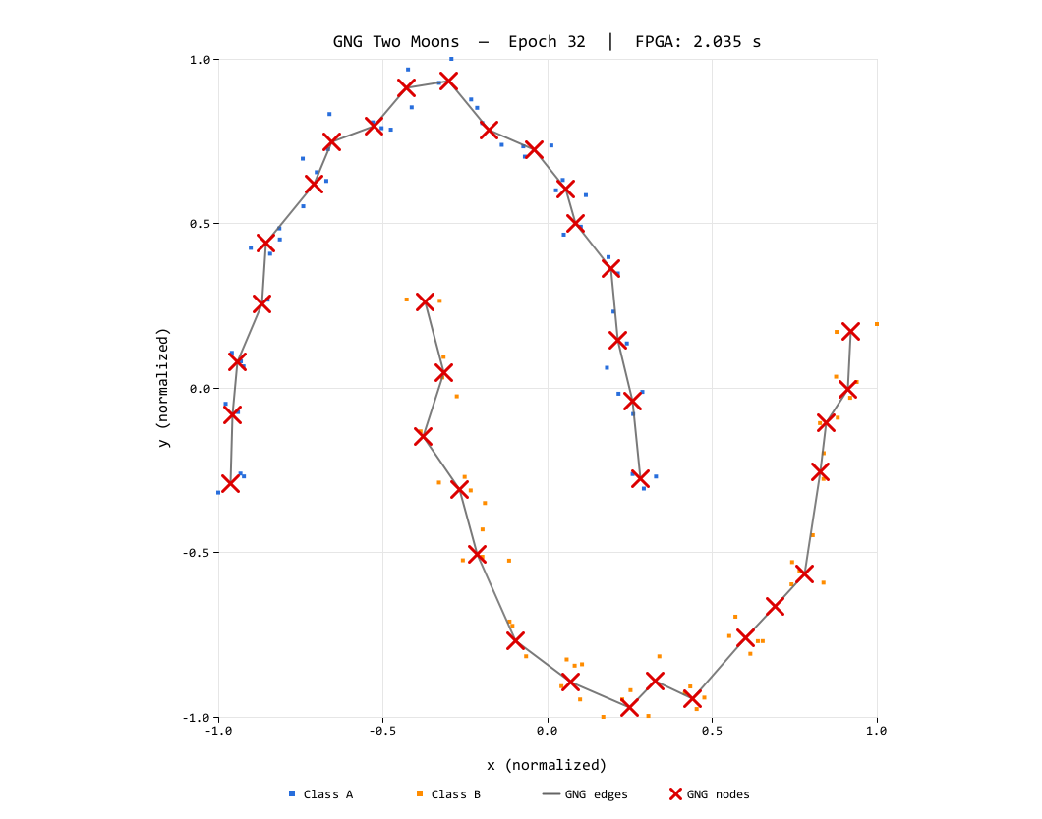
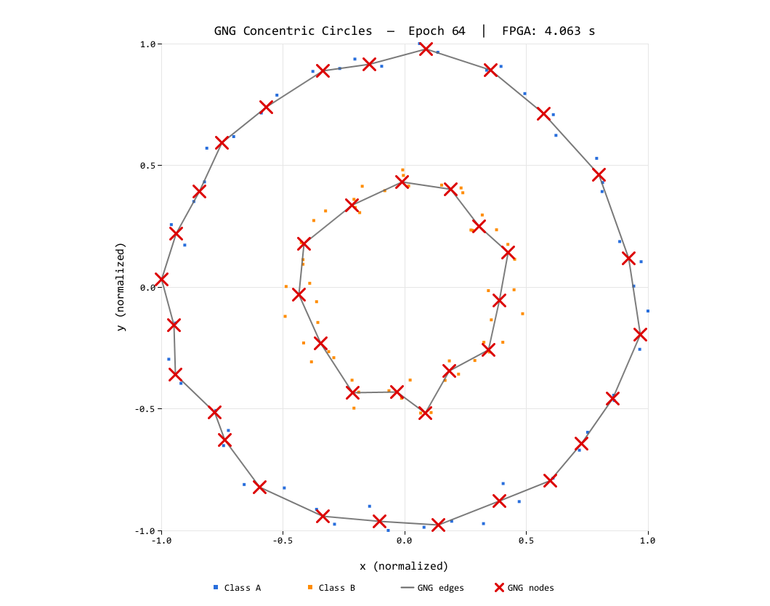

Edge-Cell Graph Encoding and Fixed-Point Arithmetic
for FPGA Growing Neural Gas
Teuku Zikri Fatahillah¹ Raditya Artha Rochmanto¹² Achmad Fahrul Aji¹² Anhar Risnumawan¹³ Chyan Zheng Siow¹⁴ Naoyuki Kubota¹
¹ Tokyo Metropolitan University, Japan ² Politeknik Negeri Semarang, Indonesia ³ Politeknik Elektronika Negeri Surabaya, Indonesia ⁴ Changsha Cultural and Creative Arts Vocational College, China
Motivation & Problem
Key Idea: Edge-Cell Encoding
▸ Edge robots & micro-UAVs need on-board unsupervised learning — no cloud, no labels.
▸ GNG fits (incremental, self-organizing) but is memory-heavy.
▸ Dense adjacency O(N²) = 1,600 B and floating-point are costly on small FPGAs.
Store only the upper triangle of the adjacency, one byte per edge, age+1 encoded:
E = N(N−1)/2 = 780 B (vs 1,600 B dense)
Our fix — store only the upper-triangular half:
▸ cell = 0 no edge · cell = v>0 active, age = v−1
▸ No active bit; over-age prune = one compare (v > 51).
▸ Fused NB_SCAN folds decay + aging + move + prune in one scan.
stored: edge-cell (age+1)
not stored (symmetric half)
Dense O(N²) = 1,600 B
→ 780 B half-adjacency
= −51% edge storage
Integer Fixed-Point Arithmetic
16-bit signed coords in [−1000, 1000] — shift-scaled rates, no FPU and no divider:
dist d² = Δx² + Δy² 9×9 DSP, 35-bit
winner Δ = (77·δ) >> 8 ε ≈ 0.301 Q8
neighbor Δ = (66·δ) >> 16 ε ≈ 0.001 Q16
decay err −= err >> 8 β ≈ 0.996
Our Contributions
A fully integer, single-FSM GNG engine in synthesizable VHDL on the Sipeed Tang Nano 9K — no soft-core CPU, no FPU.
▸ Edge-cell encoding: half-adjacency as 8-bit age+1 — 780 B vs 1,600 B.
▸ Shift-based Q8/Q16 rates ⇒ single-cycle DSP multiplies.
▸ Fused update pass: decay + aging + move + prune in one scan.
Results
Memory footprint (Nₘₐₓ=40)
FPGA utilization (GW1NR-9C)
 | Edge | Total
Dense adj. | 1600 B | 2000 B
Edge-cell | 780 B | 1180 B
Reduction | 51% | 41%
Resource | Used | %
LUT | 3205 | 38%
FF | 1408 | 22%
BSRAM | 6 | 24%
DSP | 5 | 50%
GNG Algorithm Core
Topology quality & runtime (27 MHz)
Graph G = (V, E), weight vectors wᵢ ∈ ℝ². Per input ξ:
▸ Find winner s₁ and runner-up s₂.
▸ Accumulate / decay error; move s₁ toward ξ.
▸ Age edges of s₁; move neighbors; prune over-age.
▸ Connect (s₁, s₂); every λ steps insert a node.
Dataset | Nodes | Edges | QE | TE | µs/sample
Two Moons | 40 | 37 | 0.146 | 0.00 | 624
Concentric Circles | 40 | 40 | 0.200 | 0.04 | 627
Deterministic ~625 µs/sample ⇒ ~1,600 samples/s on a sub-10K-LUT FPGA.
Learned Topologies
FPGA Architecture
Single synchronous FSM datapath @ 27 MHz (no PLL). Three BRAMs: node / edge / dataset. 80-bit node word = x · y · act · deg · err.
INIT
SAMPLE
WIN_SCAN
UPDATE
Two Moons (left) and Concentric Circles (right), Nₘₐₓ = 40.
Conclusion
NB_SCAN
CONNECT
INSERT
DBG/SNAP
A fully integer, sub-10K-LUT FPGA GNG engine. Edge-cell encoding halves edge storage; Q8/Q16 fixed-point keeps QE/TE low with deterministic latency — a foundation for continual clustering at the edge.
Supported by JST Moonshot R&D, grant JPMJMS2034.
Deterministic, bounded per-sample latency — each BRAM read-modify-write ≥ 3 cycles.
Source code
& datasets

