Slide 1
EC601 Replacement Presentation Option 3. Kaggle Steel Defect Detection
Zhang Ting
ID: U60112569
Aug.30th, 2019

Slide 2
Content
Introduction
Data Set
Product Concept
User Story
Minimum Viable Product (MVP)
System Architecture
Testing Strategy
Alternatives for Machine Learning Approach

Slide 3
Problem Introduction
Quality is a critical factor in steel industrial production
Manual inspection in most quality control is slow and unreliable
Automated machine vision inspection is a faster and more reliable method

Slide 4
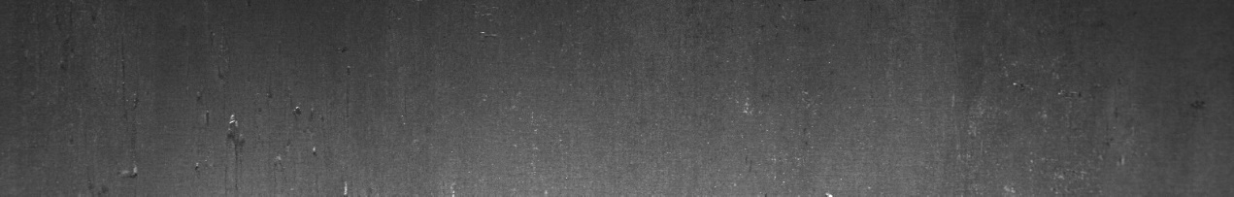

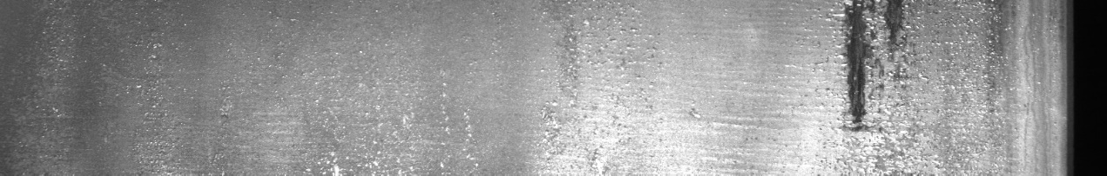

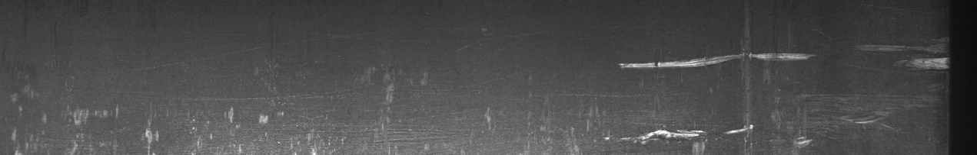
Data Set
Normal steel surface
Defective steel surface (Welding, Cracking, Oxidation, Exfoliation etc.)

Slide 5
Product Concept
Based on the competition provided by Severstal:
“the main goal of the competition is to develop an algorithm for localizing and classifying the defects on a steel sheet.”
Our product is designed to satisfy three main requirements:
(1) Are there defects on the steel surface?
(2) If any defects, where are they?
(3) What kinds of defects?

Slide 6
Product Concept
Input images
Image preprocessing
Locate and mark defects
Predict type of defect
Present information to users

Slide 7
Product Concept
General image data preprocessing methods are applied to the input images in order to reduce the distortion and eliminate the noise in the images.
Our product will work on the interested regions with a specific grid size to find the areas where the defects may occur.
Training and classifying are essential on these specific grid size sub-regions
This trained model helps users make predictions regarding the preprocessed test images and highlights the defective regions
Localization of defects will have a rough shape rather than a simple bounding box

Slide 8
User Story
As a user, several requirements should be satisfied:
(1) Are there any defects existing in the image
(2) The user should know where the defect is located in the image
(3) The user should know the type of defect
(4) The system should be reliable for the users

Slide 9
User Story
Are there any defects in the image?
The fundamental outcome of the algorithm is whether there is a defect.
The user should know where the defect is located in the image:
Users view the defects with the visualized rough profile

Slide 10
User Story
(3) The user should know the type of defect:
There can be various types of defects occurring in the image.
A simple line or circle is an example of a simple geometric defect
Complex defective shapes include oxidation, exfoliation, texture-like defects.
In order to analyze the defect, classification for the defect is necessary.

Slide 11
User Story
(4) The system should be reliable for the users:
Our product should guarantee that all critical defects will be detected
without generating false alarms
The user needs a reliable system that provides high accuracy.

Slide 12
Minimum Viable Product
Minimum viable product includes both training and testing operations.
MVP will do preprocessing operations (morphological filtering and edge detection) to eliminate the noise and thus increase the prediction accuracy.
Then the preprocessed images will be divided into several blocks with specific pixels size and the blocks of interest are chosen by algorithm. These chosen blocks are labeled and contribute to the training of the model.

Slide 13
Minimum Viable Product
Principle Component Analysis (PCA) realizes the feature extraction of the block.
Self-Organizing Map (SOM) realizes the classification of each block.
The well-trained model will finally give out the prediction for each block and highlight the blocks with different colors according to their defective type.

Slide 14
System Architecture
Input Image
Data Preprocessing
Region of Interest Chosen
Training && Testing
Morphological Filtering
Thresholding Edge Detection
Simple Shape Detection
Region of Interest Selection
Region of Interest Detection
Labeled Image
PCA Feature Extraction
PCA Feature Extraction
SOM Training
SOM Classification

Slide 15
Data Preprocessing
Input Image
Phase 1. Morphological Filtering:
The Gaussian and Morphological filters are operated on the image to form a gray scale image and eliminate the effect of noise
Morphological Filtering
Thresholding Edge Detection
Simple Shape Detection
Region of Interest Selection
Region of Interest Detection
Labeled Image
PCA Feature Extraction
PCA Feature Extraction
SOM Training
SOM Classification

Slide 16
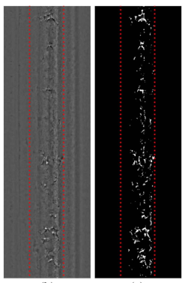
Data Preprocessing
Input Image
Phase 2. Thresholding Edge Detection:
Threshold edge detection method is applied to segment the gray level image. The image is transformed to a binary image which is clear to detect the interested region in the later phase.
Morphological Filtering
Thresholding Edge Detection
Simple Shape Detection
Region of Interest Selection
Region of Interest Detection
Labeled Image
PCA Feature Extraction
PCA Feature Extraction
SOM Training
SOM Classification

Slide 17
Simple Detection
Input Image
Phase 3. Simple Shape Detection:
The binary image produced in the phase 2 will be submitted to phase 3. Hough transform is used in this phase to detect simple shape like straight-line and circle defects.
These kinds of defects will be directly predicted to the output module
Morphological Filtering
Thresholding Edge Detection
Simple Shape Detection
Region of Interest Selection
Region of Interest Detection
Labeled Image
PCA Feature Extraction
PCA Feature Extraction
SOM Training
SOM Classification

Slide 18
Region of Interest
Input Image
Phase 4. Region of Interest Detection:
A window with a specific size like 32 x 32 pixels will slide through the whole binarized image to form sub-image regions. Among these regions, the region with a quantity of total pixels over a threshold and without any line & circle will be chosen to next phase and be the candidate for the training.
These regions are called region of interest, and they may contain the defects.
Morphological Filtering
Thresholding Edge Detection
Simple Shape Detection
Region of Interest Selection
Region of Interest Detection
Labeled Image
PCA Feature Extraction
PCA Feature Extraction
SOM Training
SOM Classification

Slide 19
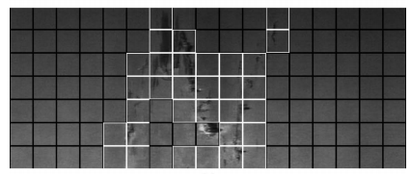
Reason for dividing into sub-images
Dividing the image into several sub-images could make it easier to extract features out of local regions without losing so many important information.
Also, dividing into blocks makes the localization clearer and more accurate
Localization draws out a rough profile of defects rather than simply using a bounding box

Slide 20
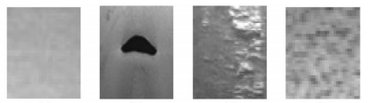
Region of Interest
Input Image
Phase 5. Region of Interest Selection:
These regions of interest will be recorded and saved. Then the system will crop the corresponding regions from the image after phase 1 filtering.
These regions will be used for both training and predicting.
Morphological Filtering
Thresholding Edge Detection
Simple Shape Detection
Region of Interest Selection
Region of Interest Detection
Labeled Image
PCA Feature Extraction
PCA Feature Extraction
SOM Training
SOM Classification

Slide 21
Training
Input Image
Phase 6. Labeled Image:
The regions of interest chosen from the former phase are labeled as defective or normal for training. If it is defective, the corresponding defect type is also labeled.
Morphological Filtering
Thresholding Edge Detection
Simple Shape Detection
Region of Interest Selection
Region of Interest Detection
Labeled Image
PCA Feature Extraction
PCA Feature Extraction
SOM Training
SOM Classification

Slide 22
Training
Input Image
Phase 7. PCA Feature Extraction:
Use PCA (Principal Component Analysis) to extract the features out of the regions.
PCA is a method that could both reduce the data dimensions and also keep the critical features of the data. Our product chooses PCA since it can be applied easily by using sklearn API and extract features well without losing important information.
Morphological Filtering
Thresholding Edge Detection
Simple Shape Detection
Region of Interest Selection
Region of Interest Detection
Labeled Image
PCA Feature Extraction
PCA Feature Extraction
SOM Training
SOM Classification

Slide 23
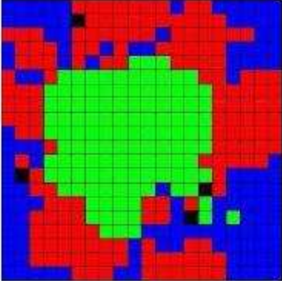
Training
Input Image
Phase 8. SOM Training:
SOM--- Self-Organizing Map is clustering method that could be used as a grouping classification.
The feature vectors with the defective labels are trained by SOM and form a model that could be used later.
Morphological Filtering
Thresholding Edge Detection
Simple Shape Detection
Region of Interest Selection
Region of Interest Detection
Labeled Image
PCA Feature Extraction
PCA Feature Extraction
SOM Training
SOM Classification

Slide 24
Testing
Input Image
Phase 9. PCA Feature Extraction:
This phase is similar as the phase 7. The regions of interest are chosen from the phase 1 and feature vectors are extracted out to be used for classification.
Morphological Filtering
Thresholding Edge Detection
Simple Shape Detection
Region of Interest Selection
Region of Interest Detection
Labeled Image
PCA Feature Extraction
PCA Feature Extraction
SOM Training
SOM Classification

Slide 25
Testing
Input Image
Phase 10. (Testing) SOM Classification:
SOM model will detect and predict type if the defects exist in these sub-images.
The sub-images with the defects detected will be highlighted by specific colored block boxes corresponding to their defect types.
The examples are shown in next slide:
Morphological Filtering
Thresholding Edge Detection
Simple Shape Detection
Region of Interest Selection
Region of Interest Detection
Labeled Image
PCA Feature Extraction
PCA Feature Extraction
SOM Training
SOM Classification

Slide 26
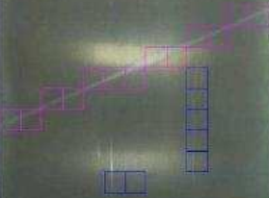
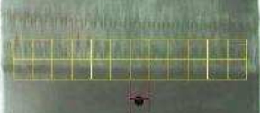
Example Output

Slide 27

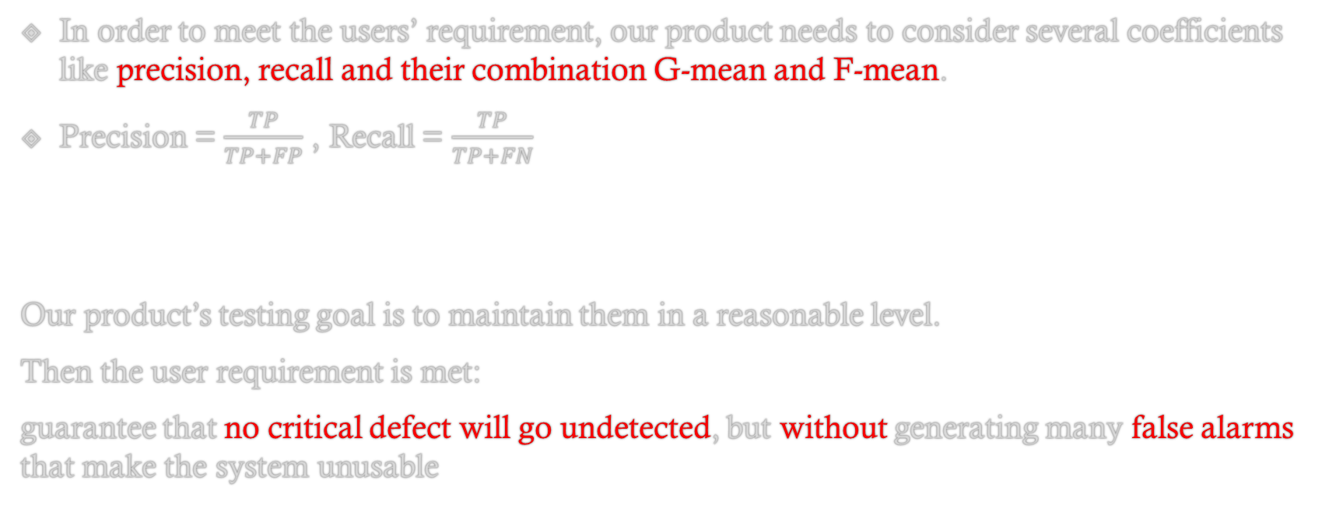
Testing Strategy
In order to meet the users’ requirement, our product needs to consider several coefficients like precision, recall and their combination G-mean and F-mean.
Precision = $\frac{TP}{TP+FP}$ , Recall = $\frac{TP}{TP+FN}$
Our product’s testing goal is to maintain them in a reasonable level.
Then the user requirement is met:
guarantee that no critical defect will go undetected, but without generating many false alarms that make the system unusable

Slide 28
Alternative 1: Feature extraction and training/classification model
During literature research about the method of the feature extraction → few method about the feature extraction on the steel surface image.
The oxidation and cracks on the steel surface remind me of the fabric and the clothes. The textured analysis methods are generally usable for the steel defect detection.
Recommend: 2D discrete wavelet transform

Slide 29
Alternative 1
Total number of articles recommending DWT: 6
[1] Automatic Defect Detection on Hot-Rolled Flat Steel Products
[2] Defect detection for corner cracks in steel billets using a wavelet reconstruction method
[3] Vision-based defect detection of scale-covered steel billet surfaces
[4] Texture classification and segmentation using wavelet packet frame and Gaussian mixture model
[5] Automated surface inspection for statistical textures
[6] Stitching defect detection and classification using wavelet transform and BP neural network

Slide 30
2D discrete wavelet transform
Discrete Wavelet Transform is one of the famous textured analysis methods. The PCA feature extraction method could be replaced by 2D discrete wavelet transform (DWT). In the computational period of the DWT, we could decompose the 32 x 32 input sub-images into three levels which are vertical level, horizontal level and diagonal level and extract the features out in these three levels respectively.
Also, the training model of SOM could also be replaced by Support Vector Machine (SVM) which creates a hyper-plane that could help classify the defect types.

Slide 31
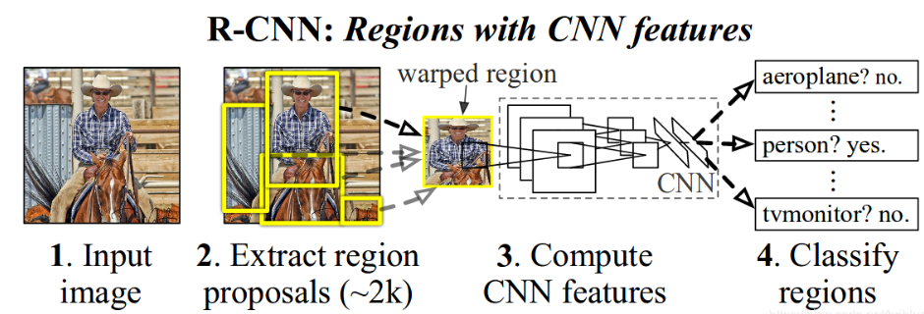
Alternative 2: Alternative for localization: Mask RCNN
Actually, in the field of object localization, RCNN is popular and useful for the multiple object and region localization

Slide 32
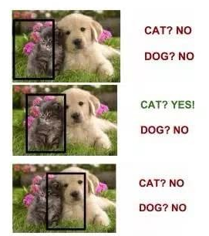
RCNN & Faster RCNN
RCNN is neural network that slides a specific size window through the whole image and select some interested region which produced by Region Proposal Network (RPN). Classifier makes the classification and detection in each proposal region and finally multiple objects could be detected in the whole image.

Slide 33
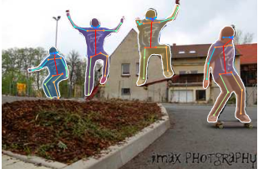
Mask RCNN
During literature review, I found a neural network named Mask R-CNN is suitable for our product.
It combines both faster-RCNN and instance segmentation together. It has two branches in total, one is for multiple objects detection and the other is for instance segmentation which could outline the location of the defects clearly

Slide 34
Alternative 2
Total number of articles recommending RCNN: 4
[7] Autonomous Structural Visual Inspection Using Region-Based Deep Learning for Detecting Multiple Damage Types
[8] Automatic Localization of Casting Defects with Convolutional Neural Networks
[9] Detection of Rail Surface Defects Based on CNN Image Recognition and Classification
[10] Mask R-CNN
However, consider that our input images are gray scale and don’t have so many vivid features among the whole picture, Mask R-CNN is difficult to work well in our problem as detecting defects on steel surface since the instance segmentation can be difficult

Slide 35
Reference
Automatic Defect Detection on Hot-Rolled Flat Steel Products. Santanu Ghorai, Member, IEEE, Anirban Mukherjee, Member, IEEE, M. Gangadaran, and Pranab K. Dutta, Member, IEEE. 2013.
Defect detection for corner cracks in steel billets using a wavelet reconstruction method. Yong-Ju Jeon,1 Doo-chul Choi,1 Sang Jun Lee,1 Jong Pil Yun,2 and Sang Woo Kim. 2014.
Vision-based defect detection of scale-covered steel billet surfaces. Jong Pil, Yun SungHoo Choi, Sang Woo Kim. 2009.
Texture classification and segmentation using wavelet packet frame and Gaussian mixture model. Soo Chang Kim, Tae Jin Kang. 2006.
Automated surface inspection for statistical textures. Du Ming Tsai, Tse-Yun Huang. 2003.
Stitching defect detection and classification using wavelet transform and BP neural network. W.K. Wong, C.W.M. Yuen, D.D. Fan, L.K. Chan, E.H.K. Fung. 2009.
Autonomous Structural Visual Inspection Using Region-Based Deep Learning for Detecting Multiple Damage Types. Young Jin Cha, Wooram Choi, Gahyun Suh & Sadegh Mahmoudkhuni. 2018.
Automatic Localization of Casting Defects with Convolutional Neural Networks. Max Ferguson, Ronay Ak, Yung-Tsun Tina Lee, Kincho H. Law.
Detection of Rail Surface Defects Based on CNN Image Recognition and Classification. Lidan SHANG, Qiushi YANG, Jianing WANG, Shubin LI, Weimin LEI. 2018.
Mask R-CNN. Kaiming He Georgia Gkioxari Piotr Dollar Ross Girshick. 2018.

Slide 36
Q & A
Thank you

