Slide 1




An Army-sponsored University Affiliated Research Center
Human swarm interaction using plays, audibles, and a virtual spokesperson
Patricia Chaffey, Ron Artstein, Setareh Nasihati Gilani, and others
The work depicted here was sponsored by the U.S. Army. Statements and opinions expressed do not necessarily reflect the position or the policy of the United States Government, and no official endorsement should be inferred.

Slide 2
Motivation
Robotic swarms = multiple robots that act as a team
People need to interact with the swarm
Interacting with each member = high cognitive load
Methods for controlling the swarm
Our contribution: verbal interaction

Slide 3
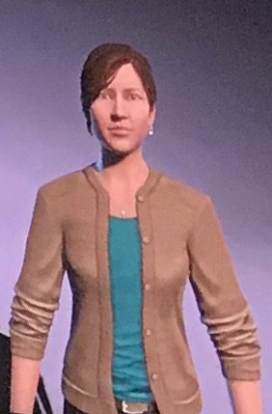
Model
Two paradigms facilitate interaction
Plays and audibles: predefined, flexible sequences for multi-robot coordination
Spokesperson: virtual human character as a verbal interface to the swarm

Slide 4
Outline
Simulation environment
Wildfire evacuation scenario
Collection of interaction data

Slide 5
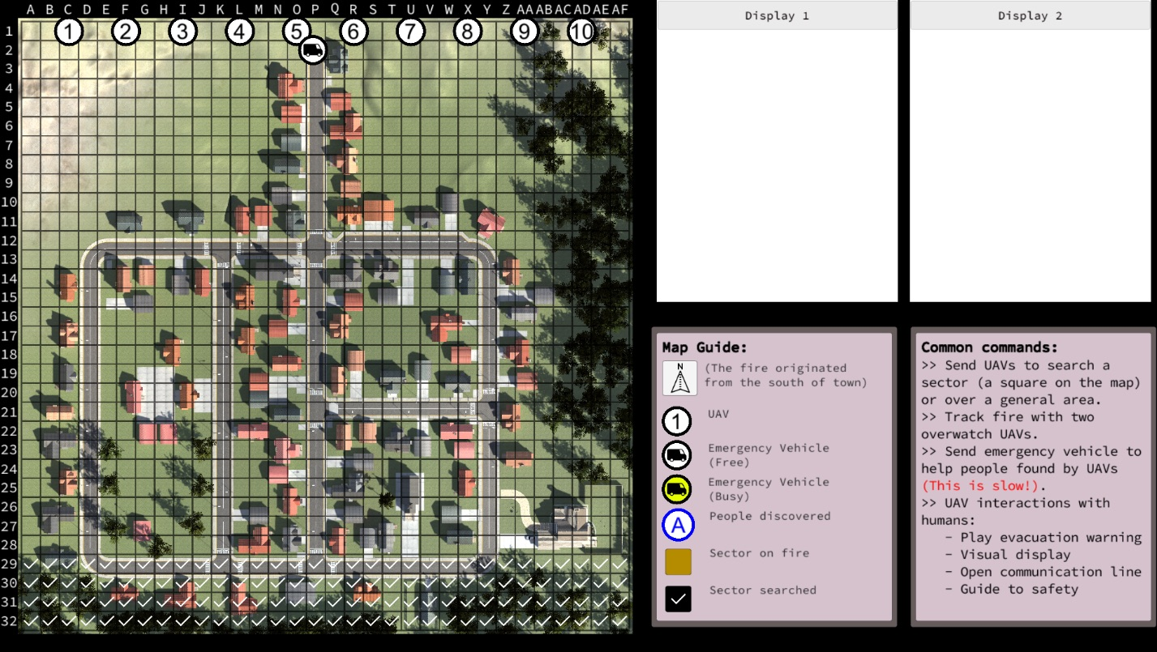

Slide 7
Plays
Overwatch: One or more drones monitor the fire’s spread
Search: One or more drones to search for residents in a designated area
Warning: Broadcast evacuation warning to nearby residents
Monitor: Follow the location of an identified resident
Guide: Guide a resident to safety

Slide 8
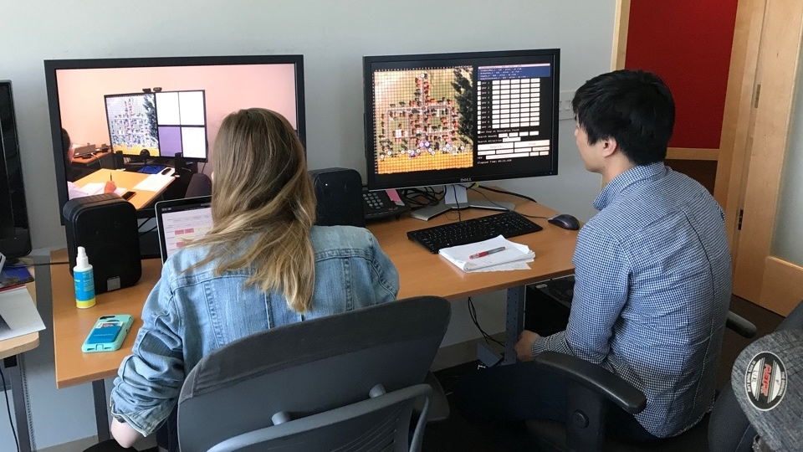
Wizard of Oz

Slide 9
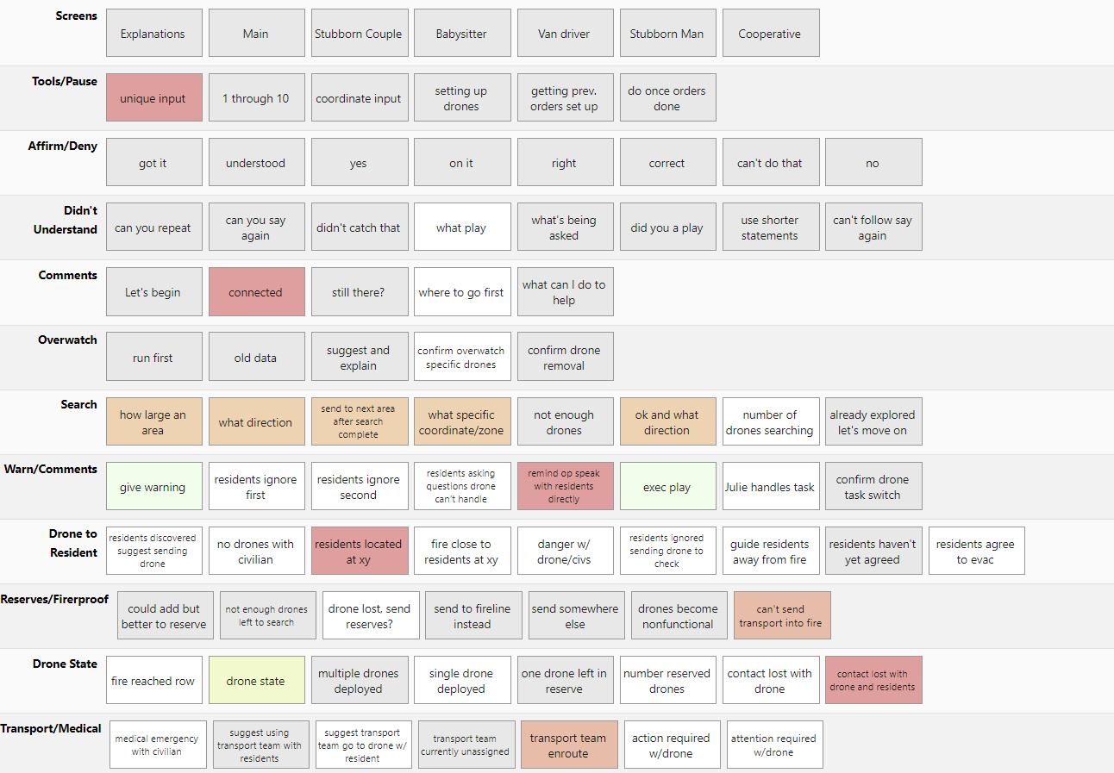
Agent control interface

Slide 10
Data collection
Identify communication strategies
Collect training data for automation
31 participants
2 trials each

Slide 11
Lives saved
Improve from first trial (median 2) to second (median 3)
Strong correlation between first and second trials (r = 0.45)

Slide 12
Communication strategies
Micro-managing the drones is too slow
Utilizing the spokesperson helps outcomes
Variation in language: grid coordinates vs descriptions

Slide 13
Conclusions
People can communicate verbally with robot swarms
Predefined plays and a personified spokesperson are helpful
Next steps:
Transcribe, align, analyze the recordings
Automate language understanding
Learn dialogue strategies
Extend the simulation

Slide 14
Our team
Patricia Chaffey | David M. Krum | Rhys Yahata
Ron Artstein | David Nelson | Anton Leuski
Kallirroi Georgila | Kevin Huynh | Volodymyr Yanov
Kimberly A. Pollard | Alesia Gainer | David Traum
Setareh Nasihati Gilani | Seyed Hossein Alavi

