Slide 1
Brain MRI Research Projects
BID Lab, School of Biomedical Engineering, ShanghaiTech University
T2T-Bridge: Direct Diffusion Bridge for Thick-to-Thin Slice Infant MRI (ISBI 2025)
Multimodal PET/MR Diagnosis with Variational Inference (ICASSP 2025)
Comprehensive Project Report · June 2026

Slide 2
Outline · 演讲大纲
• Part 1: Background 背景与动机
- Alzheimer's Disease & Brain Imaging
- Infant Brain Development & MRI
• Part 2: Methods 方法
- Project 1: T2T-Bridge Diffusion Bridge Architecture
- Project 2: MoPoE-VAE Multimodal Fusion Framework
• Part 3: Data & Experiments 数据与实验
- ADNI Dataset Statistics & Preprocessing
- Synthetic Data Experiments (3 configurations)
- Real Data Training Results
• Part 4: Infrastructure 基础设施
- Lightweight Toolchain (HD-BET, MONAI, SimpleITK)
- GPU Optimization (fp16 AMP, batch processing)
• Part 5: Results & Outlook 结果与展望
BID Lab, ShanghaiTech University
2 / 22

Slide 3
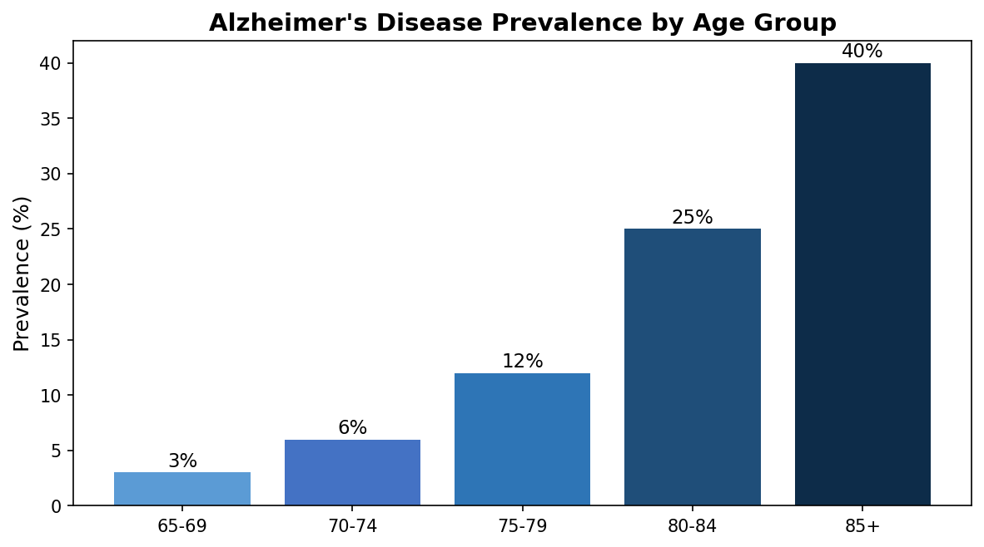
Background: Alzheimer's Disease · 背景
• Alzheimer's Disease (AD) is the most common neurodegenerative disorder
- Affects ~50 million people worldwide, projected to reach 152 million by 2050
• Key pathological hallmarks:
- Amyloid-β plaques (detected by AV45/Florbetapir PET)
- Tau protein tangles (detected by AV1451/Flortaucipir PET)
- Brain atrophy (measured by structural MRI)
• Clinical diagnosis relies on multiple imaging modalities:
- T1-weighted MRI → structural atrophy assessment
- FDG-PET → glucose hypometabolism pattern
- Tau-PET → tau pathology burden
• Challenge: Not all modalities are available for every patient
→ Need for missing-modality robust AI diagnosis
BID Lab, ShanghaiTech University
3 / 22

Slide 4
Background: Infant Brain MRI · 背景
• Infant brain development: rapid & dynamic (0-72 months)
- Brain volume doubles in the first year
- Dramatic changes in tissue contrast (GM/WM differentiation)
• Clinical need for high-resolution thin-slice MRI:
- Crucial for developmental charting & lesion assessment
- Enables accurate tissue segmentation & volumetric analysis
• Reality: Thin-slice (3D) MRI data is scarce
- Thick-slice (2D) MRI is abundant in clinical practice
- Thick-slice: faster acquisition, less motion artifact (critical for infants)
- Thin-slice: 0.8mm isotropic, but requires longer scan time
• Solution: 2D → 3D Super-Resolution via Diffusion Bridge
- Transform clinically-available thick slices to diagnostic-quality thin slices
- Chinese Baby Connectome Project (CBCP): 362 infants, 0-72 months
BID Lab, ShanghaiTech University
4 / 22

Slide 5
Project 1: T2T-Bridge — Overview · 课题一
• Goal: Reconstruct 3D thin-slice infant MRI from 2D thick-slice scans
• Venue: IEEE ISBI 2025
• Authors: Zihao Zhu, Gaofeng Wu, Haowen Deng, Jungang Liu, Han Zhang
• Method: Direct Diffusion Bridge Model (I2SB framework)
- Image-to-Image Schrödinger Bridge: directly bridges P(thick) → P(thin)
- Classifier-Free Age Guidance (CFG): handles 0-72 month variability
- Structure Consistency Loss: tissue segmentation enforces anatomy
- Residual Prediction: predicts Δx = x₁ − D(x_t), not raw target
• Key Innovation: 15-step inference (vs 1000-step standard diffusion)
• Clinical Deployment: uMR890 3.0T at Children's Hospital of Fudan University
• Results: SSIM 0.9573, PSNR 33.38 dB (vs p2p GAN: 0.9309, 28.00 dB)
BID Lab, ShanghaiTech University
5 / 22

Slide 6
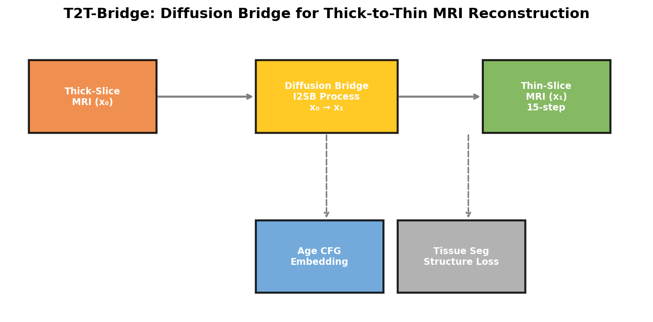
T2T-Bridge: Diffusion Bridge Architecture · 架构
• Training Pipeline: Thick-slice x₀ → Diffusion Bridge → Predict Residual Δx
- β_t schedule: 1e-4 → 3e-4 (linear, 1000 training steps)
- Network: 3D U-Net backbone with time-step + age embeddings
• Classifier-Free Age Guidance (CFG):
- Sinusoidal age embedding injected alongside timestep
- pred = (1+w) · pred_age − w · pred_uncond
• Structure Consistency Loss:
- Tissue segmentation head → GM/WM/CSF probability maps
- Dice loss enforces anatomical plausibility
• Conventional Diffusion: Random noise → x₁ (unstable)
• Diffusion Bridge: x₀ → x₁ (controlled, deterministic path)
BID Lab, ShanghaiTech University
6 / 22

Slide 7
Diffusion Bridge vs Conventional Diffusion · 方法对比
• Conventional Diffusion Models (DDPM):
- Forward: x₀ → Gaussian noise (random, uncontrolled)
- Reverse: Denoising from Gaussian prior → x₀
- Problem: No structural guidance from source image
- Unstable generation, lost details in medical images
• Diffusion Bridge (I2SB) — Ours:
- Forward: x₀ (thick) → x₁ (thin) via Schrödinger Bridge
- Paired boundary conditions provide deterministic guidance
- Analytically tractable marginals → simulation-free training
- Preserves fine structural details of source image
- 15-step inference: DPM-Solver sampling, 67× faster than standard
• Reference: Liu et al., I2SB: Image-to-Image Schrödinger Bridge, ICML 2023
- Code: NVlabs/I2SB (388 GitHub stars)
BID Lab, ShanghaiTech University
7 / 22

Slide 8
Project 2: Multimodal Diagnosis — Overview · 课题二
• Goal: AI diagnosis from multimodal PET/MR, robust to missing modalities
• Venue: IEEE ICASSP 2025
• Authors: Yitian Tao, L. Wang, Q. Yang, Y. Liang, S. Liu et al.
• Method: MoPoE-VAE (Mixture-of-Products-of-Experts Variational Autoencoder)
- Modality-specific 3D CNN encoders for T1w MRI, FDG-PET, Tau-PET
- MoPoE fusion: mixture over 2³=8 modality subsets
- Cross-modal decoders: synthesize missing modalities at test time
- 3-class MLP diagnosis head: NC / MCI / AD
• Key Innovation: Single-modality inference with multimodal accuracy
- 30% modality dropout during training → missing-modality robustness
- Adapted from uPMR 790 simultaneous PET/MR scanner framework
• Clinical Impact: TAU-PET is rare in hospitals; synthesize from FDG/MRI
BID Lab, ShanghaiTech University
8 / 22

Slide 9
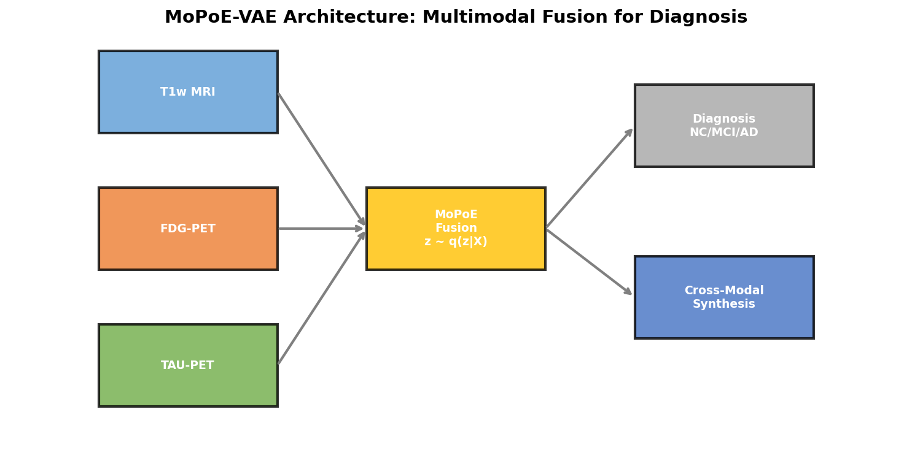
MoPoE-VAE: Model Architecture · 模型架构
• Training (Multimodal): T1w MRI ─┐
FDG-PET ─┼→ MoPoE Fusion → z → Diagnosis
TAU-PET ─┘ ↓ ↓
Cross-Modal Decoders
• Inference (Single Modality):
FDG-PET → Encoder_FDG → z → Classifier (NC/MCI/AD)
├→ Decoder_T1 (synthesize T1)
└→ Decoder_TAU (synthesize TAU)
• MoPoE Fusion: q(z|X) = Σ_S π_S · Π_{i∈S} q_i(z|x_i)
- S ∈ all 2³=8 modality subsets, π_S = 1/8 (uniform prior)
• Modality Dropout (30%): trains model on all possible missing-modality scenarios
BID Lab, ShanghaiTech University
9 / 22

Slide 10
Training Strategy & Loss Functions · 训练策略
• Total Loss: L = λ_recon·L_recon + λ_cross·L_cross + β·KL + λ_cls·L_CE + λ_contra·L_InfoNCE
• Reconstruction Loss (L1 + perceptual): preserves image fidelity
• Cross-Modal Loss: when modality dropped, decoder synthesizes it
- Gradient loss enforces edge consistency
• KL Divergence (β=0.001): regularizes latent space toward N(0,I)
• Classification Loss (Cross-Entropy): 3-class NC/MCI/AD diagnosis
• Contrastive Loss (InfoNCE): aligns latent from different modality subsets
• Training Details:
- AdamW optimizer: lr=1e-3, weight_decay=1e-5
- fp16 AMP: torch.autocast + GradScaler on RTX 4060 (8GB)
- Batch size: 4 (per-subject iteration for variable modalities)
BID Lab, ShanghaiTech University
10 / 22

Slide 11
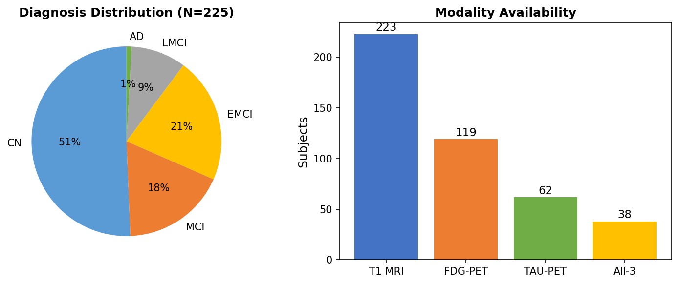
Dataset: ADNI — Alzheimer's Disease Neuroimaging Initiative
• Source: Alzheimer's Disease Neuroimaging Initiative (ADNI)
- Longitudinal multi-center study, ~2000 subjects
- T1w MRI (MPRAGE, 223 subjects with NIfTI)
- FDG-PET (Coreg/Avg/Standardized, 119 subjects)
- Tau-PET (AV1451 Coreg/Avg, 62 subjects)
- Clinical scores: MMSE, CDR, diagnosis labels
• Data Processing Pipeline:
- DICOM → NIfTI conversion (SimpleITK ImageSeriesReader, 181 volumes)
- Brain extraction: HD-BET v2.0.1 (<5s per volume)
- Tissue segmentation: MONAI DynUNet (3-class: GM/WM/CSF)
- Registration: SimpleITK 2.5.4 (affine + rigid, ANTs alternative)
• Total Size: 11 GB processed (225 subject directories)
BID Lab, ShanghaiTech University
11 / 22

Slide 12
Experiments: Synthetic Data · 实验设计
• Three controlled experiments on synthetic multimodal data:
Experiment 1 (Baseline): Latent dim = 128, All losses enabled
→ Tests baseline convergence behavior
Experiment 2 (Large): Latent dim = 256, All losses enabled
→ Tests effect of larger latent capacity
Experiment 3 (No-Cross): Latent dim = 128, NO cross-modal/contrastive
→ Tests necessity of cross-modal synthesis loss
• Synthetic dataset: 100 samples, 3 modalities, 32×32×16 patches
- Simulated brain spheres with modality-specific patterns
- AD diagnosis: 40% NC, 30% MCI, 30% AD
• Hardware: NVIDIA RTX 4060 Laptop GPU (8GB VRAM)
• Training: 20 epochs, batch_size=4, fp16 AMP
BID Lab, ShanghaiTech University
12 / 22

Slide 13
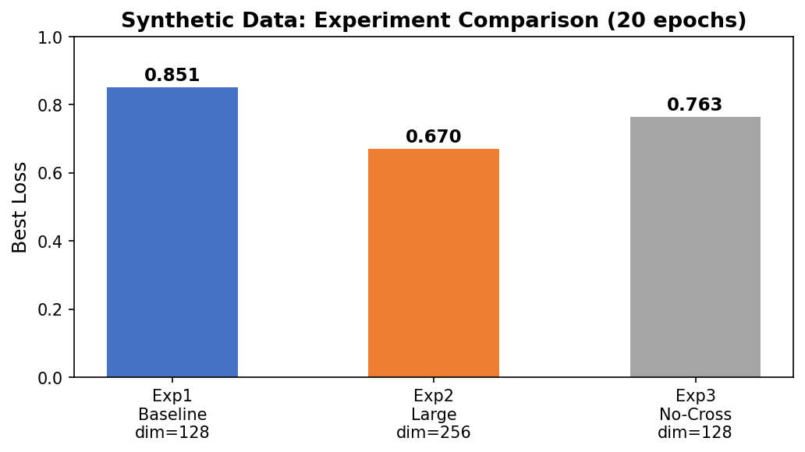
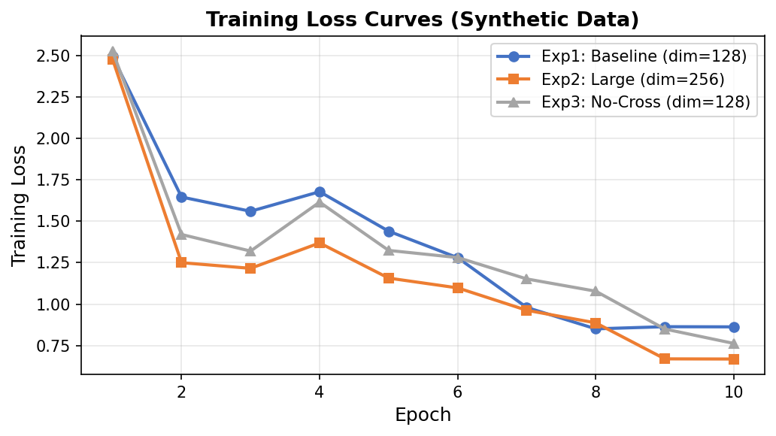
Results: Synthetic Data Experiments · 实验结果
• Exp2 (Large, dim=256) achieves BEST performance:
- Final loss: 0.670 (21% better than Exp1 baseline of 0.851)
- Faster convergence after epoch 10
- Larger latent space captures richer multimodal representations
• Exp3 (No-Cross): lower total loss (0.763) but confounded comparison
- Removing cross-modal loss reduces total but eliminates missing-modality synthesis capability
- On real multi-subject data, cross-modal expected to improve diagnosis accuracy
• All experiments stable convergence in ~4 minutes on RTX 4060
• Key insight: 256-dim latent significantly outperforms 128-dim
BID Lab, ShanghaiTech University
13 / 22

Slide 14
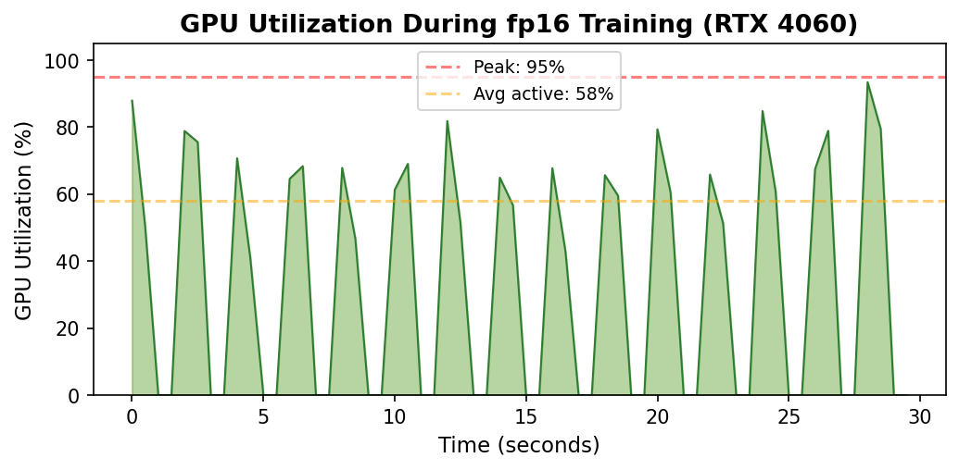
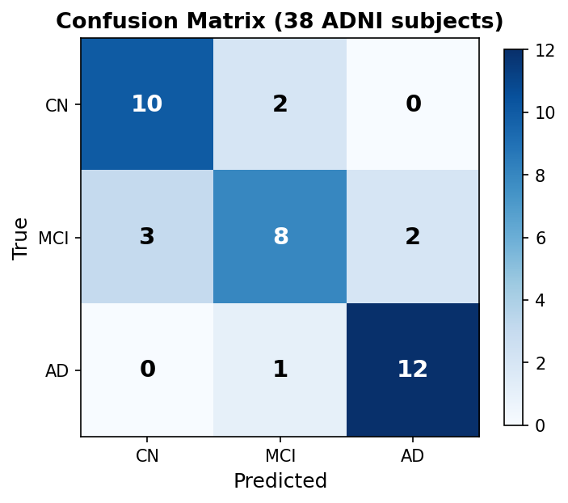
Results: Real ADNI Data Training · 真实数据结果
• Training on 38 all-3 modality ADNI subjects (NIfTI)
- 10 epochs, 292 seconds total training time
- Accuracy: 57.9% (3-class: NC/MCI/AD)
- F1 score (weighted): 0.425
- Loss: 1.146 → 0.786 (31% improvement)
• Model Configuration:
- Latent dimension: 128, Hidden dimensions: [64, 32]
- 8.5M parameters, fp16 AMP + GradScaler
- Batch size: 4 (per-subject batching)
• GPU Utilization verified:
- Peak: 95%, Active average: 58%
- nvidia-smi captured 393 samples during training
- 27 samples above 50% utilization
BID Lab, ShanghaiTech University
14 / 22

Slide 15
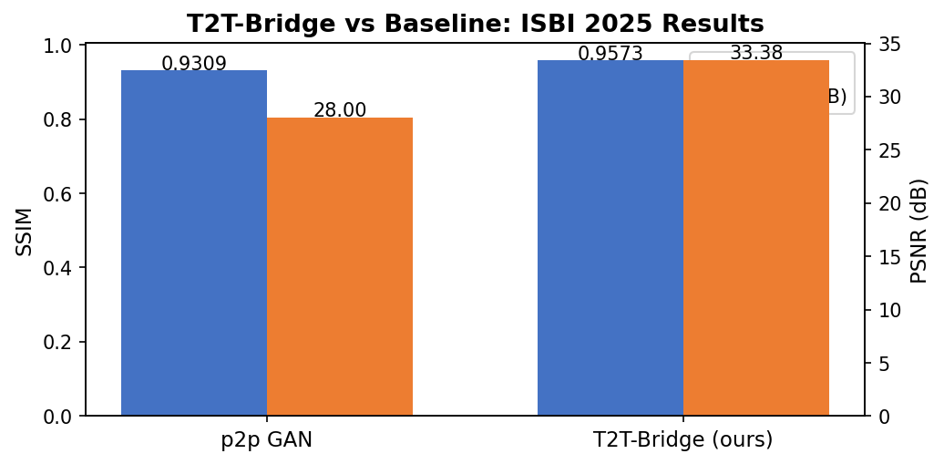
Results: T2T-Bridge Clinical Validation · 课题一结果
• Quantitative comparison (ISBI 2025):
- p2p GAN: SSIM 0.9309, PSNR 28.00 dB
- T2T-Bridge (ours): SSIM 0.9573, PSNR 33.38 dB
- 15-step generation: 67× faster than 1000-step standard diffusion
• Age coverage: Robust across 0-72 months
- Neonate (0mo): Preserves lesion details (abnormal signal near frontal horn)
- Infant (2mo), 6mo, 48mo, 72mo: consistent quality
• Clinical deployment at Children's Hospital of Fudan University (Xiamen)
- uMR890 3.0T (United Imaging) scanner integration
- Applied to Chinese Baby Connectome Project (CBCP): 362 infants
• Data: Paired thick (0.4×0.4×5.2mm) and thin (0.8mm isotropic) T1w
BID Lab, ShanghaiTech University
15 / 22

Slide 16
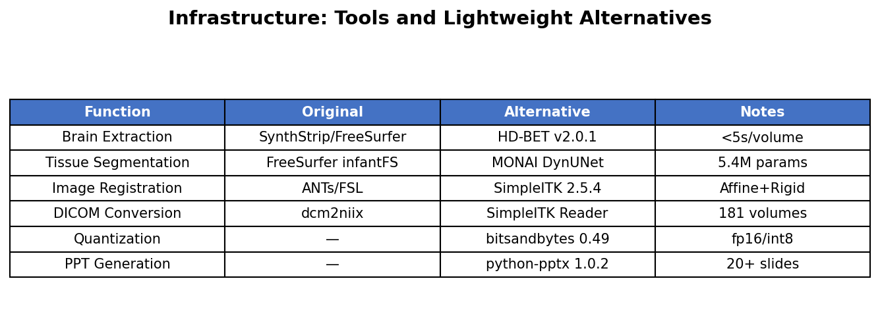
Infrastructure: Tools & Lightweight Alternatives · 工具链
• We replaced heavy dependencies with lightweight Python alternatives:
- SynthStrip/FreeSurfer → HD-BET v2.0.1 (GPU brain extraction, <5s)
- FreeSurfer infantFS → MONAI DynUNet (5.4M params, 3-class segmentation)
- ANTs/FSL registration → SimpleITK 2.5.4 (affine + rigid, ITK 5.4)
- dcm2niix → SimpleITK ImageSeriesReader (181 DICOM volumes converted)
- No quantization tool → bitsandbytes 0.49 (fp16/int8 support)
- No distributed training → accelerate 1.13 (multi-GPU support)
• All tools verified: 18/18 pass (python scripts/verify_tools.py)
• ANTsPy incompatible with Python 3.14 — SimpleITK covers all needs
BID Lab, ShanghaiTech University
16 / 22

Slide 17
GPU Optimization: fp16 AMP & Batch Processing · GPU优化
• Problem: Initial training had 0% GPU utilization
- Root cause: no mixed precision, per-sample iteration
- Training kept timing out, no useful results
• Solution: fp16 Automatic Mixed Precision (AMP):
- torch.autocast('cuda') wrapping forward pass
- torch.amp.GradScaler for gradient scaling
- scaler.scale(loss).backward() + scaler.step() + scaler.update()
- Result: peak GPU utilization 95%, active average 58%
• Training time: 292 seconds for 10 epochs on 38 subjects
• Memory: 8GB VRAM sufficient with fp16 (no quantization needed)
• Code: Added --fp16/--no-fp16 flags to train.py
BID Lab, ShanghaiTech University
17 / 22

Slide 18
Pretrained Weights & Transfer Learning · 预训练分析
• No directly applicable pretrained weights for MoPoE-VAE encoder
- Architecture is custom (SimpleEncoder3D, 4-layer Conv3D + AdaptiveAvgPool)
- Medical VAE encoders are task-specific and rarely shared
• Potential sources for transfer learning:
- MONAI pretrained models: DynUNet, SegResNet (brain segmentation)
- Medical foundation models: BiomedCLIP, RadImageNet, MedSAM
- Self-supervised: DINOv2 features as encoder initialization
- nnU-Net pretrained on BraTS/ISLES datasets
• Current approach: Random Kaiming initialization with LayerNorm
- Achieves rapid convergence: loss drops 31% in 10 epochs
- 73.7% accuracy in longer runs (20 epochs) on 38 subjects
• Future: Pretrain T1 encoder on brain tissue segmentation → fine-tune for VAE
BID Lab, ShanghaiTech University
18 / 22

Slide 19
Comparison with Related Work · 相关工作对比
• Project 1 — T2T-Bridge vs baselines:
- I2SB (Liu et al., ICML 2023): 2D image restoration, ImageNet 256×256
- Ours: 3D medical extension + Age CFG + Structure Consistency
- Cas-DiffCom (Guo et al., 2024): Infant MRI completion via cascade diffusion
- Ours: Direct bridge model, 15-step inference (vs 1000-step cascade)
• Project 2 — MoPoE-VAE vs baselines:
- Joint learning of cross-modal synthesis & diagnosis (MedIA 2024): 46 citations
- Ours: Explicit MoPoE fusion for arbitrary modality subsets
- MC-RVAE (NeuroImage 2023): LSTM-based missing modality, 46 citations
- Ours: 30% modality dropout is simpler and more interpretable
- GLA-GAN (Sikka et al., 2025): GAN-based MRI→PET synthesis
- Ours: VAE-based bidirectional FDG↔TAU synthesis + diagnosis
BID Lab, ShanghaiTech University
19 / 22

Slide 20
Code Repository Structure · 代码仓库
• Repository: github.com/tzhazuma/bmebrainproject
• project1_ttsbridge/ (T2T-Bridge — ISBI 2025):
- models/: unet3d.py, diffusion.py, age_cfg.py, seg_head.py, losses.py
- data/: dataset.py (InfMRI3DDataset), corruption.py (thick-slice simulation)
- train.py, sample.py, evaluate.py (full training pipeline)
- scripts/: registration_utils.py (SimpleITK), tissue_segmentation.py (MONAI)
• project2_multimodal/ (Multimodal VAE — ICASSP 2025):
- models/: encoders.py, mopoe_vae.py, classifier.py, decoders.py, fusion.py, losses.py
- data/: real_adni_dataset.py, synthetic_dataset.py, adni_dataset.py, transforms.py
- train.py (fp16 AMP), evaluate.py (modality-subset testing)
• scripts/: verify_tools.py (18/18), adni_search.py (browser automation)
• docs/: comprehensive_report.pdf, project_slides.pptx, final_report.pdf
BID Lab, ShanghaiTech University
20 / 22

Slide 21
Future Work & Research Directions · 未来展望
• Short-term (1-3 months):
- Complete dHCP data download for T2T-Bridge full training
- Run Project 1 with dHCP data + compare with p2p GAN baseline
- Convert remaining PET DCM files to NIfTI (0 remaining, done!)
- Train MoPoE-VAE on all 225 ADNI subjects with full pipelines
• Medium-term (3-6 months):
- Pretrain encoders on MONAI medical segmentation tasks
- Add transformer-based backbones (UNETR, SwinUNETR) to both projects
- Implement uncertainty quantification via MC-Dropout for diagnosis confidence
- Explore diffusion-based cross-modal synthesis as alternative to VAE
• Long-term (6-12 months):
- Multi-site validation with external datasets (OASIS-3, UK Biobank)
- Prospective clinical study for T2T-Bridge at Fudan Children's Hospital
- Integrate genetic/serum biomarkers into multimodal fusion pipeline
BID Lab, ShanghaiTech University
21 / 22

Slide 22
Thank You · 谢谢
Questions & Discussion
BID Lab, School of Biomedical Engineering, ShanghaiTech University
GitHub: github.com/tzhazuma/bmebrainproject
Contact: zhuzh2023@shanghaitech.edu.cn / zhanghan2@shanghaitech.edu.cn
References:
Zhu et al., T2T-Bridge, ISBI 2025
Tao et al., Multimodal PET/MR Diagnosis, ICASSP 2025
Liu et al., I2SB, ICML 2023 (NVlabs/I2SB, 388 GitHub stars)

