Slide 1
Working with files

Slide 2
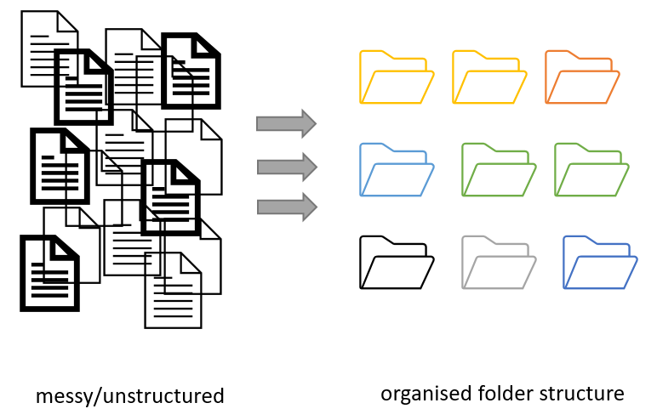
Project organization
Figure credits: Andrés Romanowski
Notes:
Before you even start collecting or working with data you should decide how to structure and name files and folders. This will:
allow for standardized data collection and analysis by many team members.
make it easier for the researcher to determine where files should be saved.
avoid file duplication.
help make retrieval and archiving more efficient.

Slide 3
Consistent naming and organization of files in folders has two main goals:
Find files quickly
Ability to tell the file content without opening it

Slide 4
It is important to develop a standardised naming convention
consistent
encoding of experimental factors
meaningful to you and your collaborators
give you a sense of the content
easily identify if something is missing

Slide 5

Example
LD_phyA_off_t04_2020-08-12.norm.xlsx
could be a file that contains:
normalized data (norm),
from experiment in long day (LD)
for genotype phyA
with media without sucrose (off)
at timepoint 4 (t04)

Slide 6
Exercise 1
Naming and sorting
Notes:
Using dates up front makes it difficult to quickly find data for particular conditions or genotypes. It also masks the “logical” order of samples or timepoints.
Named months break the “expected” sorting, same as dates without leading 0
The lack of consistency makes it very difficult to get data from related samples/conditions.
Without leading zeros, ‘s12’ appear before s1 and s2
the first (and second) part of the name are easiest to spot
the last file is also from LD conditions, but appears after SD, same with ‘phya’ genotypes
the last 3 file names are easiest to read as all parts appear on top of each other due to the same 3 letter-length codes ons and off
Without leading zeros, ‘s12’ appear before s1 and s2

Slide 7
Exercise 1 - solution
Using dates up front makes it difficult to quickly find data for particular conditions or genotypes. It also masks the “logical” order of samples or timepoints.
Named months break the “expected” sorting, same as dates without leading 0
The lack of consistency makes it very difficult to get data from related samples/conditions.
Without leading zeros, ‘s12’ appear before s1 and s2
the first (and second) part of the name are easiest to spot
the last file is also from LD conditions, but appears after SD, same with ‘phya’ genotypes
the last 3 file names are easiest to read as all parts appear on top of each other due to the same 3 letter-length codes ons and off
Without leading zeros, ‘s12’ appear before s1 and s2

Slide 8
Naming Files
Do’s:
Include date in the name. Use YYYY-MM-DD or YYYMMDD format, eg. 20210920 Add date at the end of the file UNLESS you organize files chronologically
Include version number (if applicable) (ortogonal to date) Use leading zeroes (i.e.: v005 instead of v5)

Slide 9
Naming Files
Do’s:
Encode shortly biological or experimental relevant information, data catagory, etc. Example information to include:
sample, site, patient id
drug treatments, doses, names
environmntal conditions
genotypes, markers,
technique
Data operation: normalized, cleaned, detrended, clustered

Slide 10
Naming Files
Do’s:
Add leading zeros to numerical values
Add prefixes to numerical values: eg. S003, TR005

Slide 11
Naming Files
Do’s:
Make sure the file format extension is present at the end of the name (e.g. .doc, .xlsx, .mov, .tif)
Add a PROJECT_STRUCTURE (README) file in your top directory which details your naming convention, directory structure and abbreviations

Slide 12
Naming Files
Don'ts:
Avoid using spaces (use _ or - instead)
Avoid using commas and special characters (e.g. ~ ! @ # $ % < > ?[ ] { } ‘)
Avoid using language specific characters (e.g óężé)

Slide 13
Naming Files
Don'ts:
Avoid using long names (should not exceed 30 characters)
Avoid repeating information from parent elements ELN_MI_20200101.tiff in Electron_Microscopy folder
Avoid using deep paths with long names (i.e. deeply nested folders with long names)

Slide 14
Exercise 2
A good name
Notes:
1 b)
2 a)
3 b)

Slide 15
Exercise 2 - solution
1b) rna-levels-by-site.v002.xlsx
2a) 20210906-birds-count-EDI.csv
3b) ld_phyA_on_s02-t01_2020-07-12.norm.xlsx
Notes:
1 b)
2 a)
3 b)

Slide 16
Folders vs. Files
Folders permit grouping relevant data together
Folders help to keep files names short
Notes:
Establishing a system that allows you to access your files, avoid duplication and ensure that your data can be easily found needs planning.
You can start by developing a logical folder structure. To do so, you need to take into account the following suggestions:
Use folders to group related files. A single folder will make it easy to locate them.
Name folders appropriately: use descriptive names after the areas of work to which they relate.
Structure folders hierarchically: use broader topics for your main folders and increase in specificity as you go down the hierarchy.
Be consistent: agree on a naming convention from the outset of your research project.

Slide 17
Exercise 3
Folders vs Files

Slide 18
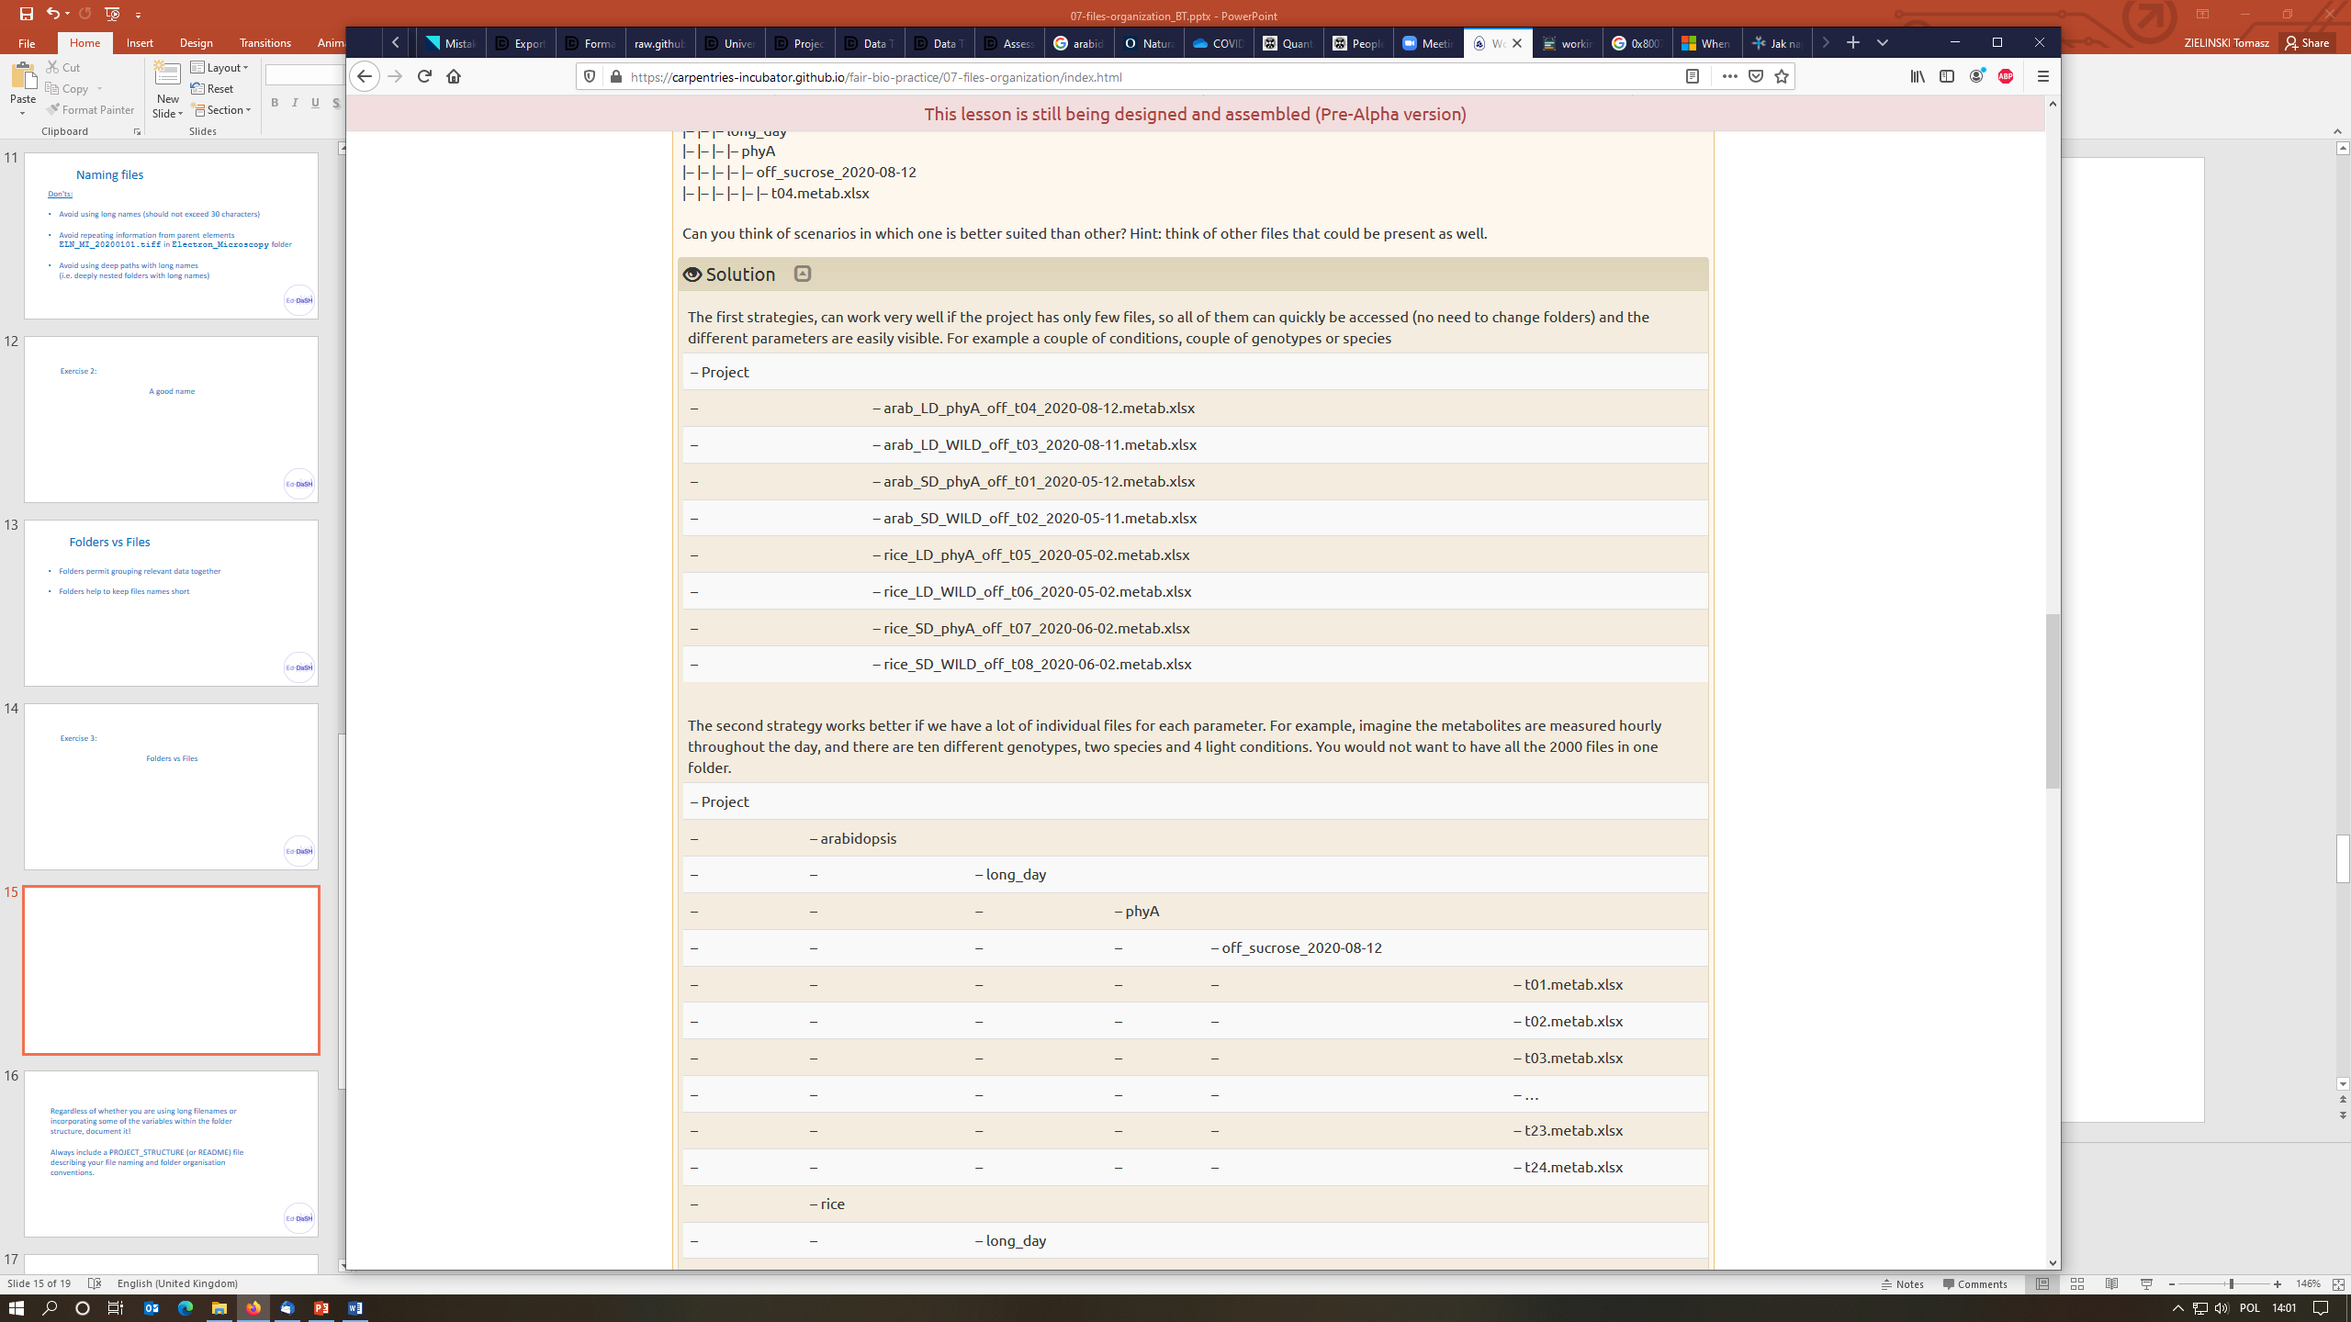
The first strategy can work very well if the project has only few files, so all of them can quickly be accessed (no need to change folders) and the different parameters are easily visible. For example a couple of conditions, couple of genotypes or species

Slide 19
The second strategy works better if we have a lot of individual files for each parameter. For example, imagine the metabolites are measured hourly throughout the day, and there are ten different genotypes, two species and 4 light conditions. You would not want to have all the 2000 files in one folder.

Slide 20
Regardless of whether you are using long filenames or incorporating some of the variables within the folder structure, document it!
Always include a PROJECT_STRUCTURE (or README) file describing your file naming and folder organisation conventions.
Notes:
Your naming conventions might need some adjustments as the project progresses. Don’t despair, just document it!
If you change the strategy document it in PROJECT_STRUCTURE (or README) stating why you made the change and when. Update the locations and names of files which followed the old convention

Slide 21
Use folders to group related files. A single folder will make it easy to locate them.
Name folders appropriately: use descriptive names after the areas of work to which they relate.
Structure folders hierarchically: use broader topics for your main folders and increase in specificity as you go down the hierarchy.
Be consistent: agree on a naming convention from the outset of your research project

Slide 22
Exercise 4
Organization strategies
Notes:
The Good enough practices in scientific computing paper makes the following simple recommendations:
Put each project in its own directory, which is named after the project
Put text documents associated with the project in the ‘doc’ directory
Put raw data and metadata in a ‘data’ directory
Put files generated during cleanup and analysis in a ‘results’ directory
Put project source code in the ‘src’ directory
Put compiled programs in the ‘bin’ directory
Name all files to reflect their content or function: use names such as ‘bird_count_table.csv’, ‘notebook.md’, or ‘summarized_results.csv’.
Do not use sequential numbers (e.g., result1.csv, result2.csv) or a location in a final manuscript (e.g., fig_3_a.png), since those numbers will almost certainly change as the project evolves.
The b) structure is called “Organized by analysis” or “by figure”
The structure similar to c) is recommended for Brain Imaging Data Structure BIDS, as it is organized by patient and type of scans
d) is useful when we are interested in outcomes of drug treatments

Slide 23
Backing up your project files and folders
Back up (almost) everything created by a human or recorded by a machine as soon as it is created.
Always backup your files in 3 places, at least one should be off-site.
USB sticks are a failure-prone option and are not a valid solution for backup of scientific data
A robust backup cannot be achieved manually
Notes:
Do you know how and where to keep 3 copies of your data which are always up to date?
Secure data preservation is very difficult to achieve without institutional support and know-how. One option is cloud storage, but not all data may be put in a public cloud.
You should always check your institutional guidelines and what solutions are available in your organisation.

Slide 24
Plan, plan, revise, update, adhere
If you change the strategy document it in PROJECT_STRUCTURE (why you made the change and when)
Update the locations and names of files which followed the old convention
Bulk renaming of files can be done with the software such as Ant Renamer, RenameIT or Rename4Mac.

Slide 25
Exercise benefits of good files managment
Notes:
Have you realised that the above suggestions mean including valuable metadata as part of your folder structure and file names?
Bulk renaming of files can be done with the software such as Ant Renamer, RenameIT or Rename4Mac.

Slide 26
Key points
A good file name suggests the file content
Good project organization saves you time
Describe your files organization in PROJECT_STRUCTURE or README including naming convention

