Slide 1

(Meta)data in Excel

Slide 2
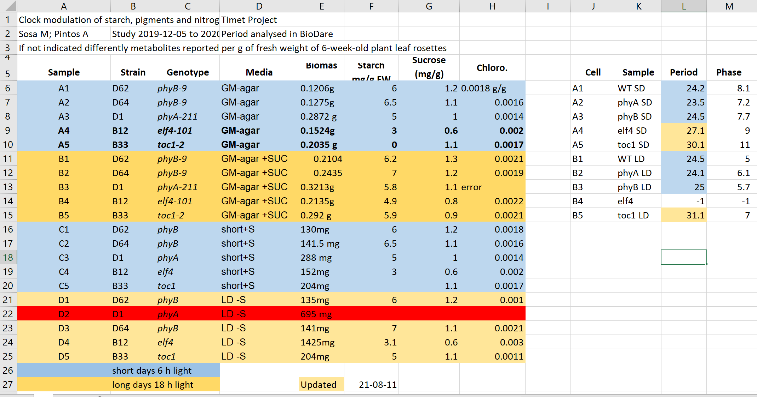
Exercise 1
What can go wrong with data in Excel

Slide 3
Exercise 1: Solution
Why are the data in two tables, are period measurement related to the metabolics i.e. same samples?
Do colours in metabolite and period tables have the same meaning?

Slide 4

Exercise 1: Solution
Why is row 22 is red any why does H13 says error?

Slide 5
Exercise 1: Solution
What is the meaning of values in media column?

Slide 6
Exercise 1: Solution
Are the genotypes same in different blocks or not?

Slide 7
Exercise 1: Solution
Before averaging the biomass, weight needs conversion to the same unit, and the unit should be removed from the text.

Slide 8
Exercise 1: Solution
Averaging per genotype needs manual selection of the suitable entries

Slide 9
Exercise 1: Solution
Saving to text
Information about light conditions is completely lost
The header columns are scrambled
The update date may change its meaning depending on the locale (switch year with day)

Slide 10
Common Spreadsheet errors
Using multiple tables
Don’t! It confuses both humans and computers.
Using multiple tabs
Harder to do programmatic analysis and extra sheets could be overlooked, but can be a good place to put secondary data or metadata. Use with caution.

Slide 11
Common Spreadsheet errors
Not filling in zeros
Zero can mean no data recorded, but a computer will treat the value as zero. Therefore, record zeros as zeros and missing data as nulls.
Using problematic null values
Best to record nulls as blanks in data fields, and keep a neighbouring column to comment that it’s null. NEVER: 0, -1, -100, 1000

Slide 12
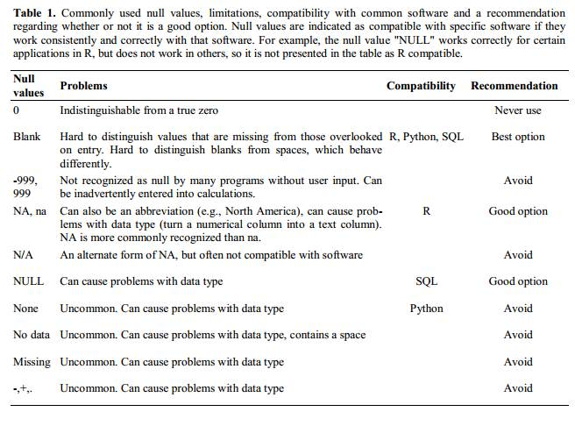
Common Spreadsheet errors
Not filling in zeros
Zero can mean no data recorded, but a computer will treat the value as zero. Therefore, record zeros as zeros and missing data as nulls.
Using problematic null values
Best to record nulls as blanks in data fields, and keep a neighbouring column to comment that it’s null. NEVER: -1, -100, 1000
White et al. Nine simple ways to make it easier to (re)use your data
doi:10.4033/iee.2013.6b.6.f

Slide 13

Common Spreadsheet errors
Using formatting to convey information organising data
- Computers can’t interpret formatting easily. Better to keep a column/ field to record that data. - Don’t merge cells.

Slide 14
Common Spreadsheet errors
Placing comments or units in cells
Computers struggle with these
Entering 1 < piece of information in a cell
Keep 1 data in each cell, and use as many cells as necessary
Male 30
Female 28
LD 30C SUC
LD 15C NO
SD 30C NO
Sex | Age
Male | 30
Female | 28
Day_length | Temp_C | Added_ Sucrose
LD | 30 | YES
SD | 15 | NO
SD | 30 | NO

Slide 15
Common Spreadsheet errors
Inconsistency in used values
Be consistent and try to use a formal naming system defined in your field.
Using problematic field names
Underscores not spaces. Avoid abbreviations. Include units.
E. Coli, EColi, Escherichia coli
Good Name | Good Alternative | Avoid
Max_temp_C | MaxTemp | Maximum Temp (°C)
Precipitation_mm | Precipitation | precmm
Mean_year_growth | MeanYearGrowth | Mean growth/year
sex | sex | M/F
weight | weight | w.
cell_type | CellType | Cell Type
Observation_01 | first_observation | 1st Obs

Slide 16
Common Spreadsheet errors
Using special characters in data
Computers struggle with these
Values without fields: always label values with column headers
! “ # $ % & '
óęłńöüä
Ann Smart and Daniele Hardwork
Starch content in Arabidopsis under different light conditions
Authors | Ann Smart | Daniele Hardwork
Title | Starch content in Arabidopsis under different light conditions

Slide 17
Exercise 2:
Spotting problems

Slide 18
Exercise 2: Solution
Using multiple tables
Using multiple tabs
Not filling in zeros
Using problematic null values
Using formatting to convey information and organizing data
Placing comments or units in cells
Entering more than one piece of information in a cell
Inconsistency in used values
Using problematic field names
Using special characters in data
Values without field labels
Row 5 Row 2 Column C Column E Column L

Slide 19
Exercise 2: Solution
Using multiple tables
Using multiple tabs
Not filling in zeros
Using problematic null values
Using formatting to convey information and organizing data
Placing comments or units in cells
Entering more than one piece of information in a cell
Inconsistency in used values
Using problematic field names
Using special characters in data
Values without field labels
5,9
Row 5 Row 2 Column C Column E Column L

Slide 20
Exercise 2: Solution
Using multiple tables
Using multiple tabs
Not filling in zeros
Using problematic null values
Using formatting to convey information and organizing data
Placing comments or units in cells
Entering more than one piece of information in a cell
Inconsistency in used values
Using problematic field names
Using special characters in data
Values without field labels
5,9
11,7
Row 5 Row 2 Column C Column E Column L

Slide 21
Exercise 2: Solution
Using multiple tables
Using multiple tabs
Not filling in zeros
Using problematic null values
Using formatting to convey information and organizing data
Placing comments or units in cells
Entering more than one piece of information in a cell
Inconsistency in used values
Using problematic field names
Using special characters in data
Values without field labels
5,9
11,7
Row 5 Row 2 Column C Column E Column L
8

Slide 22
Exercise 2: Solution
Using multiple tables
Using multiple tabs
Not filling in zeros
Using problematic null values
Using formatting to convey information and organizing data
Placing comments or units in cells
Entering more than one piece of information in a cell
Inconsistency in used values
Using problematic field names
Using special characters in data
Values without field labels
5,9
11,7
Row 5 Row 2 Column C Column E Column L
8
6,5

Slide 23
Exercise 2: Solution
Using multiple tables
Using multiple tabs
Not filling in zeros
Using problematic null values
Using formatting to convey information and organizing data
Placing comments or units in cells
Entering more than one piece of information in a cell
Inconsistency in used values
Using problematic field names
Using special characters in data
Values without field labels
5,9
11,7
3
Row 5 Row 2 Column C Column E Row 22
8
6,5

Slide 24
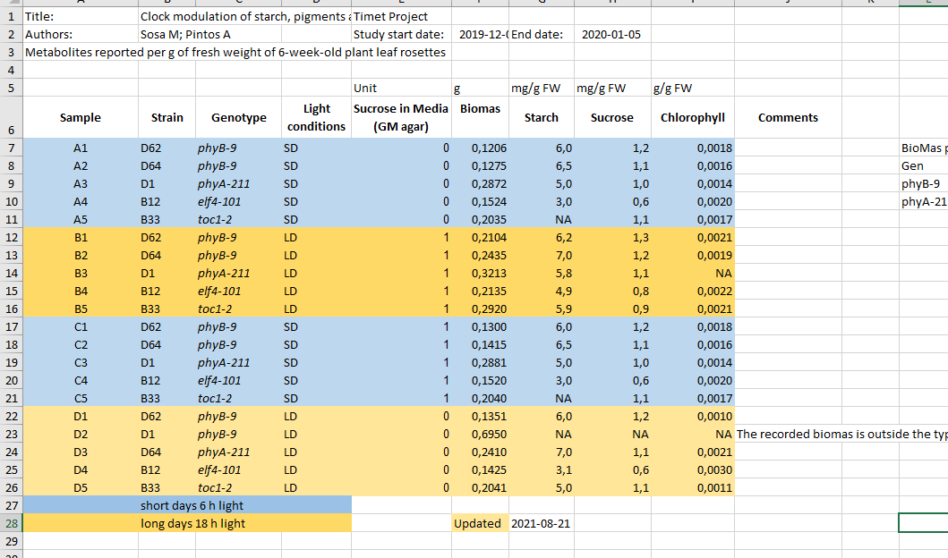
Better metadata
Do you think it would take more effort to record the data this way compared to the example before?
How long do you think it took to "clean" the original, problematic data?

Slide 25
Exercise 3
Open excel and type following values into the cells:
Is what you see what you typed?
Can you force it?
Do you know which year the dates represent?
A | B | C | D | E | F
Gene | SEPT2 | Sample | 0013 | Record | 12/5/4
Mar1 | 1 March | Mar-1 | 1-3 | 14/3/20 | 43904

Slide 26
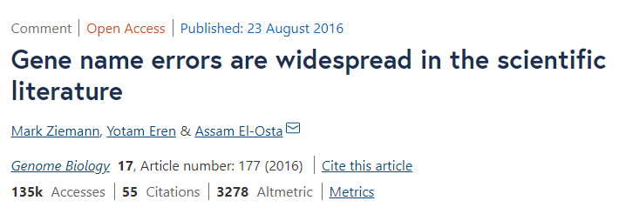
Outsmarted by Excel
Roughly 1 in 5 of 3,600 genetics papers investigated included errors in their gene lists that were due to Excel automatically converting gene names to things like calendar dates or random numbers.
→ Always document what format you are using to represent dates when using text files (.csv, .tsv) .

Slide 27
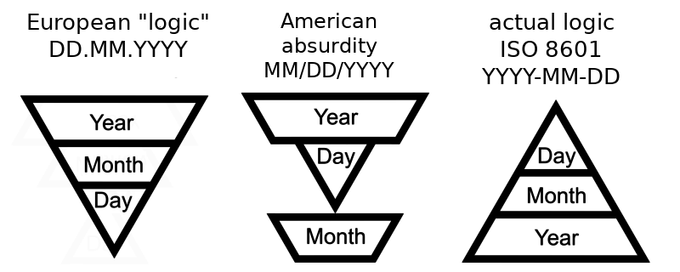
Dates

Slide 28
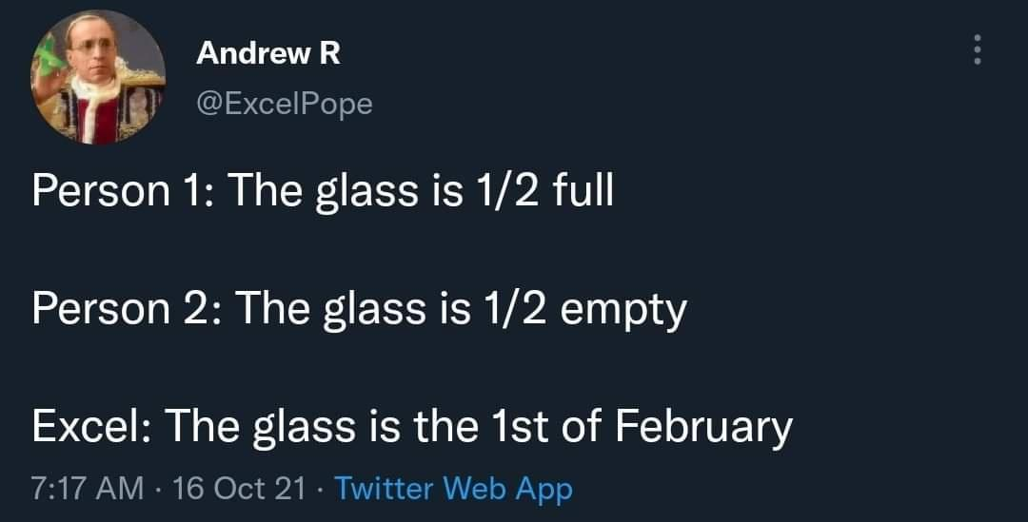
Dates
CC BY @ExcelPope

Slide 29
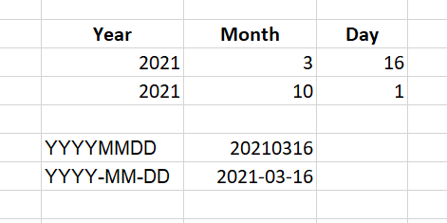
Dates
Store dates in 3 columns for year, month and day
Store the date as an ISO string: YYYYMMDD YYYY-MM-DD

Slide 30
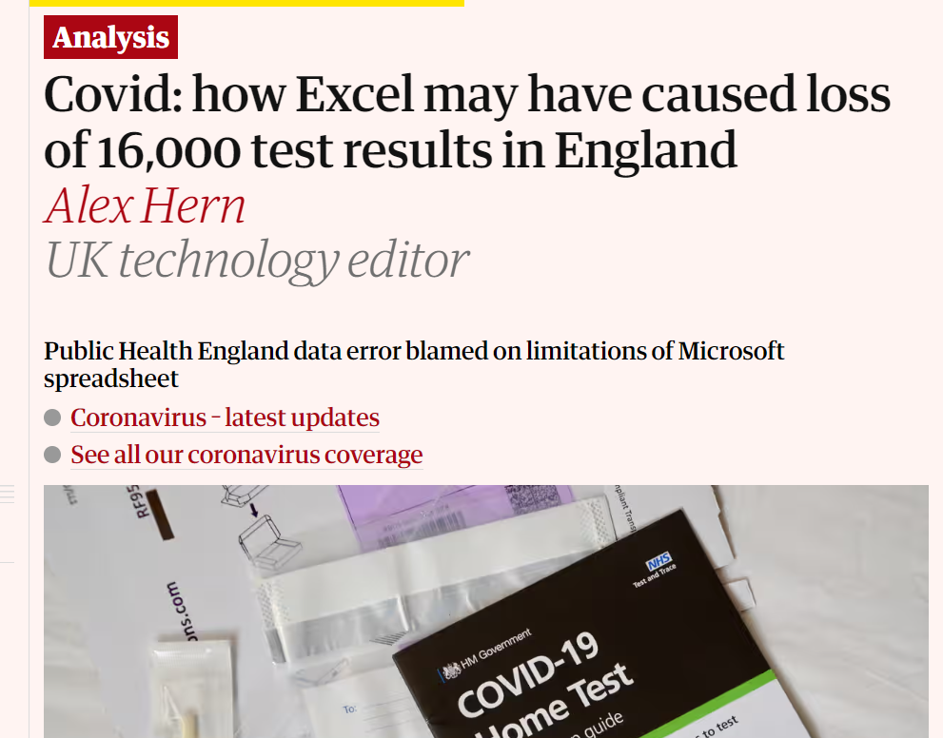
Other potential limitation
One lab had sent its daily test report to PHE in the form of a CSV file
PHE loaded into Microsoft Excel, and the new tests at the bottom were added to the main database
But Microsoft Excel files can only be 1,048,576 rows long or even less in older versions
the bottom rows got cut off and were no longer displayed once the limit was reached

Slide 31
To use or not to use Excel
Excel file format .xlsx is now open, and nowadays it is admissible as being FAIR.
However, plain text files like coma or tab separated values (.csv, .tsv) can be accessed without any special software and also be easily imported into other formats and environments, such as SQLite and R. They’re good for maximum portability and endurance.
If you only use Excel, and so does your community, just keep using it. Just be aware of possible pitfalls, especially when working with genes(protein)' names(accession numbers).

Slide 32

Cleaning data with OpenRefine
https://openrefine.org/
A powerful tool for working with messy data: cleaning it; transforming it from one format into another.
Find and merge the synonyms like: E. Coli, EColi, Escherichia coli into one,
Split values in the Name field into FirstName and LastName.
There is a carpentry course available: Data Cleaning with OpenRefine for Ecologists

Slide 33
(Meta)data in tables
Never use formatting to encode information
Include only one piece of information in a cell
It is easier to store data in the correct form than to clean data for reuse

