Slide 1
Introduction to Open Science and FAIR principles

Slide 2

Open Science
Open science is transparent and accessible knowledge
that is shared and developed
through collaborative networks.

Slide 3






Open Science
Open science is the movement to make scientific research accessible to all levels of the society
general public
amateurs
professionals
students
teachers
publications
data
physical samples
software

Slide 4
Open Science - Charactersitics
Web-based tools to facilitate information exchange collaboration
Transparency in experimental methodology, observation, and collection of data
Public availability and reusability of scientific data, methods and communications

Slide 5
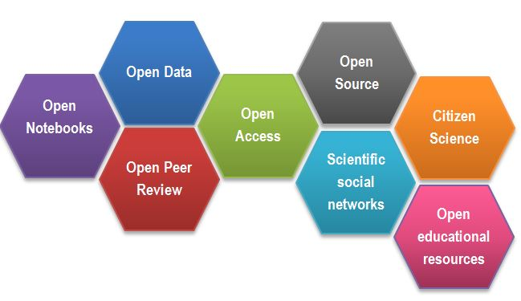
Open Science
CREDITS [1] CC BY

Slide 6

Outcomes of Openness
Collaboration
Speed
Unpublished/negative results
Re-use
Learn by example
Feedback

Slide 7
Open Science motivation: Money
Scientific knowledge is a product of social collaboration and its ownership belongs to the community.
From an economic point of view, scientific outputs generated by public research are a public good that everyone should be able to use at no cost.
€10.2bn lost every year because of not accessible data (plus additional 16bn if accounting for re-use and research quality).
Source: Credits [2]

Slide 8
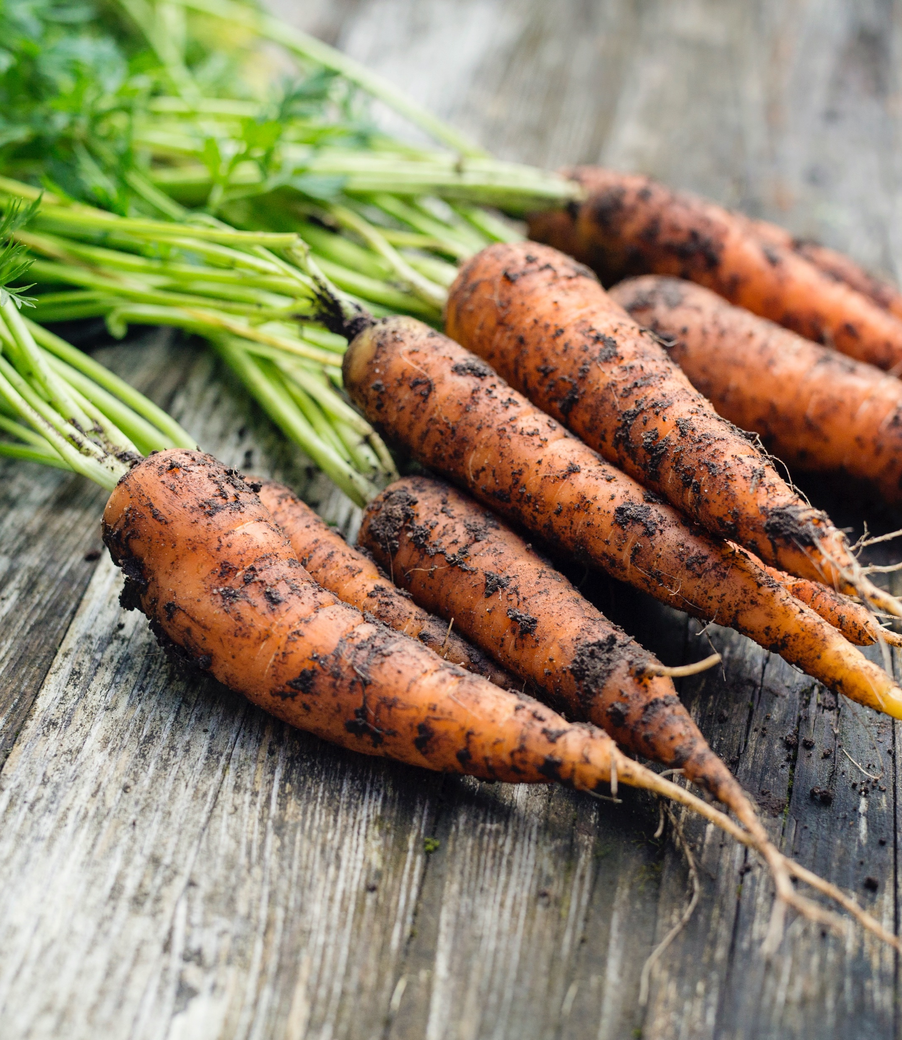
Motivation
“stick”
Large UK funding bodies such as The Wellcome Trust are big supporters of Open Science
“carrot”
Exercise

Slide 9

DORA
Declaration on Research Assessment
the need to eliminate the use of journal-based metrics, such as Journal Impact Factors, in funding, appointment, and promotion considerations;
the need to assess research on its own merits rather than on the basis of the journal
the need to capitalise on the opportunities provided by online publication (such as relaxing unnecessary limits … exploring new indicators of significance and impact)
CREDITS [5] CC BY

Slide 10
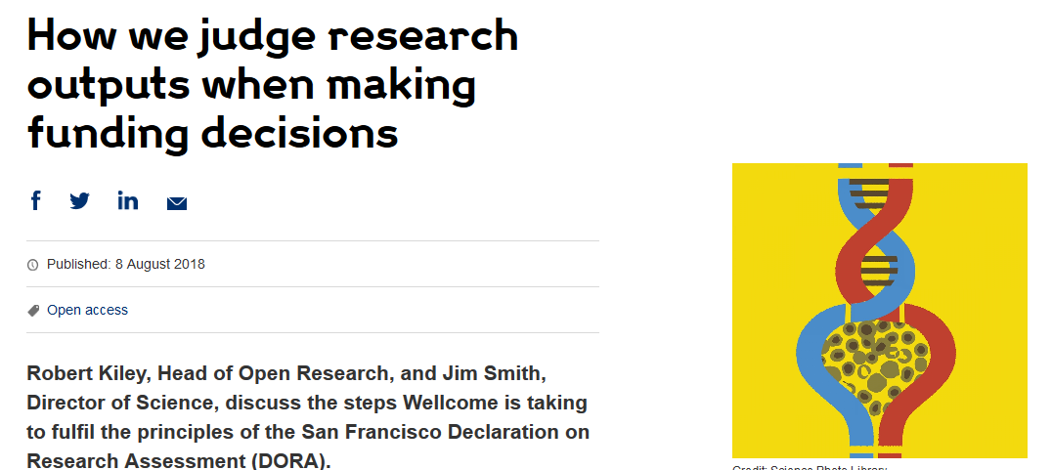

DORA: Funders adoption
Wellcome
London, United Kingdom
Cancer Research UK
London, UK
Application includes:
List of research outputs
Summary of 3-5 achievements
Space to describe other measures of impact
Reminds peer reviewers and committee
members of DORA principles throughout
funding process
Application includes:
List of research outputs
Contributions to mentorship
Output sharing plan to advance potential health benefits
Plans for public engagement
Guidance provided to advisory panel members
CREDITS [5] CC BY
Notes:
Wellcome example: https://wellcome.ac.uk/news/how-we-judge-research-outputs-when-making-funding-decisions
Cancer Research UK example: https://www.cancerresearchuk.org/funding-for-researchers/research-features/2018-02-20-improving-research-evaluation-dora

Slide 11
Narrative CV
Generation of Knowledge
Development of Individuals and Collaborations
Supporting Broader Society and the Economy
Supporting the Research Community

Slide 12
Narrative CV
A broad definition of ‘output’ is used, such as datasets, patents and software.
Special attention is paid to Open Science, which outputs are openly available.
New metrics: retweets, online views and downloads, discussions, presence in mass media technology platforms

Slide 13
It is easier to be prepared than to fake it
It takes time to make the outputs public
The quality of open outputs is easy to assess
Timestamps

Slide 14

Why we are not doing Open Science already
….

Slide 15
Why we are not doing Open Science already
lack of expertise
sensitive data
misuse (fake news)
lack of confidence (the fear of critics)
the costs in $ and in time
IP

Slide 16



What data to share
Data does not only mean Excel files with recorded measurements from a machine.
Data also includes:
Information about biological samples:
patient (ilness, demographic, sample type)
animal/ plant tissue (live, in culture, frozen, etc)
bacterial / yeast stocks etc
Quantitative / numerical data: Spreadsheets (tables), csv files
Images (pictures, microscopy images, 3D scans)
Code (Software programs, analysis codes, algorithms)
DNA/RNA sequences (plasmids, sequencing files, etc)
Protocols (recipes, laboratory and measurement protocols)

Slide 17
But how (not) to share in practice

Slide 18
Data from publications
…

Slide 19
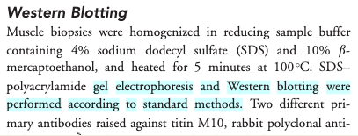
Impossible protocol

Slide 20
Impossible average
Difficult to find the right data table and column
Numerical data in pdf not suitable for calculations

Slide 21
Common problems
Only averaged data available
No numerical data available
Data tables as PDF files in supporting information
Vendor specific file formats
Links to non existing group websites / databases
Data / Code “on request”

Slide 22
Common problems
the protocol was difficult to find (the loops)
the protocol difficult to access (pay wall)
and not reusable as it lacked the necessary details (dead-end)
In the second example
the data were in a wrong format (not interoperable)
The data were not clearly described (not reusable)

Slide 23

FAIR principles
CREDITS [5] CC BY

Slide 24
FAIR principles
Findable:
persistent identifiers pointing to the data
descriptions that allow discovery by both humans and computers
Accessible:
(meta)data retrieval by standard protocols (http)
metadata available even when the data are not
Interoperable:
(meta)data saved in open/common format (interpretable for various tools)
(meta)data should use vocabularies that follow FAIR principles.
Re-usable:
data should be well-described so that they can be replicated and/or combined in different settings
conditions of the reuse should be stated with a clear license

Slide 25
Findable & Accessible
Deposit data to an external, reputable public repository.
Repositories provide persistent identifiers (PIDs), catalogue options, advanced metadata searching, and download statistics. Some repositories can also host private data or provide embargo periods, meaning access to all data can be delayed.
There are general “data agnostic” repositories, for example:
Dryad, Zenodo, FigShare, Dataverse.
Or domain specific, for example:
UniProt – protein data, GenBank – sequence data, MetaboLights – metabolomics data.

Slide 26

Reusable
Describe your data well (good metadata)
provide as many details as possible (prepare good metadata)
write a README file describing the data or embed it in tables
use descriptive column headers for the data tables
tidy data tables, make them analysis friendly
use (meta)data formats (e.g. SBML, SBOL)
use commonly known terms and PIDs in descriptions
follow recommendations Minimum Information Standards

Slide 27
Reusable
Attach license files. Licenses explicitly declare conditions and terms by which data and software can be re-used.
We recommend:
for data: Creative Commons Attribution (CC BY) license
for code: a permissive open source license such as the MIT, BSD, or Apache license.

Slide 28
FAIR exercise
What makes it FAIR
https://doi.org/10.5281/zenodo.6339631
CREDITS [5] CC BY

Slide 29
FAIR vs Open Science
FAIR != Open
The data record can be FAIR but the data itself can remain hidden
FAIR data can easily be made public and become Open
Open data which are not FAIR have limited value

Slide 30
Open Science and FAIR Quiz
…

