Slide 1
Public repositories

Slide 2



Research data repositories are online repositories that enable the preservation, curation and publication of research ‘products’:
data
code
protocols

Slide 3
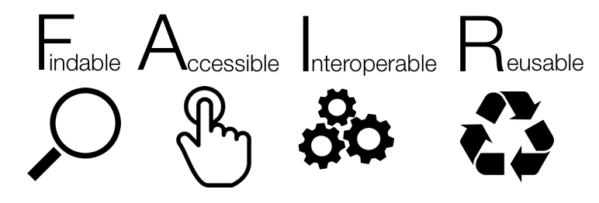
Repositories are crucial for
Notes:
Findable -> means that the data can be discovered by both humans and machines
Accessible -> means that the data are archived in long-term storage and can be made available using standard technical procedures
Interoperable -> data can be exchanged and used across different applications and systems
Reusable -> means that the data are well documented and curated and provide rich information about the context of data creation

Slide 4

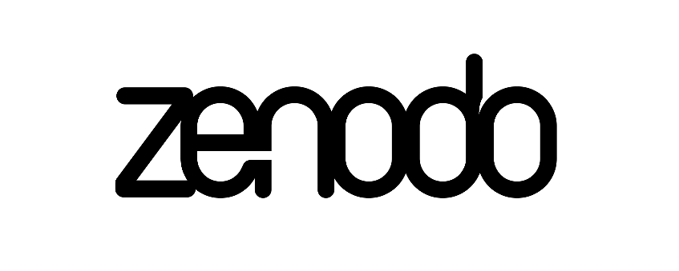
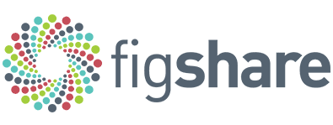
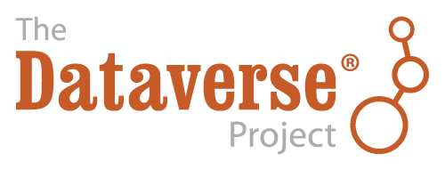


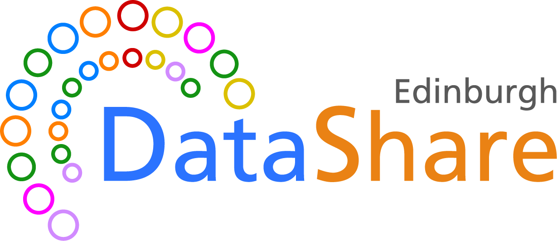
There are general “data agnostic” repositories
Dryad (http://datadryad.org)
Zenodo (http://zenodo.org)
FigShare (http://figshare.com)
Dataverse (http://dataverse.org)
Open Science Framework (https://osf.io/)
$ (but can be free)
Free
Free and $
Free
Free
Or your own institutional repository - e.g., University of Edinburgh has
Notes:
Dryad is an international open-access repository of research data. It is a nonprofit organization that provides long-term access to its contents at no cost to users. The base DPC per data submission is $150 USD unless funded by the institution, publishers or funders.
Fee waivers are automatically granted for submissions originating from researchers based in countries classified by the World Bank as low-income or lower-middle-income economies. Access is free.
Zenodo built and operated by CERN and OpenAIRE to ensure that everyone can join in Open Science. Free, up to 50 GB per dataset, Higher quotas can be requested and granted on a case-by-case basis. but you can upload several datasets, no size limits.
Figshare is an online open access repository free to upload content and free to access – upload up to 20 GB. of open data. Company supported by Digital Science, a subsidiary of Springer Nature. 100GB = $450 but can upload up 2TB if you pay 7.000 or more.
Dataverse is funded by Harvard with additional support from the Alfred P. Sloan Foundation, National Science Foundation, National Institutes of Health, Helmsley Charitable Trust, IQSS's Henry A. Murray Research Archive, and many others.
Harvard Dataverse Repository is free for all researchers worldwide (up to 1 TB). Provides free consultation and paid curation services to help collection managers develop their collections to ensure FAIR deposit of content
OSF: free, open platform to share projects, preprints or datasets. Public Projects Storage Limit: 50 GB; File Size Limit: 5GB/file upload limit for native OSF Storage
Dryad, Figshare and Dataverse work with institutions and funders to have independent installations and the affiliated institutions will often have more features and will allow higher storage caps.

Slide 5



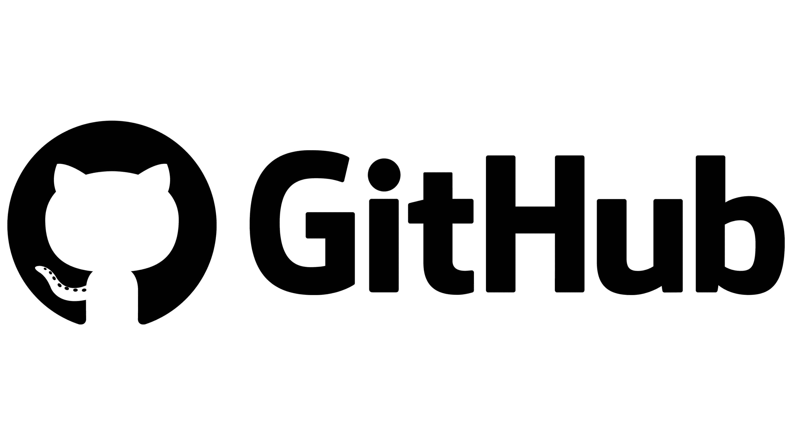

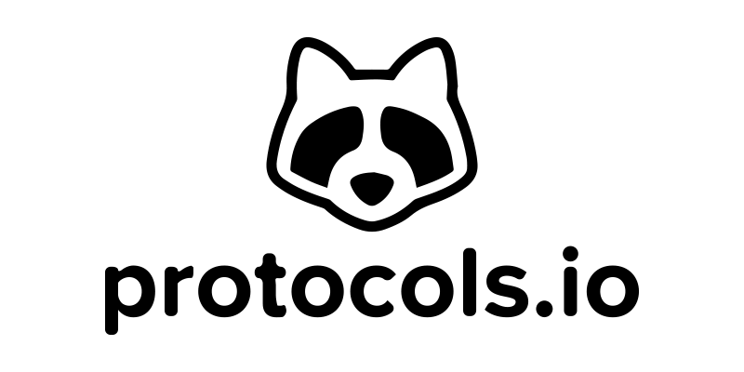
Or “domain” (type) specific repositories
UniProt (https://www.uniprot.org/) – protein data
GenBank (https://www.ncbi.nlm.nih.gov/genbank/) – sequence data
MetaboLights (https://www.ebi.ac.uk/metabolights/) – metabolomics data
GitHub (https://github.com/) – for code
BioImage Archive (https://www.ebi.ac.uk/bioimage-archive/) – for images
Protocols.io (https://www.protocols.io/) –for protocols

Slide 6
Exercise 1. Public record
1a. Dataset description
https://doi.org/10.5281/zenodo.5045374

Slide 7
Minimal data set (after PLOS)
Minimal data set to consist of the data required to replicate all study findings reported in the article, as well as related metadata and methods.
The values behind the means, standard deviations and other measures reported
The values used to build graphs
The points extracted from images for analysis.
(no need for raw data if the standard in the field is to share data that have been processed)
https://journals.plos.org/plosbiology/s/data-availability

Slide 8
Exercise 1b. Dataset discovery
https://doi.org/10.5281/zenodo.5045374

Slide 9
Dataset discovery - Solution
Zenodo is a good place to keep your data separate from your paper. It gives access to all files, allowing you to cite the data as well (or instead of) the paper.
However, it is not (always) good for discovery, and does not enforce metadata standards, except that a very few metadata fields are mandatory!

Slide 10
Domain specific repositories
Higher exposure
Data specific features (e.g., visualization)
Enforced minimal metadata
API for data retrieval / aggregation /searching
Curated data
Better searching
Interlinking between data types

Slide 11
Domain specific repositories
Exercise 3

Slide 12
Dataset discovery - Solution
Some advantages are:
The repository is more relevant to your discipline than a generalist one.
Higher exposure (people looking for those specific types of data will usually first look at the specific repository).
Higher number of citations (see above).

Slide 13
Finding repositories – use recommendations
Majority of the publishers have their lists, for example
[BioMed Central / Springer Nature] - (https://www.springernature.com/gp/authors/research-data-policy/recommended-repositories)
[Elsevier] - (https://www.elsevier.com/about/policies/research-data)
[PLoS] - (https://journals.plos.org/plosbiology/s/recommended-repositories)
Or funders
[BBSRC] - (https://bbsrc.ukri.org/research/resources/)
[NERC] - (https://nerc.ukri.org/research/sites/environmental-data-service-eds/policy/)
Or our curated list
https://www.wiki.ed.ac.uk/display/RDMS/Suggested+data+repositories

Slide 14
Finding repositories
FAIRSharing.org – search engine
Repositories
Data standards
Policies
(too) many options for each type
-Inventory of identified trusted repositories (ERCEA)
https://zenodo.org/record/7728016#.ZCWRkXbMKUm

Slide 15
Finding repository
Exercise 4

Slide 16
Finding repository - Solution
Find a repo for genomics data:
GEO/SRA and ENA/ArrayExpress are good examples. Interestingly these repositories do not issue a DOI.

Slide 17
Evaluating a data repository
1. Who is behind it? What is its funding?
2. Quality of interaction/interface: is the interaction for purposes of data deposit or reuse efficient,
effective and satisfactory for you?
3. Take-up and impact:
what can I put in it? is anyone else using it? will others be able to find stuff deposited in it? is the repository linked to other data repositories? can others cite the data?
4. Policy and process: does it help meeting community standards, good practices and policies? is it curated?

Slide 18
Repositories Summary
Find suitable repository(ies) as soon as you get your data
If repository permits embargo deposit data as soon as you get it (especially if analysed externally)
Deposit simultaneously to a very specialized repo and a „main stream” one (better discovery)
Cross link your repositories’ records
Add data availability section to your papers and list all the public records
List your data sets in ORCID

Slide 19

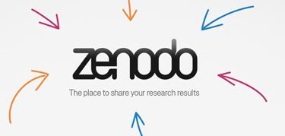
What about GitHub?
To make the exact version of your code referenced in a publication, you can create snapshot of the repository and obtain a DOI for it.
For example, you can use the data archiving tool in Zenodo (or Figshare) to archive a GitHub repository.
YES!
Image credits:
Zenodo logo: Openaire.eu
Github logo: Klint Finley (TechCrunch+)
Notes:
https://docs.github.com/en/repositories/archiving-a-github-repository/referencing-and-citing-content

Slide 20
What about the ReadMe file?
Always include a ReadMe file when you deposit in “General” research data public repositories, such as Zenodo.
An example readme file can be found at
BioRDM’s Wiki Page
https://www.wiki.ed.ac.uk/x/XbRVHQ

Slide 21
What about sharing data as “Supplementary Information”?
- Limited amount of data that can be uploaded
Dataset not easily discovered on its own
Publication might not be OA
Does not provide a DOI for the dataset
Repositories hold records that are not related to publications

Slide 22
Repositories Summary
Repository records are another form of scientific output!
Add a good Data Availability Statement to your papers and list all the public records
List data sets in your ORCID record

Slide 23
Repositories Summary
Find suitable repository(ies) as soon as data are generated
If the repository permits embargo, deposit your data as soon as they are obtained (especially if analysed by 3rd party)
Deposit simultaneously to a very specialized repo and a 'mainstream' one (for better findability)
Cross link repositories’ records

Slide 24
Repositories and FAIR – Exercise 5
Why is choosing a domain specific repository over Zenodo more FAIR?
How can selecting a repository for your data as soon as you do an experiment (or even before!) benefit you research and help your data become FAIR?
What’s your favourite research data repository? Why?

