Slide 1
BOGGLE
Adina Margolis, Tziporah Neuberger, Chana Sklar

Slide 2
BOGGLE
An Overview
In this game the user is presented with a board of letters and given a certain amount of time to enter all the words he finds. Letters of a word can be adjacent to each other side by side or diagonally.
When time is up, the user is no longer able to enter words. The words are then checked to see if they exist on the board and then in the dictionary. The user receives points for valid words based on their length.
At the end of each round the points are then added together and displayed to the user. They are also added to the total number of points the user has earned for that game. The user can chose to play as many rounds as he wants and can quit after any turn.

Slide 3
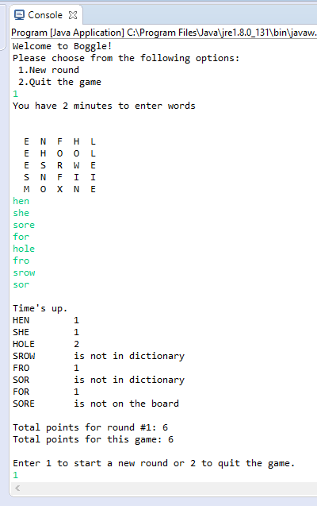
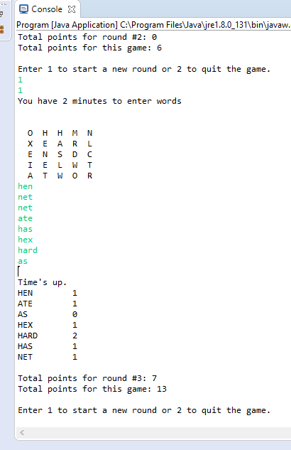
Sample
Output

Slide 4
Programming Challenges Randomizing the dice
Originally, the dice were set in their position for each boggle board, and the only random part was that each die had six letter options that were randomly chosen each time, corresponding to the 6 sides of a real die.
Now, we added code that simulates the dice being “shaken up” and dropped into any position - Each die, with its 6 letter options, now ends up on a random position on the board.
How is this done?

Slide 5
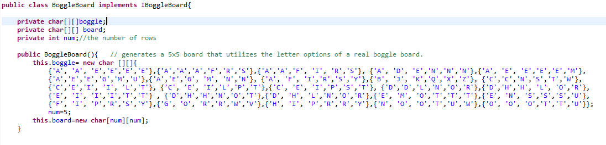
Programming Challenges
cont. Randomizing the Dice….
The char values on each die is hardcoded into a two-dimensional array. Each row in the 25-row array corresponding to each of the 25 dice, contains 6 char values to replicate a six sided die.

Slide 6
Programming Challenges
cont. Randomizing the Dice….
When a board is created, an array list is initialized to keep track of which dice were already assigned to the board. An index from 0-24 is chosen at random from this array list. The number this index is holding is the die chosen. This number is then removed from the array list, which automatically shifts everything over and resets the size() of the array list of available indices. Now the next time a die is chosen, only an index from 0-23 is available. The numbers these indices are holding are all the dice that are left. It will continue to loop through until all the dice have been used.
Each time a dice is randomly selected, a random generator will also generate which of the 6 indices on the dice will be used to provide the letter in that position on the board.
By the double usage of the random generator, each position on the board is filled with a random die and a random character on that die.
(code on next slide )

Slide 7
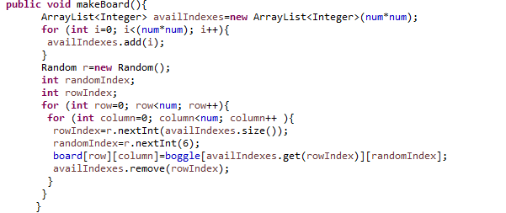
Programming Challenges cont. Randomizing the dice

Slide 8
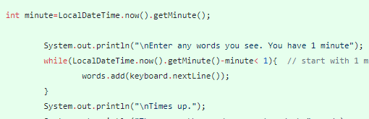
Programming Challenges
The Timer
We tried different things, and made our first presentation with a basic loop that allowed the user to enter words until the difference between start time and current time reached 1 minute.
Problem: the loop only checked if time was up after each word entered. If the user entered nothing, the program just stayed there without displaying “Time’s up.”

Slide 9
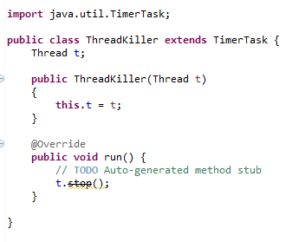
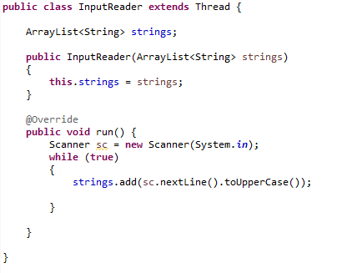
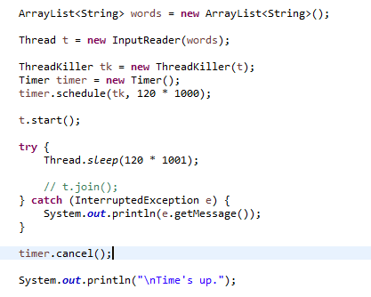
Programming Challenges
cont. The Timer
In the end we realized that this will be a bigger challenge than we thought because it involves multi-threading - user inputting words at the same time as the timer is running.
After trial-and-error and some assistance, we added some Timer classes and some code to main() and now the Timer stops when the time is up, no matter what the user does.

Slide 10
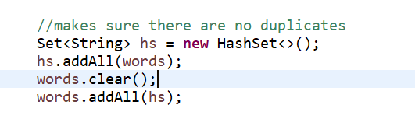
Programming Challenges
Dealing with Duplicate Words
Before checking any words entered,
we instantiated a HashSet in main to
ensure that there were no duplicate
words in the array list of user input.
This was crucial so methods would
not be called twice for the same word and so the user would not receive double the amount of points for one word.

Slide 11
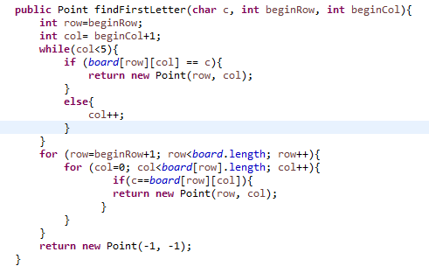
Programming Challenges Checking if words are on the board
Two separate steps were necessary:
Step one: Finding the first letter
It requires going through the entire
board systematically and keeping track
of where the first letter was found.
It then has to separately loop
through that row continuing with
the column after the first
letter was last found.
When this method finally returns
false, the word is not in the board.

Slide 12
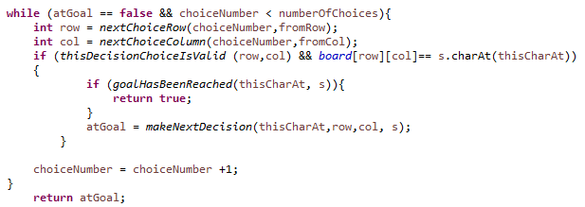
Programming Challenges cont. Checking if words are on the board
Step two: Check if the next letter of the word could be found in any of the 8 dice surrounding the current letter.
This code is modeled after
the ‘knight tour’ example of
recursive methods. It stores
an array of 8 possible moves
to dice adjacent to the current
letter and checks if any contain
the next letter.

Slide 13
Programming Challenges
Checking if Words Are In the Dictionary:
Originally …...
Initially, the checking was done in main. Every word that the user entered would get compared against every word in the dictionary to see if it was there. If the word was found it would return true, if not it would return false. The two main problems with this approach were:
This operation would be done on a word that was not even on the board which was a waste of resources
going through the entire dictionary seemed inefficient

Slide 14
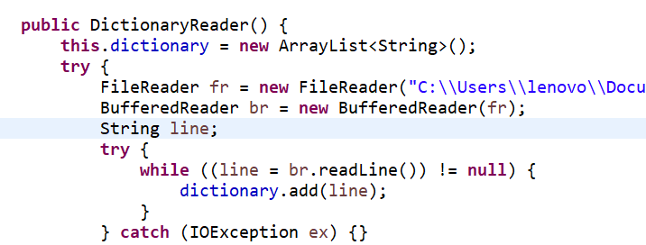
Programming Challenges
cont. Checking if Words Are In the Dictionary
We created a dictionary checker class.
In its constructor, a dictionary
file is read in and copied into an array
list.

Slide 15
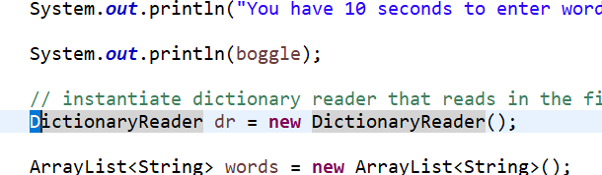
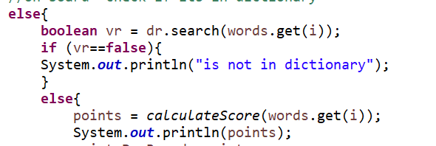
Programming Challenges
Dictionary Search in the Driver Program
- The DictionaryReader object is
instantiated only one time at the
beginning of main so the Dictionary
file only has to be read through in
its entirety one time.
- Only when a word entered by the user is
found to be on the board, do we call
dictionaryReaderObject.search() and
pass in that word.

Slide 16
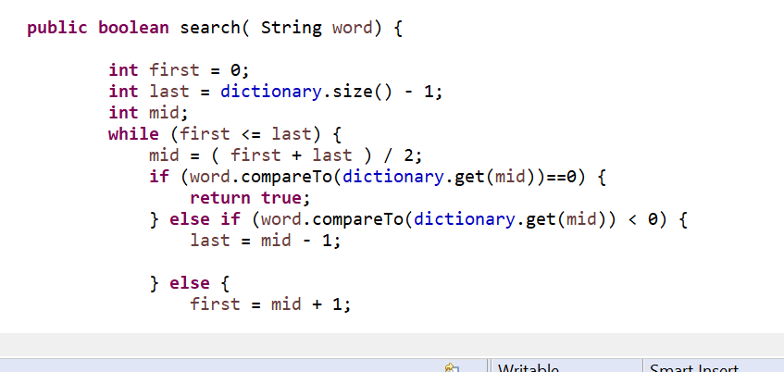
Programming Challenges
cont. Checking if Words Are In the Dictionary
This search method of the DictionaryReader class conducts a binary search to find the word. The file, and therefore the array list, is in alphabetical order , so the binary search is most efficient.

Slide 17
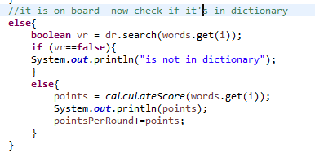
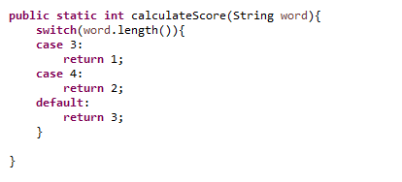
Calculating the Points
If a word is found on the board and in the dictionary, it is sent to the calculateScore() method in the driver program which calculates the score according to the word length. Player receives 1,2, or 3 points.

Slide 18
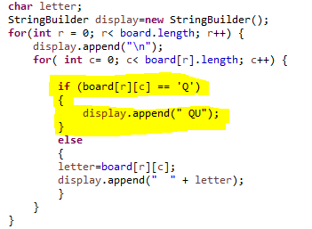
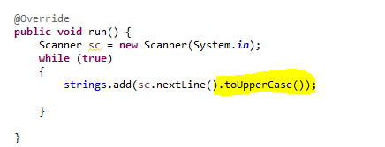
Some Struggles …..
We needed “Qu” to always appear together on the board, but our dice was a double char array which can’t hold 2 chars. So we put an if statement into the BoggleBoard’s toString().
Finding a dictionary text file that had the words that were needed on it.
When we first started using the dictionary file, it was finding no words. After searching around for the problem in the code, we realized that the dictionary file was in UPPERCASE but the user was typing in lowercase. So we inserted code that converted each word entered to UPPERCASE before it was added to the list of words.

Slide 19
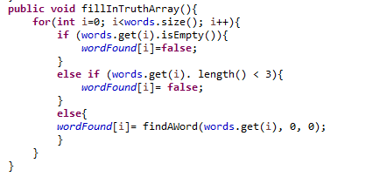

Some Struggles….
4. Sometimes it would say a word was not in the dictionary that was in the file. The problem was a glitch in the binary search
5. Dealing with words that were 1 or 2 letters. We didn’t want it to throw an exception when they entered it or give them points. So we changed the word checker to only check for words of length >= 3, and in main, if word length was less than 3, we displayed “0 points, too short.”

Slide 20
...THE END!!
HOPE YOU ENJOYED!
IF YOU HAVE ANY QUESTIONS, FEEL FREE TO ASK…...

