Slide 1
GPS
GROUP 5

Slide 2
What is GPS
GPS standands for Global Positioning System ,It is a satellite-based navigation network that provides anyone with a receiver their precise geographic location, speed, and current time. Owned by the United States and operated by the U.S. Space Force, it is a free global utility used for everything from driving directions to synchronizing financial markets. It helps find where things are on Earth. GPS works by using messages from satellites that fly around Earth. There are 24 main satellites and some extras just in case. To find a place exactly, GPS uses four satellites in a method called trilateration.

Slide 3
What is trilateration?
Trilateration is the process of determining your position based on the intersection of spheres. When a receiver receives a signal from one of the satellite, it calculates its distance from the satellite considering a 3-D sphere with the satellite located at the center of the sphere. Once the receiver does the same with 3 other GPS satellites, the receiver then proceeds to find the intersection point of the 3 spheres to calculate it's location. Once the position of a receiver is calculated, the GPS device can then easily calculate:
Time of sunrise and sunset
Speed
Track distance to destination of the GPS receiver.

Slide 4
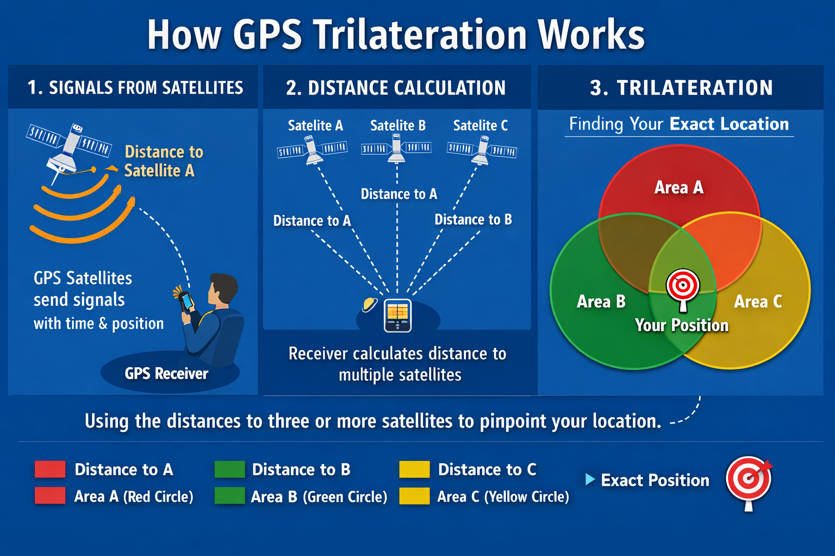

Slide 5
History of GPS
Pre-Satellite Era (1940s–1950s)
Navigation relied on LORAN, a land-based radio system
Used signal timing from ground stations for ships and aircraft
Limited by geography and required large infrastructure
Sputnik Revelation (1957)
Launch of Sputnik I changed navigation technology
Scientists used the Doppler Effect to track satellite movement
Discovery: known satellite positions could help locate users on Earth
Early Foundations (1960s–1972)
Transit (1960): First satellite navigation system for U.S. Navy submarines
Provided location updates only once per hour
Timation (1967): Introduced atomic clocks for precise positioning

Slide 6
Cont.……
Development of NAVSTAR GPS (1973–1993)
U.S. Department of Defense created NAVSTAR GPS
1978: First experimental GPS satellite launched
1983: President Ronald Reagan opened GPS for civilian use
1993: Full 24-satellite constellation achieved
From Military Tool to Global Utility (1995–Present)
1995: GPS became fully operational
2000: Selective Availability removed by President Bill Clinton
Civilian accuracy improved from ~100m to ~10m

Slide 7
Cont.……
2018–Present: GPS III satellites improved accuracy and anti-jamming
Today
Managed by the U.S. Space Force
Around 31 operational satellites
At least 4 satellites visible anywhere on Earth at all times

Slide 8
Where GPS Is Now (2026 Trends)
As of 2026, GPS has evolved from a basic navigation tool into a critical digital infrastructure that supports industries, governments, and everyday life worldwide.
Modern GPS III Satellites: New GPS III satellites provide stronger signals, higher accuracy, better resistance to jamming, and improved support for aviation, defense, and civilian users.
Integration with AI and IoT: GPS is now connected with Artificial Intelligence (AI), Internet of Things (IoT) devices, and cloud platforms to deliver real-time location intelligence for smarter decision-making.

Slide 9
Cont.……
Autonomous Systems: GPS plays a major role in self-driving cars, delivery drones, smart farming equipment, and robotic systems that require precise movement and positioning.
Smart Cities and Infrastructure: Used in traffic management, public transport tracking, utility monitoring, and urban planning to improve city efficiency and safety.
Financial and Communication Systems: GPS timing supports banking transactions, stock markets, mobile networks, and internet synchronization through highly accurate atomic clock signals.

Slide 10
Cont……
Disaster Response and Environmental Monitoring: Helps monitor floods, earthquakes, climate change, wildlife movement, and emergency rescue operations across the world.
Beyond Navigation: GPS is now essential for security, automation, research, communication, and global economic systems—not just for finding directions.

Slide 11
How GPS works?
Any instant of time, there are at least 4 GPS satellites in line of sight to a receiver on the earth. Each of these GPS satellites sends information about its position and the current time to the GPS receiver at fixed regular instants of time. This information is transmitted to the receiver in the form of signal which is then intercepted by the receiver devices. These signals are radio signals that travel with the speed of light. The distance between a GPS receiver and the satellite is calculated by finding the difference between the time the signal was sent from GPS satellite and the time the GPS receiver received the signal.

Slide 12
Cont……
Once the receiver receives the signal from at least three satellites, the receiver then points its location using trilateration process. A GPS requires at least 3 satellites to calculate 2-D position(latitude and longitude on a map). In this case, the GPS receiver assumes that it is located at mean sea level. However, it requires at least 4 satellites to find receivers 3-D position(latitude, longitude, and altitude).

Slide 13
The Three GPS Segments
GPS operates through a coordinated dance between three distinct parts:
The Space Segment: A constellation of over 24 satellites orbiting Earth at about 20,000 km. They are arranged so that at least four satellites are visible from virtually any point on the planet at all times.
The Control Segment: Ground stations around the world that monitor the satellites, ensuring they stay in the correct orbit and their internal clocks remain incredibly accurate.
The User Segment: Your smartphone, car navigation system, or watch. These devices only receive signals; they do not send data back to the satellites.

Slide 14
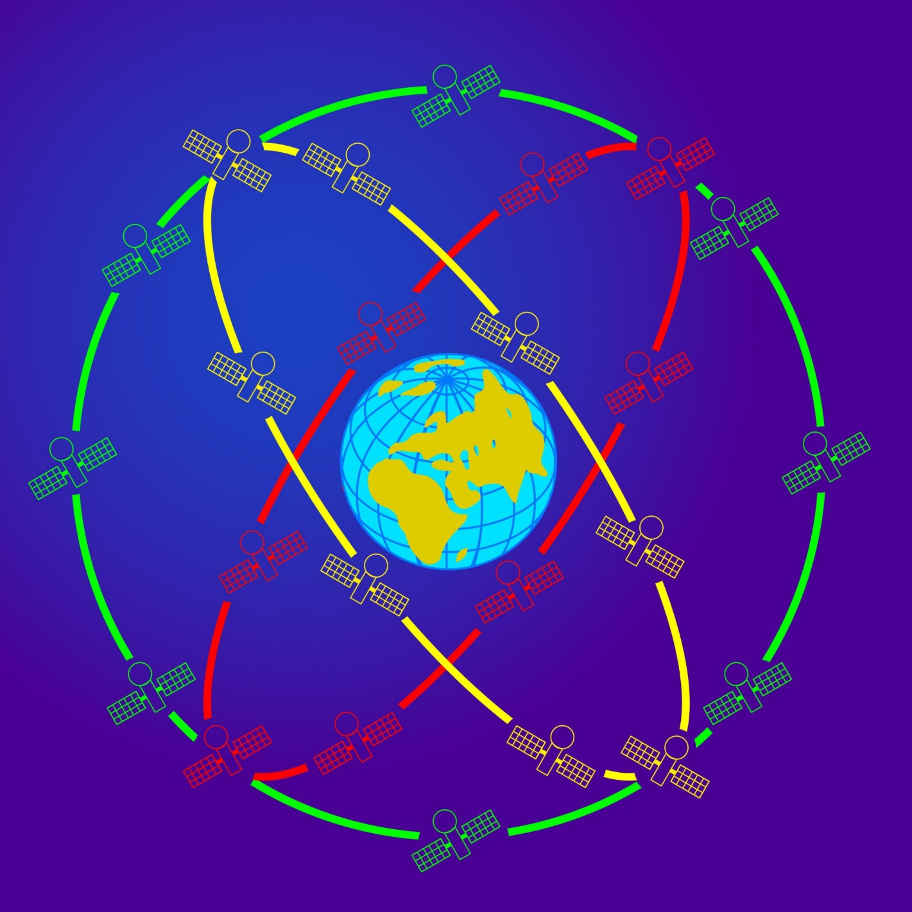
Cont……

Slide 15
GNSS
While GPS is the name most people know, it is actually just one part of a much larger concept called GNSS (Global Navigation Satellite System).
GNSS as the umbrella term (like "Smartphone") and "GPS" as a specific brand or model (like "iPhone").
What is GNSS?
GNSS refers to any satellite constellation that provides signals from space, transmitting positioning and timing data to receivers on the ground. A GNSS-capable receiver can pick up signals from multiple different systems at once, making it much more accurate and reliable than a device that only uses GPS.

Slide 16
Cont……
The Major Global Systems
Currently, there are four "Global" systems that cover the entire planet:
System | Country/Region | Satellites (approx.)
GPS | United States | 31
GLONASS | Russia | 24
Galileo | European Union | 26+
BeiDou | China | 35+

Slide 17
Categories of GPS
By User/Application:
Consumer-Grade: Found in smartphones, cars, and smartwatches.
Professional-Grade: Used for surveying, agriculture, and high-precision mapping (centimeter accuracy).
Timing Receivers: Used in financial markets, power grids, and cellular base stations for precise time synchronization.
By Frequency:
Single-Frequency (L1): Standard, lower cost, average accuracy.
Dual-Frequency (L1/L2 or L1/L5): Higher accuracy, eliminates atmospheric delays.

Slide 18
Cont……
By Technology:
DGPS (Differential GPS): Uses ground-based stations to improve accuracy.
GNSS Receivers: Modern receivers that track GPS, GLONASS (Russia), Galileo (EU), and BeiDou (China) simultaneously.

Slide 19
Differential GPS[DGPS]
DGPS is an improvement over GPS that provides enhanced location accuracy Working:
The GPS receiver also called as the base station must be set up at a precisely known location
The base station receiver calculates it's position based on the satellite signals and compares it's location to the known location
The difference between the two locations is applied to the data recorded by the GPS receiver
Provides position accuracy in sub-meter to cm range

Slide 20
Cont……
DGPS uses a network of fixed ground-based stations to broadcast the difference between the positions indicated by the GPS satellite systems and the known fixed positions. These stations broadcast the difference between the measured satellite pseudo-ranges and actual pseudo-ranges and the receiver stations may correct their pseudo-ranges by the same amount.

Slide 21
Key Uses of GPS
Navigation: GPS helps people find their way from one place to another. It's used in car navigation systems, smartphone apps, and by hikers and sailors. GPS tells you where you are and how to get to where you want to go.
Mapping: GPS makes it easier to create accurate maps. Surveyors use GPS to mark exact locations of roads, buildings, and natural features. This helps make detailed maps for cities, forests, and other areas.
Tracking: GPS can follow the movement of things or animals. Companies use it to keep track of their trucks. Scientists use GPS to study animal migration.

Slide 22
Cont……
Emergency Services: When someone calls for help, GPS can tell rescuers exactly where to go. This is really important for accidents in remote areas or at sea. It helps ambulances, fire trucks, and rescue teams reach people faster.
Time Keeping: GPS satellites have very accurate clocks. They send out time signals that computers and networks use to stay in sync. This is important for things like cell phone networks, power grids, and financial systems that need precise timing.

Slide 23
Applications of GPS
Industrial and Business Applications
Precision Agriculture: GPS guides tractors, irrigation systems, and fertilizer application to increase productivity and reduce waste
Fleet Management: Companies track trucks, buses, and delivery vehicles in real time for better route planning and fuel savings
Construction and Surveying: Engineers use GPS for land measurement, machine control, and accurate building alignment
Mining Operations: GPS helps monitor heavy equipment, improve excavation accuracy, and enhance worker safety
Aviation and Shipping: Aircraft and ships use GPS for navigation, route optimization, and collision prevention

Slide 24
Cont……
Public Services and Safety
Emergency Response: Ambulances, police, and fire services use GPS to reach accident locations faster
Disaster Management: GPS helps track floods, earthquakes, storms, and supports rescue operations
Military and Defense: Used for navigation, surveillance, missile guidance, and secure operations
Smart Cities: GPS supports traffic control, public transport tracking, and urban planning

Slide 25
Cont……
Daily Life Applications
Mobile Navigation: Apps like Google Maps help people find directions and avoid traffic
Ride-Hailing Services: Apps like Uber and Bolt depend on GPS for driver-passenger location matching
Fitness and Health: Smartwatches track walking, running, cycling, and outdoor activities
Personal Security: Family tracking apps improve safety and location sharing
Tourism and Recreation: GPS supports hiking, camping, geocaching, and travel exploration

Slide 26
Advantages and Disadvantages of GPS
The GPS function can be used in any country, whether in a metro city and even in the desert. It can be used for navigation virtually to any point in the world.
GPS is simple to use. Most smartphones have the GPS built-in so you don't need extra devices. Just open the map app and you are ready to go.
GPS can be off by the 10 to 15 meters. This means it might not show you the exact spot which can be the problem if you need to find something small and specific.
GPS signals can be blocked by the tall buildings, mountains and even thick trees. This means it might not work well in the cities with the skyscrapers or in the dense forests.

Slide 27
What GPS Can Do for GIS?
GPS helps GIS by giving it exact location information. GPS is like a very accurate map that tells you where things are on Earth. GIS is a system that uses computers to make maps and analyze location data. When GPS and GIS work together, they can create better, more accurate maps. GPS tells GIS exactly where things are, like buildings, roads, or trees. This helps GIS make maps that show the real world very closely.
With GPS data, GIS can also track moving things. This team-up of GPS and GIS helps people make better decisions about land use, city planning, and taking care of nature.

Slide 28
Technical challenges face by GPS:
Time synchronization:
Each of the GPS satellites are equipped with an atomic clock to keep the time updated and accurate. In order to update and provide precise timing on the receiver, the receiver uses the fourth GPS satellite to keeps it's timing accurate. With the timing with the receiver and GPS satellites maintained by atomic clocks, the exact time difference can be calculated by the receiver. The GPS satellites are constantly managed from ground-based stations to resolve time synchronization.

Slide 29
Cont……
Significance of ultra precision of time synchronization:
Electromagnetic radiation propagate with the speed of light. The accuracy in position is directly proportional to the time measurement, as speed * time = distance, therefore, even a slight deviation in time calculation can create huge difference in distance due to large speed of light.
Real time update of exact location of the satellite.
This is done by monitoring the satellites from a number of widely distributed ground based system.

Slide 30
Important Facts About GPS
GPS is owned and operated by the United States Space Force.
It uses a network of at least 24 satellites (usually around 30+ active satellites).
Satellites orbit about 20,200 km above Earth.
A GPS receiver needs signals from at least 4 satellites to determine an accurate position.
GPS works 24/7 in all weather conditions, anywhere on Earth.
It is free to use for civilians worldwide.
Accuracy:
Standard GPS: about 3–10 meters
With advanced methods (like DGPS): can be centimeters

Slide 31
THANK YOU

Slide 32
GROUP MEMBERS
S/N | NAME | REGISTRATION NUMBER
1 | JULIANA LOTSON ABRAHAM | NIT/BCS/2023/515
2 | ERICK SALUS LUCAS | NIT/BCS/2023/579
3 | VLADMIR BONIFACE MASSAWE | NIT/BCS/2023/535
4 | GODFREY DEUSDEDITH DAMAS | NIT/BCS/2023/496
5 | JACKSON AYUBU MWALONGO | NIT/BCS/2023/492

