Slide 1
PROJECT MEMBERS
S/N | FULL NAME | REG.NUMBER
01 | JACKSON AYUBU MWALONGO | NIT/BCS/2023/492
02 | NAZAKIA JAPAN MARTINE | NIT/BIT/2023/2164
03 | VIVIAN | NIT/BIT/2023/
04

Slide 2
Particulars and Project Information
TITLE: SCHOOL MANAGEMENT INFORMATION SYSTEM(SMIS)
PROJECT TYPE: SOFTWARE DEVELOPMENT PROJECT

Slide 3
Background
Historically, schools have been hindered by "data silos" where student records, departmental information, and staff workloads are managed in isolation, leading to administrative bottlenecks and insecure communication. This project addresses these inefficiencies by centralizing the management of departments, lecturers, and courses, while introducing a sophisticated automation engine to solve the complex logistical challenge of timetable generation. By replacing manual scheduling with a constraint-based automated subsystem and providing an encrypted gateway for parental engagement, the platform transforms the school from a reactive environment into a proactive, data-driven organization that optimizes both administrative resources and student academic outcomes.

Slide 4
Problem Statement
Educational institutions currently struggle with "information silos" where departmental records, lecturer workloads, and student data are managed through fragmented physical files or isolated spreadsheets, leading to administrative errors and the logistical nightmare of manual, conflict-prone timetabling. Furthermore, communication with parents remains dangerously insecure and delayed, Also the issue of Timetable arrangement in done manually which can result to duplication of session to a single tutor. This project seeks to bridge these gaps by replacing inefficient, manual processes with an automated, encrypted, and intelligent ecosystem that optimizes resource scheduling and proactively identifies at-risk students through historical data analysis.

Slide 5
Significance of the Project
By integrating departmental management and automated scheduling, the platform eliminates the logistical complexity of manual timetabling, ensuring that lecturers and facilities are utilized at peak efficiency without scheduling conflicts. Beyond operational savings, the project bridges the critical communication gap through an encrypted parental portal, fostering a transparent home-school partnership that prioritizes student safety and engagement. Most importantly, the inclusion of predictive performance modeling shifts the academic focus from post-failure assessment to early intervention, providing educators with the data-driven foresight needed to secure better national exam results and long-term academic outcomes for every student.

Slide 6
Main Objective
To design, develop and implement a unified digital ecosystem that centralizes school administrative operations and to ensure parental participation in school issues for their children.

Slide 7
Specific Objectives
To develop a centralized administrative ecosystem that automates core tasks such as student record keeping and attendance tracking, while providing school leadership with a real-time analytics dashboard to monitor staff workloads, institution performance and facility utilization.
To engineer a secure messaging and notification module that utilizes end-to-end encryption for transparent and private parent-teacher communication.
To develop a system to provide parents with a dedicated mobile portal for real-time access student attendance, assignments, fee payment and other school announcements.
To develop an automated timetable generation subsystem that utilizes constraint-satisfaction algorithms to produce conflict-free schedules based on teacher availability.
To implement a Role-Based Access Control mechanism that defines specific permissions for Administrators. Teachers(basing on their position), non-teaching staffs and Parents to ensure data security and functional focus

Slide 8
Scope of the Project
The project will focus on the development of a dual-platform digital ecosystem comprising a comprehensive web-based administrative dashboard and a secure mobile portal for parents. Internally, the system is bounded by the creation of robust subsystems to manage departmental hierarchies, staff workloads and course mapping, alongside a specialized engine designed to automatically generate conflict-free timetables based on pre-defined technical constraints. The academic scope includes real-time attendance tracking, gradebook management, and a high-level analytics dashboard for leadership, while the communicative scope is focused on an encrypted gateway for instant parental notifications and messaging.

Slide 9
Introduction to the Literature Review
Several studies and systems have been developed to manage school operations such as student registration, attendance tracking, fee management, and academic record keeping. Systems like ShuleSoft and InfoTaaluma have paved the way in the Tanzanian context by digitizing school management and enhancing parental involvement through real-time notifications via SMS and mobile applications. While these existing systems effectively reduce manual work and improve data accuracy, they primarily function as administrative tracking tools with limited capabilities in advanced logistical optimization. This literature review discusses existing systems related to school management and identifies critical gaps—specifically the need for fully automated, constraint-based timetable generation and more robustly integrated departmental resource management—that this project aims to address.

Slide 10
Review of Existing Studies and Systems
ShuleSoft (2024) developed a comprehensive school management ecosystem to streamline critical institutional operations including student registration, fee management via local payment gateways, and academic reporting. Their system provides real-time access to student data and has significantly improved transparency between schools and parents through a dedicated mobile application. This platform highlights that integrating local financial services with school administration can enhance the efficiency of fee collection and administrative accountability compared to traditional paper-based methods.
Similarly, InfoTaaluma (2023) presented a cloud-based school management platform that shifted academic record keeping and attendance tracking from manual logs to a digital environment. Their system helped administrators access student performance records easily, reduced manual workloads for teachers, and improved the reliability of school-to-parent communication through automated SMS and push notifications. Their work demonstrates that digital systems are essential for maintaining a secure and consistent flow of information between the school and home.

Slide 11
Identified Gaps in Existing Systems
From the reviewed literature, it is evident that many existing school management systems focus mainly on basic record keeping and administrative tracking. However, most systems lack:
Automated Constraint-Based Scheduling: While many platforms allow for manual timetable entry, they lack an intelligent engine to autonomously resolve conflicts of teachers' availability.
Integrated Departmental Resource Mapping: Existing systems often treat departments as simple labels rather than active management units that track specific teacher workloads, specializations, and subject allocations in a unified way.

Slide 12
Relation to the Proposed System
The proposed Integrated School Administration Platform and Secure Parental Communication system adopts the proven administrative frameworks seen in systems like ShuleSoft and InfoTaaluma, but extends their utility by shifting from simple data storage to active operational intelligence. While the reviewed literature establishes the success of digital record-keeping in reducing paper waste and improving data accuracy, this project uses those records as the "input layer" for its Automated Timetable Generation Subsystem.
In essence, the proposed system stands as a hybridized ecosystem; it utilizes the centralized database model of the reviewed literature but applies a logic layer to solve the specific administrative bottlenecks—scheduling and secure communication—that currently remain as manual burdens in the Tanzanian educational sector.

Slide 13
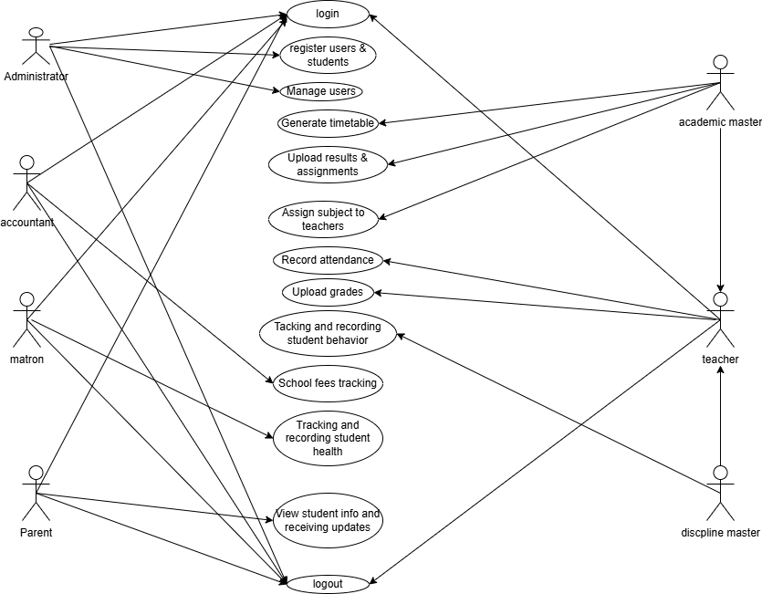
USE CASE DIAGRAM

Slide 14
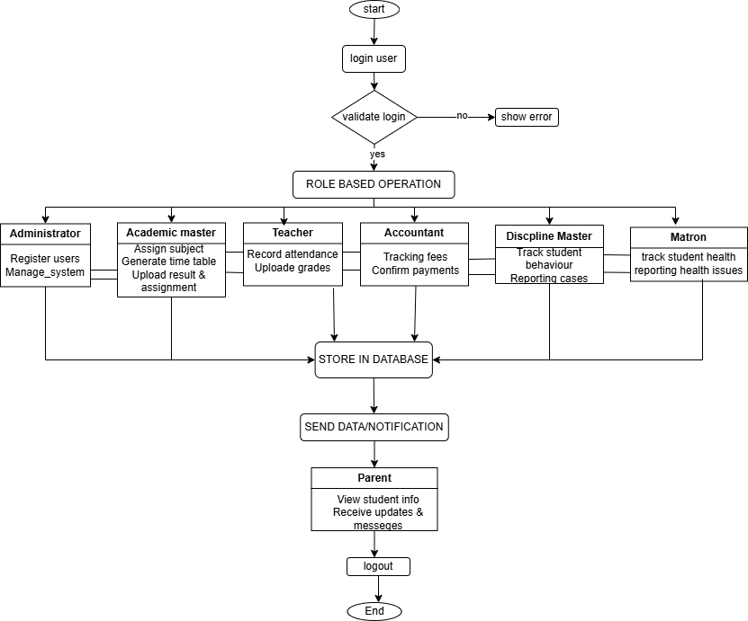
FLOW CHART DIAGRAM

Slide 15
References
ShuleSoft (2024). ShuleSoft: The leading school management system in Tanzania. ShuleSoft Official Documentation and Technical Overview. [Online]. Available: https://shulesoft.africa/
InfoTaaluma (2023). InfoTaaluma: Cloud-based school management and information system for Tanzania. InfoTaaluma Platform Resources. [Online]. Available: https://infotaaluma.com/
Gunawan, A., Ng, K. M., & Poh, K. L. (2022). A constraint-based automated school timetabling system: Algorithms and implementation. International Journal of Software Engineering and Knowledge Engineering.

