Slide 1
课前汇报
Transformer
VCR

Slide 2
Transformer
定义
一个特殊的 Sequence to sequence(Seq2seq) model

Slide 3
疑问
Encoder’s block 和重复多次的关系
Input Embedding?
NAT Decoder?
Wq、Wk、Wv的一致性
Mask Self-attention

Slide 4

Sequence-to-sequence (Seq2seq)
Input a sequence, output a sequence
The output length is determined by model.
Speech
Recognition
你
好
嗎
N
T
機
器
學
習
Machine
Translation
machine
learning
N
N’
machine
learning
機
器
學
習
Speech
Translation
Language without text
Notes:
Speech Recognition + Machine Translation
Why don’t we simply concatenate two system?

Slide 5

output sequence
Encoder
Decoder
Input sequence

Slide 6
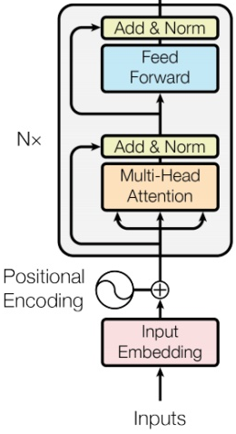








Encoder
Transformer’s Encoder
Can use RNN or CNN.
$$h^{1}$$
$$h^{2}$$
$$h^{3}$$
$$h^{4}$$
Encoder
$$x^{1}$$
$$x^{2}$$
$$x^{3}$$
$$x^{4}$$
Notes:
可以用 CNN, RNN
不用拘泥於 Transformer’s Encoder

Slide 7
$$h^{1}$$
$$h^{2}$$
$$h^{3}$$
$$h^{4}$$
Block
…
…
…
…
FC
FC
FC
FC
Block
Block
Self-attention
$$x^{1}$$
$$x^{2}$$
$$x^{3}$$
$$x^{4}$$

Slide 8

BERT
Ue the same network architecture as transformer encoder.
$$h^{1}$$
$$h^{2}$$
$$h^{3}$$
$$h^{4}$$
Encoder
Residue
+ Layer norm
$$x^{1}$$
$$x^{2}$$
$$x^{3}$$
$$x^{4}$$

Slide 9









…
$$\left[\begin{aligned}x_{1}^{′} \\ x_{2}^{′} \\ ⋮ \\ x_{K}^{′}\end{aligned}\right]$$
$$x_{i}^{′}=\frac{x_{i}−m}{σ}$$
norm
Layer Norm
norm
norm
+
residual
$$a+b$$
$$\left[\begin{aligned}x_{1} \\ x_{2} \\ ⋮ \\ x_{K}\end{aligned}\right]$$
mean $m$
FC
standard deviation $σ$
$$b$$
+
$$a$$
Self-attention

Slide 10
Decoder – Autoregressive (AT)
distribution
(Speech Recognition as example)
學 | 0.0
機 | 0.8
器 | 0.0
習 | 0.1
…… | ……
機
Size V
max
(common characters)
softmax
Encoder
Decoder
( 機器學習 )
(special token)
START
Notes:
What is BOS?

Slide 11
Autoregressive
機
器
學
習
max
max
max
max
Encoder
Decoder
( 機器學習 )
START
機
器
學
Notes:
What is BOS?

Slide 12
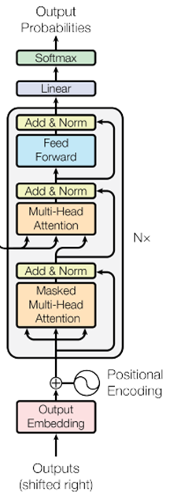
ignore the input from the encoder here ☺
機
器
學
習
max
max
max
max
Decoder
START
機
器
學
Notes:
What is BOS?

Slide 13
Encoder
Decoder

Slide 14








Self-attention
Masked Self-attention
$$b^{1}$$
$$b^{2}$$
$$b^{3}$$
$$b^{4}$$
$$a^{1}$$
$$a^{2}$$
$$a^{3}$$
$$a^{4}$$
Can be either input or a hidden layer
Notes:
Masked: attend on the generated sequence

Slide 15
















Self-attention
Masked Self-attention
$$b^{2}$$
$$α_{2,1}^{′}$$
$$α_{2,2}^{′}$$
$$α_{2,3}^{′}$$
$$α_{2,4}^{′}$$
$$q^{1}$$
$$k^{1}$$
$$v^{1}$$
$$q^{2}$$
$$k^{2}$$
$$v^{2}$$
$$q^{3}$$
$$k^{3}$$
$$v^{3}$$
$$q^{4}$$
$$k^{4}$$
$$v^{4}$$
$$a^{1}$$
$$a^{2}$$
$$a^{3}$$
$$a^{4}$$
Consider how does decoder work
Why masked?
Notes:
Relation between attention and CNN
Global receptive field (compared to convolutional architectures)

Slide 16
Autoregressive
We do not know the correct output length.
Never stop!
機
器
學
習
慣
……
max
max
max
max
max
Encoder
Decoder
( 機器學習 )
START
機
器
學
習

Slide 17
distribution
Adding “Stop Token”
學 | 0.0
機 | 0.8
器 | 0.0
習 | 0.1
…… | ……
END | 0.0
Size V
(common characters)
softmax
Encoder
Decoder
機 器 學 習
START
Notes:
What is BOS?

Slide 18
Autoregressive
Stop at here!
機
器
學
習
END
max
max
max
max
max
Encoder
Decoder
( 機器學習 )
START
機
器
學
習

Slide 19

AT v.s. NAT
Decoder – Non-autoregressive (NAT)
w₁
w₃
w₁
END
w₂
END
w₂
w₃
w₄
AT Decoder
NAT Decoder
START
w₁
w₂
w₃
START
START
START
START

Slide 20
Encoder-Decoder -Cross attention
output sequence
Encoder
Decoder
Input sequence

Slide 21
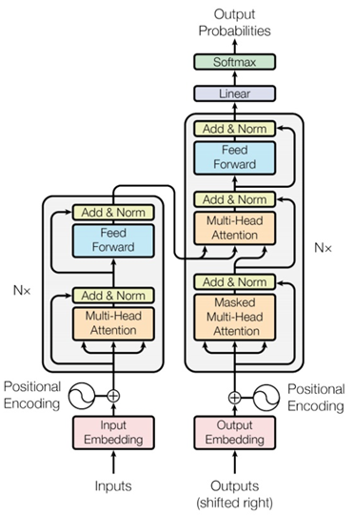
Notes:
I need to know consider which layer?

Slide 22








Cross attention
FC
$$v$$
$$α_{1}^{′}$$
$$α_{2}^{′}$$
$$q$$
$$k^{1}$$
$$v^{1}$$
$$k^{2}$$
$$v^{2}$$
$$a^{1}$$
$$a^{2}$$
Encoder
Self-attention(Mask)
START
Notes:
Relation between attention and CNN
Global receptive field (compared to convolutional architectures)

Slide 23






Fully Connect Feedforward Network
hidden layer
+
$$a_{1}$$
+
$$x_{1}$$
1
1
$$x_{2}$$
+
$$a_{2}$$
+
1
1
$$x_{3}$$
……
+
$$a_{3}$$
+
Neuron
1
1
Neural Network

