Slide 1

Self-attention
Notes:
Check: multi-head attention
=============
Multiple related input example
Same input, different labels
=====
Using DNN to fit
What is the problem? Noisy?
=====
How about
Self-attention
===
All types of ML problems:
Input:
One vector
A set of vectors (seq, image, graph), relation is important
Output:
One vector
Regression (target is a vector: closer is better)
Classification (?????) it is good enough to get a vector
A set of vectors (seq, image, graph)
Output size is known (input-output relation is clear)
Output size is unknown

Slide 2
Sophisticated Input
Input is a vector
Input is a set of vectors
Model
Scalar or Class
Model
Scalars or Classes
(may change length)

Slide 3
Vector Set as Input
this is a cat
One-hot Encoding
Word Embedding
apple = [ 1 0 0 0 0 …… ]
dog
bag = [ 0 1 0 0 0 …… ]
rabbit
run
cat = [ 0 0 1 0 0 …… ]
jump
cat
dog = [ 0 0 0 1 0 …… ]
tree
flower
elephant = [ 0 0 0 0 1 …… ]
Notes:
給一個需要上下文的例子

Slide 4
What is the output?
Each vector has a label.
focus of this lecture
Model
N
N
The whole sequence has a label.
Model
seq2seq
Model decides the numbers of labels itself.
Model
N
Translation (HW5)
N’

Slide 5
Sequence Labeling
Is it possible to consider the context?
Fully-connected
FC can consider the neighbor
FC
How to consider the whole sequence?
a window covers the whole sequence?
FC
FC
FC
FC
window
I
saw
a
saw
Notes:
Good for HW2, context is good enough

Slide 6

Self-attention
FC
FC
FC
FC
with context
Self-attention
Notes:
https://arxiv.org/abs/1706.03762

Slide 7

FC
FC
FC
FC
Self-attention
FC
FC
FC
FC
Self-attention

Slide 8








Self-attention
$$b^{1}$$
$$b^{2}$$
$$b^{3}$$
$$b^{4}$$
$$a^{1}$$
$$a^{2}$$
$$a^{3}$$
$$a^{4}$$
Can be either input or a hidden layer

Slide 9
Self-attention
$$b^{1}$$
$$α$$
relevant?
$$a^{1}$$
$$a^{2}$$
$$a^{3}$$
$$a^{4}$$
Find the relevant vectors in a sequence

Slide 10





Self-attention
Dot-product
$$α$$
$$=q∙k$$
$$q$$
$$k$$
$$W^{q}$$
$$W^{k}$$
Notes:
Does normalization important???

Slide 11














Self-attention
$$α_{1,2}=q^{1}∙k^{2}$$
$$α_{1,3}=q^{1}∙k^{3}$$
$$α_{1,4}=q^{1}∙k^{4}$$
attention score
$$α_{1,2}$$
$$α_{1,3}$$
$$α_{1,4}$$
$$q^{1}$$
query
$$k^{2}$$
key
$$k^{3}$$
$$k^{4}$$
$$a^{1}$$
$$a^{2}$$
$$a^{3}$$
$$a^{4}$$
$$q^{1}=W^{q}a^{1}$$
$$k^{2}=W^{k}a^{2}$$
$$k^{3}=W^{k}a^{3}$$
$$k^{4}=W^{k}a^{4}$$

Slide 12








Self-attention
$$α_{1,i}^{′}=exp\left(α_{1,i} \right)/\sum_{j}{exp\left(α_{1,j} \right)}$$
$$α_{1,1}^{′}$$
$$α_{1,2}^{′}$$
$$α_{1,3}^{′}$$
$$α_{1,4}^{′}$$
Soft-max
$$α_{1,1}$$
$$α_{1,2}$$
$$α_{1,3}$$
$$α_{1,4}$$
$$q^{1}$$
$$k^{1}$$
$$k^{2}$$
$$k^{3}$$
$$k^{4}$$
$$a^{1}$$
$$a^{2}$$
$$a^{3}$$
$$a^{4}$$
$$q^{1}=W^{q}a^{1}$$
$$k^{2}=W^{k}a^{2}$$
$$k^{3}=W^{k}a^{3}$$
$$k^{4}=W^{k}a^{4}$$
$$k^{1}=W^{k}a^{1}$$

Slide 13






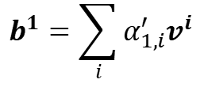


Self-attention
Extract information based on attention scores
$$b^{1}=\sum_{i}{α_{1,i}^{′}v^{i} }$$
$$b^{1}$$
$$α_{1,1}^{′}$$
$$α_{1,2}^{′}$$
$$α_{1,3}^{′}$$
$$α_{1,4}^{′}$$
$$q^{1}$$
$$k^{1}$$
$$v^{1}$$
$$k^{2}$$
$$v^{2}$$
$$k^{3}$$
$$v^{3}$$
$$k^{4}$$
$$v^{4}$$
$$a^{1}$$
$$a^{2}$$
$$a^{3}$$
$$a^{4}$$
$$v^{1}=W^{v}a^{1}$$
$$v^{2}=W^{v}a^{2}$$
$$v^{3}=W^{v}a^{3}$$
$$v^{4}=W^{v}a^{4}$$

Slide 14
Self-attention
parallel
$$b^{1}$$
$$b^{2}$$
$$b^{3}$$
$$b^{4}$$
$$a^{1}$$
$$a^{2}$$
$$a^{3}$$
$$a^{4}$$
Can be either input or a hidden layer

Slide 15



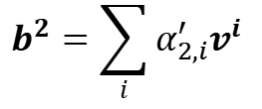




Self-attention
$$b^{2}=\sum_{i}{α_{2,i}^{′}v^{i} }$$
$$b^{2}$$
$$α_{2,1}^{′}$$
$$α_{2,2}^{′}$$
$$α_{2,3}^{′}$$
$$α_{2,4}^{′}$$
$$q^{1}$$
$$k^{1}$$
$$v^{1}$$
$$q^{2}$$
$$k^{2}$$
$$v^{2}$$
$$q^{3}$$
$$k^{3}$$
$$v^{3}$$
$$q^{4}$$
$$k^{4}$$
$$v^{4}$$
$$a^{1}$$
$$a^{2}$$
$$a^{3}$$
$$a^{4}$$
Notes:
Relation between attention and CNN
Global receptive field (compared to convolutional architectures)

Slide 16









Self-attention
$$q^{1}$$
$$q^{2}$$
$$q^{3}$$
$$q^{4}$$
$$a^{1}$$
$$a^{2}$$
=
$$a^{3}$$
$$q^{i}=W^{q}a^{i}$$
$$W^{q}$$
$$a^{4}$$
$$Q$$
$$I$$
$$a^{1}$$
$$a^{2}$$
$$k^{1}$$
$$a^{3}$$
$$k^{2}$$
$$a^{4}$$
$$k^{3}$$
$$k^{i}=W^{k}a^{i}$$
$$k^{4}$$
=
$$W^{k}$$
$$K$$
$$I$$
$$a^{1}$$
$$a^{2}$$
$$a^{3}$$
$$v^{1}$$
$$a^{4}$$
$$v^{2}$$
$$v^{3}$$
$$v^{i}=W^{v}a^{i}$$
$$v^{4}$$
=
$$W^{v}$$
$$V$$
$$I$$
$$q^{1}$$
$$k^{1}$$
$$v^{1}$$
$$q^{2}$$
$$k^{2}$$
$$v^{2}$$
$$q^{3}$$
$$k^{3}$$
$$v^{3}$$
$$q^{4}$$
$$k^{4}$$
$$v^{4}$$
$$a^{1}$$
$$a^{2}$$
$$a^{3}$$
$$a^{4}$$

Slide 17





Self-attention
$$α_{1,1}$$
$$k^{1}$$
$$α_{1,1}=$$
$$k^{1}$$
$$q^{1}$$
$$α_{1,2}=$$
$$k^{2}$$
$$q^{1}$$
$$α_{1,2}$$
$$k^{2}$$
$$=$$
$$q^{1}$$
$$α_{1,3}$$
$$k^{3}$$
$$α_{1,3}=$$
$$k^{3}$$
$$q^{1}$$
$$α_{1,4}=$$
$$k^{4}$$
$$q^{1}$$
$$α_{1,4}$$
$$k^{4}$$
$$α_{1,1}$$
$$α_{1,2}$$
$$α_{1,3}$$
$$α_{1,4}$$
$$q^{1}$$
$$k^{1}$$
$$v^{1}$$
$$q^{2}$$
$$k^{2}$$
$$v^{2}$$
$$q^{3}$$
$$k^{3}$$
$$v^{3}$$
$$q^{4}$$
$$k^{4}$$
$$v^{4}$$
Notes:
Relation between attention and CNN
Global receptive field (compared to convolutional architectures)
(ignore $\sqrt{d}$ for simplicity)

Slide 18




























Self-attention
$$α_{1,1}$$
$$k^{1}$$
$$α_{1,1}=$$
$$k^{1}$$
$$q^{1}$$
$$α_{1,2}=$$
$$k^{2}$$
$$q^{1}$$
$$α_{1,2}$$
$$k^{2}$$
$$=$$
$$q^{1}$$
$$α_{1,3}$$
$$k^{3}$$
$$α_{1,3}=$$
$$k^{3}$$
$$q^{1}$$
$$α_{1,4}=$$
$$k^{4}$$
$$q^{1}$$
$$α_{1,4}$$
$$k^{4}$$
$$α_{2,1}$$
$$α_{2,2}$$
$$α_{2,3}$$
$$α_{2,4}$$
$$q^{1}$$
$$k^{1}$$
$$v^{1}$$
$$q^{2}$$
$$k^{2}$$
$$v^{2}$$
$$q^{3}$$
$$k^{3}$$
$$v^{3}$$
$$q^{4}$$
$$k^{4}$$
$$v^{4}$$
$$α_{1,1}^{′}$$
$$α_{2,1}^{′}$$
$$α_{3,1}^{′}$$
$$α_{4,1}^{′}$$
$$α_{1,1}$$
$$α_{2,1}$$
$$α_{3,1}$$
$$α_{4,1}$$
$$k^{1}$$
$$α_{1,2}^{′}$$
$$α_{2,2}^{′}$$
$$α_{3,2}^{′}$$
$$α_{4,2}^{′}$$
$$α_{1,2}$$
$$α_{2,2}$$
$$α_{3,2}$$
$$α_{4,2}$$
$$k^{2}$$
$$α_{1,3}^{′}$$
$$α_{2,3}^{′}$$
$$α_{3,3}^{′}$$
$$=$$
$$q^{1}$$
$$q^{2}$$
$$q^{3}$$
$$q^{4}$$
$$α_{4,3}^{′}$$
$$α_{1,3}$$
$$α_{2,3}$$
$$α_{3,3}$$
$$α_{4,3}$$
$$k^{3}$$
$$α_{1,4}^{′}$$
$$α_{2,4}^{′}$$
$$α_{3,4}^{′}$$
$$α_{4,4}^{′}$$
$$α_{1,4}$$
$$α_{2,4}$$
$$α_{3,4}$$
$$α_{4,4}$$
$$k^{4}$$
$$Q$$
$$A′$$
$$A$$
$$K^{T}$$
Notes:
Relation between attention and CNN
Global receptive field (compared to convolutional architectures)

Slide 19

















Self-attention
$$b^{1}$$
$${\hat{α}}_{1,1}$$
$${\hat{α}}_{1,2}$$
$${\hat{α}}_{1,3}$$
$${\hat{α}}_{1,4}$$
$$q^{1}$$
$$k^{1}$$
$$v^{1}$$
$$q^{2}$$
$$k^{2}$$
$$v^{2}$$
$$q^{3}$$
$$k^{3}$$
$$v^{3}$$
$$q^{4}$$
$$k^{4}$$
$$v^{4}$$
$$α_{1,1}^{′}$$
$$α_{2,1}^{′}$$
$$α_{3,1}^{′}$$
$$α_{4,1}^{′}$$
$$α_{1,2}^{′}$$
$$α_{2,2}^{′}$$
$$α_{3,2}^{′}$$
$$α_{4,2}^{′}$$
$$b^{1}$$
=
$$b^{2}$$
$$b^{3}$$
$$b^{4}$$
$$v^{1}$$
$$v^{2}$$
$$v^{3}$$
$$v^{4}$$
$$α_{1,3}^{′}$$
$$α_{2,3}^{′}$$
$$α_{3,3}^{′}$$
$$α_{4,3}^{′}$$
$$O$$
$$V$$
$$α_{1,4}^{′}$$
$$α_{3,4}^{′}$$
$$α_{2,4}^{′}$$
$$α_{4,4}^{′}$$
$$A′$$
Notes:
Relation between attention and CNN
Global receptive field (compared to convolutional architectures)

Slide 20








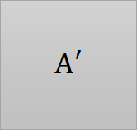
Self-attention
$$Q$$
=
$$I$$
$$W^{q}$$
$$K$$
=
$$I$$
$$W^{k}$$
$$V$$
=
$$I$$
$$W^{v}$$
Parameters to be learned
$$A′$$
$$A$$
=
$$Q$$
$$K^{T}$$
Attention Matrix
$$A′$$
$$O$$
=
$$V$$
Notes:
反正就是一堆矩陣乘法，用 GPU 可以加速

Slide 21























Multi-head Self-attention
Different types of relevance
$$q^{i,1}=W^{q,1}q^{i}$$
$$b^{i,1}$$
$$q^{i,2}=W^{q,2}q^{i}$$
$$q^{i,1}$$
$$q^{i,2}$$
$$k^{i,1}$$
$$k^{i,2}$$
$$v^{i,1}$$
$$v^{i,2}$$
$$q^{j,1}$$
$$q^{j,2}$$
$$k^{j,1}$$
$$k^{j,2}$$
$$v^{j,1}$$
$$v^{j,2}$$
$$q^{i}$$
$$k^{i}$$
$$v^{i}$$
$$q^{j}$$
$$k^{j}$$
$$v^{j}$$
$$q^{i}=W^{q}a^{i}$$
$$a^{i}$$
(2 heads as example)
$$a^{j}$$

Slide 22

Multi-head Self-attention
Different types of relevance
$$q^{i,1}=W^{q,1}q^{i}$$
$$b^{i,1}$$
$$q^{i,2}=W^{q,2}q^{i}$$
$$b^{i,2}$$
$$q^{i,1}$$
$$q^{i,2}$$
$$k^{i,1}$$
$$k^{i,2}$$
$$v^{i,1}$$
$$v^{i,2}$$
$$q^{j,1}$$
$$q^{j,2}$$
$$k^{j,1}$$
$$k^{j,2}$$
$$v^{j,1}$$
$$v^{j,2}$$
$$q^{i}$$
$$k^{i}$$
$$v^{i}$$
$$q^{j}$$
$$k^{j}$$
$$v^{j}$$
$$q^{i}=W^{q}a^{i}$$
$$a^{i}$$
(2 heads as example)
$$a^{j}$$

Slide 23


Multi-head Self-attention
Different types of relevance
$$b^{i,1}$$
$$b^{i}$$
=
$$W^{O}$$
$$b^{i,2}$$
$$q^{i,1}$$
$$q^{i,2}$$
$$k^{i,1}$$
$$k^{i,2}$$
$$v^{i,1}$$
$$v^{i,2}$$
$$q^{j,1}$$
$$q^{j,2}$$
$$k^{j,1}$$
$$k^{j,2}$$
$$v^{j,1}$$
$$v^{j,2}$$
$$q^{i}$$
$$k^{i}$$
$$v^{i}$$
$$q^{j}$$
$$k^{j}$$
$$v^{j}$$
$$q^{i}=W^{q}a^{i}$$
$$a^{i}$$
(2 heads as example)
$$a^{j}$$

Slide 24
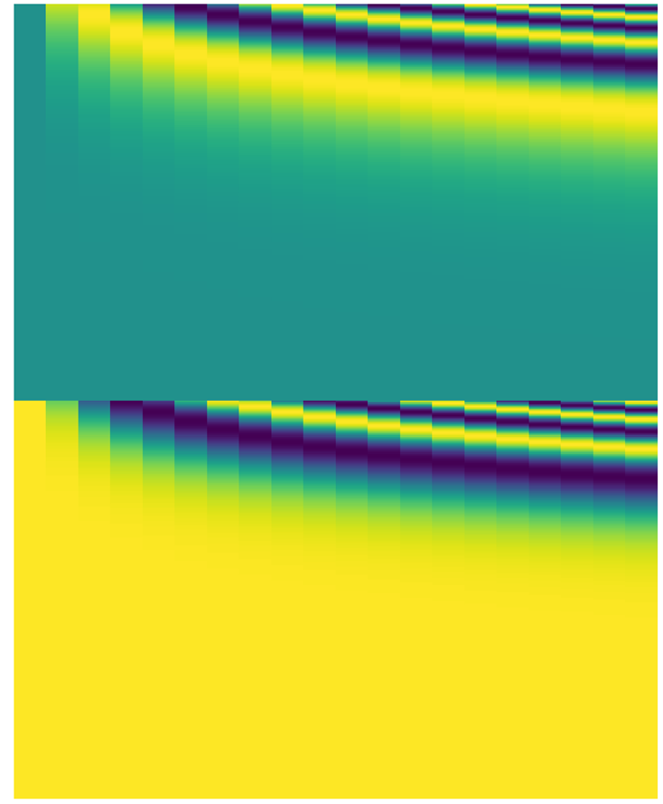


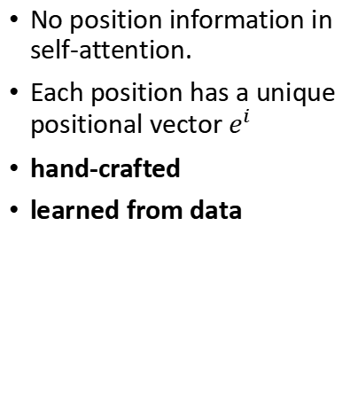
Positional Encoding
Each column represents a positional vector $e^{i}$
No position information in self-attention.
Each position has a unique positional vector $e^{i}$
hand-crafted
learned from data
$$q^{i}$$
$$k^{i}$$
$$v^{i}$$
$$e^{i}$$
+
$$a^{i}$$
-1
1
Notes:
A real example of positional encoding for 20 words (rows) with an embedding size of 512 (columns). You can see that it appears split in half down the center. That's because the values of the left half are generated by one function (which uses sine), and the right half is generated by another function (which uses cosine). They're then concatenated to form each of the positional encoding vectors.

Slide 25
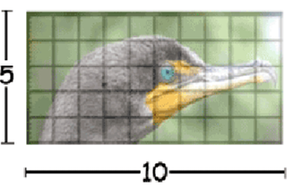
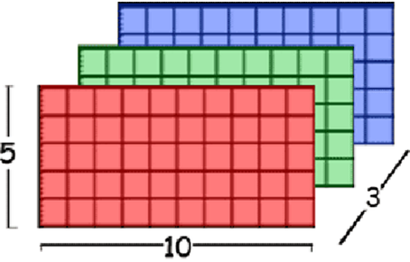
Self-attention for Image
An image can also be considered as a vector set.
This is a vector.

Slide 26
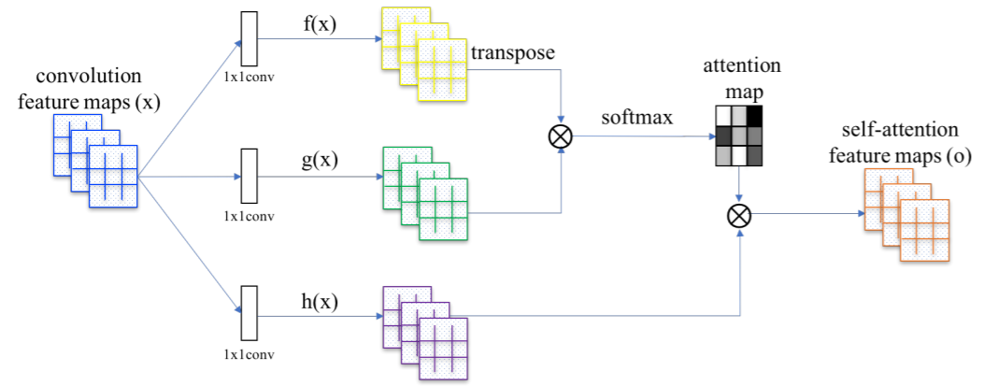
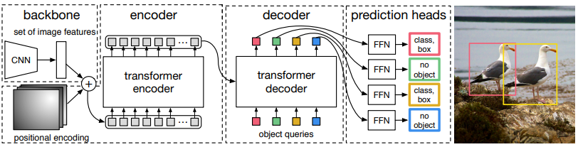
Self-Attention GAN
https://arxiv.org/abs/1805.08318
DEtection Transformer (DETR)
https://arxiv.org/abs/2005.12872
Notes:
https://github.com/facebookresearch/detr
https://arxiv.org/abs/2005.12872
https://analyticsindiamag.com/object-detection-with-transformers/

Slide 27
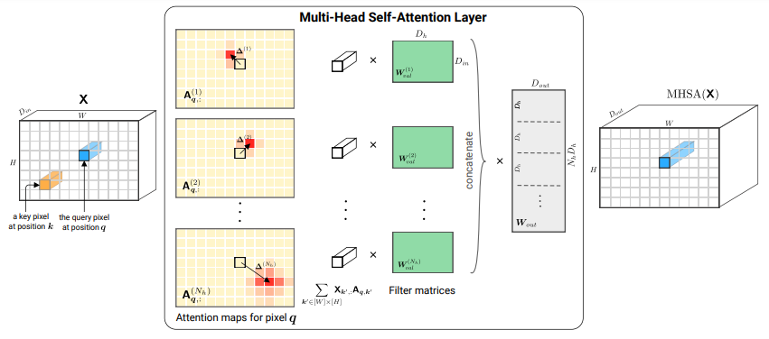
Self-attention v.s. CNN
Self-attention
CNN
On the Relationship between Self-Attention and Convolutional Layers
https://arxiv.org/abs/1911.03584
Notes:
Shall I explain this more …?
ICLR 2020

Slide 28
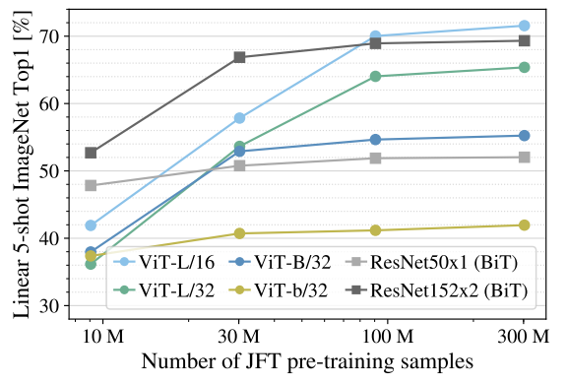
Self-attention v.s. CNN
Good for more data
Self-attention
Good for less data
CNN
An Image is Worth 16x16 Words: Transformers for Image Recognition at Scale
https://arxiv.org/pdf/2010.11929.pdf
Notes:
Self needs more data to work
Vision Transformer (ViT)
ViT-L/16 means the “Large” variant with 16×16 input patch size.

Slide 29

Self-attention v.s. RNN
FC
FC
FC
FC
memory
RNN
RNN
RNN
RNN
hard to consider
nonparallel
parallel
Self-attention
easy to consider
Transformers are RNNs: Fast Autoregressive Transformers with Linear Attention
https://arxiv.org/abs/2006.16236
Notes:
RNN + attention https://arxiv.org/abs/1611.08656

