Slide 1
使用说明
Notes:
http://localhost:8761/
localhost:5555/cargoservice/v1/customers/3/cargos/3
localhost:5555/customerservice/v1/customers/3
localhost:5555/routes
localhost:5555/api/cargo/v1/customers/3/cargos/3
localhost:5555/api/customer/v1/customers/3
localhost:5555/api/cargostatic/v1/customers/3/cargos/3
docker-compose up --scale customerservice=2
git commit -a -m
git push -u origin master

Slide 2
分布式系统关系图
zuulserver
database
cargoservice
customerservice
eurekaserver
configserver
Git

Slide 3
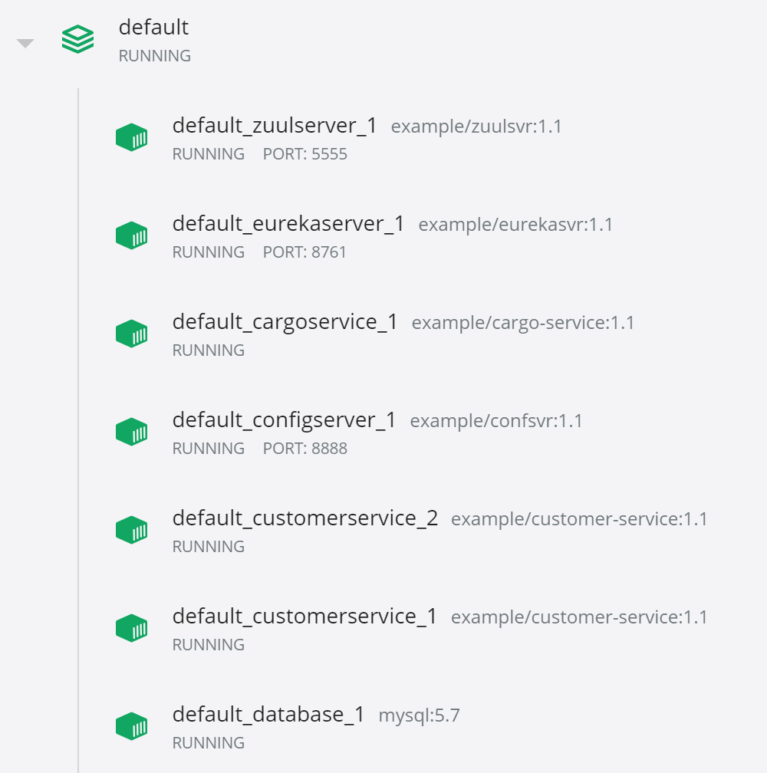

Slide 4
谢谢！

