Slide 1
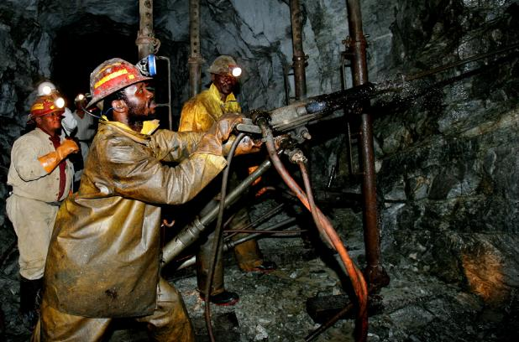
Data Mining FP Tree
2012/11/14 林子修

Slide 2
0
Workflolw

Slide 3
Scan DB to find L1
Item | frequency
1 | 1
2 | 1
3 | 4
4 | 3
5 | 5
6 | 1
7 | 3
8 | 3
TID | Item bought
1 | 1, 3, 4, 5,7,8
2 | 3, 4, 5,7
3 | 2, 3, 5,8
4 | 4, 5,7
5 | 3, 5,6,8

Slide 4
Scanning DB again
Minimum support: 3
{}
3
4
5
7
8
Item | frequency
1 | 1
2 | 1
3 | 4
4 | 3
5 | 5
6 | 1
7 | 3
8 | 3
Item bought
1, 3, 4, 5,7,8
3, 4, 5,7
2, 3, 5,8
4, 5,7
3, 5,6,8

Slide 5
Scanning DB again
Minimum support: 3
{}
5 | 3 | 4 | 7 | 8
5:1
Item | frequency
1 | 1
2 | 1
3 | 4
4 | 3
5 | 5
6 | 1
7 | 3
8 | 3
Item bought
1, 3, 4, 5,7,8
3, 4, 5,7
2, 3, 5,8
4, 5,7
3, 5,6,8
3:1
4:1
7:1
8:1

Slide 6
Scanning DB again
{}
5
3
4
7
8
5:5
3:4
4:1
4:2
8:2
7:1
7:2
8:1

Slide 7
FP-Growth
FP-Growth(Tree, α)
If Tree only one path
display all association
else
for each(ai in the header of Tree) do {
β := ai U α
generate(β with support = ai.support)
construct β's conditional base pattern and β's conditional FP-Tree Treeβ
if Tree β ≠Ø
then call FP-growth(Tree β, β)
Initially call:
FP-Growth(Tree, null)

Slide 8
FP-Growth
5 | 3 | 4 | 7
3 | 2 | 2 | 1
{}
5
3
4
7
8
{8}
5:5
3:4
4:1
5:3
4:2
8:2
7:1
7:2
Frequent pattern: 8
8:1

Slide 9
FP-Growth
{8}
5
5:3
Frequent pattern: 8、8,5

Slide 10
1
Performance Measurement

Slide 11
1k 10k 100k

Slide 12
1000k

Slide 13
D1 D2

Slide 14
2
FP tree vs. Apriori

Slide 15
1k

Slide 16
10k

Slide 17
100k

Slide 18
1000k

Slide 19
D1

Slide 20
D2

Slide 21
3
Summary

Slide 22
