Slide 1
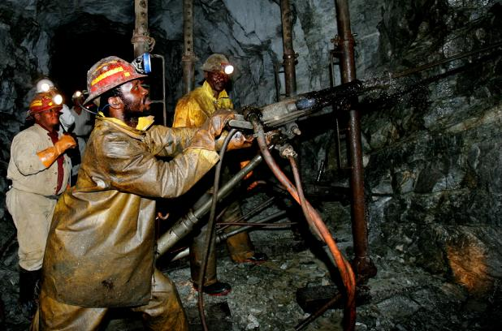
Apriori
2012/10/17 林子修

Slide 2
Outline
Workflow
Candidate Generation
Discovering Large Itemsets
Performance Measurement
Summary

Slide 3
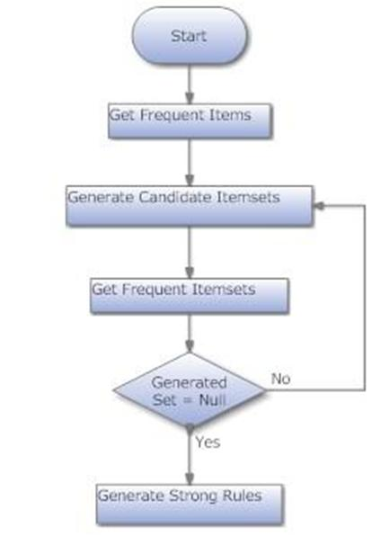
Workflow

Slide 4
Candidate Generation
K = 1
Database
100 | A C D
200 | B C E
300 | A B C E
400 | B E
C1
A | 100 300
B | 200 300 400
C | 100 200 300
D | 100
E | 200 300 400
Scan Database

Slide 5
Candidate Generation(cont.)
K > 1
AB | 300
AC | 100 300
AE | 300
BC | 200 300
BE | 200 300 400
CE | 200 300
A | 100 300
B | 200 300 400
C | 100 200 300
E | 200 300 400
e.g.
AB = A ∩ B

Slide 6
Candidate Generation(cont.)
Find A ∩ B
A
100 | 300
B
200 | 300 | 400

Slide 7
Discovering Large Itemsets
Minimum support: 50%
AB | 300
AC | 100 300
AE | 300
BC | 200 300
BE | 200 300 400
CE | 200 300
AC | 100 300
BC | 200 300
BE | 200 300 400
CE | 200 300
e.g.
Count(AB) = 1 < 2
Itemset AB is
not Large itemsets

Slide 8

Performance
Measurement

Slide 9
Runtime - 1k 10k 100k

Slide 10
Runtime - 1000k

Slide 11
Runtime - D1 D2

Slide 12
Runtime / Large Itemsets total – D1
1% | 2% | 3% | 4% | 5% | 6%
672+561 | 438+4 | 298 | 214 | 140 | 90

Slide 13
Runtime / Large Itemsets total – D2
1% | 2% | 3% | 4% | 5% | 6%
672+561 | 438+4 | 298 | 214 | 140 | 90
1% | 2% | 3% | 4% | 5% | 6%
228 | 3 | 0 | 0 | 0 | 0

Slide 14
Summary
此方法的瓶頸將會在記憶體
Minmum support的大小關係到程式執行的時間、探勘後資料的價值

