Slide 1
Block Blast with Reinforcement Learning
PPO with Afterstate: A Board-Aware Policy Gradient Approach
黃子瑄 · 陳彥璋 · 黃致穎 · 譚聲全 · 呂訢誠

Slide 2
Agenda
01
Background
Game overview & motivation
02
Environment
Observation · Action encoding · Masking
03
PPO-AF Method
Afterstate concept · Domain motivation · Architecture
04
Comparison
Baseline / DQN / PPO / PPO-AF results
05
Demo
Live gameplay visualization
06
Conclusion
Summary & future work

Slide 3
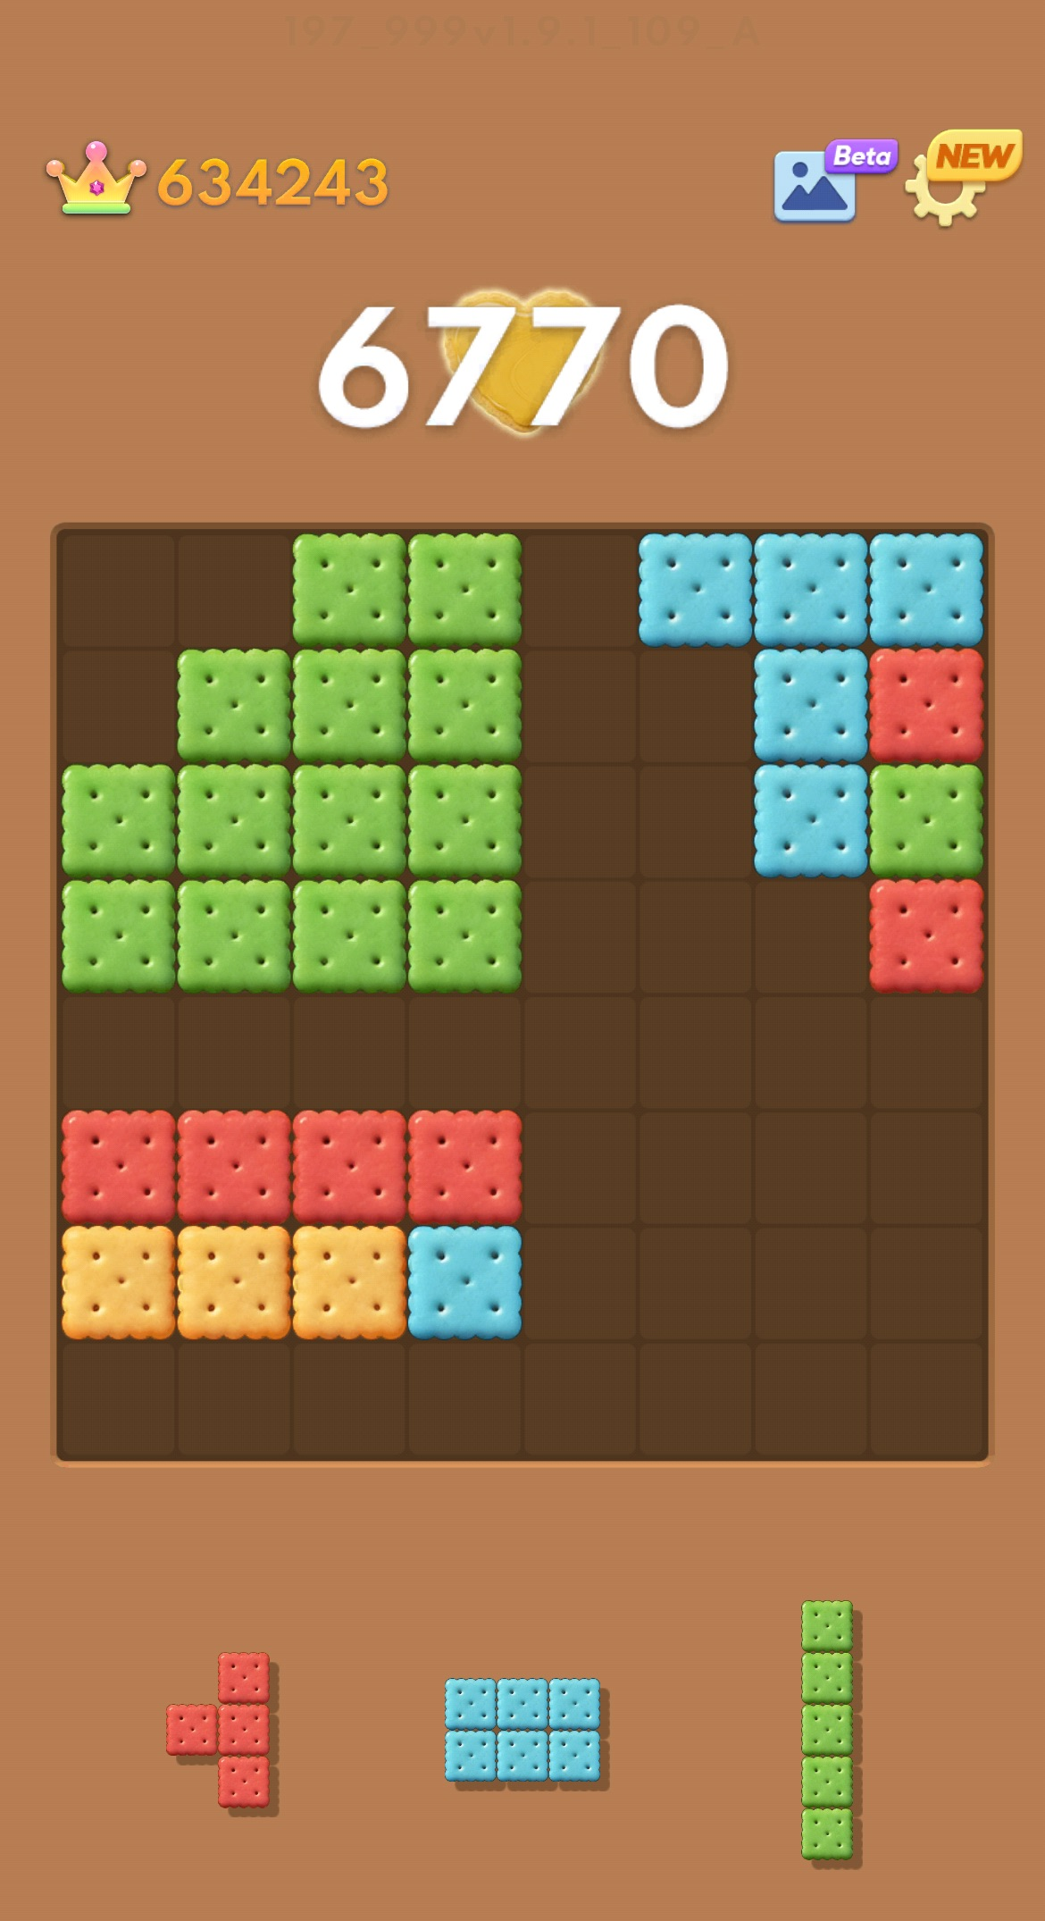
Background
Game Overview & Motivation
What is Block Blast?
8 × 8 Grid — A compact strategic puzzle environment.
Round-Based — Each round deals 3 pieces; all must be placed before the next round begins.
Clearing Logic — Fill any complete row or column to score points and reclaim space.
Termination — The game ends when no remaining piece can be legally placed.

Slide 4
Background
Game Overview & Motivation
Why Reinforcement Learning?
No Closed-Form Solution: 8×8 × 35 piece combinations make exhaustive search infeasible.
Natural MDP Fit: State transitions and reward signals are well-defined.
Greedy Is Not Enough: Greedy scores 3.97 vs. PPO-AF's 34.41 — long-horizon planning matters.
No Human Data Needed: Pure self-play, zero annotation cost.
Research Question
Can a board-aware afterstate representation help PPO learn more efficiently and achieve higher scores than standard PPO or DQN on Block Blast?

Slide 5
Environment Design
Action Space
Discrete(192) — encoded as piece_idx × 64 + row × 8 + col
Each action selects a piece and its placement position.
Reward
Sparse: +1 per row/column cleared; −10 on death.
Dense: Sparse + (−0.02 × holes) − (0.01 × bumpiness per step).
Action Masking
env.action_masks() returns a (192,) bool array.
Masks out-of-bounds, overlapping, and already-used piece slots.
Episode terminates when all actions are masked.

Slide 6
Environment Design
Observation Space
Field | Shape | Description
board | (8, 8) float32 | Board grid; 0 = empty, 1 = filled.
pieces | (3, 5, 5) float32 | Each piece rendered as a 5×5 binary grid; used slots are all zeros.
pieces_left | (3,) float32 | Binary flags indicating which piece slots remain unused.
heuristics | (40,) float32 | Hand-crafted features: column heights, holes, bumpiness, etc.; normalized to [0, 1].

Slide 7
PPO-AF: What is an Afterstate?
Concept
Concept
An afterstate is the board configuration that results immediately after an action is taken — before the environment deals new pieces.
Afterstate (s’)
(env deals new pieces)
State (s)
Take action a
State s+1
Key insight: afterstates from different (s, a) pairs may be identical, allowing the critic to generalize across action paths that lead to the same board.

Slide 8
PPO-AF: Why Afterstate for Block Blast?
Domain Motivation
Motivation
1
Deterministic placement
Given (s, a), the resulting board is fully determined. No stochasticity between action and afterstate — a perfect fit.
2
Pieces are noise for the critic
The 3 incoming pieces vary randomly each round. A critic conditioned on the board state ignores this irrelevant noise.
3
Board captures all long-term value
Future scores depend entirely on the board layout, not on which pieces happened to be present when the action was taken.

Slide 9
PPO-AF: Architecture
Actor → Afterstate Features · Critic → Board State
Architecture
Standard CNN PPO
PPO-AF
State (s)
board (8 × 8) + pieces (3 ×5 ×5)
State (s)
board (8 × 8) + pieces (3 ×5 ×5)
↓
↓
Simulate placement on board
Extract 9 board features
CNN Encoder
Conv → Conv → FC
vs.
↓
↓
↓
Shared Linear
Scores each action’s afterstate
Actor
Critic
↓
π(a|s)
V(s)
Actor
Critic
π(a|s)
V(ŝ)

Slide 10
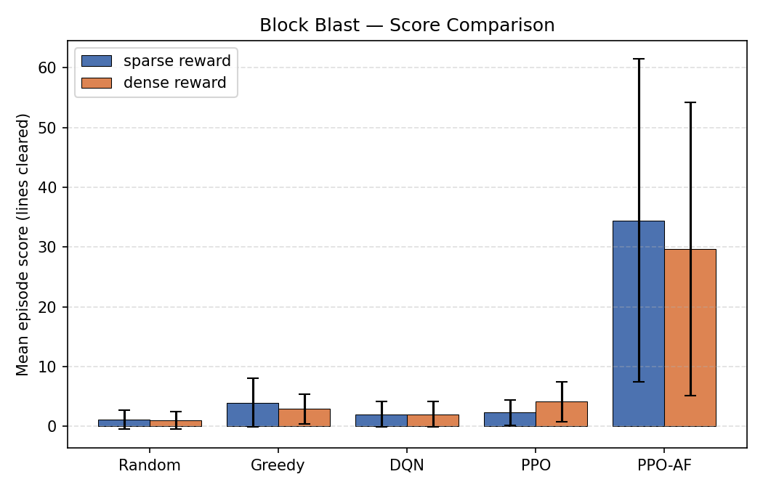
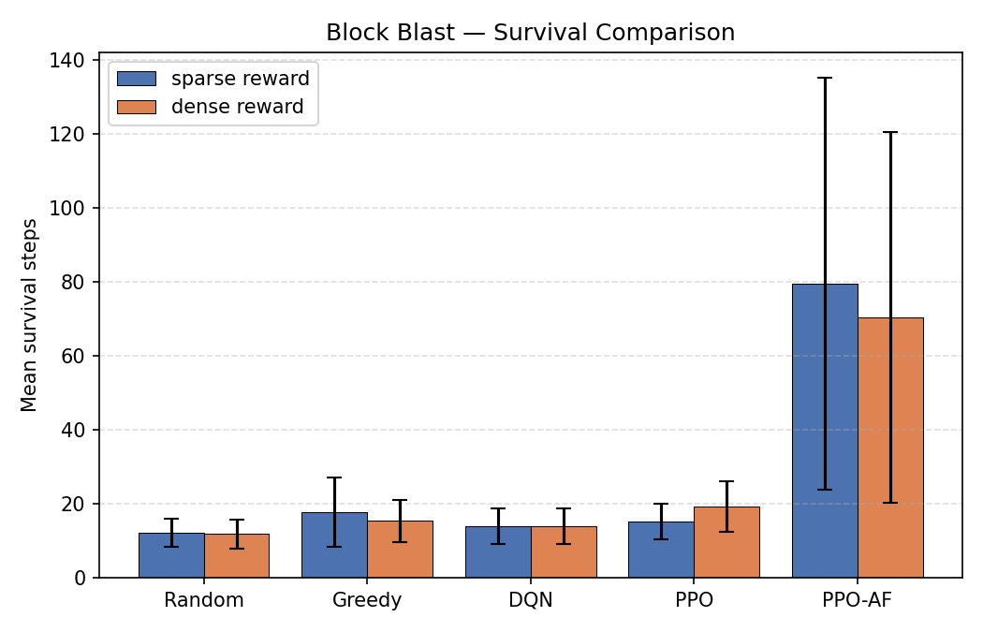
Method Comparison
Baseline · DQN · PPO · PPO-AF

Slide 11
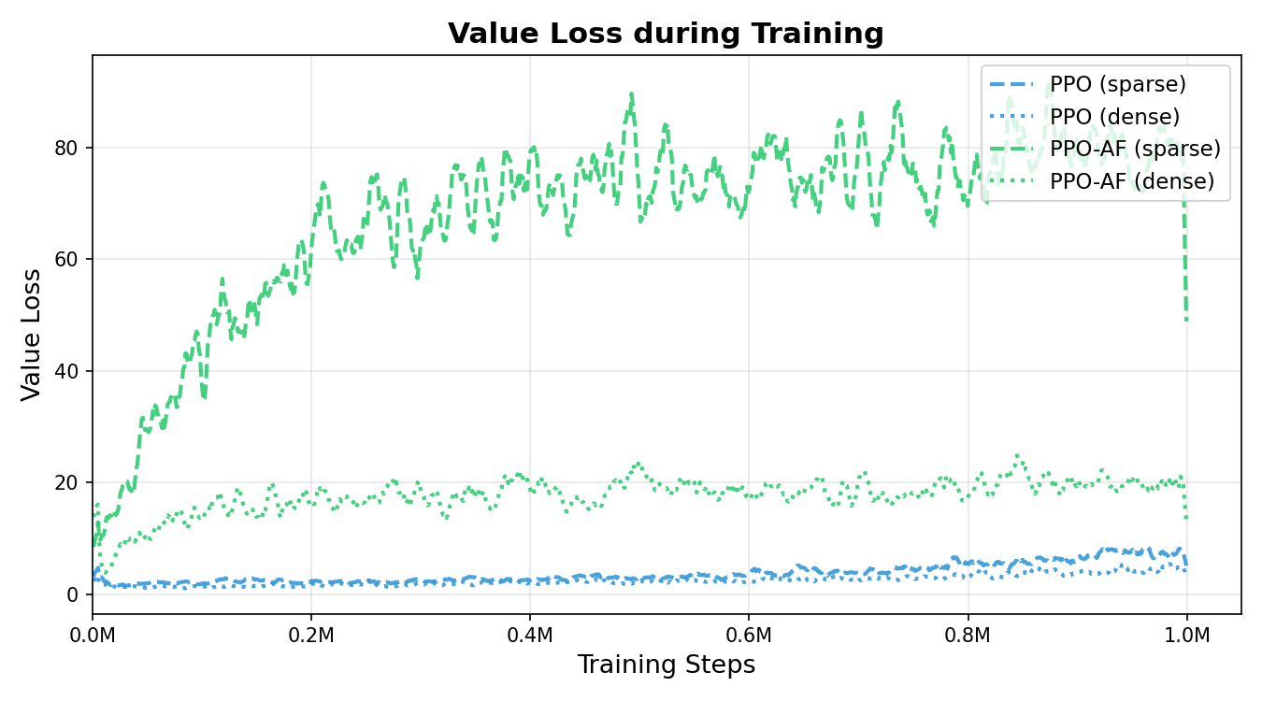
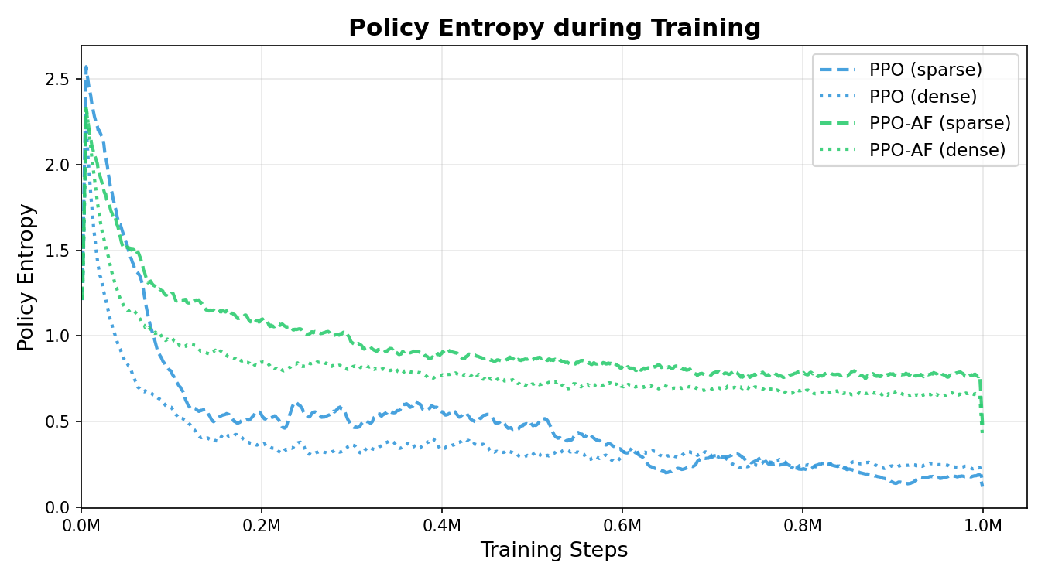
Method Comparison
Baseline · DQN · PPO · PPO-AF

Slide 12
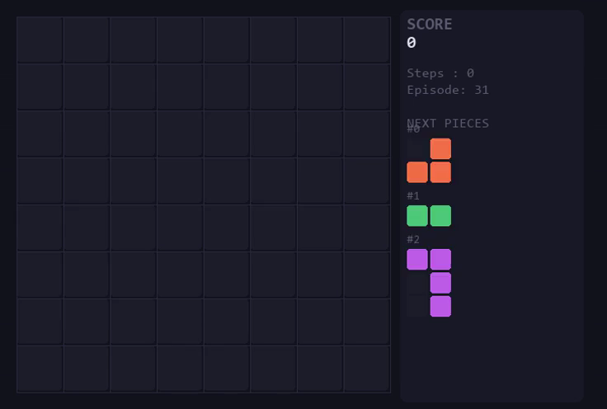
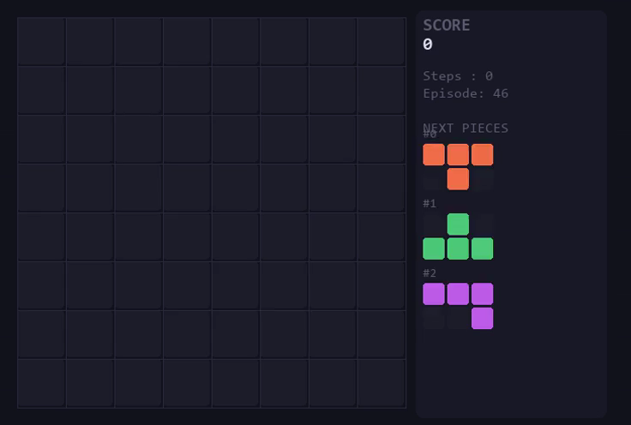
Demo
Live Gameplay Visualization
Baseline agent playing Block Blast
Random
Greedy

Slide 13
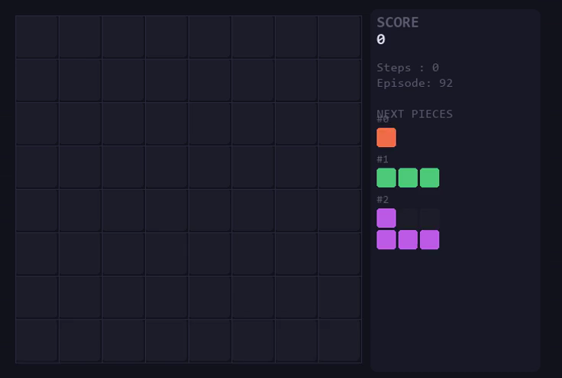
Demo
Live Gameplay Visualization
PPO-AF agent playing Block Blast

Slide 14
Conclusion
Summary
We built a Block Blast Gymnasium environment with 192 discrete actions and action masking
We compared Random, Greedy, DQN, and PPO on a shared CNN backbone
We validated that PPO-AF — a board-aware afterstate critic — is highly effective on Block Blast, achieving 34.41 mean score vs. 4.16 for standard PPO
Future Work
Multi-step lookahead — plan across all 3 pieces per round before placing
Multi-seed evaluation — current results use a single seed; averaging across seeds would strengthen the statistical claim
Reward shaping tuning — the optimal coefficient between sparse and dense reward for PPO-AF is still unexplored (sparse outperformed dense: 34.41 vs 29.66)

Slide 15
Thank You · Q & A

Slide 16
Appendix
9 Hand-crafted Features
Feature | Description
lines_cleared | Rows + columns cleared by this placement
eroded_piece_cells | Piece cells that participated in a cleared line
holes_after | Empty cells with a filled cell above them (holes)
max_height_after | Maximum column height after placement
mean_height_after | Mean column height after placement
bumpiness_after | Sum of absolute differences between adjacent column heights
row_transitions_after | Number of filled↔empty boundaries within each row
col_transitions_after | Number of filled↔empty boundaries within each column
near_full_count_after | Rows + columns with ≥ 7/8 cells filled (almost ready to clear)

Slide 17
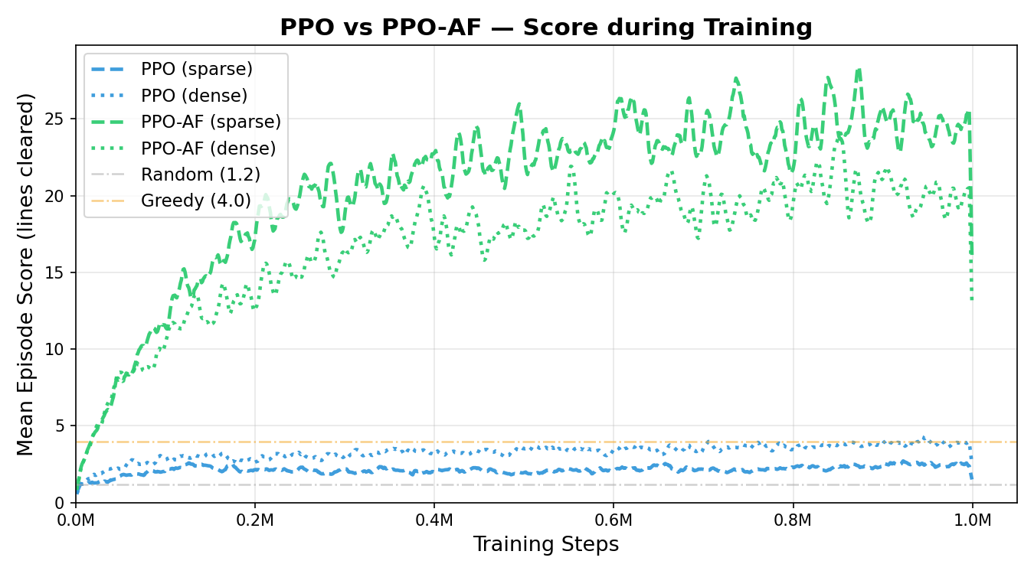
Appendix

