Slide 1
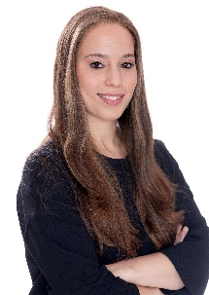
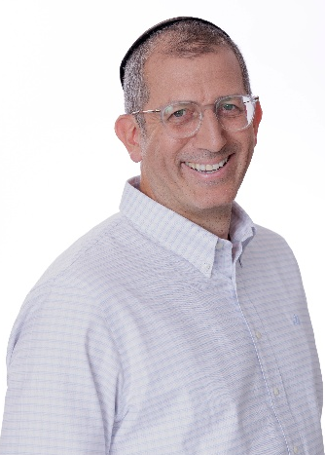
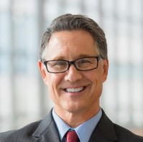
OUR TEAM LEADERS
CURRENT ROLE AT BDO:
ADD
RELEVANT EXPERIENCE:
Over six years of experience at the firm, specializing in auditing companies and serving as a financial controller for technology companies and venture capital funds.
Tzippora Kahana,
C.P.A (Israel)
Director of Finance
Technology & Hi-Tech
M: +972 [54 – 917 - 3944]
TzipporaC@bdo.co.il
14

