Slide 1
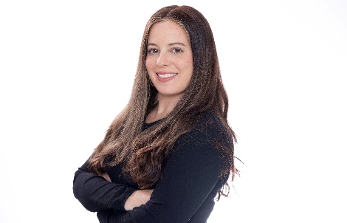
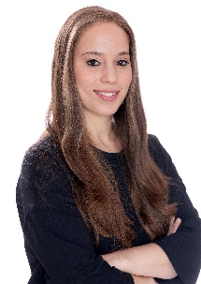
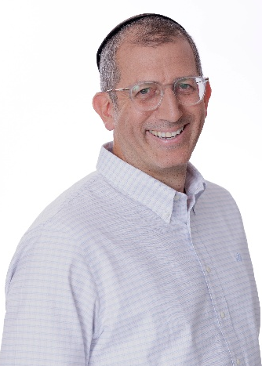
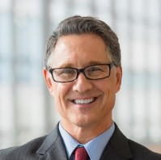
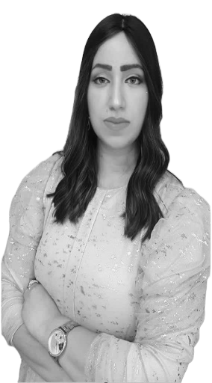
ENGAGEMENT TEAM
CURRENT ROLE AT BDO:
Director
Head of Global Accounting and Outsourcing Services for global corporations
RELEVANT EXPERIENCE:
Racheli Biton has over 15 years of experience providing payroll services to a wide range of clients, including public companies, private organizations, and non-profit organizations.
Her expertise includes payroll management and compliance, with a strong focus on ensuring adherence to labor laws and regulatory requirements, minimizing audit exposure, and preventing potential financial penalties and risks.
Racheli leads a team of payroll professionals and tax advisors, delivering a comprehensive range of services, including payroll processing for Israeli and international employees, payroll reporting and compliance, preparation of payroll reports, and professional guidance on employment and payroll-related matters.
Racheli Butito
Tax Consultant. (Isr.)
Director
Head of Global Payroll Services
M: +972 [51 –202-0148]
RacheliBu@bdo.co.il
16

