Slide 1
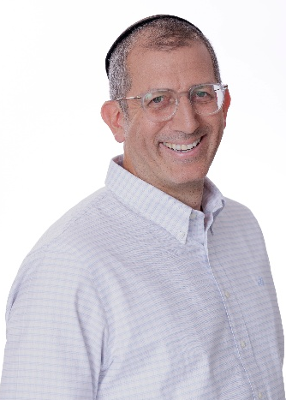
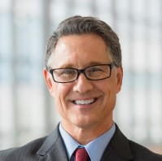
ENGAGEMENT TEAM
CURRENT ROLE AT BDO:
Tzvika Gross is leading the BSO services in Israel, for both global and domestic companies. The BSO group provides a variety of outsourcing services to the rapid growing tech eco-system in Israel, as well as to global companies operating in Israel, admin and accounting services to venture capital and PE funds.
RELEVANT EXPERIENCE:
Tzvika Gross is a certified public accountant in Israel, with a bachelor's degree in computer science, and an M.BA from the Hebrew University in Finance, Banking and Information systems.
Tzvika has been with BDO since 2012 developing the outsourcing practice of BDO Israel. His knowledge and broad experience as both auditor and advisor, as well as a CTO to several tech and telecom companies, were significant in the transformation of the BSO services in Israel into a technology and automation driven processes, with first in line professional standards, and cutting-edge quality control measures.
Tzvika has developed the Global Outsourcing Services group to provide a holistic solution to global corporations operating in Israel, for all the relevant aspects, e.g. tax, compliance, secretarial, and legal.
Tzvika established the Fund Accounting and Admin Services group, as part of the BSO provisioning, utilizing unique know-how and practices, while developing and deploying proprietary BDO information systems to enhance Investor Relations services for the Fund Admin group.
Tzvika's combined experience in both accounting and technology, positioned him as the leading partner for the Blockchain and Crypto task force of BDO Israel.
Tzvika Gross
C.P.A (Israel)
Head of Global Outsourcing Services
Technology & Life Sciences | Fintech and Blockchain
Partner
T: +972 [3 – 638 – 4307]
M: +972 [54 – 522 - 7841]
TzvikaG@bdo.co.il
13

