Slide 1
Finding Best Location in New York City for opening a Japanese Sushi Resturant

Slide 2
Introduction
New York City's demographics show that it is a large and ethnically diverse metropolis. It is the largest city in the United States with a long history of international immigration. New York City was home to nearly 8.5 million people in 2014, accounting for over 40% of the population of New York State and a slightly lower percentage of the New York metropolitan area, home to approximately 23.6 million. Over the last decade the city has been growing faster than the region. The New York region continues to be by far the leading metropolitan gateway for legal immigrants admitted into the United States.
With the diverse culture, there are many resturants in New york City, each beloning to different categories like Chinese, Japanese, and French etc.
This project visualizes the great Japanese sushi resturants in New York City.

Slide 3
Business Problem
My client wants to open his business in NYC, so I focus on that borough during my analysis. We define potential neighborhood based on the number of sushi bars which are operating right in each neighborhood.
This client thinks that Manhattan has full potential but also is a very challenging district to open a business because of high competition. New sushi bar should be open in an area that inadequate neighborhood in this way the bar can attract more customers.
This analysis is necessary to ensure that we have enough customers and that we are not so close to other sushi places. We will ultize the data methodology and analysis to find a optimal solutio for this client.

Slide 4
Data
New York City data that contains list Boroughs, Neighborhoods along with their latitude and longitude. Data source : https://cocl.us/new_york_dataset Description : This data set contains the required information. And we will use this data set to explore various neighborhoods of new york city.
Japanese resturants in each neighborhood of new york city. Data source : Fousquare API Description : By using this api we will get all the venues in each neighborhood. We can filter these venues to get only Japanese resturants.
GeoSpace data Data source : https://data.cityofnewyork.us/City-Government/Borough-Boundaries/tqmj-j8zm Description : By using this geo space data we will get the New york Borough boundaries that will help us visualize choropleth map.

Slide 5
Approach
Collect the new york city data from https://cocl.us/new_york_dataset
Using FourSquare API we will find all venues for each neighborhood.
Filter out all venues that are Japanese Resturants.
Find rating , tips and like count for each Japanese Resturants using FourSquare API.
Using rating for each resturant , we will sort that data.
Visualize the Ranking of neighborhoods using folium library(python)

Slide 6
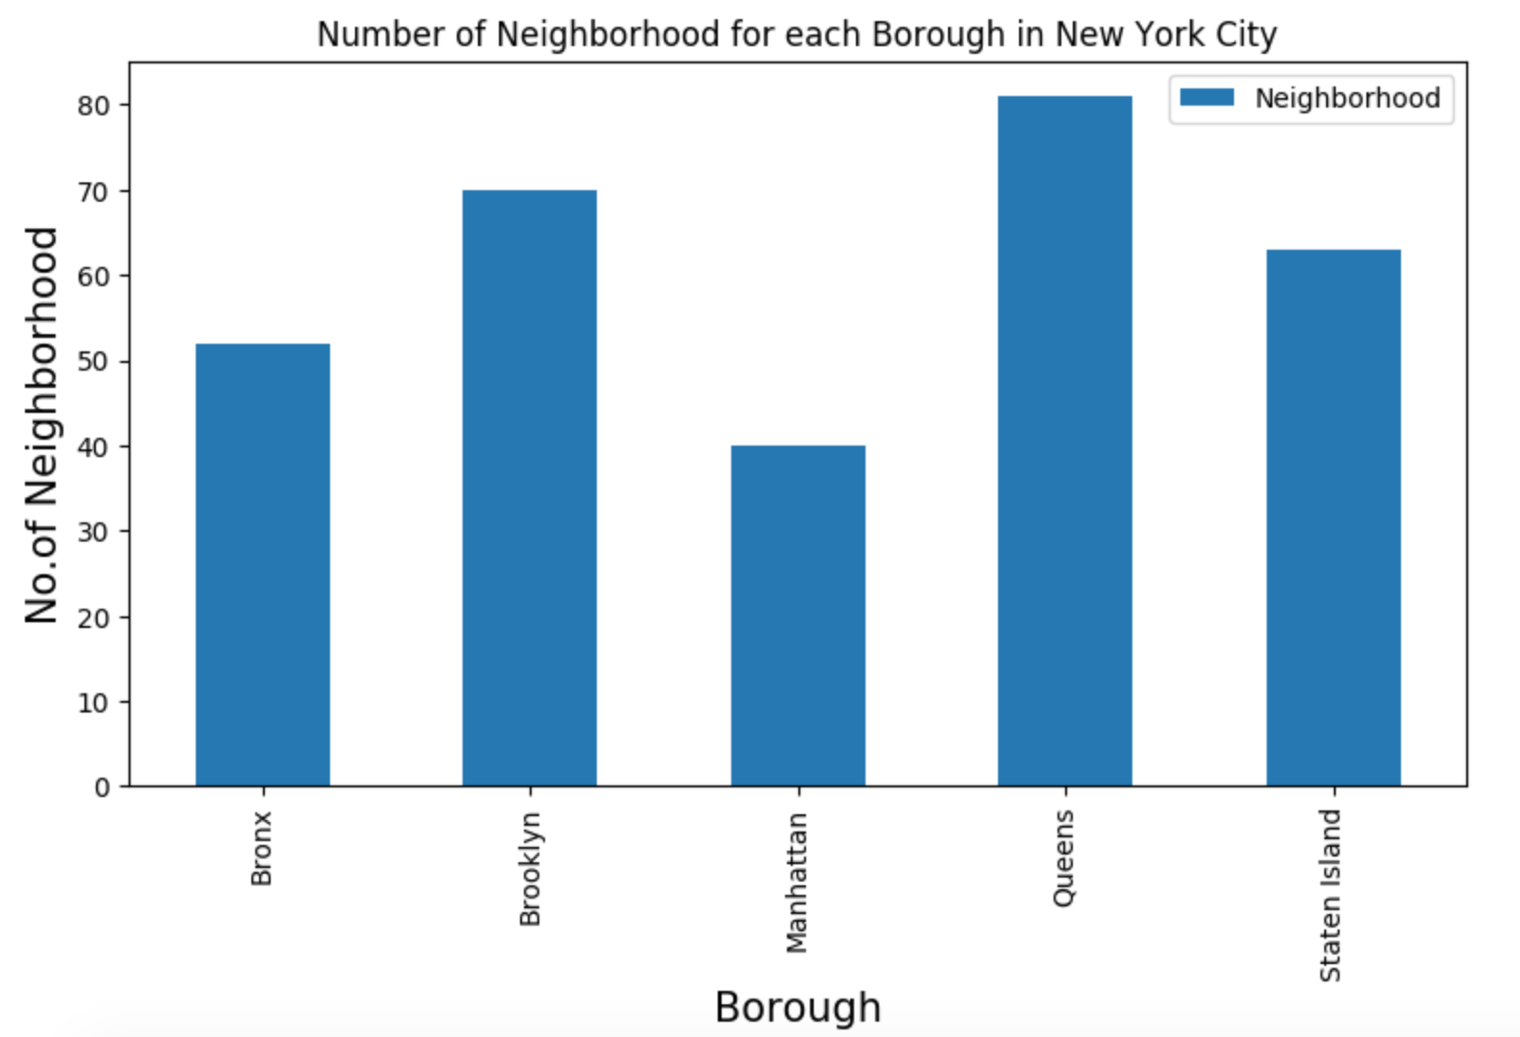
Exploratory Data Analysis
There are total of 306 different neighborhood in New York.
Queens has highest number of neighborhoods in New Yrok.
Manhattan has lowest number of
neighborhood in New York.

Slide 7

Exploratory Data Analysis
To identify the characteristics of our competitors' venues in Manhattan, we would first need to find out the number of sushi bars in Manhattan currently and their location.
We then used Google Map API to find their geographic coordinates based on their postal code addresses.
In Manhattan, there is 1763 sushi bars are currently operating.

Slide 8
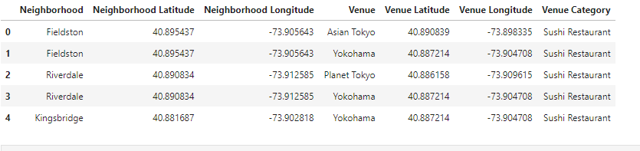
Exploratory Data Analysis
Next, we also used Google Map API to find their geographic coordinates of the 5 locations shortlisted for our sushi bar:

Slide 9
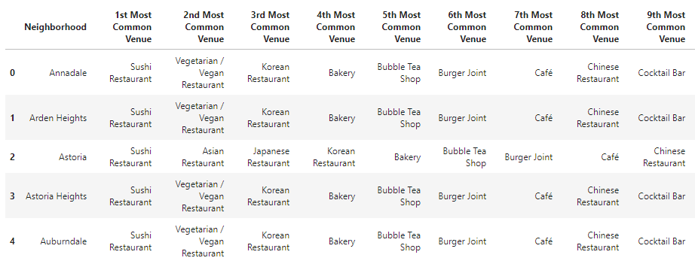
Exploratory Data Analysis
Addresses are converted into their equivalent latitude and longitude values.
Foursquare API is used to explore neighborhoods in Manhattan, New York.
Explore function to get sushi restaurant categories in each neighborhood.
Using this feature to group the neighborhoods into clusters K-means clustering algorithm.

Slide 10
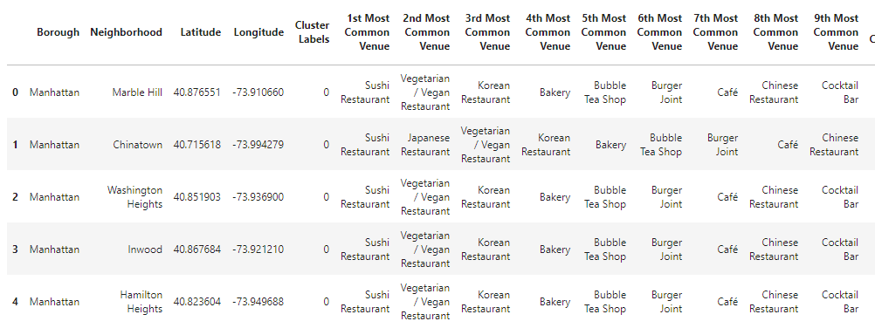
Exploratory Data Analysis
Using K-mean to clustering data area with less number of sushi bars in 5 clusters.
Cluster 0

Slide 11
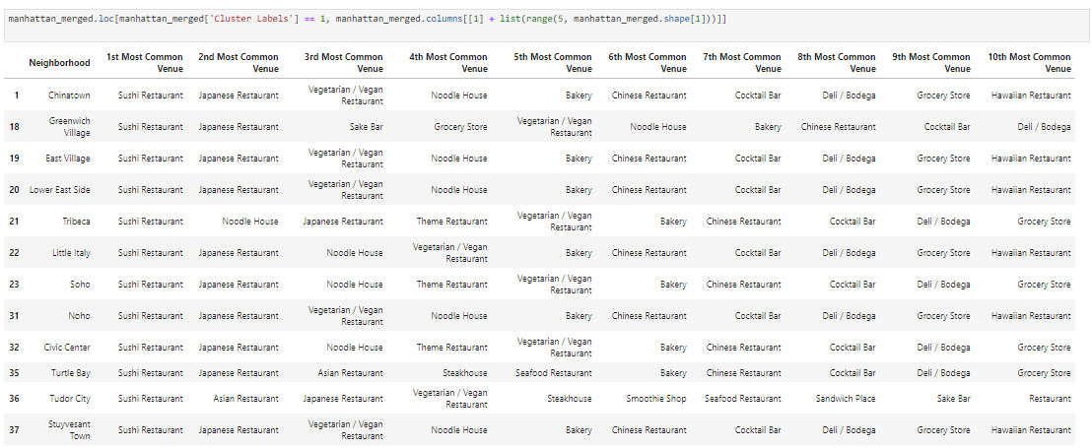
Exploratory Data Analysis
Cluster 1

Slide 12
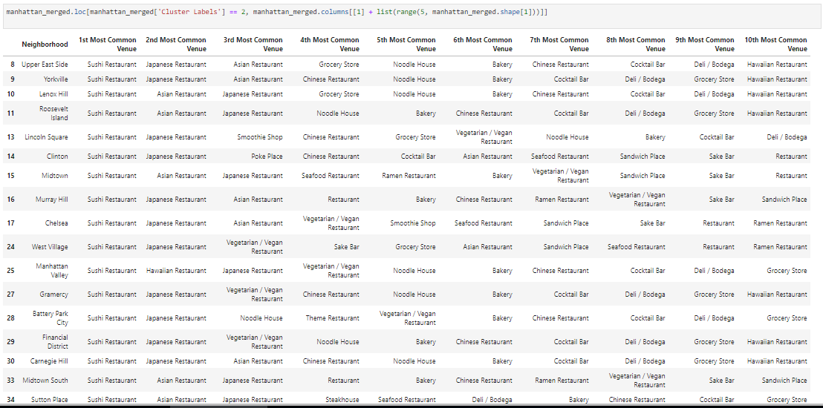
Exploratory Data Analysis
Cluster 2

Slide 13
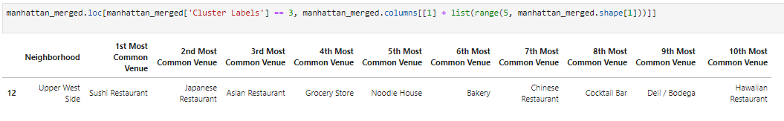
Exploratory Data Analysis
Cluster 3

Slide 14
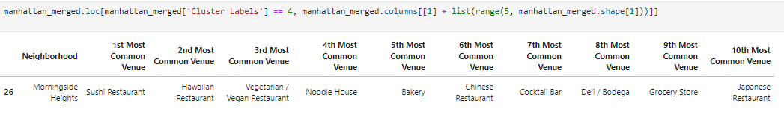
Exploratory Data Analysis
Cluster 4

Slide 15
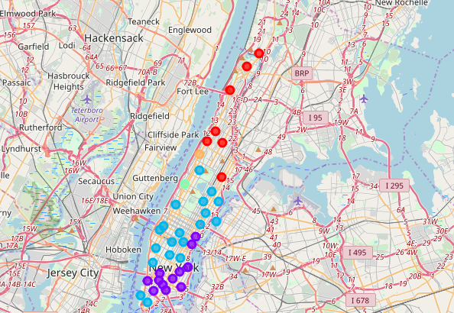
Exploratory Data Analysis
Cluster Map
Based on dataframe analysis above Cluster 3 (Upper West Side ) and Cluster 4 (Morningside Heights) areas are the best places to open a new sushi bar business, because it has less competivies resturants in the areas. On the map, we can alsod see that the cluster 3 and cluster 4 areas have less colored dots(represents #of sushi resturants) in the areas.

Slide 16
Discussion
There is high competition in Midtown and Soho because there are more Japanese sushi restaurants are currently open in the areas than the other part of the NYC. Therefore, it is very risky and competitive to open a new business in these two areas.
However, the Central Harlem has potentials to start the sushi business where it closes to Morningside Heights area. It can be done more detailed analysis by adding other factors such as transportation, demographics of inhabitants.
This analysis is performed on limited data. There might be different scope to come up with better results.

Slide 17
Conclusion
With different aspects to support the opening a business idea in an unknown location, there might be different solution to the problem. From my point of view, the sushi restaurant should opened a less competitive area, because it might attract the other side of NYC residents.
Some might think to open all similar restaurant at the same area might have a mutual beneficial effect such that people will remember this area is really famous for the sushi place. For instance, some cities will have the Japanese town.
Location is very crucial to the new restaurant business. More importantly, the success likelihood of opening a new sushi restaurant in New York city is also depend of the menu and recipe.

