Slide 1
CrowdValue A prediction model for “crowdsourced fundamental analysis” Jason Rosenfeld
View full source code Jupyter Notebook here (WIP):
http://localhost:8888/notebooks/Desktop/VIC%20Project/code/Analysis.ipynb

Slide 2
The sum of a group of investors is greater than its parts
Can professional investors outperform the market?
Yes!* (*not accounting for risk)
Using investor forums, we can test this hypothesis
We will use ValueInvestorsClub.com
Can we compile the theses of professional investors to perform even better?
Crowdsourcing casts a wider net of investment write-ups
A machine learning algorithm identifies the best ones
Previous “literature”: Do Hedge Fund Managers Have Stock-Picking Skills? http://www.retailinvestor.org/pdf/HedgeFund.pdf

Slide 3
ValueInvestorsClub.com (VIC)
What is ValueInvestorsClub?
Private access, members only investment forum
~800 users
Members must post at least 2 investment ideas per year
Members vote on quality of other investment ideas and comment on write-ups

Slide 4
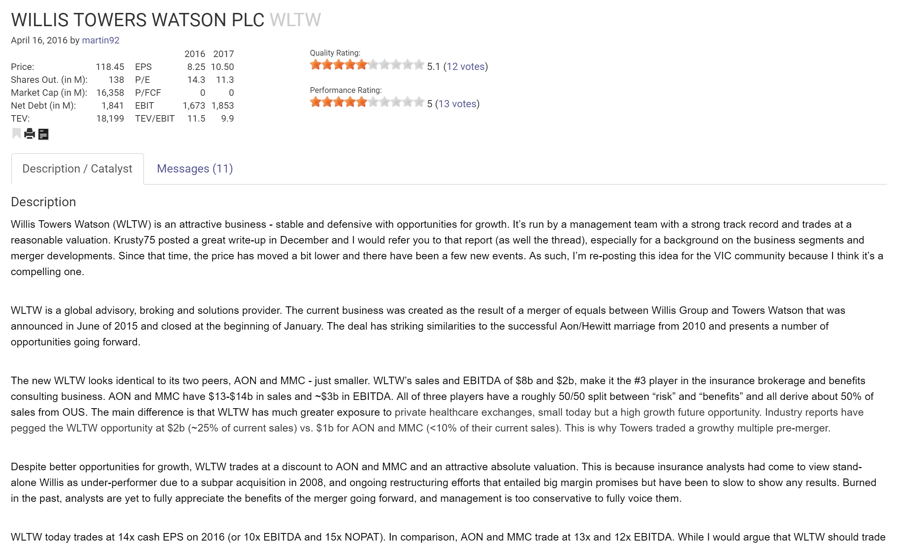
Typical investment write-up
Ticker
Community ratings
Fundamental data
Thesis

Slide 5
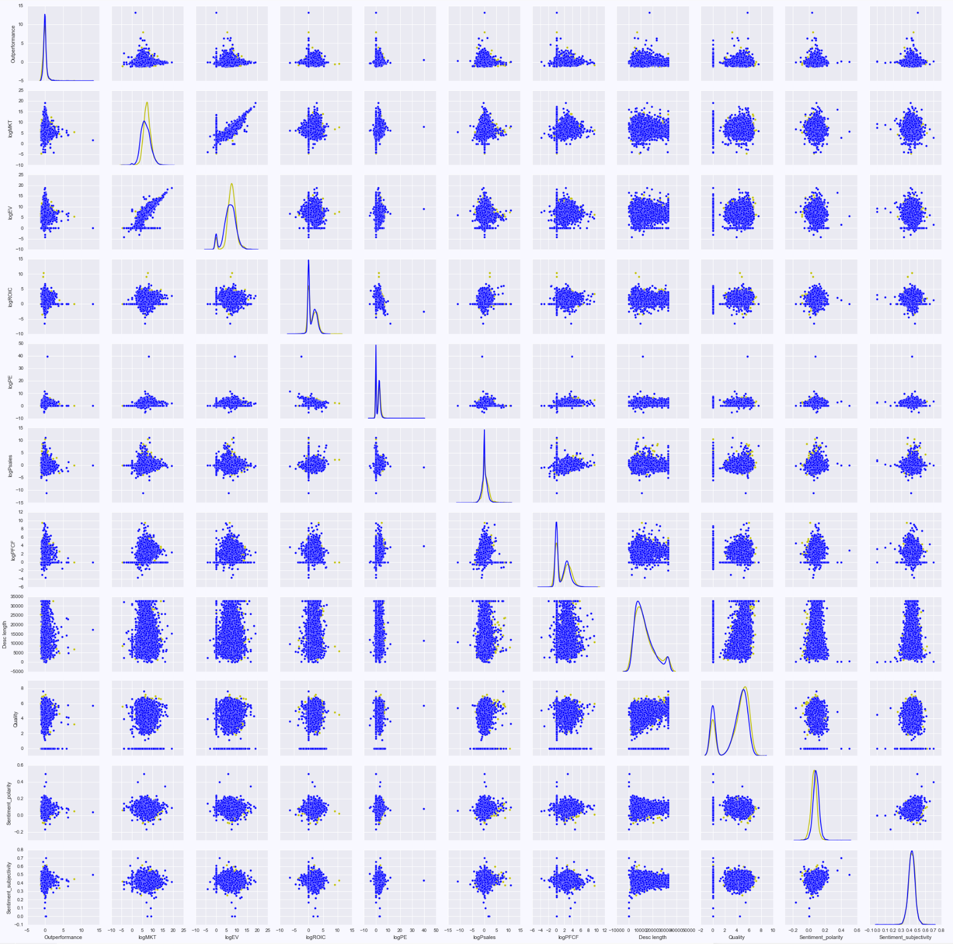
A treasure trove of data
~5,000 investment write-ups
Data includes:
Market cap, Enterprise value
Write-up text (i.e. investment thesis)
Valuation metrics (e.g. P/E, ROIC)
One year performance vs. S&P500
Bi-modal normal distributions
Often random correlation
…let’s take a closer look

Slide 6
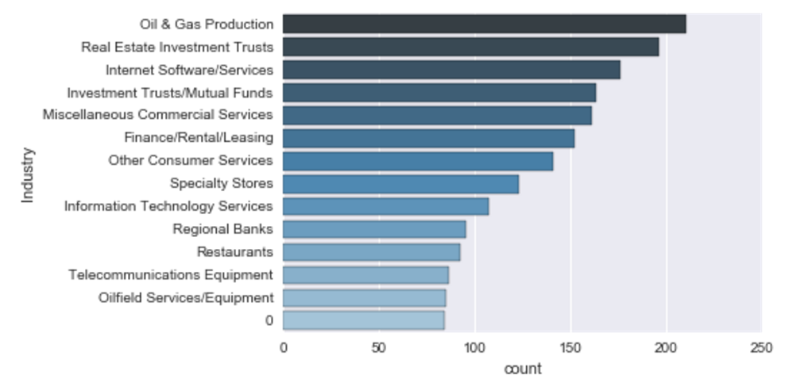
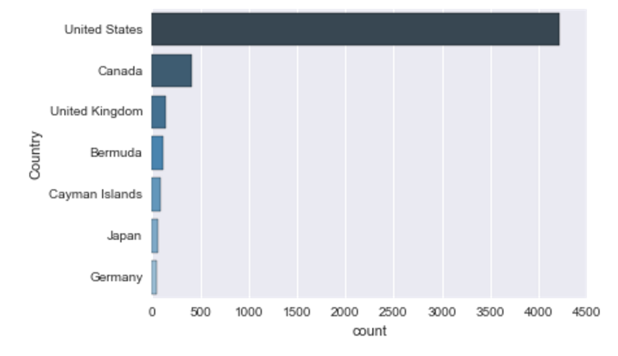
Quick facts about the write-ups
Industry
Country

Slide 7
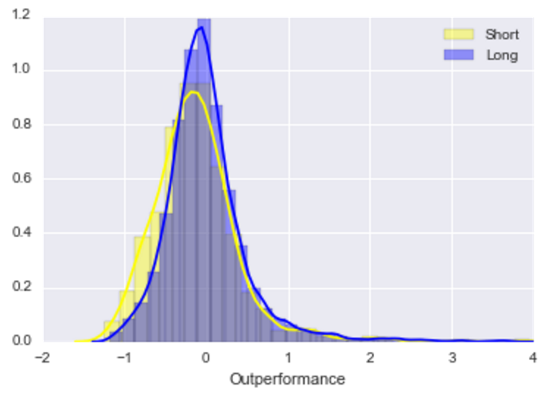
VIC members outperform the market, on average
1-year returns vs. S&P 500
Buy and hold for one year
Long Write-ups (blue)
Mean outperformance: 0.88%
Percent outperformed: 42.9%
Write-up sample size: 4,285
Short Write-ups (yellow)
Mean outperformance: (11.5)%
Percent outperformed: 34.12%
Write-up sample size: 800
Underperformed
Outperformed

Slide 8
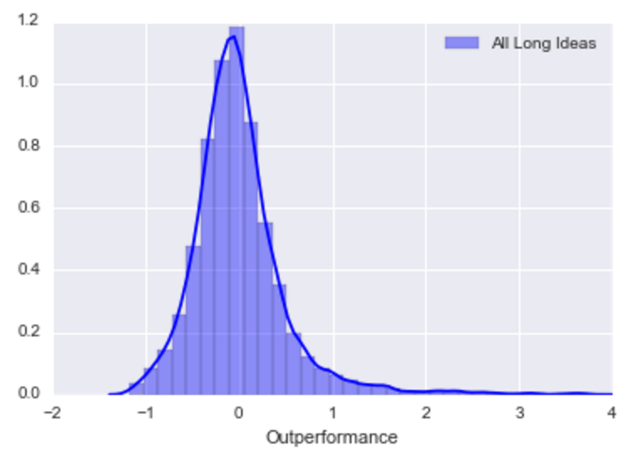
Identifying VIC’s best ideas
1-year returns vs. S&P 500
What makes one investment idea better than another?
We will only look at longs
We already have the data
Let’s use machine learning to do the dirty work
Outperformed
What do these write-ups have in common?

Slide 9
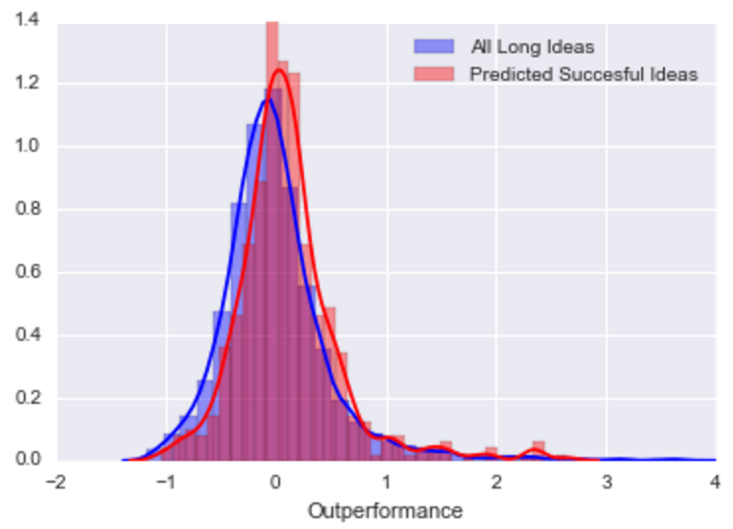
Our model can identify succesful write-ups
Using machine learning, we were able to identify likely outperformers as soon as they were posted, improving average outperformance by almost 10%.
All long write-ups (blue)
Mean outperformance: 0.88%
# of write-ups: 4285
Prediction model (red)
Mean outperformance: 10.53%
# of write-ups: 446
Model vs. All VIC Ideas
Notice how the model’s (red) distribution is “pushed” to the right compared to that of the original (blue)

Slide 10
Machine learning makes the crowd smarter
“Use machine learning to take data and do something that is better than what the humans are doing. Take the human crowdsourced data and you’re going to compute something new.”
-Eric Schmidt

Slide 11
Thanks
Send questions and comments
Contact: JRosen.1392@gmail.com

Slide 12
Appendix: model exploration
Features:
TF-IDF (n-grams), valuation metrics, sentiment, etc
Target:
Outperformed (0 or 1)
3 or 5 fold cross validation
1) Random Forest Classifier
Number of estimators: 400
ROC AUC score: 0.56 – 0.60
2) AdaBoost Classifier
Number of estimators: 50
ROC AUC score: 0.54 – 0.55
3) Naïve Bayes Classifier
Number of estimators: 50
ROC AUC score: 0.54 – 0.55
4) Neural Network Classifier
Work in progress

Slide 13
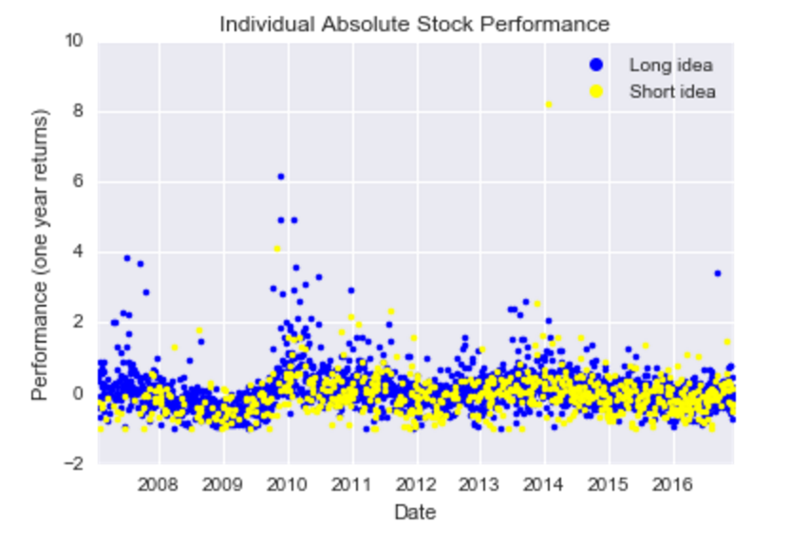
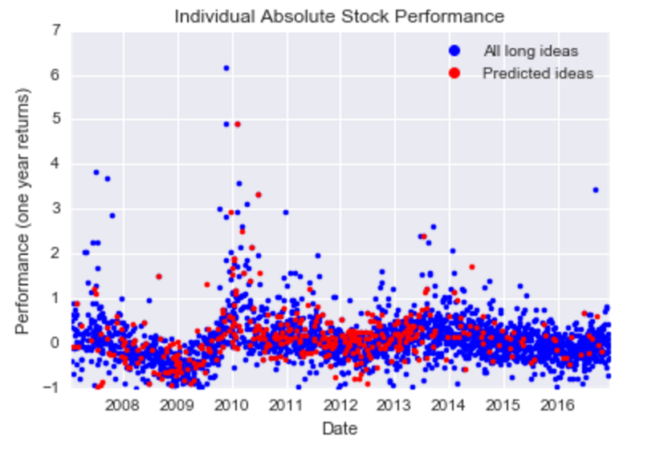
Appendix: misc visualization
All write-ups
Random Forest Classifier predictions

Slide 14
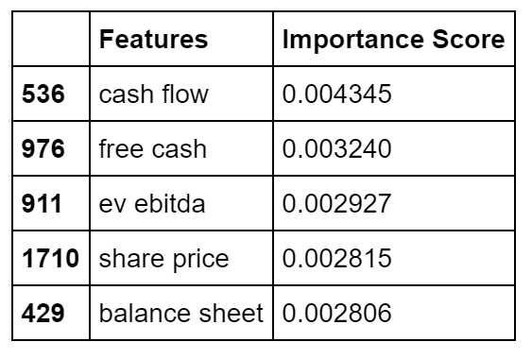
Appendix: exploring the model
Black-box models make it difficult to interpret how features/variables are being used to classify each write-up
Important features include:
Various text weightings of cash flow references
Various text weightings of valuation terms
Misc. valuation metrics
“Important” Features

Slide 15
Appendix: future steps
Extra model tuning
Feature engineering
Regression vs. Classification
Continuous model return (+XX%) vs. Discrete outperform (y/n)
Minimize error metrics
Time Series
ROI optimization
More data
Scrape message content
Include more general financial data
Automated trading algorithm
Deploy model into simulated trading environment

Slide 16
Appendix: limitations
Financial Data is expensive and/or often lumpy
Gaps in data make it difficult to use valuation metrics
Lack of free, scalable API
“Exotic” Investments have not been priced
Special Situations, Debt, M&A, Warrants are mostly excluded
No message scraping
Responses to write-ups can be indicators of future outperformance
Write-up descriptions
35,000 word-count max
Sentiment analysis used in model was trained on movie reviews
Sample Size

Slide 17
Sources
ValueInvestorsClub.com
FactSet
Presentation template by SlidesCarnival
Photographs by Unsplash

