Slide 1

DATA MINING MINI PROJECT
Using Data Mining Techniques to Promote Solar Energy for Household Use in Philippine Cities

Slide 2

1
Background
2
Business Problem
3
Methodology
4
Results
5
Conclusion & Recommendation

Slide 3
Background
PH Energy Sources
Solar Energy Potential in PH
The Philippines heavily uses coal as its energy source, accounting for 47% of the energy mix. While renewable energy (hydro, geothermal, wind, solar) accounts 24% of the energy mix.
From a geographic standpoint, the Philippines has a huge potential for solar energy.
Ave. solar radiation ranges from 128 - 203 W/m2 which is equivalent to around 4.5 - 5.5 kWh/m2/day
What is Solar Energy?
Solar energy is a powerful source of energy that can be used to heat, cool, and light homes and businesses.
Solar power is one way to decrease dependence on the increasing and volatile prices of fossil fuels .
Philippines Energy Market (trade.gov)
It’s more sun in the Philippines- Facts & Figures on Solar Energy in the Philippines (doe.gov.ph)

Slide 4
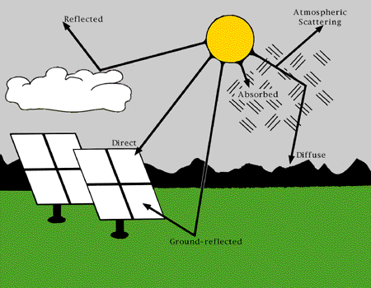


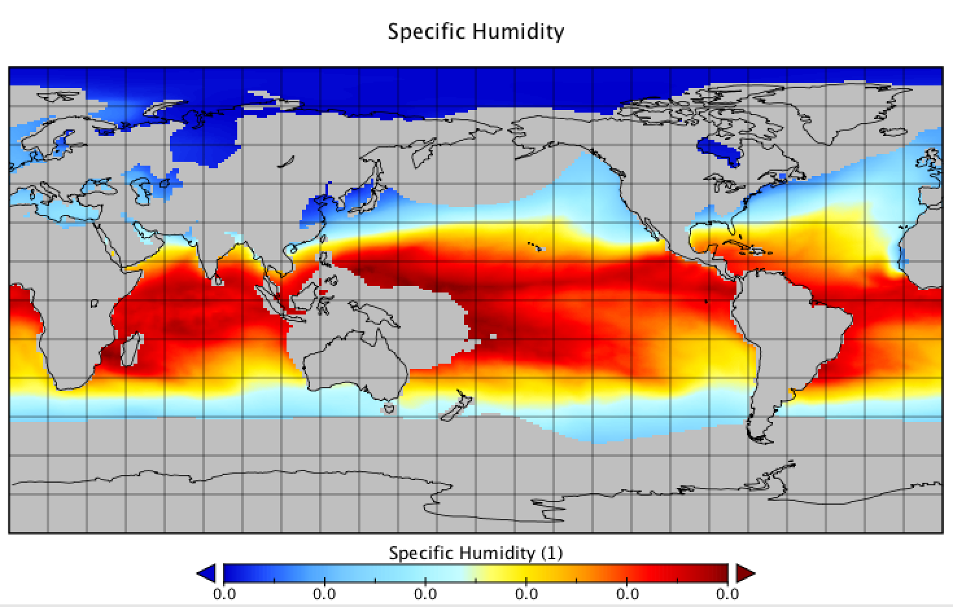
Business
Problem
Using available data on weather and solar irradiation, which cities would benefit the most in harvesting solar energy for their household use?

Slide 5
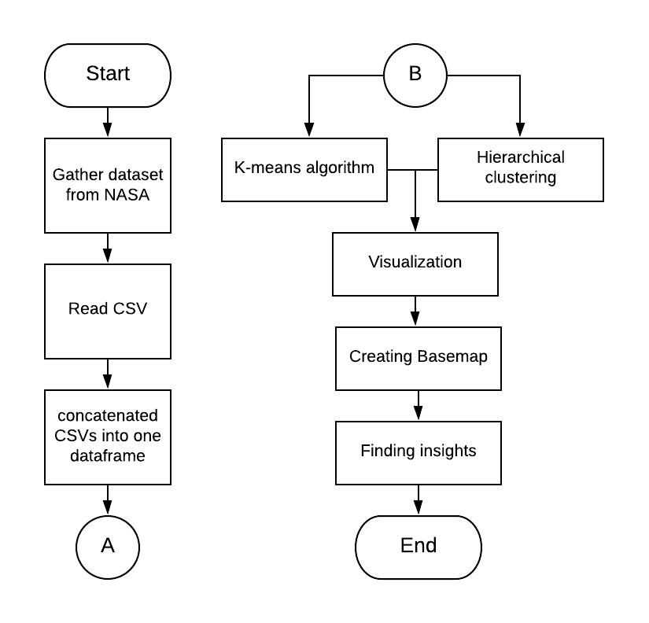
Methodology

Slide 6
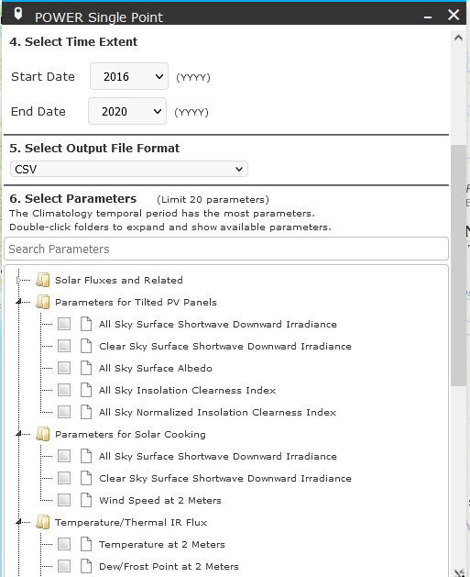
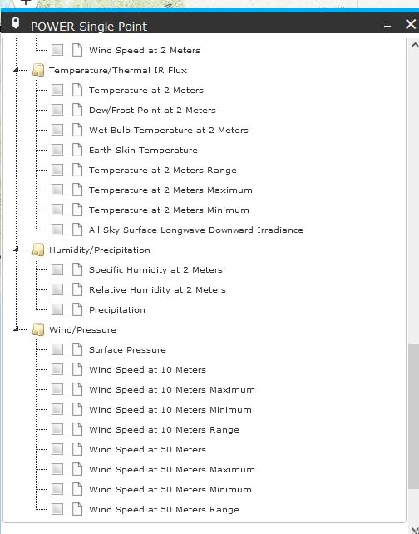
Dataset
NASA’s Prediction of Worldwide Energy Resources (POWER)

Slide 7
Dataset
Features Affecting Solar Panel Performance
Features Affecting Solar Energy Input
Clear Sky Insolation Clearness Index
A fraction representing clearness of the atmosphere
Specific Humidity at 2 Meters
The ratio of the mass of water vapor to the total mass of air at 2 meters (kg water/kg total air).
Temperature at 2 Meters
The average air (dry bulb) temperature at 2 meters above the surface of the earth.
All Sky Surface Shortwave Downward Irradiance
The total solar irradiance incident (direct plus diffuse) on a horizontal plane at the surface of the earth under all sky conditions.
An alternative term is "Global Horizontal Irradiance" or GHI.

Slide 8
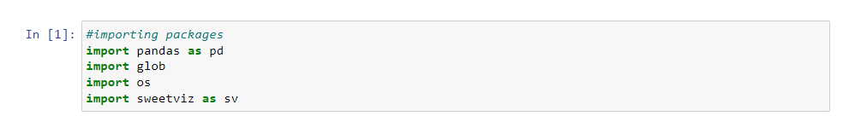
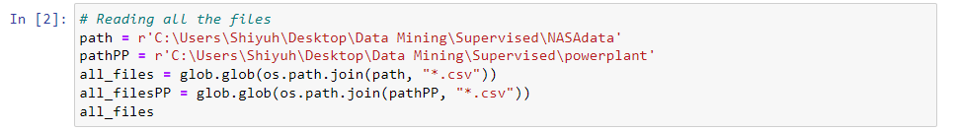
Data Cleaning
Reading all the required Packages
Opening all the csv files

Slide 9
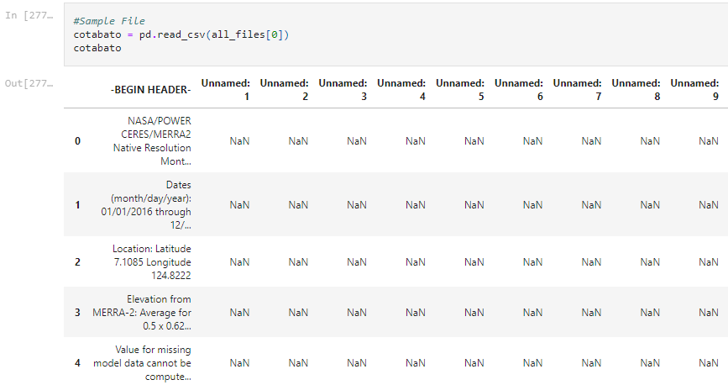
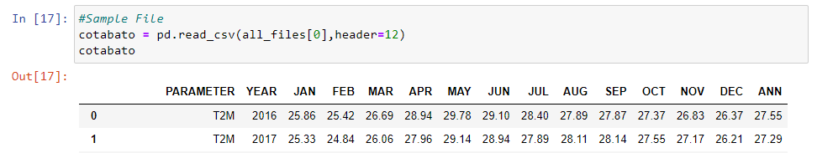
Data Cleaning
Data are not properly parsed
Header & Values are displayed; NA values do not exist

Slide 10

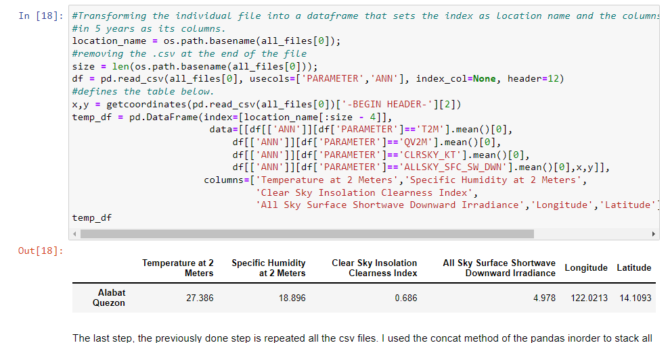
Data Transformation
Location as Index
Column is Ave. of annual value of each parameter

Slide 11
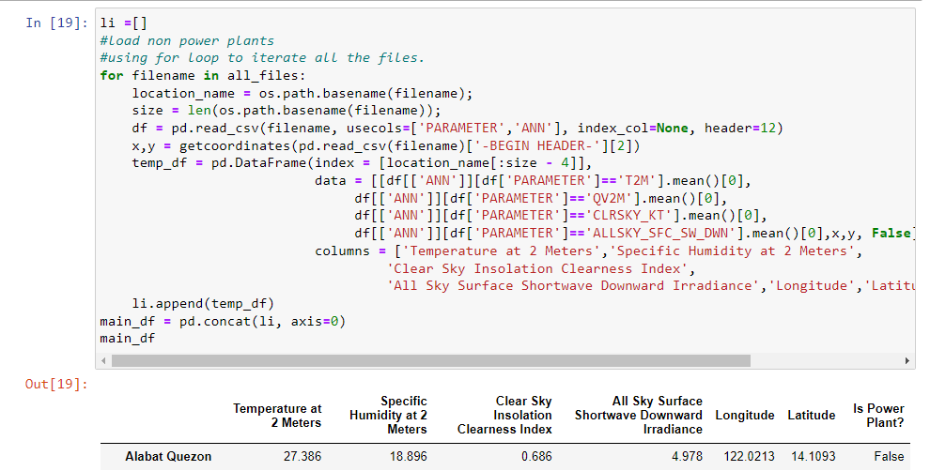
Data Transformation
Stack all the data frame into one data frame

Slide 12
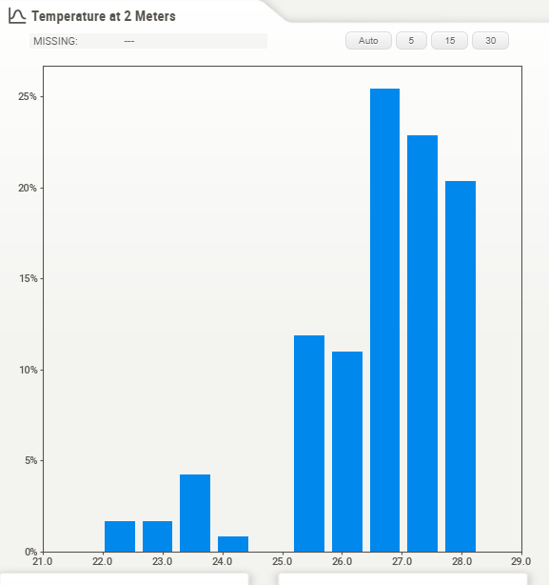
Exploring the data
The histogram for Temperature at 2M above sea level shows that most locations in our dataset have average recorded temperatures at around 26-28degC.

Slide 13
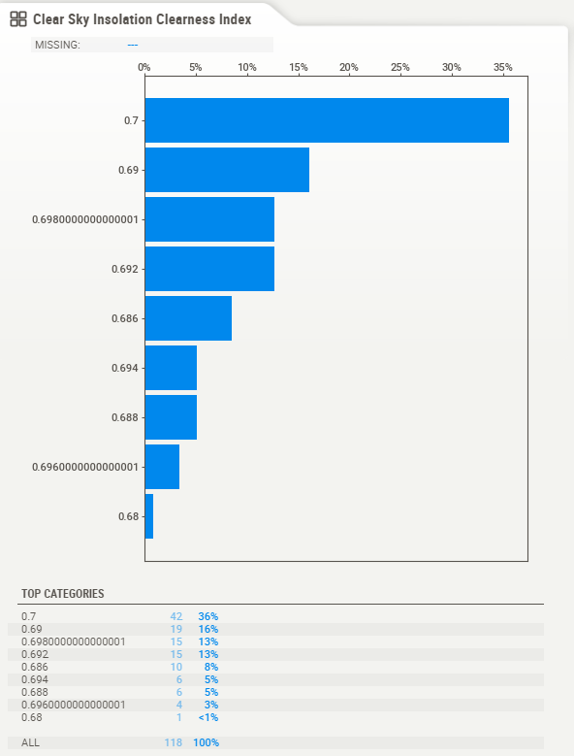
Exploring the data
The values for Clear Sky Insolation Clearness Index have a very small range (0.68-0.7). This may mean that clearness of the atmosphere is uniform for all selected locations.

Slide 14
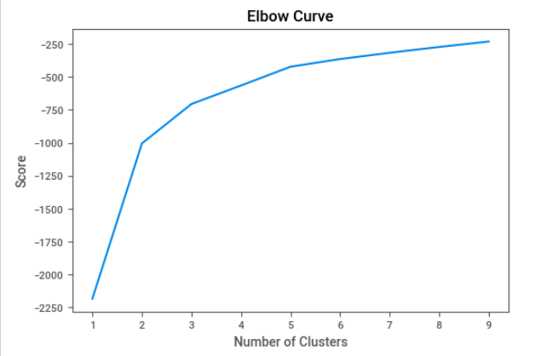
Algorithm
Finding the optimum number of clusters for k-means clustering

Slide 15
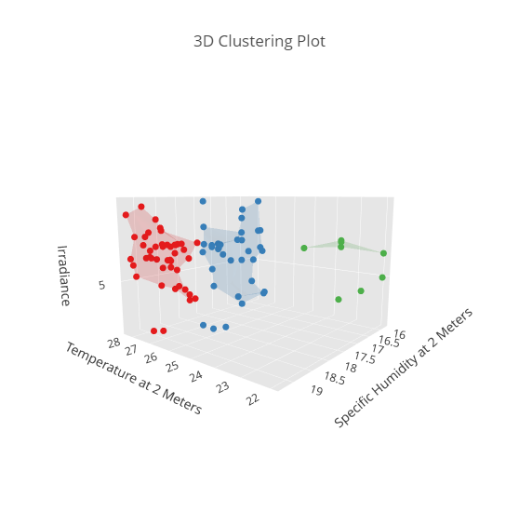
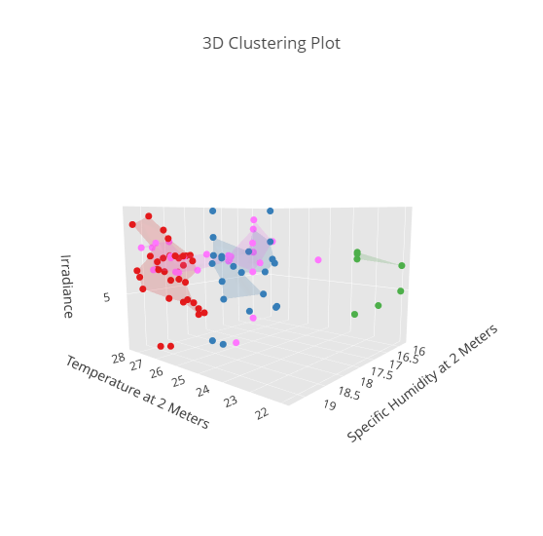
Algorithm
Clustering by K-Means Algorithm (3D Plot)
Clusters
w/Power Plants

Slide 16
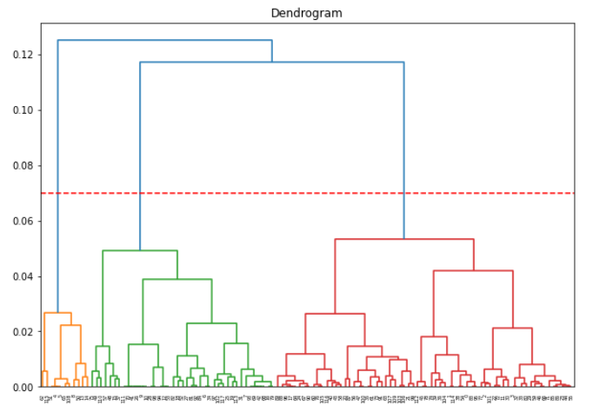
Algorithm
Hierarchical Clustering

Slide 17
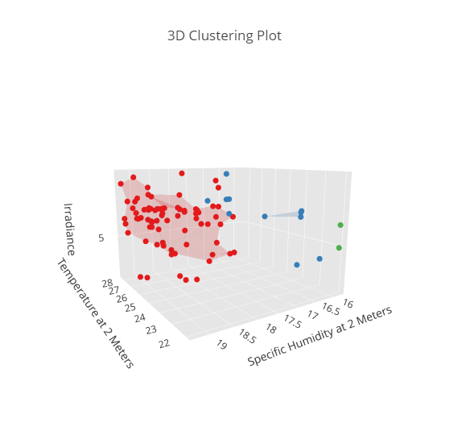
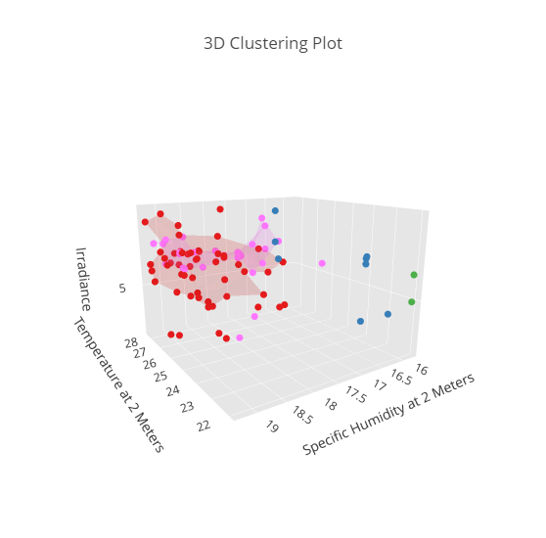
Algorithm
Clustering by Agglomerative Algorithm (3D Plot)
Clusters
w/Power Plants

Slide 18
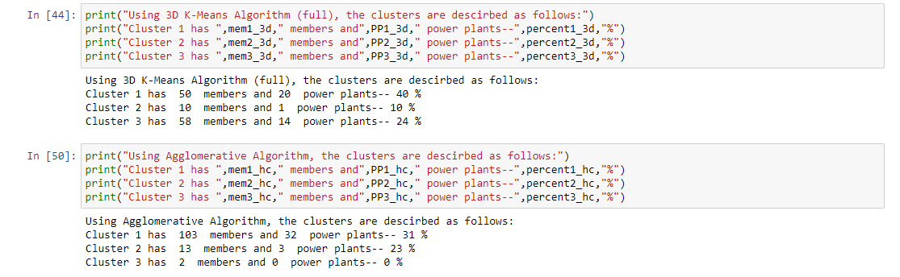
Results

Slide 19
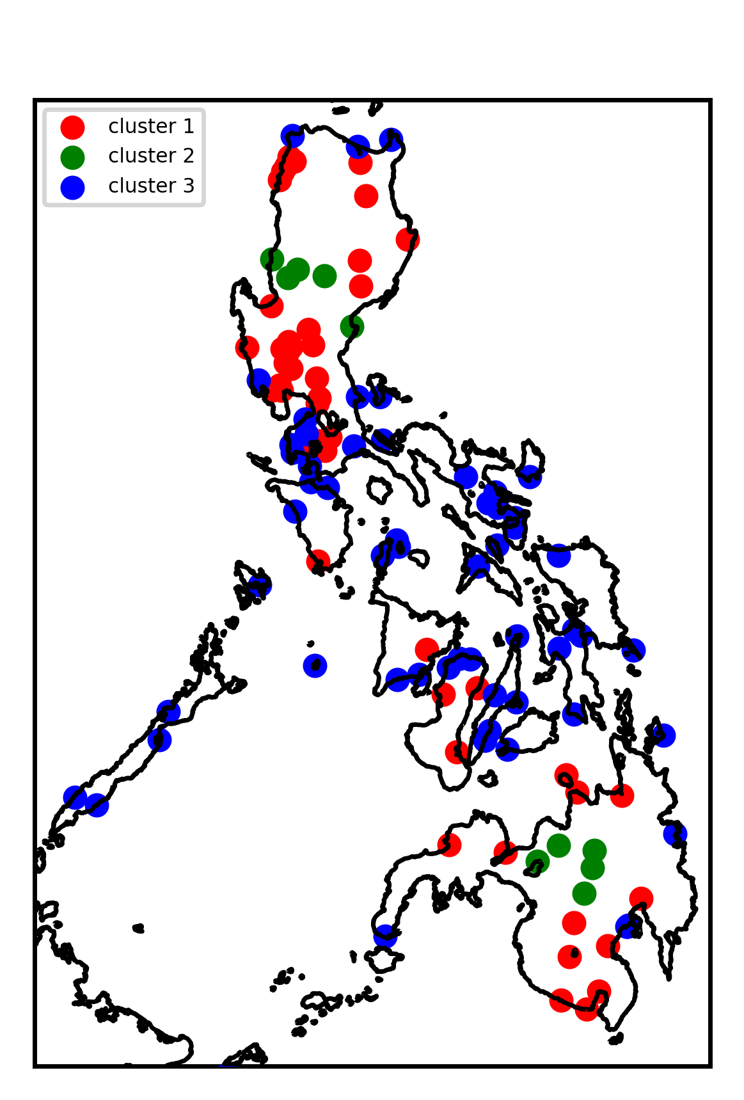
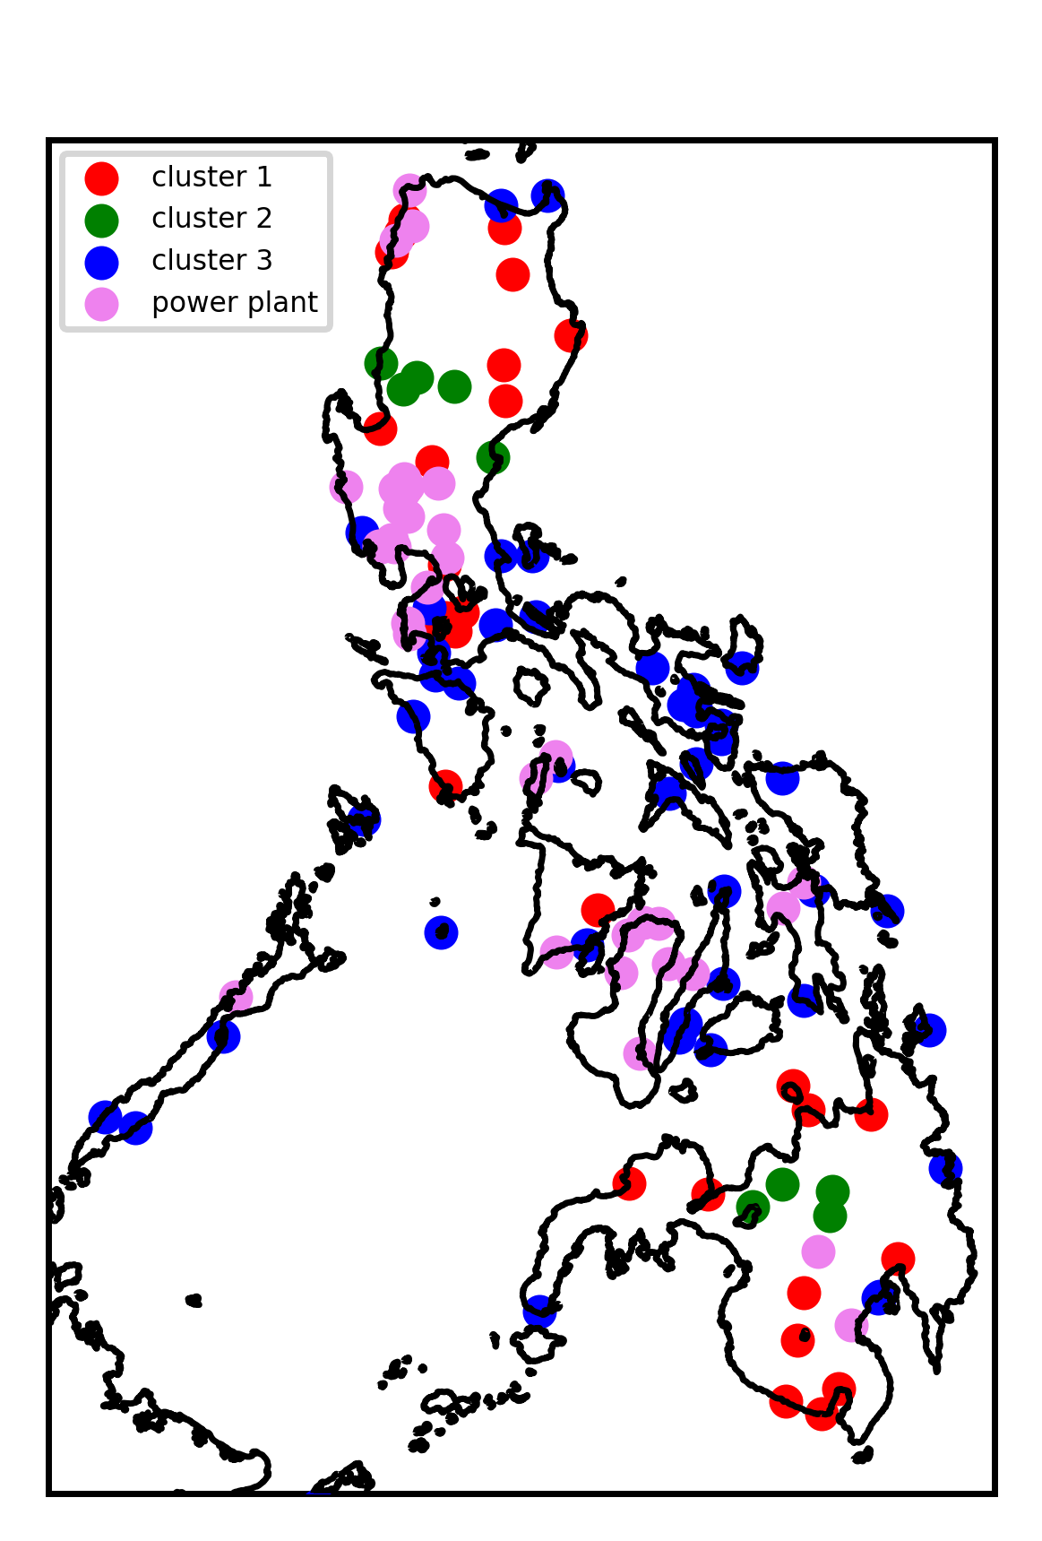
Results

Slide 20
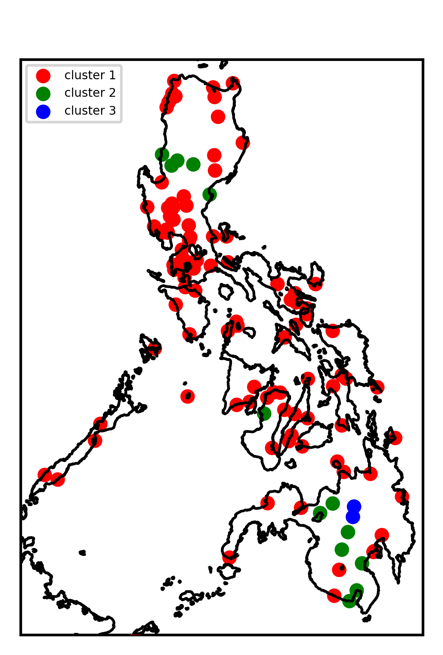
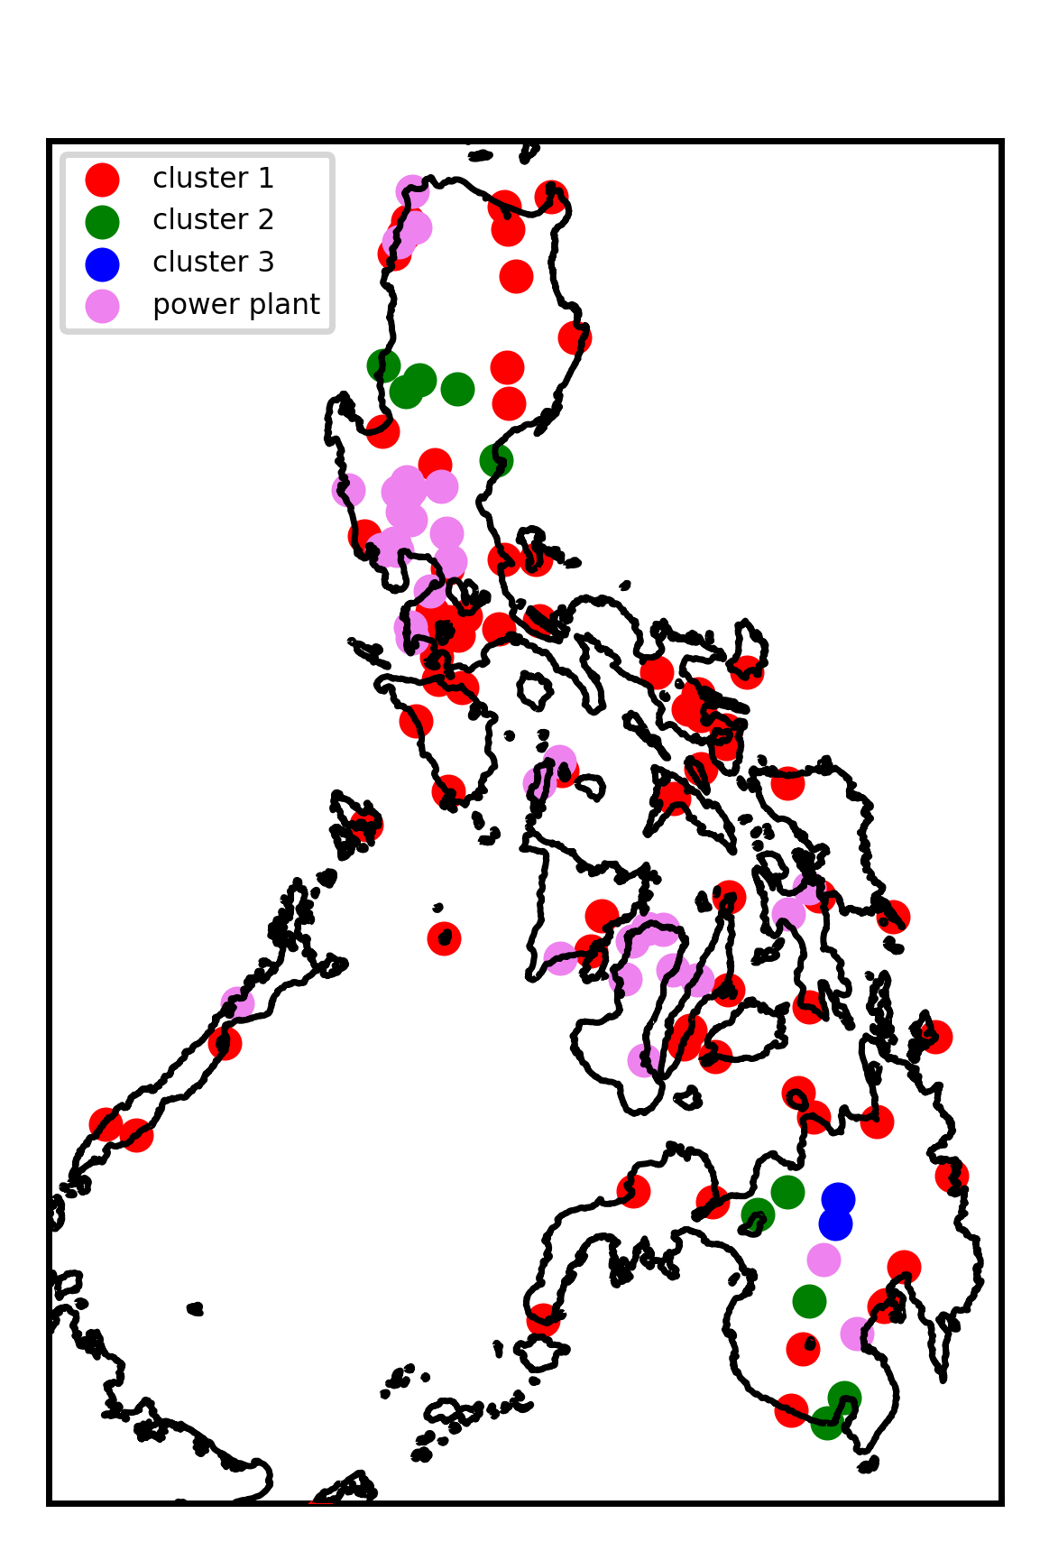
Results

Slide 21
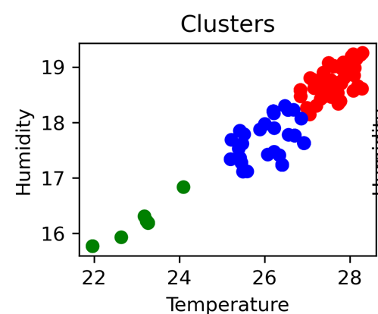
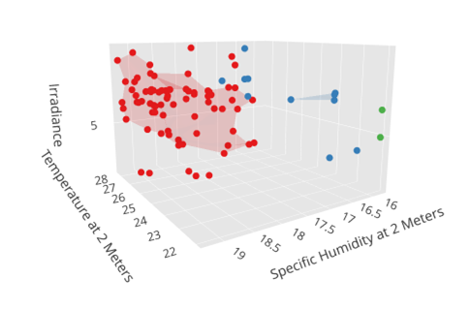
Results
Cluster 1 (Blue)
Ave. recorded temperature: 26.19 C
Humidity: 17.79
Cluster 2 (Green)
Lowest recorded temperature and humidity
Cluster 3 (Red)
most number of locations
highest recorded temperature and humidity
Results under Agglomerative Clustering
Clusters 1 and 2 overlap in terms of
temperature and humidity

Slide 22
Conclusion & Recommendation
Based on our criterion, locations under Cluster 1 would be the best prospects because they share similar features with most solar power plant sites.
It may be more logical to choose locations as prospects for solar installation since most of the locations are geographically close to each other. These are concentrated around the Mimaropa(South Luzon) & Visayas Regions.
The obtained results and methodology used provide datasets for further analysis which will be useful for better assessment of solar panel installation in the country.
The maps give better visualization of the locations which can be useful for the solar industry businesses to find the best spots to market their solar panels.
For future research works, it is recommended to include other factors which affect the solar panel efficiency such as geographic location,local topography and amount of shading in the area, and to factor in the types of solar panels to be used.
It is also recommended to integrate features such as power consumption per city.

Slide 23
Thank
you!

Slide 24

Ochoa, King Matthew
GROUP MEMBERS
Lacbawan, Joy Angeli
Cueto, Mary Grace

