Slide 1
Prism
AI-Powered Incident Management Platform
From telemetry signal to human-approved remediation
Author: Upadhyayula Avinash | October 2026 | NTT DATA

Slide 2
The Operational Challenge
Why existing workflows break under production pressure
Production errors demand immediate, structured investigation -- but teams are overwhelmed.
Logs, source context, ticketing, notifications, and Pull Requests are fragmented, manual steps.
On-call engineers repeat the same investigative patterns for every incident.
There is no consistent, auditable chain from a raw error to a safe, reviewed remediation.
The result: slower MTTR, inconsistent quality, and accountability gaps.

Slide 3
What is Prism?
The platform that closes the gap between alert and remedy
Receives OpenTelemetry log signals from MuleSoft/Anypoint or any compatible application.
Classifies severity, detects technology context, and deduplicates repeated errors automatically.
Uses a configurable LLM to produce a Root Cause Analysis (RCA) with a confidence score.
Generates a concrete code fix, a quality reflection, an RCA PDF report, and a unified patch.
Pauses for a human reviewer to approve, reject, or request a revised fix.
After approval: sends notifications, creates a Jira ticket, opens a GitHub Pull Request.
Automation accelerates
evidence gathering.
People decide what ships.

Slide 4
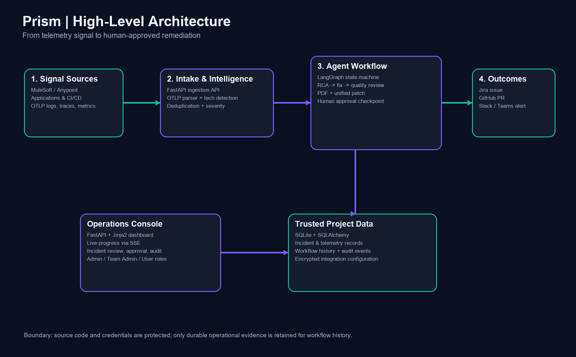
Architecture Overview
Two services, one AI workflow, one shared data store

Slide 5
The 11-Step LangGraph Workflow
Retryable, durable, and pause-safe by design
Pre-approval (automated)
1. assess_severity -- Classify from OTLP signal; fire 'Incident Created' notification
2. generate_rca -- LLM RCA with confidence score; fetches live GitHub/Anypoint context
3. generate_fix -- LLM-generated code fix with explanation
4. generate_pdf -- RCA PDF report saved to data/pdfs/
5. reflect -- Quality scores: correctness, safety, code quality, completeness
6. generate_patch -- Unified .patch file saved to data/patches/
7. await_approval -- PAUSE: human reviews RCA, fix diff, and patch before deciding
Post-approval (automated)
8. send_notifications -- Slack / Teams webhooks (from per-project DB config)
9. create_jira -- Jira ticket, patch attachment, branch/commit/PR synced to DevInfo
10. create_pr -- GitHub branch, commit fixed file, open Pull Request
11. finalize -- Persist final status, timestamps, and all integration artifact URLs

Slide 6
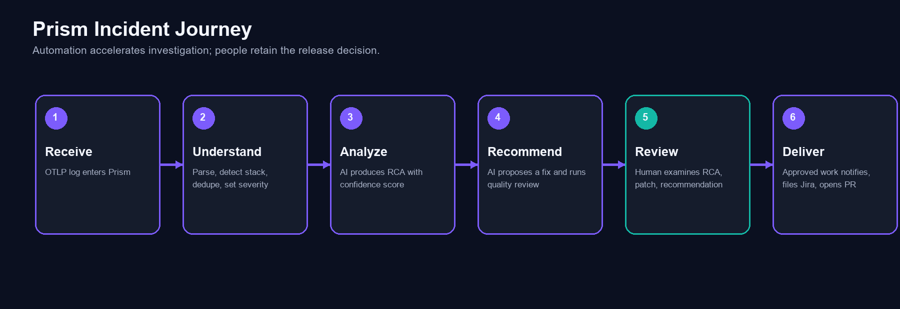
The Incident Journey in Six Stages
Prism accelerates the journey; humans govern the outcome

Slide 7
Core Capabilities
Everything a team needs from alert to remedy
OTLP intake with technology detection
SimHash error deduplication
Severity classification (HIGH / CRITICAL)
LLM-generated RCA with confidence score
LLM-generated code fix and explanation
Quality reflection (4-axis scoring)
Auto-generated RCA PDF report
Downloadable unified diff patch
Approve / reject / regenerate with feedback
Post-approval: Slack/Teams notification
Post-approval: Jira ticket + patch attach
Post-approval: GitHub branch + commit + PR
Durable workflow runs and step events
Governed post-approval recovery
Multi-tenant project isolation
Per-project encrypted credentials
Role-based access (Admin / TA / User)
Security audit trail and CSV export

Slide 8
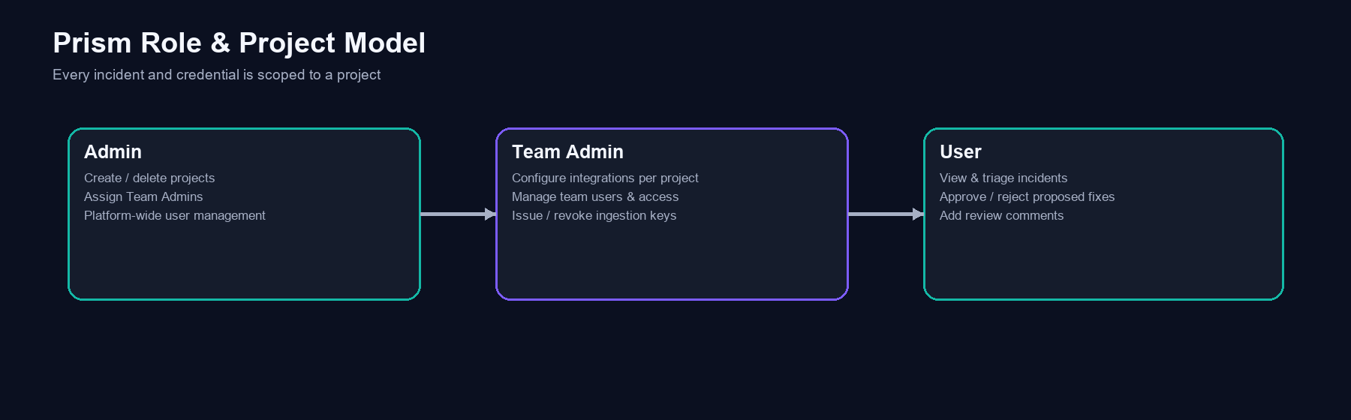
Role, Tenant & Project Model
Clean separation of platform, configuration, and review concerns

Slide 9
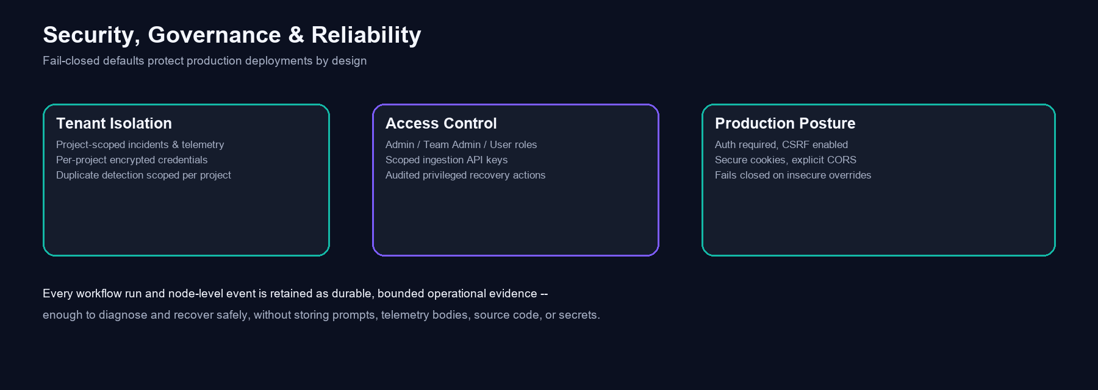
Security, Governance & Reliability
Fail-closed by default; every action is auditable

Slide 10
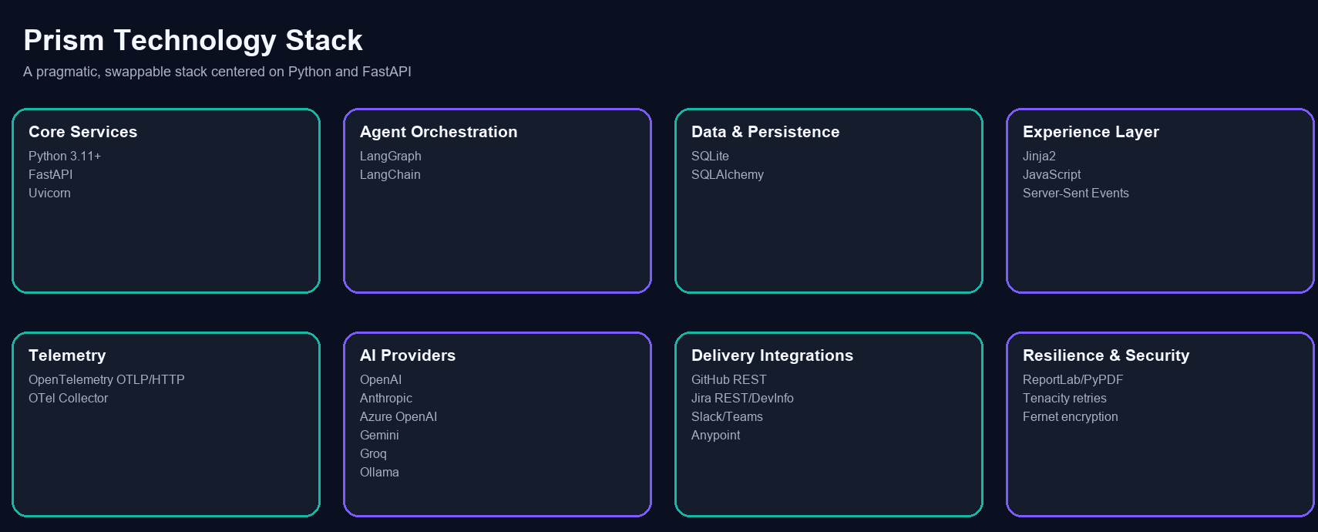
Technology Stack
Pragmatic, proven, and provider-swappable

Slide 11
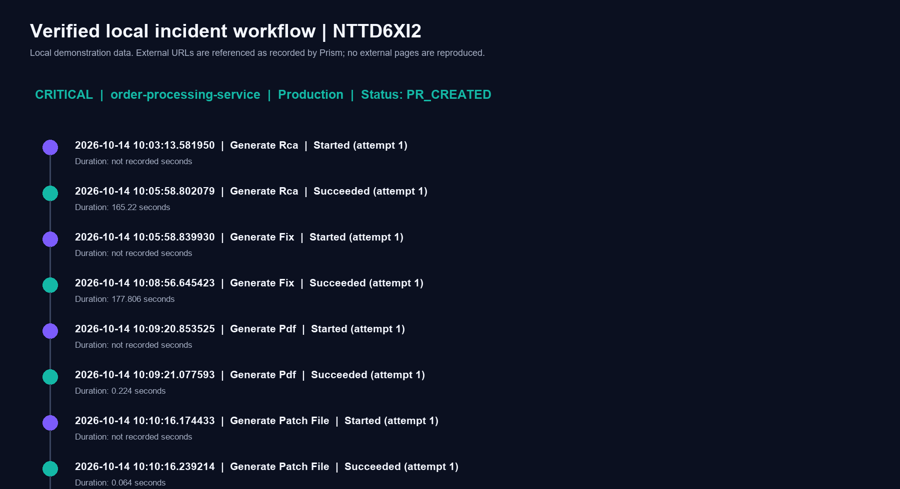
Verified Local Example: Incident NTTD6XI2
Real evidence from the local Prism database
Application: order-processing-service | Environment: Production
Severity: CRITICAL | Status: PR_CREATED | Technology: MuleSoft / DataWeave
RCA confidence: 87.5% | Approval: approved
Jira ticket: SCRUM-12 | GitHub PR: #61
Root cause: DataWeave coercion of a missing orderDate field to Date type caused CRITICAL
production failure. Fix: null-safe existence check with explicit date format.
Full run: RCA generated in 165 s | Fix generated in 178 s | Patch in 0.06 s
Post-approval workflow completed in 65 s | Total: ~7.5 minutes end-to-end.

Slide 12
Integration Model
Every integration is per-project, encrypted, and optional
LLM Provider
OpenAI, Anthropic, Azure OpenAI, Gemini, Groq, or local Ollama
GitHub
Code fetch, branch/commit/PR creation
Jira
Ticket creation, patch attach, DevInfo sync
Slack / Teams
Incident and workflow event notifications
MuleSoft Anypoint
Live CloudHub/ARM runtime context for richer RCA

Slide 13
Current Boundary & Roadmap
Honest about what Prism does and does not do today
What Prism does today
OTLP logs and derived incidents are fully persisted and rendered.
Workflow runs, step events, and security audit records are durable and queryable.
RCA, fix, quality reflection, PDF, and patch are generated when LLM is configured.
Post-approval Jira/GitHub/Slack require valid per-project integration credentials.
Prism is designed to be honest
about its boundaries -- no silent
failures, no fabricated results.
Near-term planned improvements
Trace and metric signals are acknowledged today; full persistence is a planned next step.
Fix proposals require human review; auto-merge is not on the near-term roadmap.
Expanded CI/CD feedback loops and static-analysis signals to improve RCA confidence.

Slide 14
Adoption Path
From zero to a governed, production-ready deployment
1. Deploy Prism with production security settings and a durable, shared encryption key.
2. As admin: create a project and assign a Team Admin.
3. As Team Admin: configure LLM, then optionally GitHub, Jira, Slack/Teams.
4. Issue a project ingestion key; configure collector/gateway to forward OTLP to Prism.
5. Run a controlled first incident: verify RCA quality, approval flow, and downstream delivery.
6. Measure review time, workflow success rate, and remediation quality; tune thresholds.
7. Expand to additional projects and teams with confidence.

Slide 15
Prism
Autonomous evidence gathering. Human accountability.
Automate what machines do well. Reserve decisions for people.
GitHub: https://github.com/u-avinash | LinkedIn: https://www.linkedin.com/in/avinash-upadhyayula/

