Slide 1

ImageNomeR
Image + Genome/Transcriptome Explorer
Anton Orlichenko (Tulane University)
Grant Daly (South Alabama)
Jack Freeman (Colby College)

Slide 2
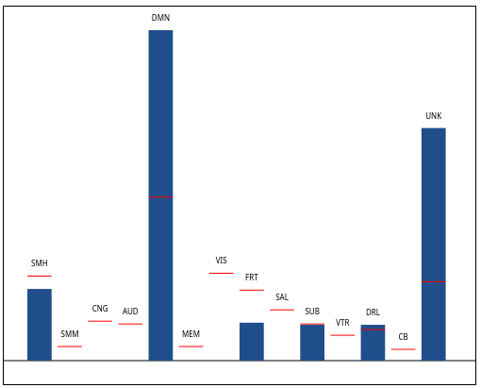
Goals
To facilitate efficient exploration of fMRI/omics data.
Current capabilities:
Convert python analysis to JSON and visualize it in the web browser
Plot a distribution of features
Visualize brain network statistics for fMRI
Brain networks among the top 20 regions (red bars are expected counts)
fMRI = 34,716 connections (14 Brain networks)
Omics = 66,023 gene products

Slide 3
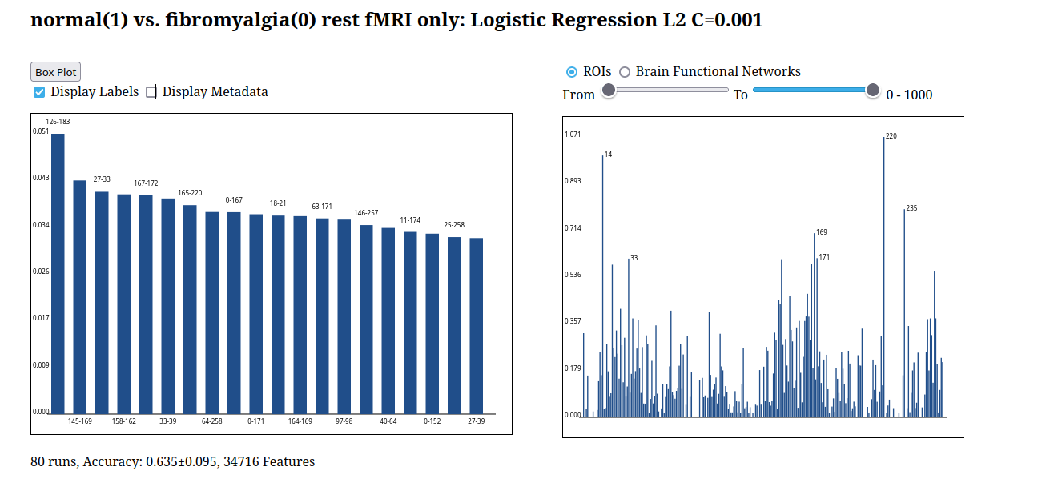
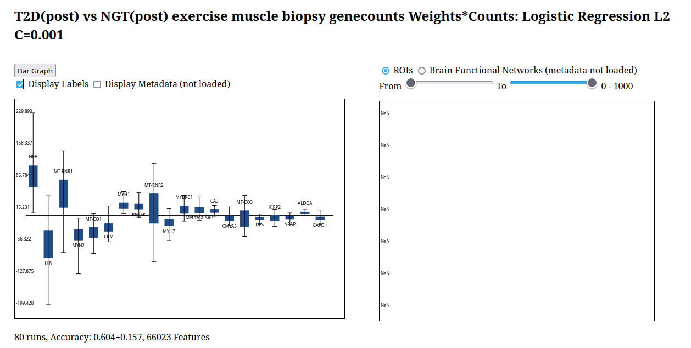
ImageNomeR Screenshots
Bar Graph/fMRI
Box Plot/Gene Counts
http://149.165.159.90/

Slide 4




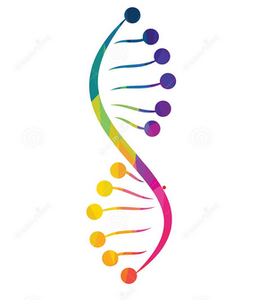

ImageNomeR Architecture
User Model
Python Library
Flask Server
Web Front-end
from imagenomer import \
Analysis, \
JsonData, \
JsonSubjects, \ JsonFCMetadata, \
JsonImage
sudo python flask_backend.py
http://localhost/
ImageNomeR

Slide 5
Datasets + Results
Brain Functional Networks (14 total)
DMN = Default mode network
VIS = Visual network
SMH = Somatomotor network (Hand)
UNK = Uncertain
fMRI dataset:
https://openneuro.org/datasets/ds004144/versions/1.0.1
Fibromyalgia 2-task fMRI, 2 groups
Most discriminative networks (40 runs):
DMN, UNK (weights only)
VIS, SMH, UNK (weights*features)
Gene count dataset:
https://www.ncbi.nlm.nih.gov/geo/query/acc.cgi?acc=GSE202295
Exercise, mRNA, type 2 diabetes, 2 groups
Vastus lateralis biopsy
Most discriminative gene products (80 runs):
NEB, MYH1/2, TTN, MT-CO1
Logistic Regression | 0.64±0.09
MLP | 0.51±0.10
Sparse MLP | 0.56±0.11
Basal | Post | Recovery
0.52±0.16 | 0.60±0.16 | 0.51±0.10

Slide 6
Thank you!

