Slide 1
SNVariome
Team 10
Hackin’ Omics 2022
8/10/2022

Slide 2
Background & Significance
Most existing PPI databases only curate a binary interactome.
integrating protein structure is critical in understanding complex human diseases because variants (GOF/LOF) have significant impacts on protein structure.
Having a more complete interactome will aid in the identification of pathogenic variants and eventually lead to an improvement in diagnostics and potentially therapeutic targeting
SNVariome (Single Nucleotide Variant interactome)
A tool that seeks to integrate protein structure, protein-protein interactions, overexpression signatures, variant data (using ClinVar, GOF/LOF data), and phenotype data (HPO terms) to develop a comprehensive interactome of clinical variants.

Slide 3

Methodology
Extraction of PPI interactions by Bharat Mishra
STRING, Human Interactome I and II, BioPlex, QUBIC, and CoFrac
SigCom LINCS API integration by Maria Jose
Up/Down regulation & expression signatures, perturbation data, tissue-specific data
Development of shiny theme and app structure by Hailey Levi
Selection of tools/packages by Pooja Singaravelu
Implementation of data & tools into shiny app by Shaurita Hutchins
Initial implementation of mygene & SigCom LINCS apis
Experimental design contributions by Bernard Hane
Web app testing by Oladosu Ayodeji

Slide 4
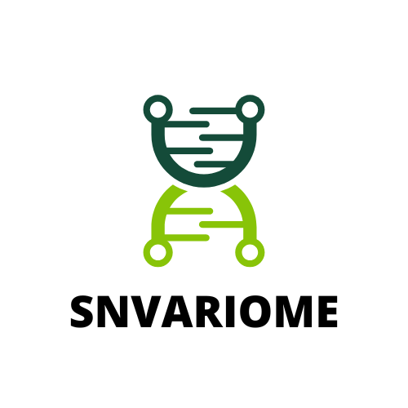
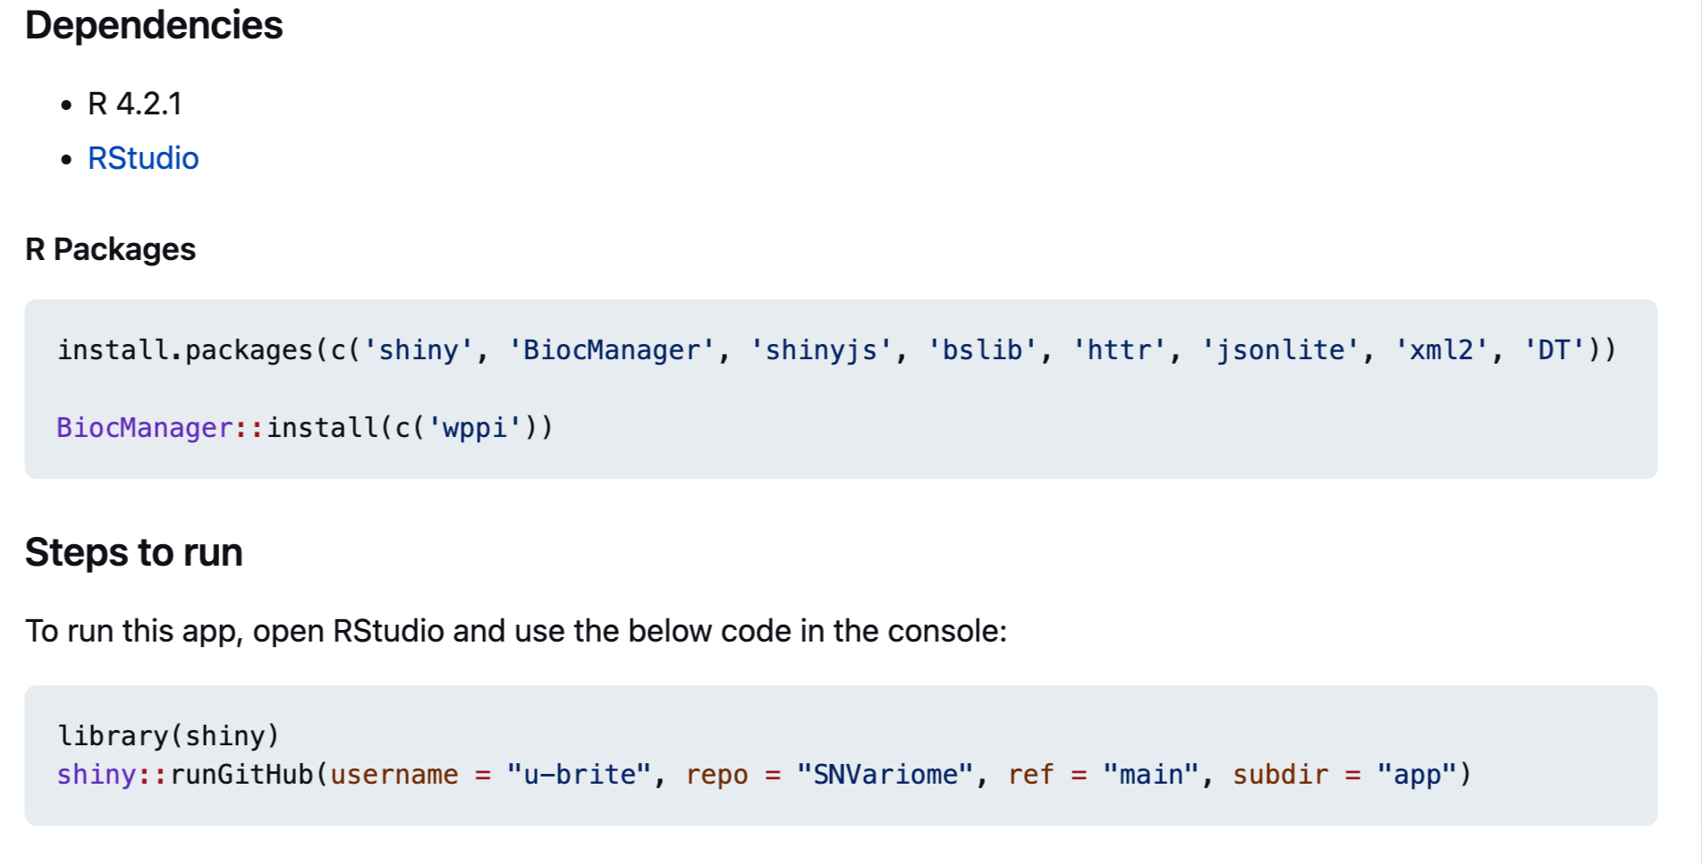

Slide 5
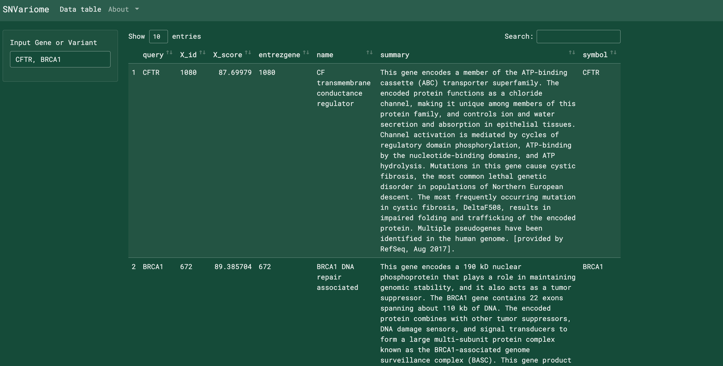

Slide 6
Future Directions
Implement visualization of protein-protein interactions
Implement Extent of Disease Clustering method
To identify disease genes with mutations likely to act via non-loss-of-function mechanisms
Identification of signatures related to pathogenic mutations that act via DN and GOF mechanisms

Slide 7

Thanks
Shaurita Hutchins | Team leader
Bernhard Hane | Team member
Oladosu Tosin Ayodeji | Team member
Bharat Mishra | Team member
Hailey Levi | Team member
Pooja Singaravelu | Team member
Maria Jose | Team member

