Slide 1

Candidate Eligibility Analysis based on Resume Classification using LSTM
Presented by:
Anusha g(1EP21AD007)
lavanya u(1ep21ad028)
r thanuja reddy(1ep21ad039)
Internal guide:
Dr. Sudhanshu Saurabh
Asst. professor
Dept. of ai&ds, epcet
Dept. of Artificial Intelligence & Data Science

Slide 2
Table of Content
Problem statement
Introduction
Objectives
Methodology
Result
Conclusion
Future Scope
Dept. of Artificial Intelligence & Data Science

Slide 3
PROBLEM STATEMENT
Manual screening of job resumes for skills and technologies is laborious and inefficient, particularly in high-volume hiring.
Keyword-based methods often miss qualified candidates due to variations in skill descriptions, leading to biases and inefficiencies.
We propose an LSTM-based machine learning solution to automate resume classification.
Our approach aims to reduce dataset dimensions and optimize the use of LSTM models for efficient, accurate, and unbiased resume screening, thereby freeing recruiters' time for deeper candidate evaluation.
Dept. of Artificial Intelligence & Data Science

Slide 4
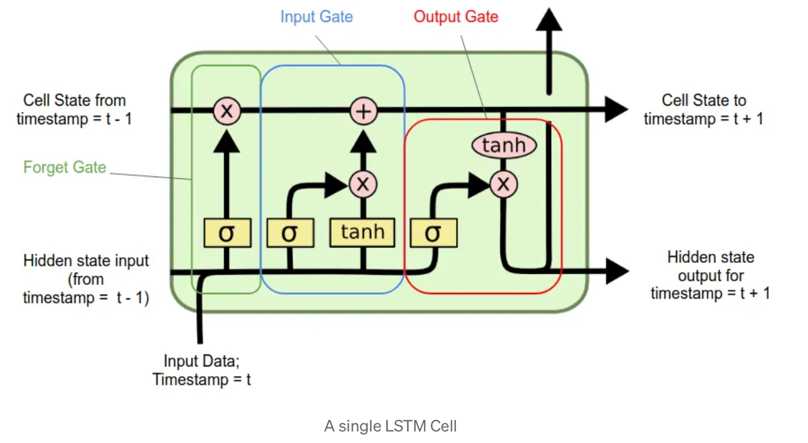
INTRODUCTION
Dept. of Artificial Intelligence & Data Science

Slide 5
Objectives:
The goal is to develop a machine learning model for real-time candidate eligibility classification analyzing resumes.
To build model that achieves high accuracy by leveraging LSTM (Long Short- Term Memory)
Classifying based on the resume content like technolgy,experience and determining the ‘eligiblity’ or ‘Not eligible’.
dataset = resume dataset(2400+ resumes in strings) from kaggle
Dept. of Artificial Intelligence & Data Science

Slide 6
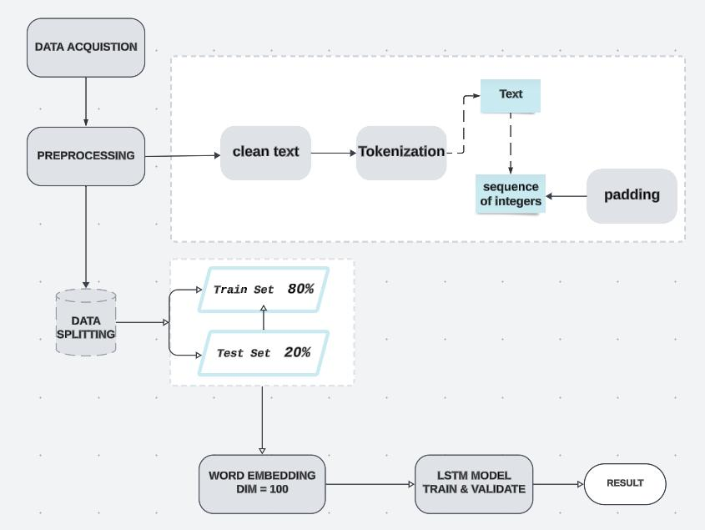
Methodology:
Proposed model flow chat
Dept. of Artificial Intelligence & Data Science

Slide 7
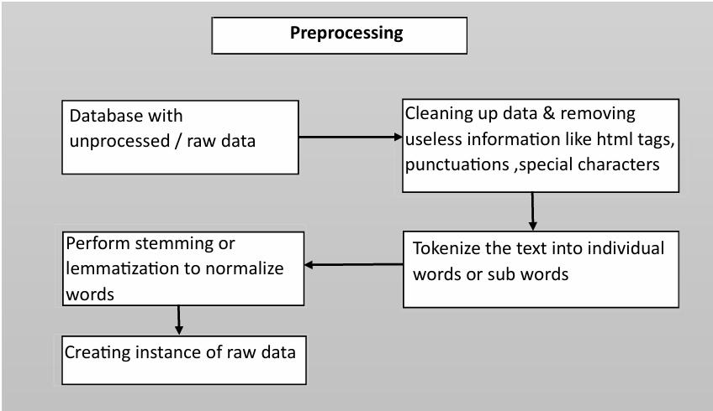
Data preprocessing:
Data is collected from kaggle website in .csv format.
Dept. of Artificial Intelligence & Data Science

Slide 8
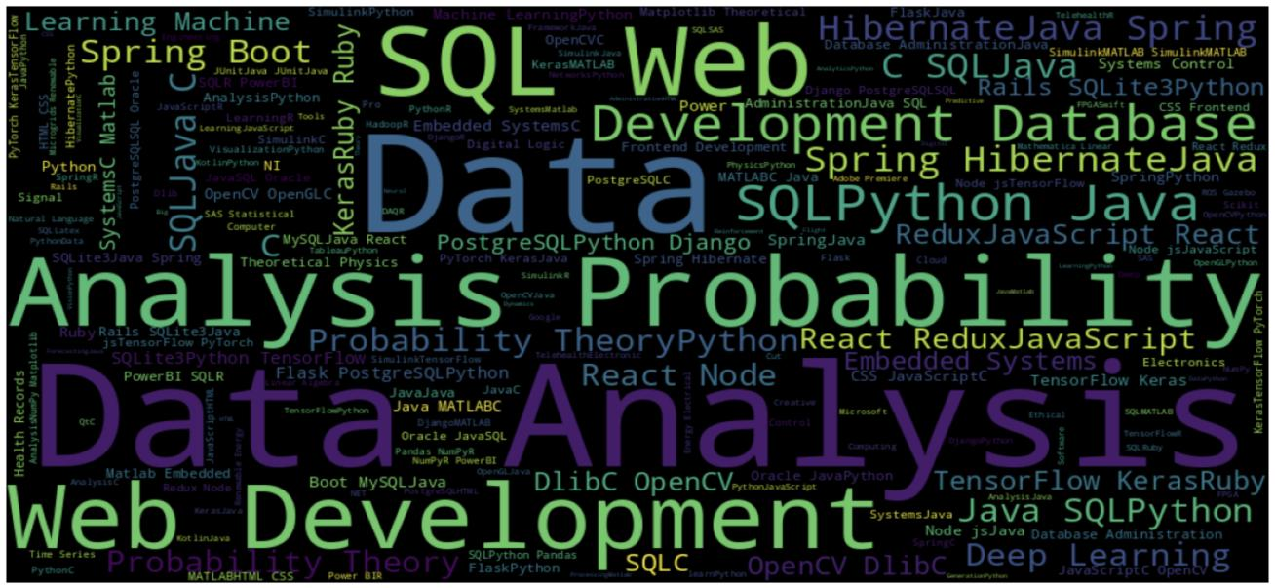
WordCloud of Our dataset:

Slide 9
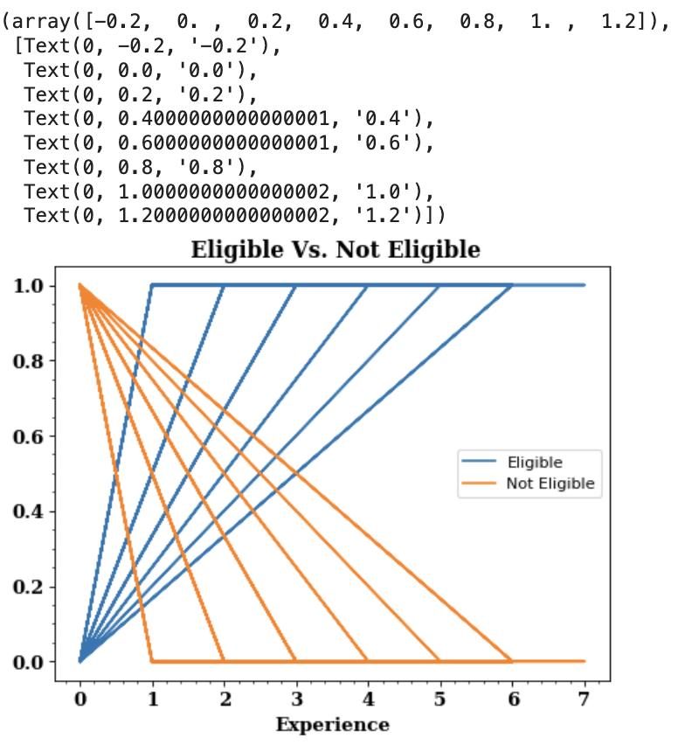
CLEANED DAT PLOT
A data plot to visualize relationship between
‘Experience the likelihood of being
‘Eligible’ or ‘Not - Eligible’.

Slide 10
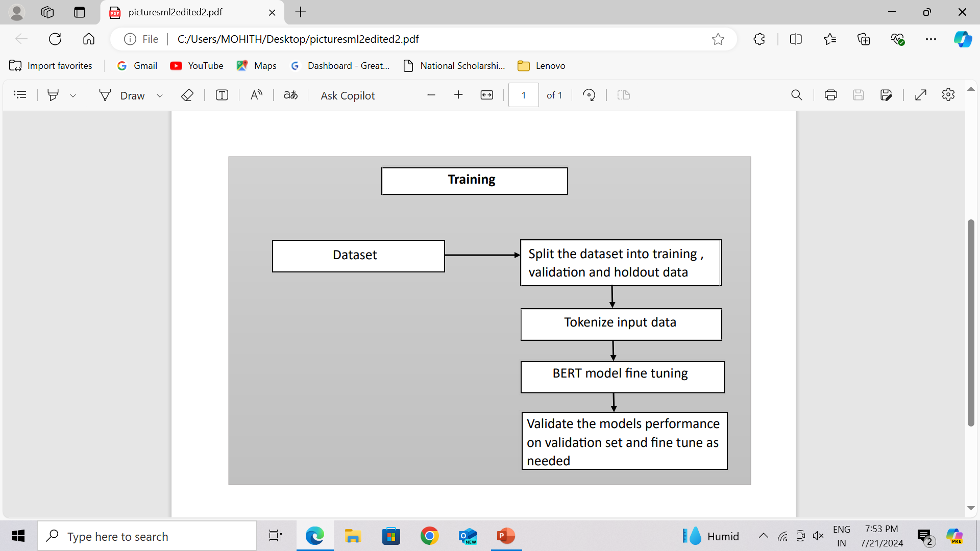
Tokenizing and Modelling:
Tokenizing involves breaking down the input text into sub-word units using the WordPiece tokenizer. Each token is mapped to an embedding vector, capturing its semantic meaning.
LSTM MODEL

Slide 11
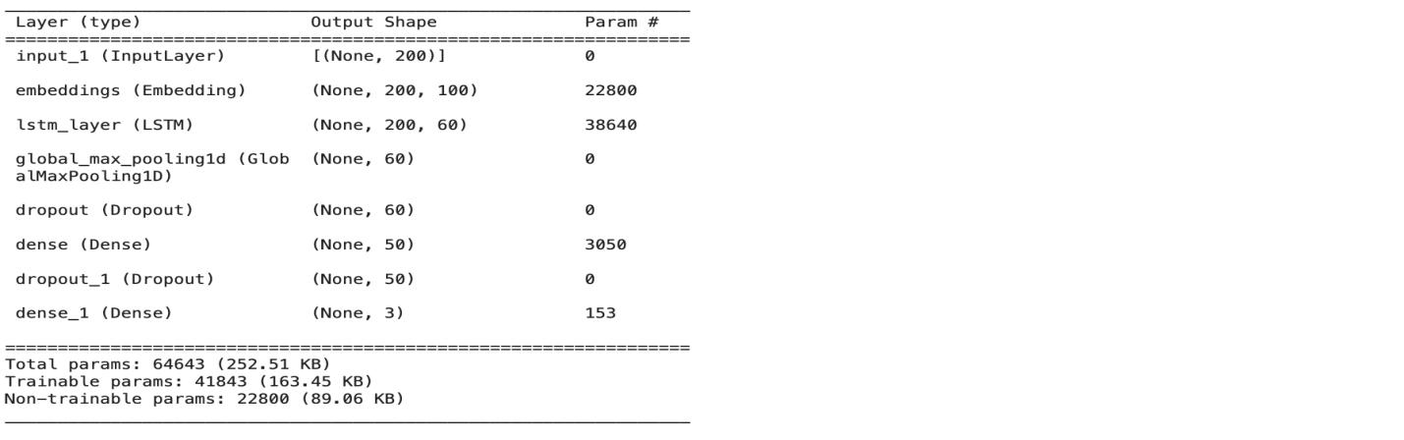
LSTM MODEL
Input Layer
This layer takes sequences of integers, each representing a tokenized word, with a fixed length .
➢ Embedding Layer
This layer uses pre-trained GloVe embeddings to convert word indices into dense vector
representations.
➢ LSTM Layer
The Long Short-Term Memory (LSTM) layer with 60 units processes the embedded sequences.
➢ Global Max Pooling Layer
This layer reduces the output from the LSTM layer by extracting the maximum value along each feature dimension.
➢ Dropout Layers
Two Dropout layers with a rate of 0.1 are added to prevent overfitting.
➢ Dense Layers
A Dense layer with 50 units and ReLU activation functions as a fully connected layer, learning non-linear combinations of features. This layer contributes to the final classification or prediction by processing the output from previous layers.

Slide 12
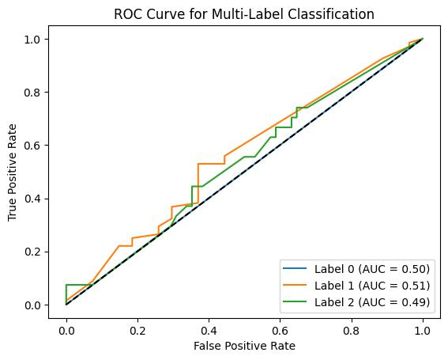
Result:
Performance Measure:The ROC curve plots the true positive rate against the false positive rate to evaluate a binaryclassification model's performance

Slide 13
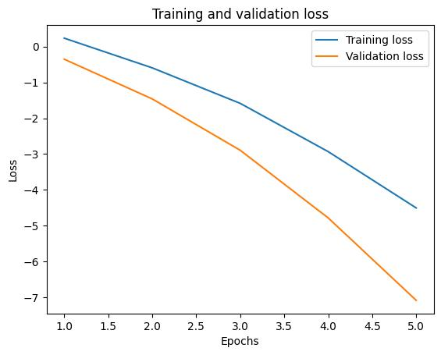
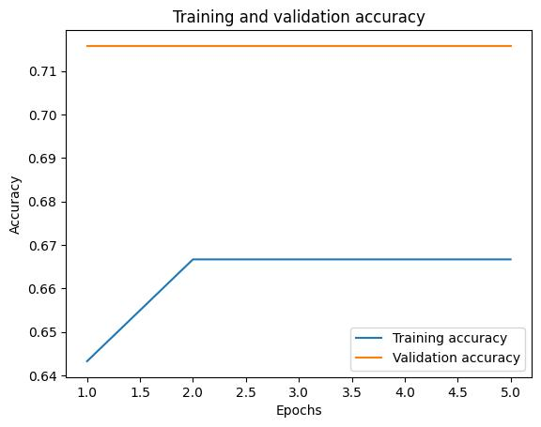
Accuracy

Slide 14
Conclusion:
Model Architecture: Utilized a Long Short-Term Memory (LSTM) network.
Learning Contextual Information: LSTM captured context from technology descriptions.
Prediction Performance: Achieved promising results in predicting multiple labels simultaneously.
Embeddings: Improved understanding of semantic relationships using pre-trained GloVe embeddings.
Evaluation Metrics: Used accuracy, ROC curves, and confusion matrices to assess model effectiveness.
Multi-label Classification: Capable of distinguishing between different classes simultaneously.
Application: Automates candidate screening and enhances screening efficiency.
Dept. of Artificial Intelligence & Data Science

Slide 15
Future Scope:
Hyperparameter Tuning: Fine-tuning parameters like number of LSTM units, dropout rates, and learning rate can enhance model performance.
Different Architectures: Experiment with bidirectional LSTMs or attention mechanisms to potentially improve accuracy and capture long-range dependencies better.
Enriching Input Features: Incorporate additional features such as candidate experience details or job requirements to provide more context and enhance predictive capabilities.
Explainability: Explore techniques like attention visualization or feature importance analysis to interpret model predictions, increasing transparency and trust.
Deployment and Integration: Deploy the model as a web service or integrate it into existing recruitment platforms for real-world application and impact.

Slide 16

Thank you
Dept. of Artificial Intelligence & Data Science

