Slide 1
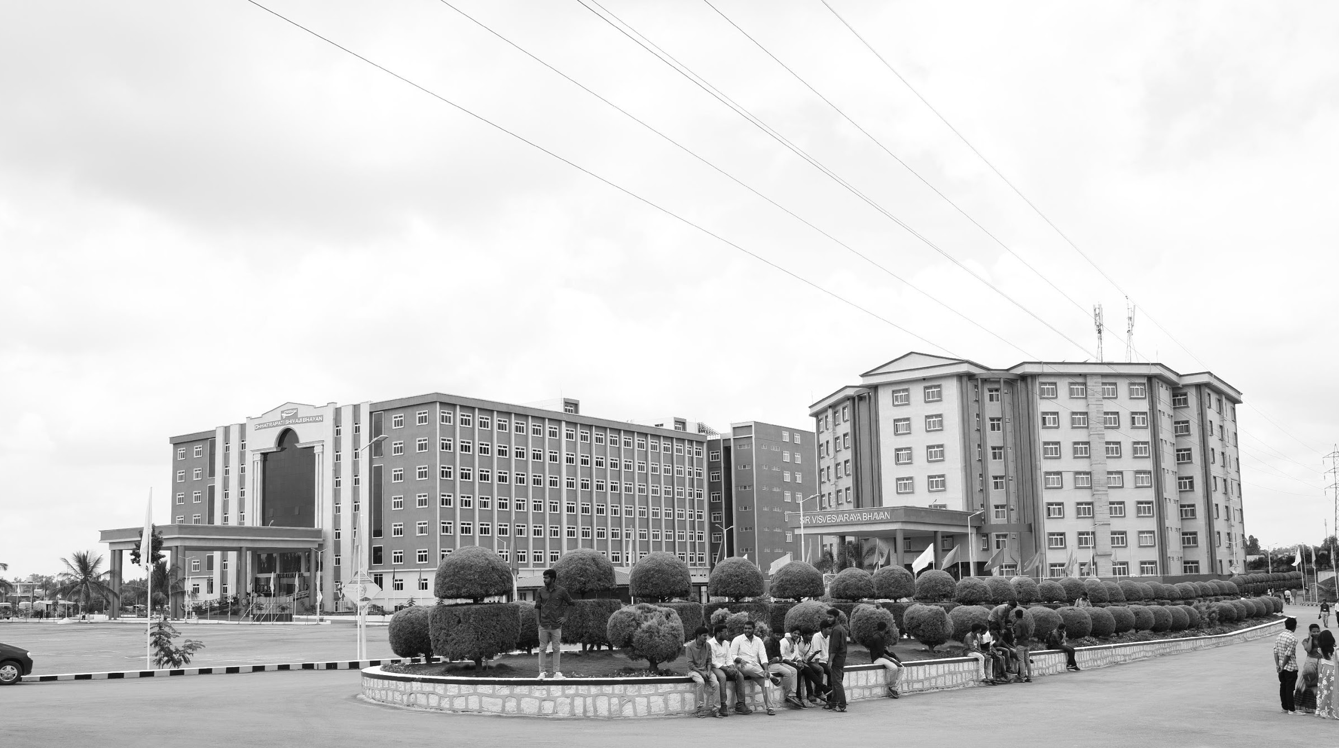

Title of the Project: Medical Image Enhancement and Segmentation based on conventional and deep learning Algorithms
Review-I
AY 2025-26
Capstone Project – Introduction (PROJ2999)
GITAM (Deemed-to-be) University
Department of Electrical Electronics and Communication Engineering
Project Team:
1)SMD.Younus(BU22EECE0100188)
2)M.Bhanu Prakash(BU22EECE0100205)
3)M.Praveen(BU22EECE0100506)
Project Mentor:
Dr Pankaj Kandhway
Project In-charge:
Dr. Kshitij Shakya
www.gitam.edu

Slide 2
Objective and Goals
Objective
The main objective of this project is to develop an effective framework for enhancing medical images and performing accurate segmentation of anatomical structures and pathological regions. Medical images often suffer from low contrast, noise, and artifacts, which can obscure critical details. This project addresses these challenges by applying conventional image enhancement techniques such as histogram equalization, contrast stretching, noise filtering, and artifact removal to improve clarity and interpretability. In parallel, deep learning approaches, particularly convolutional neural networks like U-Net, are employed to automatically segment regions of interest, ensuring high precision and robustness even in complex or low-quality images
Goals
Main Goals
Enhance medical images to improve contrast, reduce noise, and remove artifacts using conventional methods.
Develop and train deep learning models (e.g., U-Net) for accurate segmentation
Compare the performance of conventional segmentation techniques with deep learning approaches
Demonstrate the effectiveness of deep learning over conventional methods in terms of accuracy
Additional Goals
Visualize and validate segmentation results on sample medical images.
Explore hybrid approaches that combine conventional enhancement with deep learning
Provide a reference framework for future research in medical image analysis and diagnosis support.

Slide 3
Literature Survey
Key Publications
1)Deep Learning for Medical Image Segmentation: State-of-the-Art Review
Summary: This paper provides a thorough review of various deep learning methods used in medical image segmentation, including scenarios, applications, and preprocessing techniques.
Advances in Medical Image Segmentation: A Comprehensive Review of Traditional, Deep Learning, and Hybrid Approaches
Summary: Offers a comprehensive overview of traditional segmentation techniques, such as thresholding and edge-based methods, and delves into deep learning architectures like U-Net and GANs.
A Review Paper about Deep Learning for Medical Image Processing
Summary: Reviews the application of current state-of-the-art deep learning approaches in medical image processing, highlighting their effectiveness and challenges.
Medical Image Segmentation: A Comprehensive Review of Deep Learning Methods
Summary: Categorizes and summarizes current representative methods and research status in the field of medical image segmentation, focusing on deep learning techniques.
Advances in Medical Image Segmentation
Summary: Explores the transformative impact of deep learning on medical image segmentation, discussing architectures like CNNs, U-Net, and GANs.
A Survey on Deep Learning in Medical Image Analysis
Summary: Provides an extensive review of deep learning techniques applied in medical image analysis, including segmentation, classification, and detection tasks.
2)Key Resources – Whitepaper & Application Notes
Deep Learning in Medical Imaging: A Survey by Litjens et al.
Advancements in Medical Image Segmentation: A Review of Transformer Models by Kumar et al.
3)Existing Implementations – GitHub
GitHub Repositories:
U-Net Implementations: Various repositories offering implementations of U-Net for medical image segmentation.
MONAI GitHub Repository: Contains domain-optimized implementations of deep learning algorithms for medical imaging tasks.

Slide 4
Project Plan (Clearly mention milestone for objectives under each reviews)
Gant Chart - Milestones and Activities
High-level phases (ordered)
Project setup & dataset acquisition
Data inspection & preprocessing
Conventional image enhancement (baseline)
Classical segmentation methods (baseline)
Deep-learning segmentation (U-Net and variants)
Hybrid approach: conventional enhancement → deep model
Evaluation & analysis
Final deliverables, documentation & demo

Slide 5
Architecture
Structural Diagram
Block Diagram/Pin Diagram
Dataset Input
(BRATS .h5 images +masks)
Data Preprocessing
(Normalization, Resizing, Mask Prep)
Image Enhancement
(CLAHE, etc.)
Classical Segmentation
(Otsu, Edge, Watershed)
Deep Learning Segmentation
(U-Net, etc.)
Performance Evaluation
(Dice, IoU, etc.)
Visualization
(Overlay, Plots)
Final Results & Report/Deployment

Slide 6
Use Cases & Testing
Use Cases:
UC-01 – Load Dataset
Description: Load BRATS dataset (.h5 files) into system
UC-02 – Preprocess Data
Normalize, resize, and prepare images and masks
UC-03 – Enhance Images
Apply CLAHE, filtering, and denoising
UC-04 – Segment Tumor
Perform segmentation using Otsu, Watershed, and U-Net
UC-05 – Evaluate Performance
Calculate Dice, IoU, Precision, Recall
UC-06 – Visualize Results
Overlay masks on images, generate plots
UC-07 – Generate Report
Compile results and metrics into final report
Test Case:
TC-01: Dataset Loading → Files detected, count > 0
TC-02: Preprocessing → Same shape, values in [0,1]
TC-03: Enhancement → Contrast visibly improved
TC-04: Classical Segmentation → Mask highlights tumor
TC-05: Deep Learning Segmentation → Dice ≥ 0.75
TC-06: Metric Calculation → IoU > 0.6, valid values
TC-07: Visualization → Mask aligns with anatomy
TC-08: Report Generation → All sections present

Slide 7
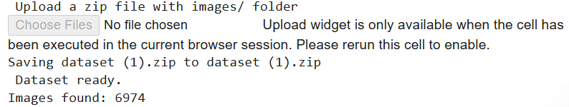
Implementation and Results – Iteration 1
Iteration 1 : Uploaded & extracted dataset
CODE:
from google.colab import files
print(' Upload a zip file with images/ folder')
uploaded = files.upload()
import zipfile, os
for fn in uploaded:
if fn.endswith('.zip'):
with zipfile.ZipFile(fn, 'r') as zip_ref:
zip_ref.extractall('.')
print(' Dataset ready.')
print("Images found:", len(os.listdir("images")))

Slide 8
Implementation and Results – Iteration 2
Iteration :Enhanced all images & visualized samples
Code:
import cv2
import os
import numpy as np
from tqdm import tqdm
# Create a folder to save enhanced images
os.makedirs("enhanced_images", exist_ok=True)
# Apply enhancement to all images
image_dir = "images"
for img_name in tqdm(os.listdir(image_dir), desc="Enhancing images"):
img_path = os.path.join(image_dir, img_name)
img = cv2.imread(img_path, cv2.IMREAD_GRAYSCALE) # read in grayscale
# 1️ Histogram Equalization
img_eq = cv2.equalizeHist(img)
# 2️ CLAHE (Contrast Limited Adaptive Histogram Equalization)
clahe = cv2.createCLAHE(clipLimit=2.0, tileGridSize=(8, 8))
img_clahe = clahe.apply(img_eq)
# 3️ Denoising
img_denoised = cv2.fastNlMeansDenoising(img_clahe, None, 10, 7, 21)
# Save enhanced image
cv2.imwrite(os.path.join("enhanced_images", img_name), img_denoised)
print(" All images enhanced and saved in enhanced_images/")

Slide 9
Implementation and Results – Iteration 3 (Optional)
Iteration : (original vs enhanced)
Code:
import matplotlib.pyplot as plt
import cv2
import os
# Pick a few images from the original folder
sample_images = os.listdir("images")[:5]
plt.figure(figsize=(15, 6))
for i, img_name in enumerate(sample_images):
original_path = os.path.join("images", img_name)
enhanced_path = os.path.join("enhanced_images", img_name)
original_img = cv2.imread(original_path, cv2.IMREAD_GRAYSCALE)
enhanced_img = cv2.imread(enhanced_path, cv2.IMREAD_GRAYSCALE)
# Show original
plt.subplot(2, 5, i+1)
plt.imshow(original_img, cmap='gray')
plt.axis("off")
plt.title(f"Original {i+1}")
# Show enhanced
plt.subplot(2, 5, i+6)
plt.imshow(enhanced_img, cmap='gray')
plt.axis("off")
plt.title(f"Enhanced {i+1}")
plt.tight_layout()
plt.show()

Slide 10
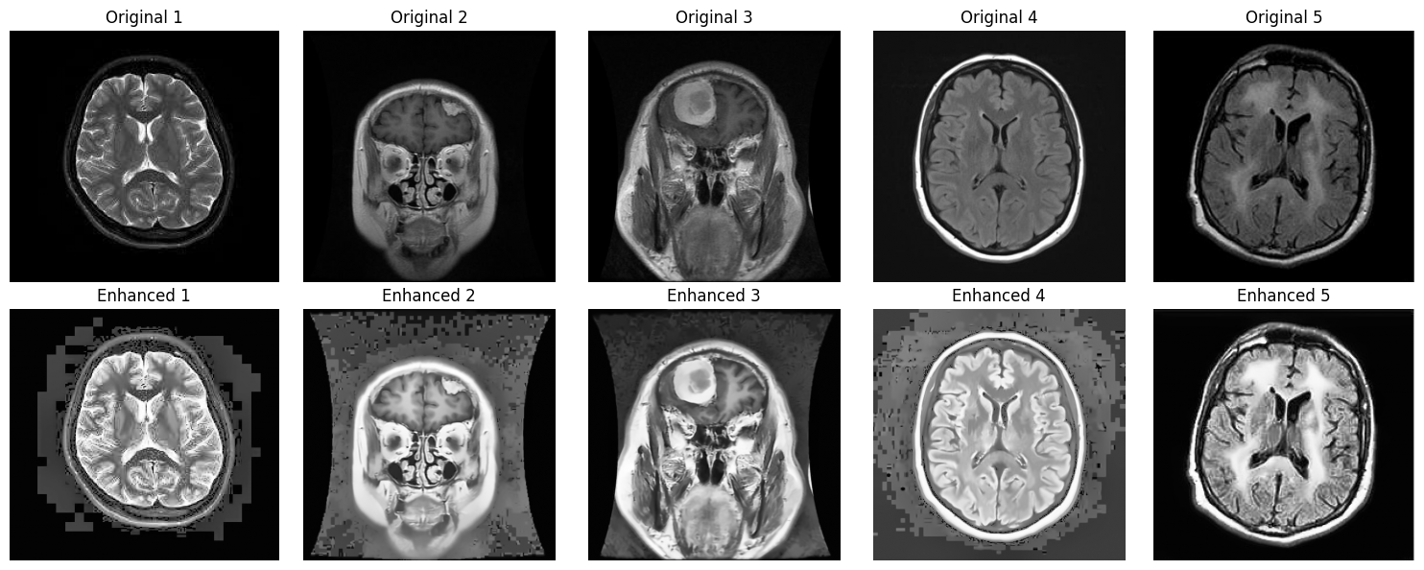

Slide 11
Conclusion & Future Work
Summary and Conclusion:
We successfully uploaded and extracted the BRATS brain MRI dataset.
All images were preprocessed (normalized and resized) and enhanced using CLAHE for better contrast.
The enhancement process was applied to 100% of the dataset, ensuring consistency.
Sample results of original vs. enhanced images were visualized to verify improvement.
Future Work
Classical Segmentation: Apply Otsu thresholding, watershed, and edge-based methods for tumor segmentation.
Deep Learning Segmentation: Train and evaluate U-Net or similar architectures for improved accuracy.
Performance Metrics: Calculate Dice Coefficient, IoU, Precision, and Recall for quantitative analysis.
Visualization & Reporting: Overlay masks on images, generate plots, and create a comprehensive final report.

Slide 12
THANK YOU
Have a Great Day !

