Slide 1

Note: The data and information in this document is reflective of a hypothetical situation and client. This document is to be used for KPMG Virtual Internship purposes only.
Sprocket Central Pty Ltd
Data analytics approach
[Division Name] - [Engagement Manager], [Senior Consultant], [Junior Consultant]

Slide 2
Note: The data and information in this document is reflective of a hypothetical situation and client. This document is to be used for KPMG Virtual Internship purposes only.
Agenda
Introduction
Data Exploration
Model Development
Interpretation

Slide 3
Note: The data and information in this document is reflective of a hypothetical situation and client. This document is to be used for KPMG Virtual Internship purposes only.
Introduction
Place headline insight or information here. This should be the most important point for this slide.
Place any information about this point here.
Place any supporting images, graphs, data or extra text here.

Slide 4
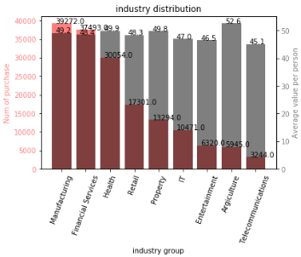
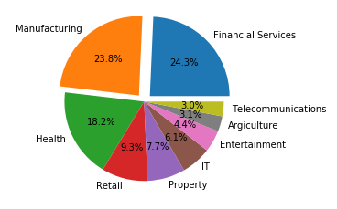
Note: The data and information in this document is reflective of a hypothetical situation and client. This document is to be used for KPMG Virtual Internship purposes only.
Data Exploration
Industry breakdown
From The distribution, we can see that the Financial, Manufacturing and Health sector lead other sector purchase by large margin.
However, The Agriculture sector purchase has the highest value per person.
From the pie chart, we can see that the Manufacturing Sector and constitute almost 50% of the customer purchase base.

Slide 5
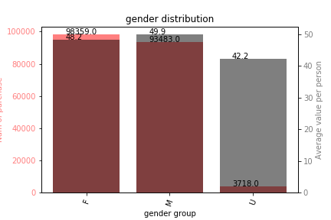
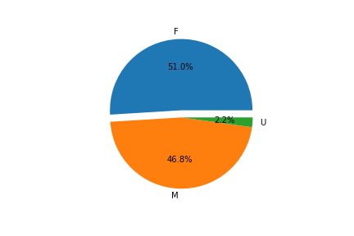
Note: The data and information in this document is reflective of a hypothetical situation and client. This document is to be used for KPMG Virtual Internship purposes only.
Data Exploration
Gender break down
From the data, we can see that gender does not play a significant role in the consumer purchase habit.

Slide 6
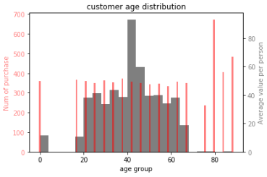
Note: The data and information in this document is reflective of a hypothetical situation and client. This document is to be used for KPMG Virtual Internship purposes only.
Data Exploration
Age breakdown
It can be observed that the main consumer base is at 40-50 age group.
The most valued consumer are at 80+ age range.

Slide 7
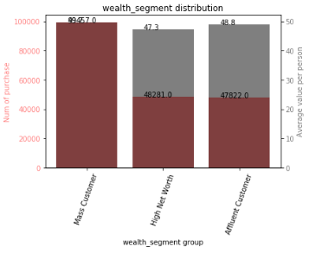
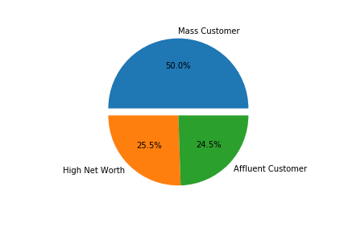
Note: The data and information in this document is reflective of a hypothetical situation and client. This document is to be used for KPMG Virtual Internship purposes only.
Data Exploration
Wealth segment break down
Mass customer makes up for the largest percentage of the consumer base.
The wealth segment does not have large effect on per capital spending.

Slide 8
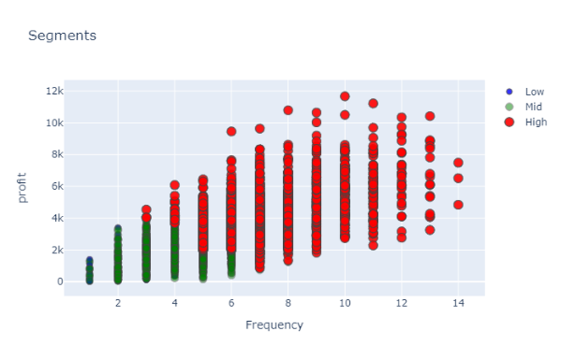
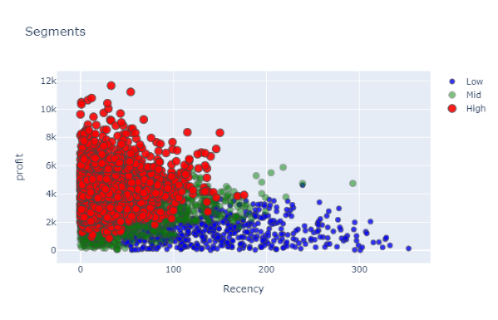
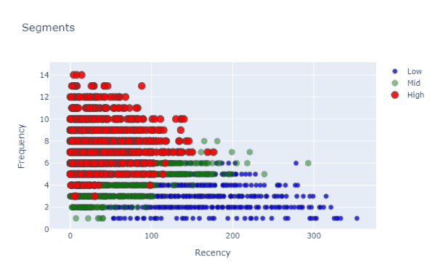
Note: The data and information in this document is reflective of a hypothetical situation and client. This document is to be used for KPMG Virtual Internship purposes only.
Data Exploration
Customer segment break down
Mass customer makes up for the largest percentage of the consumer base.
The wealth segment does not have large effect on per capital spending.

Slide 9
Note: The data and information in this document is reflective of a hypothetical situation and client. This document is to be used for KPMG Virtual Internship purposes only.
Model Development
Place headline insight or information here. This should be the most important point for this slide.
Place any information about this point here.
Place any supporting images, graphs, data or extra text here.

Slide 10
Note: The data and information in this document is reflective of a hypothetical situation and client. This document is to be used for KPMG Virtual Internship purposes only.
Interpretation
Place headline insight or information here. This should be the most important point for this slide.
Place any information about this point here.
Place any supporting images, graphs, data or extra text here.

Slide 11
Note: The data and information in this document is reflective of a hypothetical situation and client. This document is to be used for KPMG Virtual Internship purposes only.
Appendix

Slide 12
Note: The data and information in this document is reflective of a hypothetical situation and client. This document is to be used for KPMG Virtual Internship purposes only.
Appendix
This is an optional slide where you may place any supporting items.

