Slide 1
Retention Exploratory Data Analysis PowerPoint
Bill Prisbrey

Slide 2
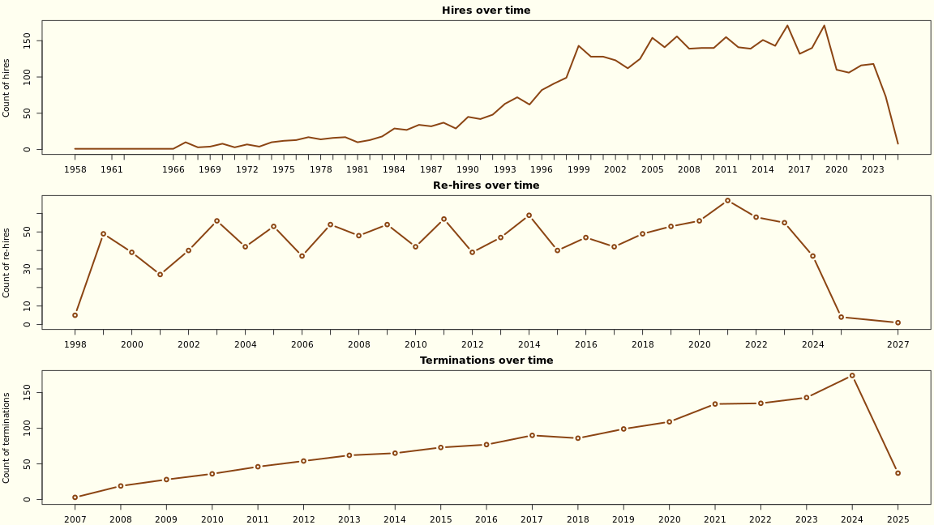
RAW DATES IN VIEW

Slide 3
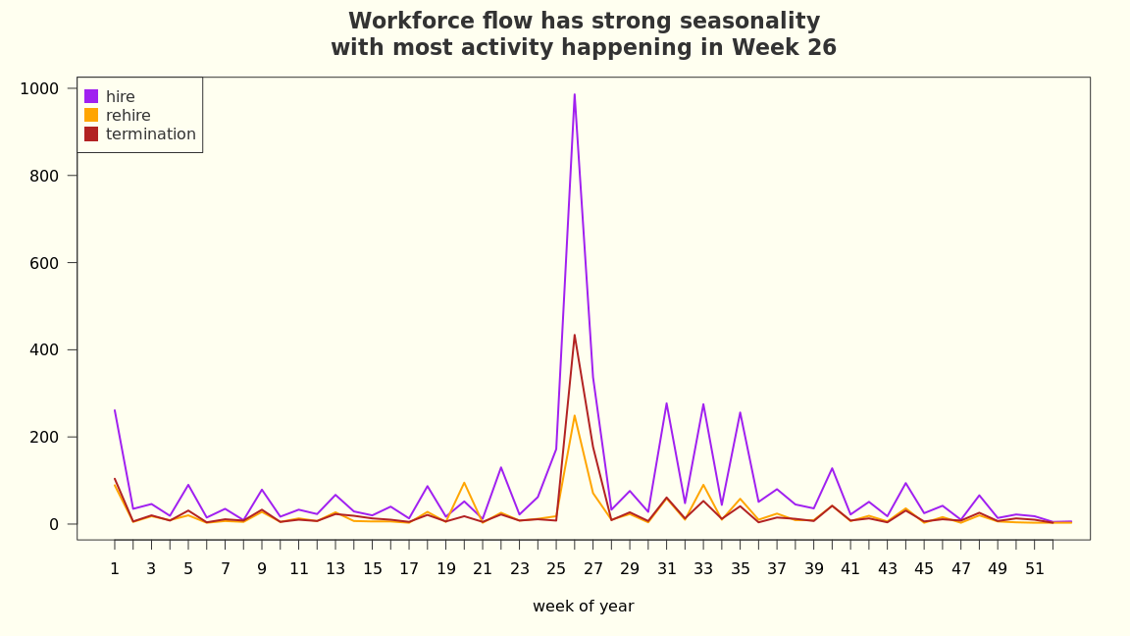
SEASONALITY

Slide 4
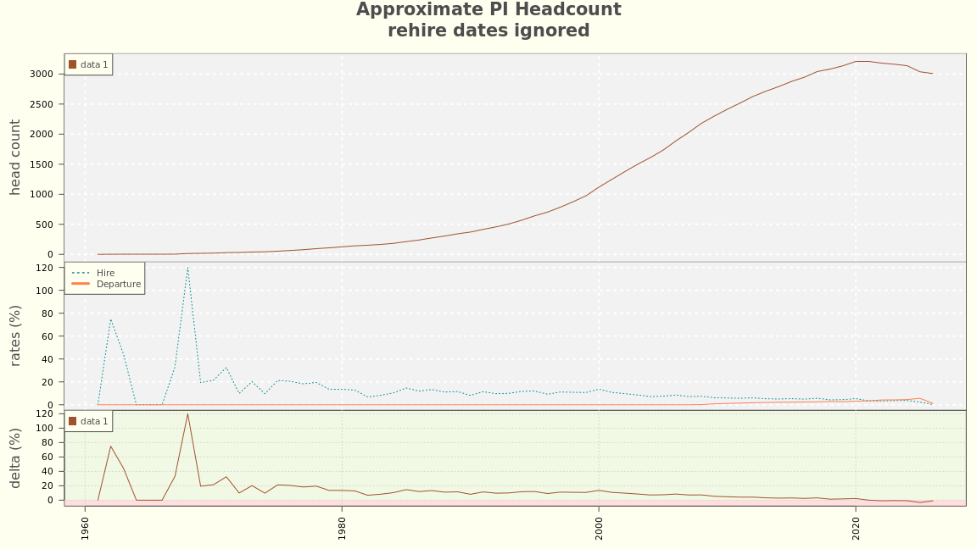
FULL SPAN

Slide 5
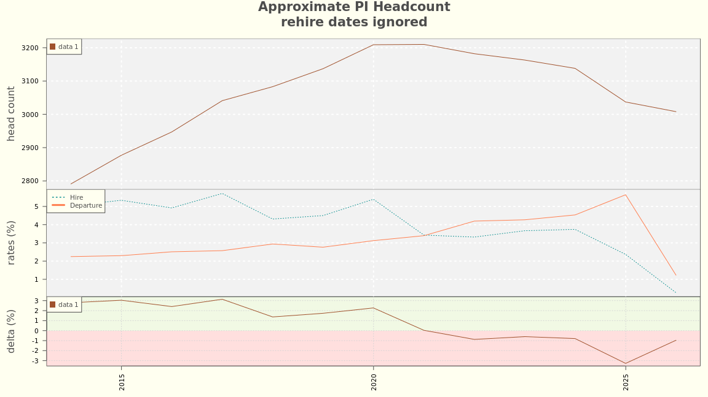
MID SPAN

Slide 6
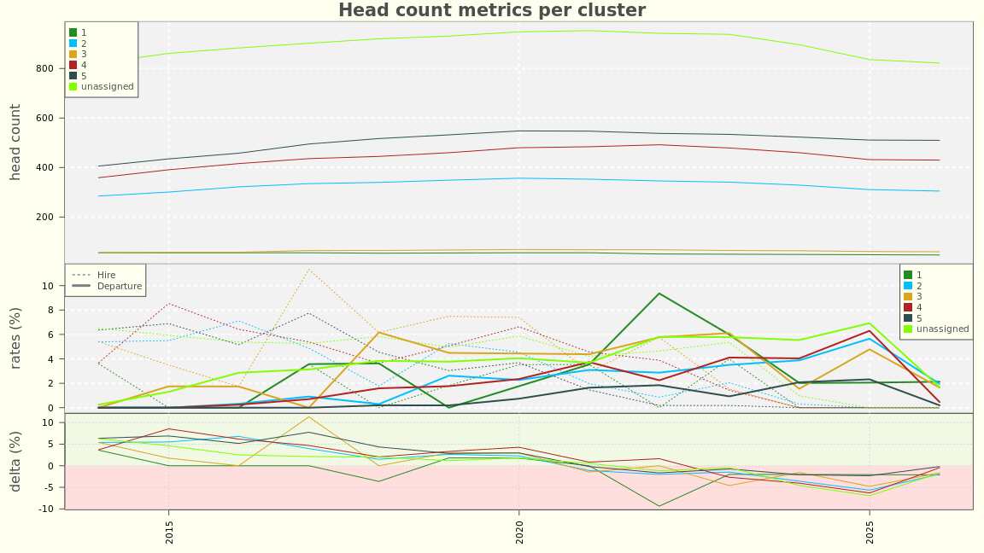
BY CLUSTER

Slide 7
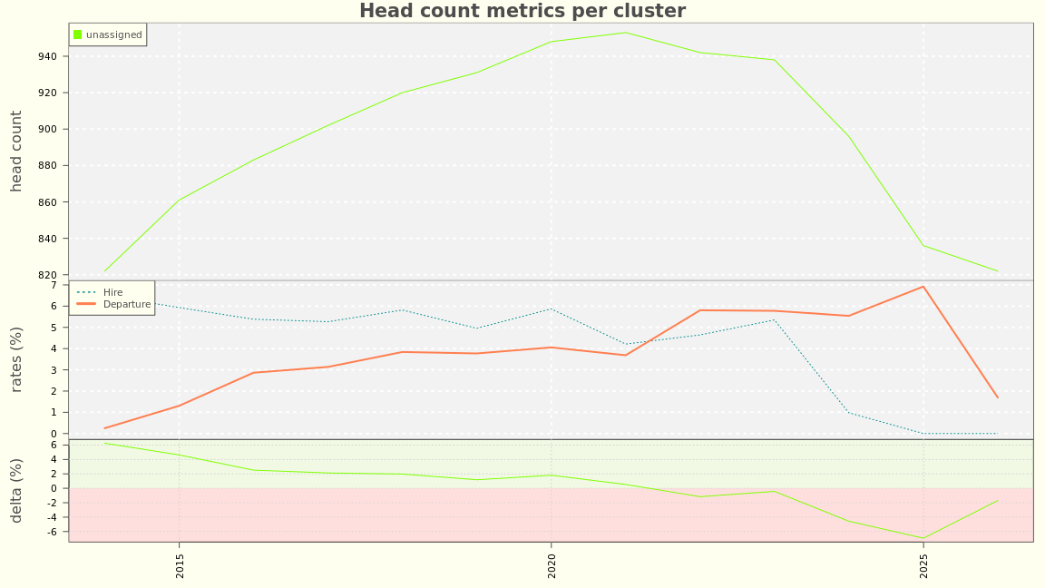
UNASSIGNED CLUSTER

Slide 8
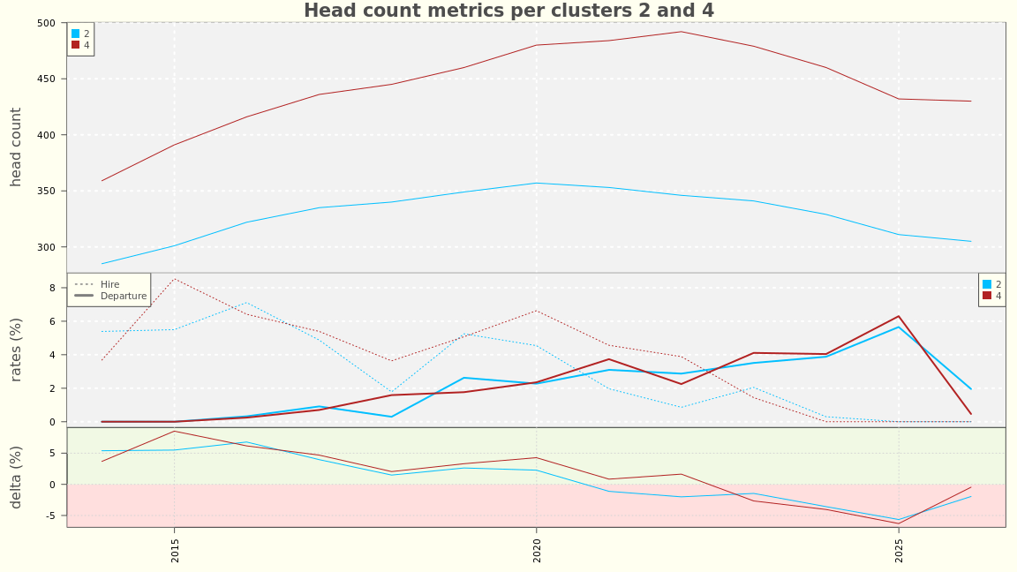
CLUSTER 2 AND 4

Slide 9
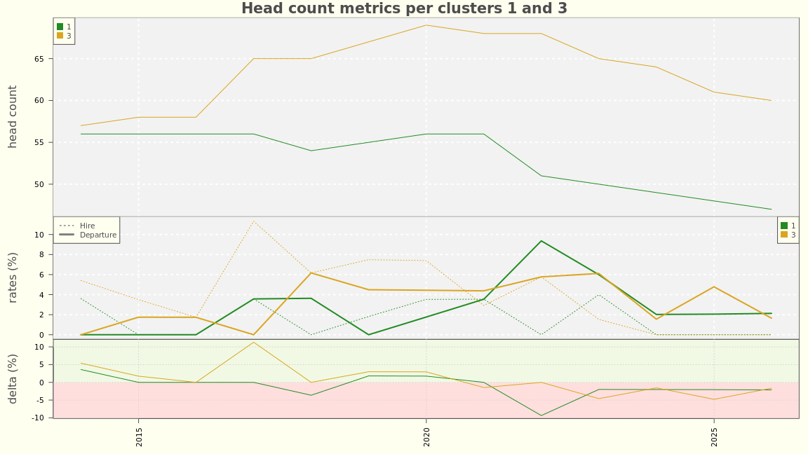
CLUSTER 1 AND 3

Slide 10
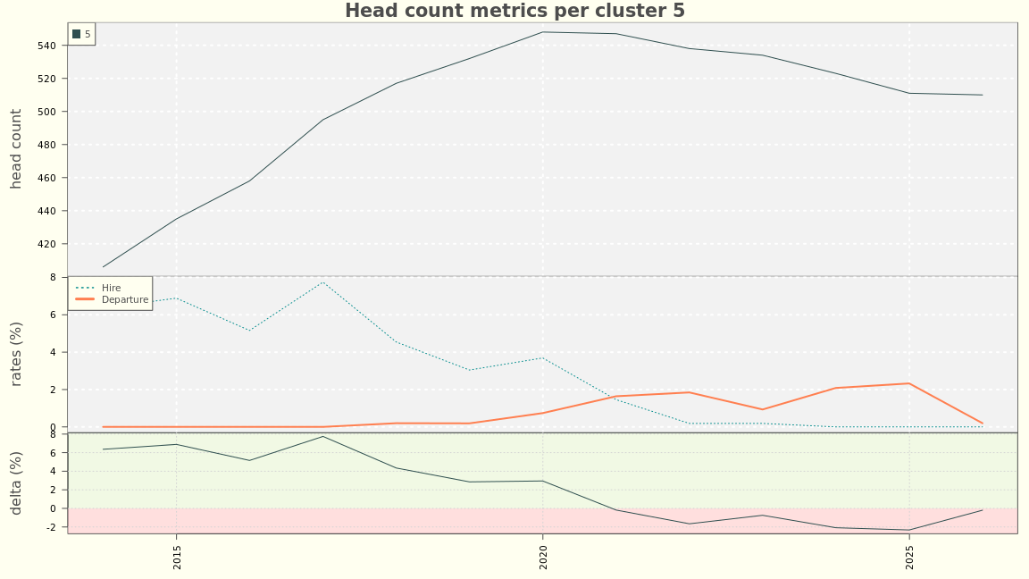
CLUSTER 5

Slide 11
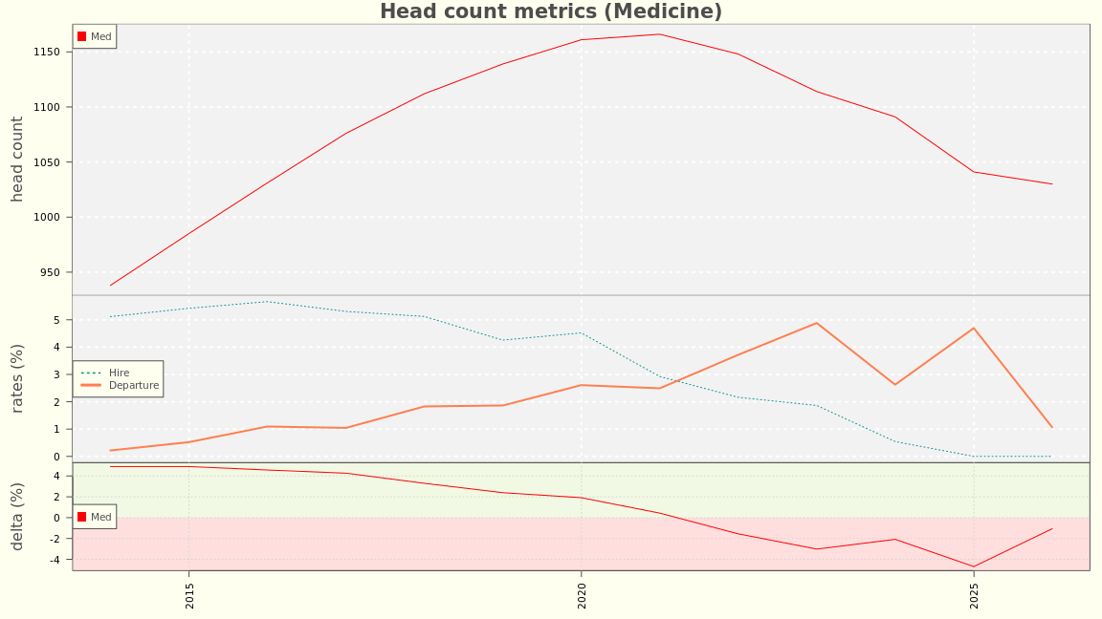
COLLEGE OF MEDICINE

Slide 12
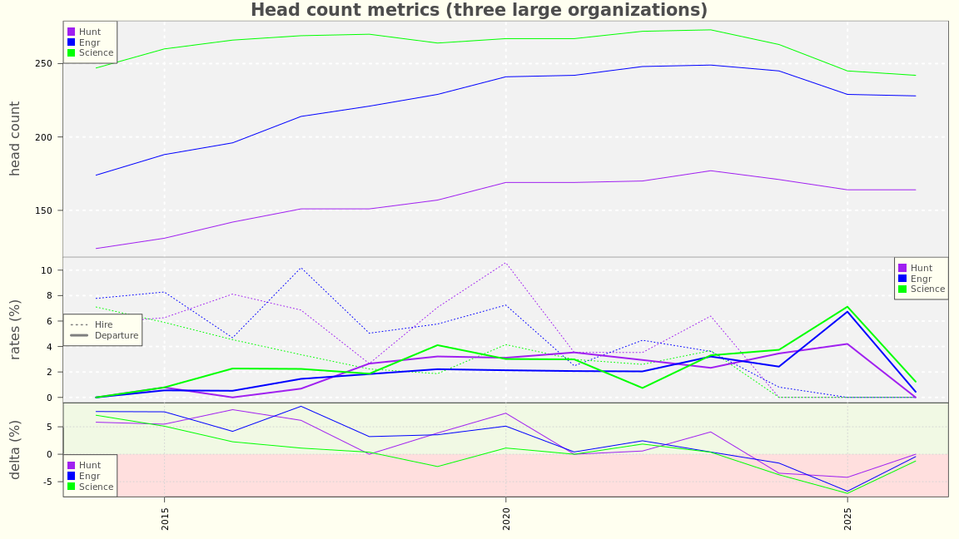
NEXT THREE LARGEST

Slide 13
REMAINDER OF COLLEGES AND INSTITUTIONS

