Slide 1

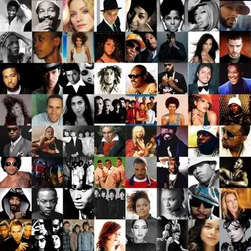
Movie and Music Artist Search Engine: MediaMatrix --Jeffrey LeRoy, Rui Liu, Jeremy Frye, Haiping Xue
http://durhamnc.gov/ich/as/bms/PublishingImages/s_p%20media_kit_jpg_scaled1000.jpg
http://www.rochellearthurs.com/uploads/images/Gallery/Music-pictures/collageLegends.jpg

Slide 2

Motivation
We need a simple music artist and movie search engine to do simple online searching job.

Slide 3
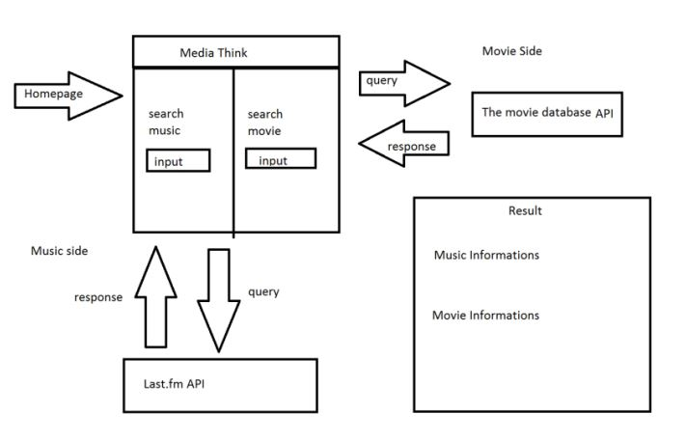
Approach Overview
Construction of Music Artist Search Engine
Construction of Movie Search Engine
Combination of these two tools.

Slide 4
Detail
JavaScript, HTML and CSS are used together to implement this task.
Two APIs are used here: Last.Fm and Movie DB.
Three files created for main manipulation: controller.js, MediaMatrix.html, style.css
Controller.js controls the main flow of the media searching process.
MediaMatrix.html controls the information for the entities including HTML elements, attributes, class and so on.
Style.css controls the appearance and format of the content on the web page.

Slide 5
Receive the “click signal”—search music or movie? Use function addEventListener(‘click’, musicFun/movieFun); Enter music search engine function or movie search engine function musicFun() or movieFun(); musicFun(): use last.fm API to obtain the object that contains all the information about the music artist. Parse the object information step by step to obtain the image, bio, top albums, origin and genres information. movieFun(): use movie DB API to obtain the object that contains all the information about the movie. Parse the object information step by step to obtain the images, cast, review, release data, rating average, total number of ratings and similar movies information. backFun(): Once “back to search” button is clicked, everything in current page is cleared and the initial page is shown.
Controller.js

Slide 6
Through this project, we practice web design skills with JavaScript, HTML, CSS and two APIs. We successfully build a mashup to do simple media search job. Due to the short time, we only use two API here, and our program does not handle all the searching ways one can think of to do a media searching job. In the future, we can develop this search engine deeply to do search by album name, cast name and so on. This project is interesting and it enhances our skills for doing web design.
Summary

