Slide 1
Taiwan Air Quality Index Prediction
Abhilash Pethota
Bharath Bhushan BR
M Rajendra Prasad
Suraj P
Vinutha A

Slide 2
Taiwan Air Quality Index Prediction

Slide 3
Problem Statement
Taiwan suffers from a combination of industrial emissions, vehicular pollution, dust storms, and pollution from neighboring countries (e.g., China), leading to significant fluctuations in air quality.
There is a growing need to predict the AQI based on the concentrations of key pollutants so that individuals, businesses, and public health authorities can make informed decisions on health risks, regulatory actions, and pollution control.
The Problem statement is "How can we predict and analyze the Air Quality Index (AQI) for Taiwan using environmental pollutant data to improve public health awareness and inform policy decisions?” using Machine Learning Algorithm.

Slide 4
Business Understanding
Taiwan faces significant air quality challenges due to both local and regional pollution sources, impacting public health and quality of life. The Air Quality Index (AQI) is a critical tool for assessing pollution levels and guiding health decisions.
Developing an accurate AQI prediction model will help individuals, businesses, and government agencies make informed choices to mitigate health risks and improve air quality management.
This model can create business opportunities in sectors like healthcare, environmental monitoring, smart city solutions, and consumer products, while also supporting policy initiatives aimed at reducing pollution and enhancing public well-being.

Slide 5
Approach
Data Collection & Understanding
Data PreProcessing
Model Training -Hyperparameters Tuning
Prediction & Evaluation
Model Interpretation
Exploratory Data Analysis
Data Visualisation

Slide 6
Data Understanding
The Taiwan Air Quality Index (AQI) is a standardized system used to communicate the level of air pollution and its potential health impacts to the public.
It measures air quality based on concentrations of key pollutants such as pm2.5 (particulate matter), pm10, ozone (o₃), nitrogen dioxide (no₂), sulfur dioxide (so₂), and carbon monoxide (co).
Key pollutants and their possible sources:
Nitrogen Dioxide - 🚗 (vehicle exhaust)
Particulate Matter - 💨 (Dust Cloud)
Carbon Monoxide - 🌍 (Earth), 🔥 (Fire)
Ozone - 🌞 (Sun) + ☁️ (Cloud)
Sulfur Dioxide - 🏭☁️(Factory Emission)

Slide 7
Data Understanding
The AQI is calculated on a scale from 0 to 500, with higher values indicating poorer air quality and greater health risks.
0-50 (Good): Air quality is considered good, with little to no risk to health.
51-100 (Moderate): Air quality is acceptable; however, there may be a slight health concern for a very small number of sensitive individuals.
101-150 (Unhealthy for Sensitive Groups): Members of sensitive groups may experience health effects.
151-200 (Unhealthy): Health effects may be experienced by everyone, especially those in sensitive groups.
201-300 (Very Unhealthy): Health alert; everyone may experience serious health effects.
301-500 (Hazardous): Emergency conditions; everyone is likely
to be affected.

Slide 8
Summary of the Dataset
Dataset is available for download from the below link -https://www.kaggle.com/Measureddatasets/taweilo/taiwan-air-quality-data-201620242
The dataset contains data from 2016-2024. As part of this project, we are considering data from year 2023-2024.
The filtered dataset contains 1232990 rows and 25 columns
The dataset contains hourly readings of over 22 counties in Taiwan and covers over 92 sites in these counties
Columns : pm2.5, pm10, Ozone (o₃), nitrogen dioxide (no₂), sulfur dioxide (so₂), carbon monoxide (co), average concentrations of pm2.5, pm10, co, o3, so2,wind speed and wind direction, siteid, sitename, latitude, longitude, county, date, unit, pollutant, status, aqi

Slide 9
Summary of the Dataset
There are missing values and duplicated values present in the dataset. The missing values might be due to defects/malfunctioning in sensors.
Few columns contains negative values, these might be due to instrument calibrations.
This Dataset contains 1232994 rows and 25 columns and there are 4 duplicated rows.

Slide 10
Exploratory Data Analysis
AQI values range from 5 to 467, with a mean of 49.76, indicating that most the data contains good AQI as compared to Hazardous AQI values. The median is 44 showing that there is slight skew towards better air quality.
⁠so2 ranges from 0.0 to 137, with 75% of the data below the value of 1.5 which indicates lesser concentrates of so2 in the atmosphere most of the time.
⁠co concentrates range from 0.0 to 3.29 indicating lesser impact on the AQI values with a mean of 0.29.
⁠o3 ranges from 0.0 to 147.0 with 75% of the data having value lesser than or equal to 41.90

Slide 11
Exploratory Data Analysis
⁠pm10 ranges from 0.0 to 1072.0 with 75% of the data below 39.0 indicating lesser concentrates of pm10 in that atmosphere most of the time. But the max value indicates unusual presence of pm10 values at times in atmosphere.
pm2.5 ranges from 0.0 to 229.0 with 75% of the data below 20.0 indicating lesser concentrates of pm2.5 in that atmosphere most of the time.
no2 concentrates ranges from 0.0 to 82.0 with a mean of 9.31, indicating good value most of the time.
nox concentrates ranges from 0.0 to 185.0 with a mean of 11.44, indicating good value most of the time.

Slide 12
Exploratory Data Analysis
no concentrates ranges from 0.0 to 142.30 with a mean of 2.09, indicating good value most of the time.
winddirec has max value as 999.00 which is not possible as winddirec is measured in degrees from 0 to 359 degrees.
There are negative values in column windspeed , it might be due to instrument calibrations. Will not be taking any action for this.

Slide 13
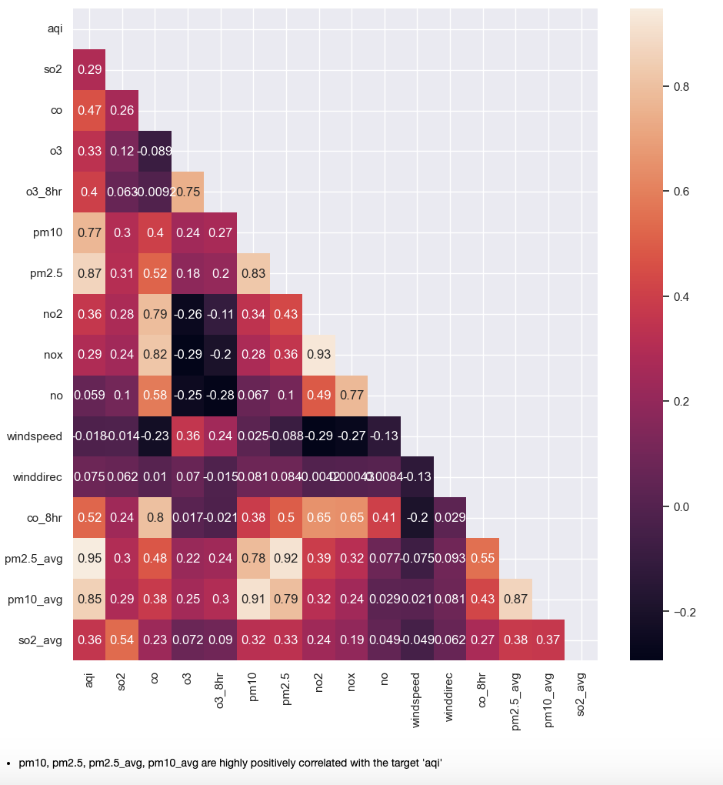
Exploratory Data Analysis
pm10, pm2.5, pm2.5_avg and pm10_avg are highly positively correlated with target aqi

Slide 14
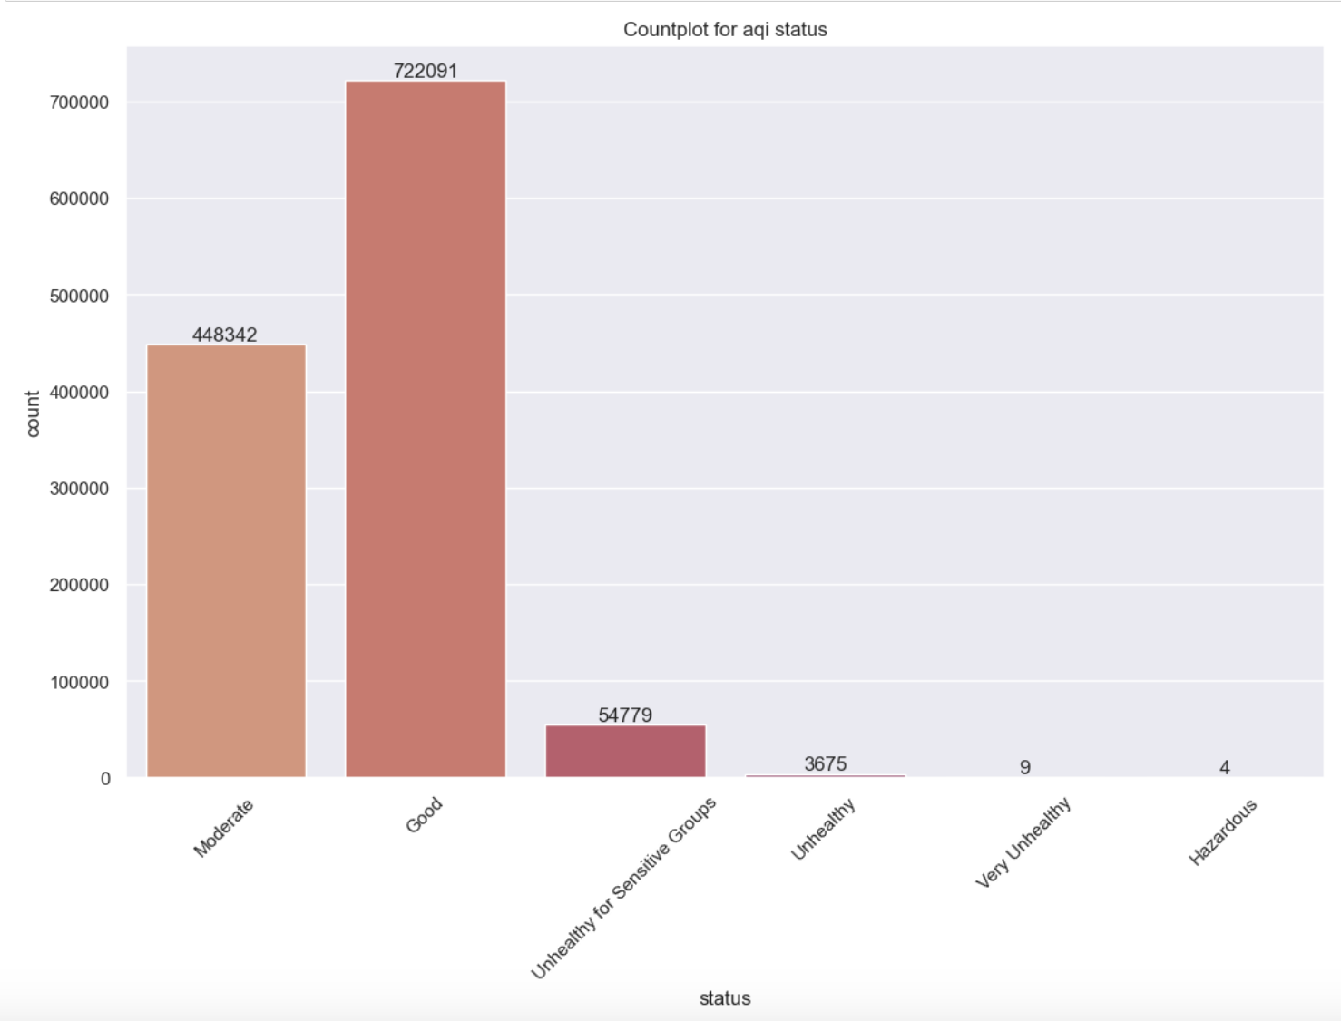
Exploratory Data Analysis
There are more instances of data with good aqi values than with hazardous aqi values

Slide 15
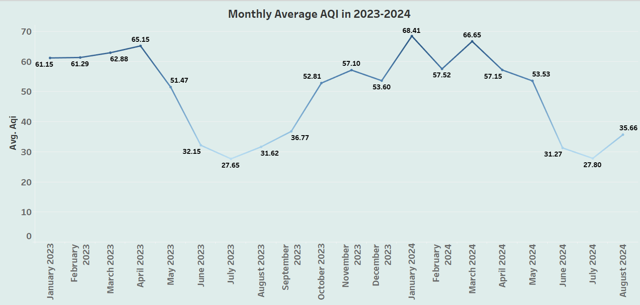
Data Visualisation
The Monthly average AQI is best during summer and worst during winter season

Slide 16
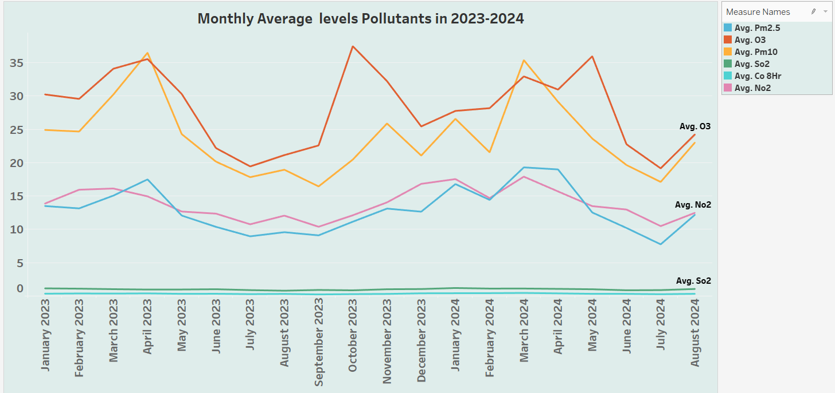
Data Visualisation

Slide 17
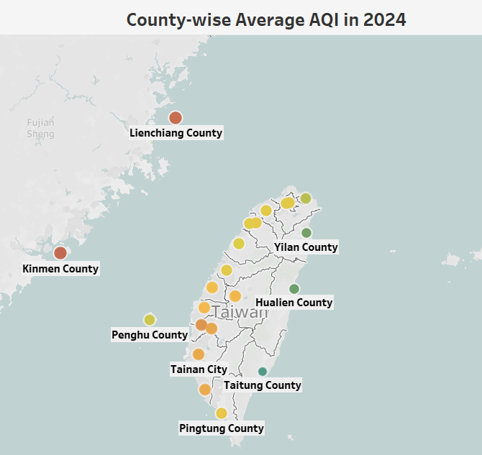
Data Visualisation
Taitung county has the best average aqi whereas Kinmen has the worst average aqi in the year 2024

Slide 18
Data Preparation
The columns with 100% NaN value ‘unit’ was dropped. The ‘pollutant’ had NaN values when the aqi value was good(which was more than 50%), hence dropped this column as it can lead to possible data leakage.
Few other columns like siteid, sitename, county, latitude, longitude were also dropped as they are not relevant for predicting the target.
The missing values were dropped as part of data preparation. Since we have a quite large dataset and due to lack of domain knowledge imputations were not done.
Winddirec column has values which were greater than 359. Generally, winddirec is measured as a degree ranging between 0 and 359. So dropped these rows.

Slide 19
Data Preparation
The final data is split into train and test with 80% train data and 20% test data.
['pm2.5_avg','o3','so2_avg','so2','no2','nox','no','windspeed','winddirec’] these columns were dropped as part of feature selection. From feature Importance of tree-based model these features were removed based on their influence on the target.
pm2.5_avg was dropped because it was causing a data leakage by contributing to 90% towards target ‘aqi prediction.
o3, so2_avg, so2, no2,nox,no,windspeed, winddirec these columns were dropped as their contribution was very negligible which was less than 2% towards target ‘aqi’.

Slide 20
Modelling
RandomForestRegressor
Accurate
Easy to tune
Handles complex, non-linear data
Resistant to overfitting
Can use oob_score

Slide 21
Modelling
RandomForestRegressor -Hyperparameters tuned using RandomizedSearchCV
n_estimators : 150
max_leaf_nodes : 100
max_features : 'sqrt'
max_depth : 12
cv : 5

Slide 22
Model Evaluation
Train Data
R^2 - 0.918
RMSE - 7.40
Test Data
R^2 - 0.918
RMSE - 7.39

Slide 23
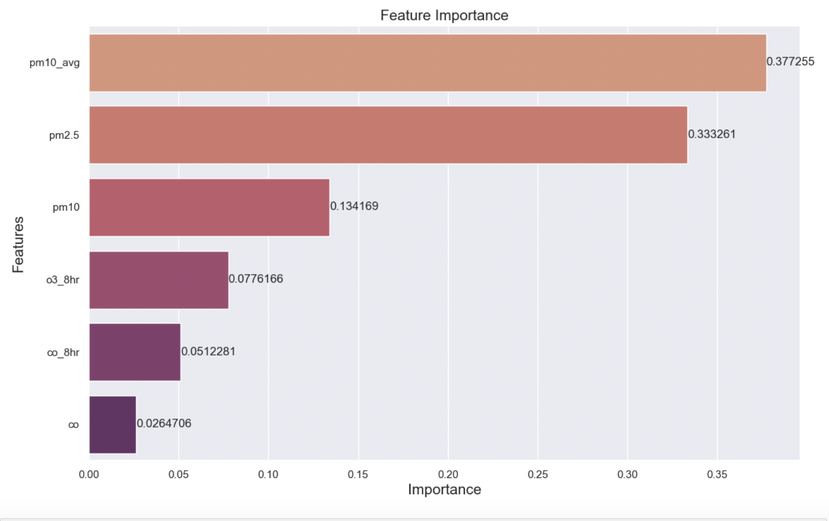
Model Interpretation
pm10_avg, pm2.5, pm10, o3_8hr,co_8hr, co are the features which are contributing to the prediction of target

Slide 24
Conclusion
The model built using RandomForestRegressor shows that the Air Quality Index is influenced by pollutant pm10_avg by 37.7% , pollutant pm_2.5 by 33.3% , pollutant pm10 by 13.4%, o3_8hr by 7.76%, co_8hr by 5.12%, co by 2.64% .
The model is generalizing well with unseen data with R^2 score of 0.918 for both train and test data.

