Slide 1
Requirements Statement
A powerful application can present multiple documents at the same time.
These documents include DrawingDocument, TextDocument, and so on.
The application is responsible for managing documents and creating them as required

Slide 2
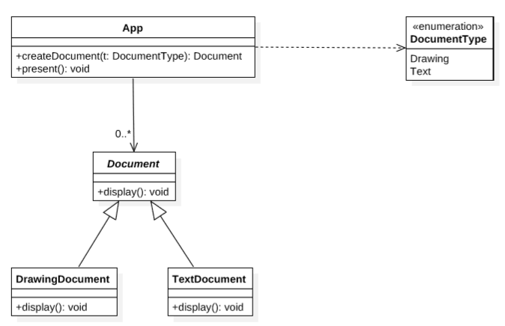
Group Design
Create document according to different documentType
manage

Slide 3
Requirements Statement
A GUI Application consists of various types of widgets such as window, scroll bar, and button.
Each widget in the GUI application has two or more implementations according to different look-and-feel standards, such as Motif and Presentation Manager.
The GUI application can switch its look-and-feel style from one to another while the widgets are being created

Slide 4
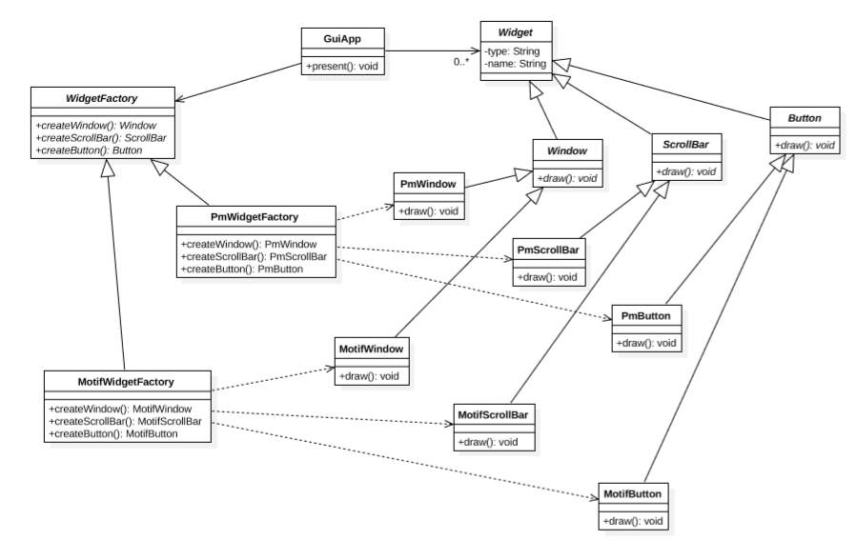
Group Design

