Slide 1
Group 1
PROJECT PROPOSAL
106-1 10/12 Software Engineering Design

Slide 2
Division
Collections (38881)
GROUP2 王本奕 王瀚磊
Graphs (3288)
GROUP3 林凡煒 蔡佳昱
Caches (5330)
Concurren (8655)
Net (1600)
I/O (4654)
Hashing (3383)
Base (5850)
Primitives (4767)
Escape (587)
EventBus(551)
Math (2958)
Reflection (2882)
Annotation (49)
Total:38881
Total:21850
Total:22974
GROUP1 張育瑄 張嘉豪 方珮雯

Slide 3
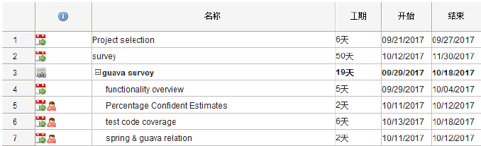
WBS

Slide 4
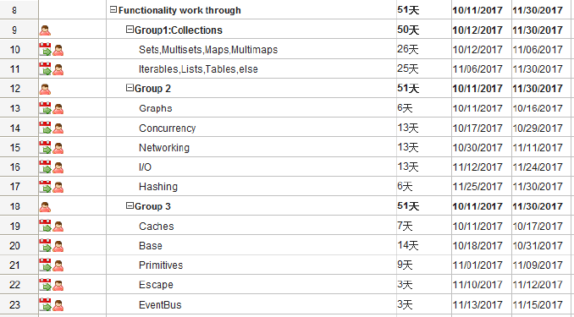
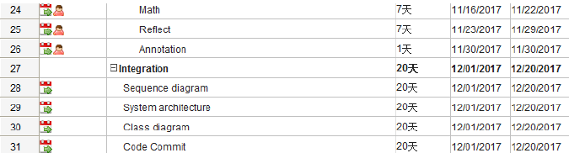
1
2
3

Slide 5
WBS

Slide 6
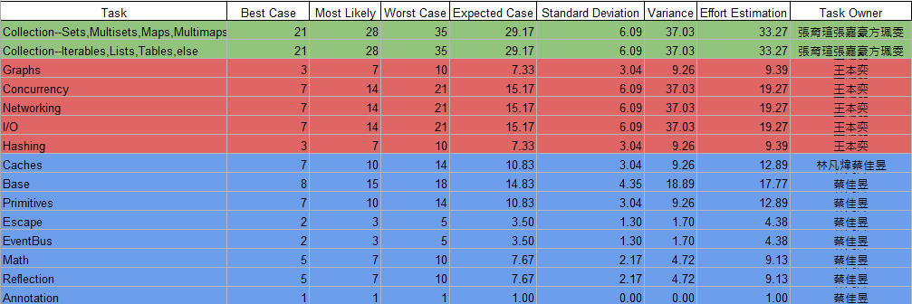
Estimation Model
1
2
3
信心水準 75%

Slide 7
Risk
java語法不熟悉
時間不夠用
預估時程的信心指數太低
system architecture 不全面

Slide 8
WHY SPRING DROPPED GOOGLE GUAVA?

Slide 9
Spring Version
V4.0.0.RELEASE 2013/12/11
- Introduced GuavaCacheManager as an alternative to ConcurrentMapCacheManager
V5.0.0.M1 2016/7/28
- Adding caching support for Caffeine

Slide 10
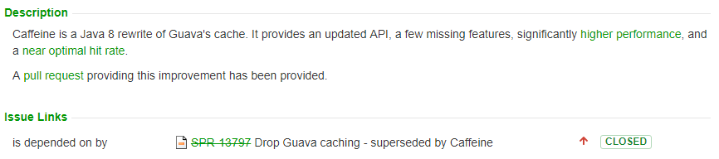
Issue: SPR-13690 (Ben Manes)
https://jira.spring.io/browse/SPR-13690
https://www.voxxed.com/2015/12/add-a-boost-of-caffeine-to-your-java/

Slide 11
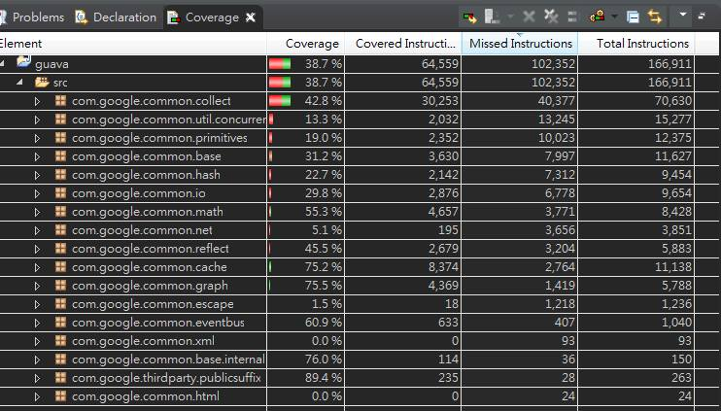
Test Code Coverage

Slide 12
Thanks!
Any questions?

