Slide 1
Group 1
PROJECT PROPOSAL
106-1 10/19 Software Engineering Design

Slide 2
Division
Collections (38881)
GROUP2 王本奕 王瀚磊
Graphs (3288)
GROUP3 林凡煒 蔡佳昱
Caches (5330)
Concurren (8655)
Net (1600)
I/O (4654)
Hashing (3383)
Base (5850)
Primitives (4767)
Escape (587)
EventBus(551)
Math (2958)
Reflection (2882)
Annotation (49)
Total:38881
Total:21850
Total:22974
GROUP1 張育瑄 張嘉豪 方珮雯

Slide 3
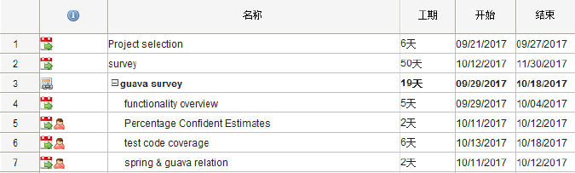
WBS

Slide 4
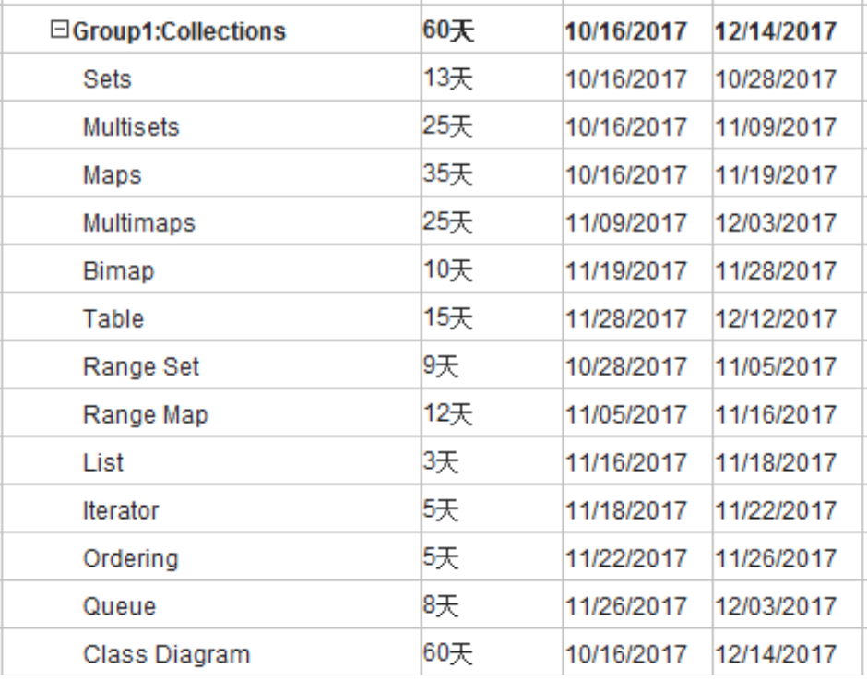

Slide 5
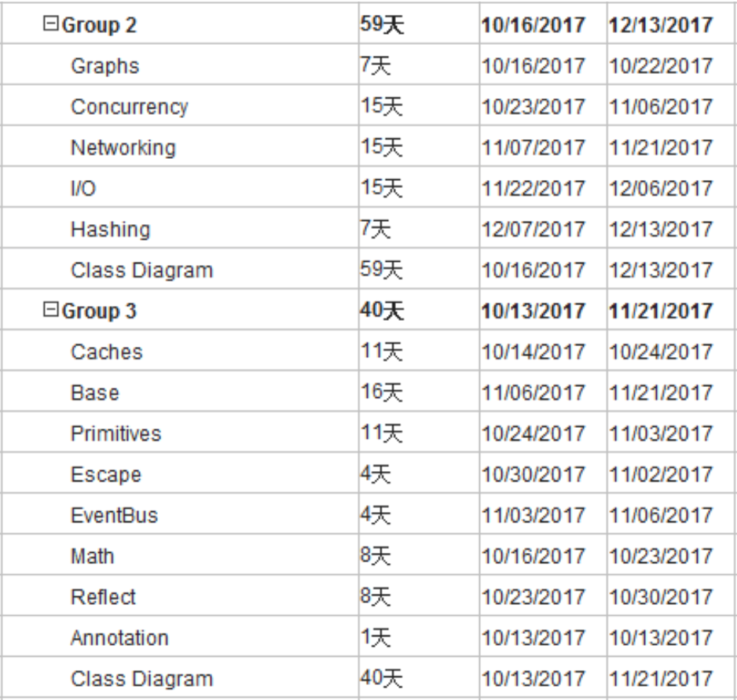

Slide 6
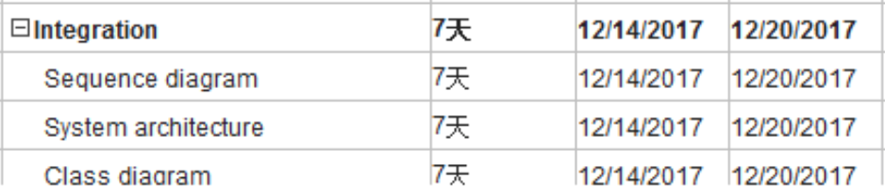
WBS

Slide 7
WHY SPRING DROPPED GOOGLE GUAVA?

Slide 8
Spring Version
V4.0.0.RELEASE 2013/12/11
- Introduced GuavaCacheManager as an alternative to ConcurrentMapCacheManager
V5.0.0.M1 2016/7/28
- Adding caching support for Caffeine

Slide 9
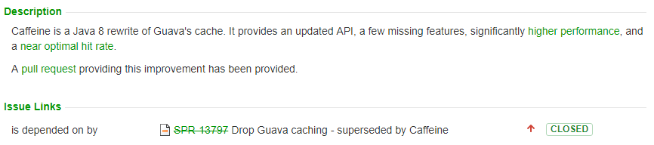
Issue: SPR-13690 (Ben Manes)
https://jira.spring.io/browse/SPR-13690
https://www.voxxed.com/2015/12/add-a-boost-of-caffeine-to-your-java/

Slide 10
Class Diagram
Group 1

Slide 11
Hospital System
Physician
RegisteredPhysician
1
1…*
Hospital
+record(tm: treatment): void
1
+admit(patient: Patient): void
Treatment
1…*
-date: string
-time: string
-result: string
+record: void
Treat
admitted
0…*
Patient
*

Slide 12
Sharpen Your Skill¹
A country has a capital city.
Country
1
1
Capital City
A dining philosopher is using
a fork.
Dining Philosopher
<< use >>
Fork
Ordinary
File
A file is an ordinary file or a directory file.
File
Directory
File

Slide 13
Sharpen Your Skill¹
Files contain records.
File
1..*
Record
Text
A drawing object is text,
a geometrical object, or
a group.
Drawing
Object
Geometrical Object
Group

Slide 14
Sharpen Your Skill²
A person uses a computer language on a project.
Person
1
Project
work_on
Computer
Language
Modems and keyboards are input/output devices.
Modem
I/O
Device
Keyboard

Slide 15
Sharpen Your Skill²
Object classes may have
several attributes.
0..*
Object
Attribute
A person plays for a team in a certain year.
Person
1
Team
play_for
Year

Slide 16
Sharpen Your Skill²
A route connects two cities.
Route
2
City
connect
A student takes a course from a professor.
Student
Professor
Course

Slide 17
Thanks!
Any questions?

