Slide 1
Group 1
PROJECT PROPOSAL
106-1 11/2 Software Engineering Design

Slide 2
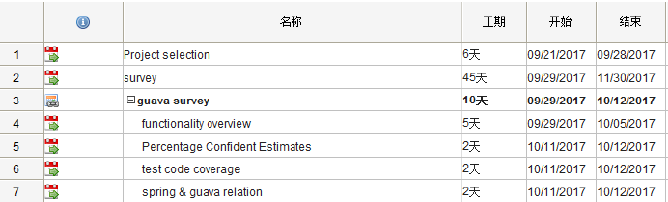
WBS

Slide 3
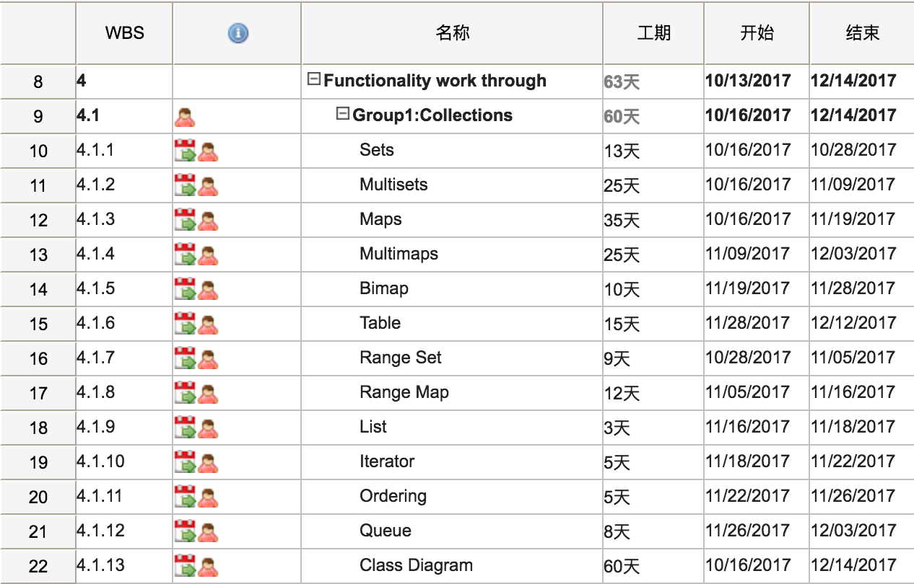
WBS

Slide 4
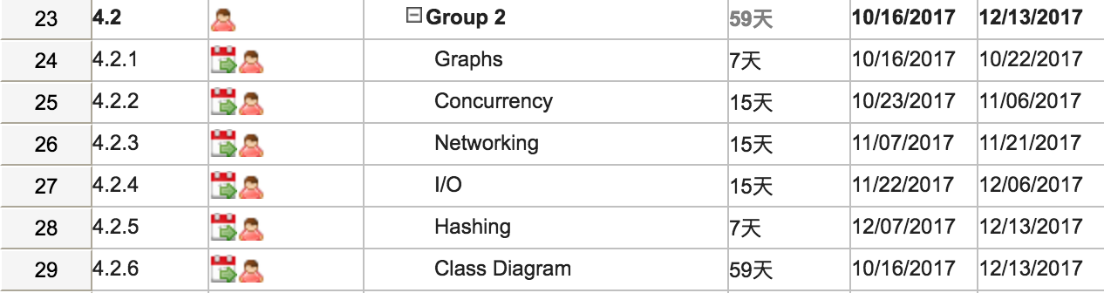
WBS

Slide 5
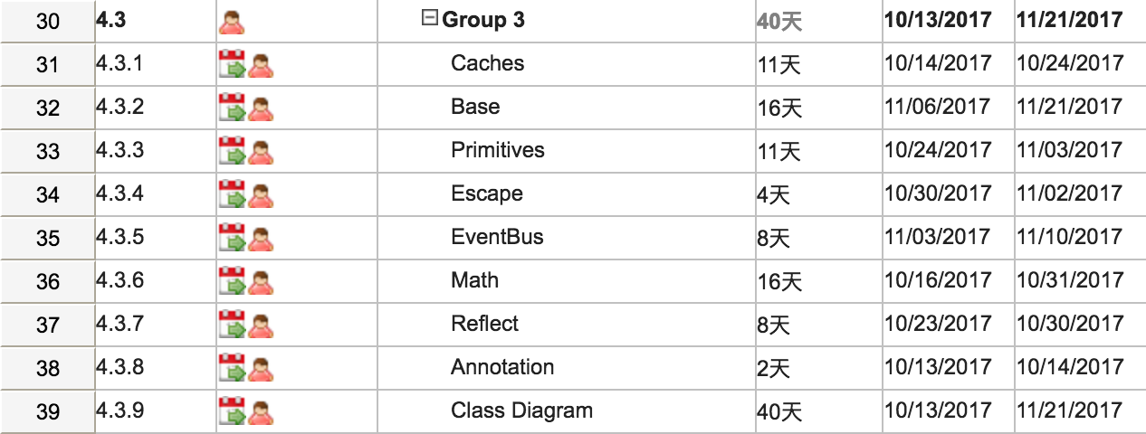
WBS

Slide 6

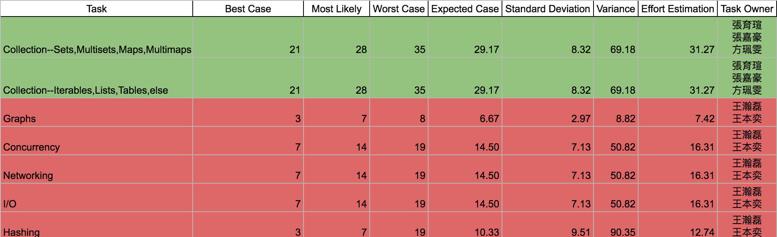
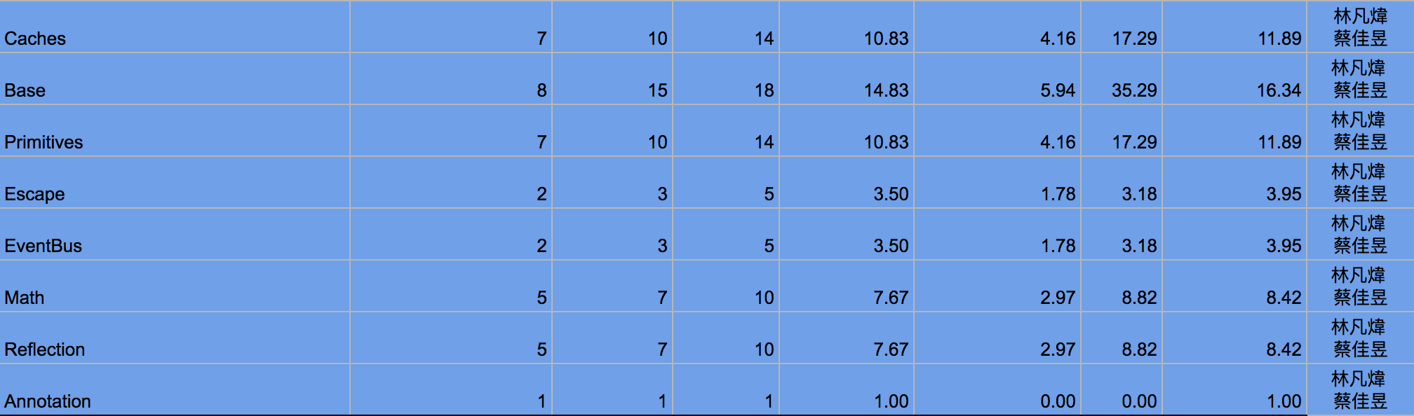
Estimation Model

Slide 7
BiMap
BiMap
Graph
Cache

Slide 8
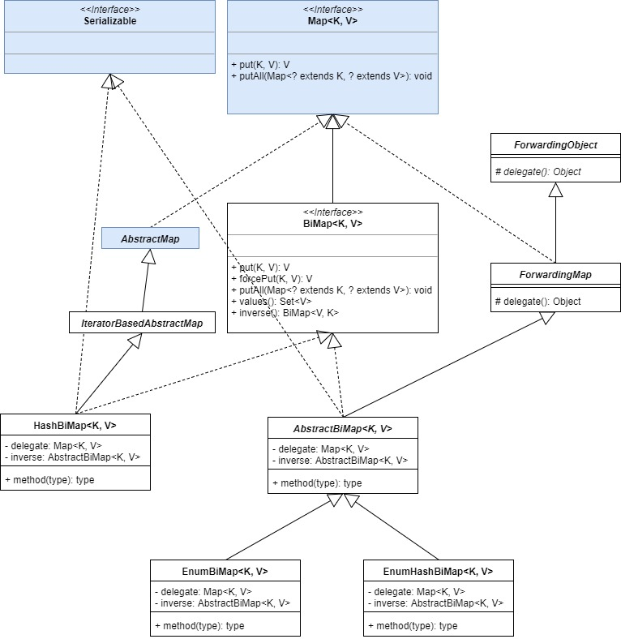

Slide 9
Graph
BiMap
Graph
Cache

Slide 10
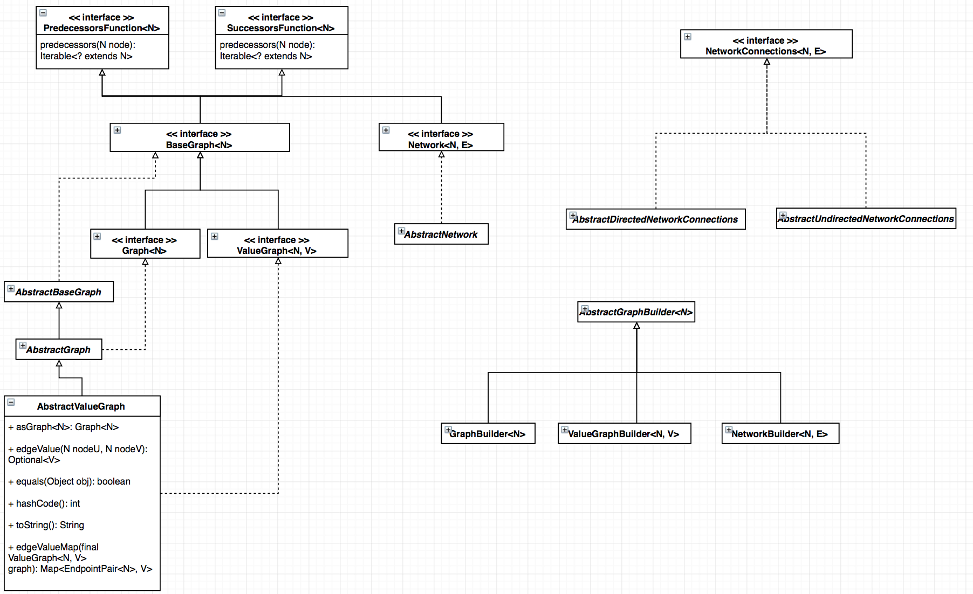
Overview
Notes:
Graph<Airport>, whose edges connect the airports between which one can take a direct flight.
ValueGraph<Airport, Integer>, whose edges values represent the time required to travel between the two Airports that the edge connects.
Network<Airport, Flight>, in which the edges represent the specific flights that one can take to get from one airport to another.

Slide 11
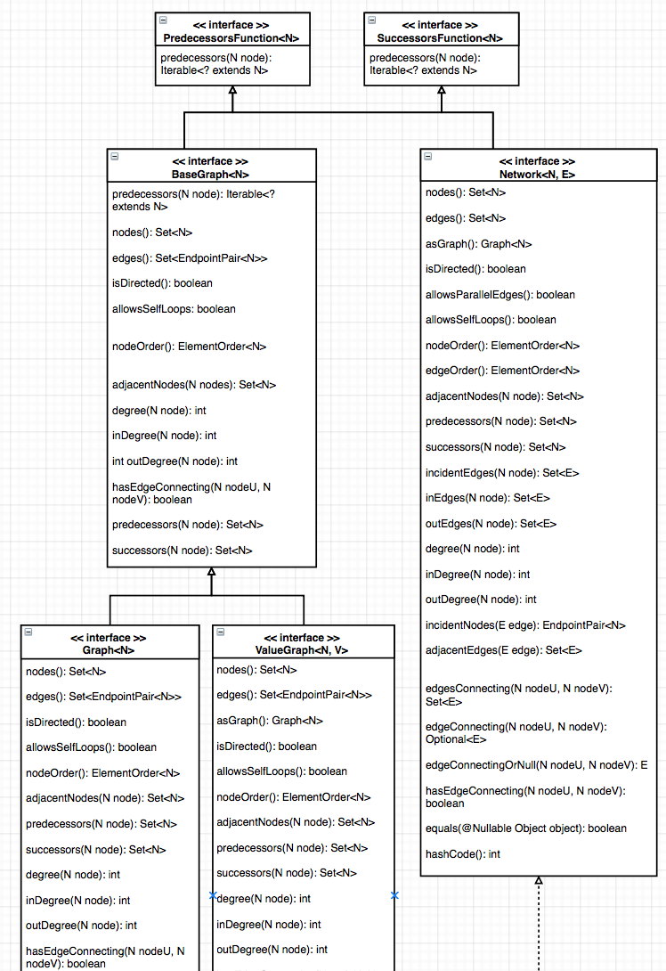
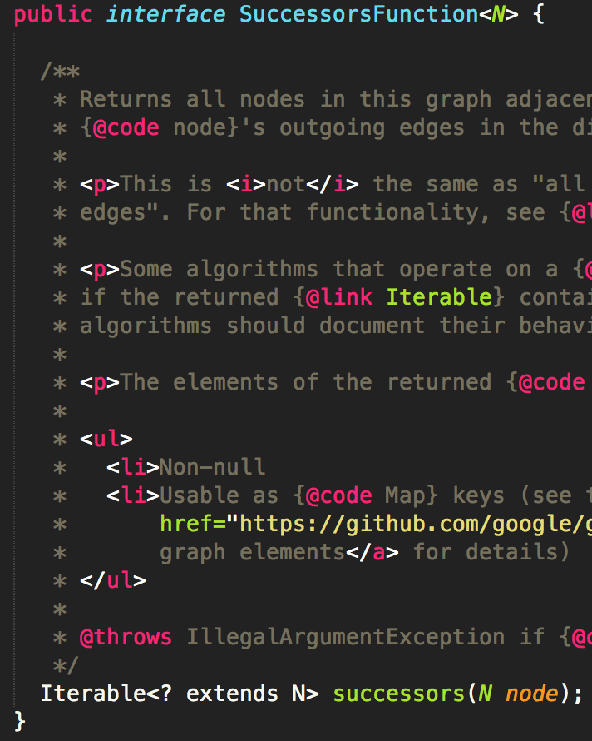
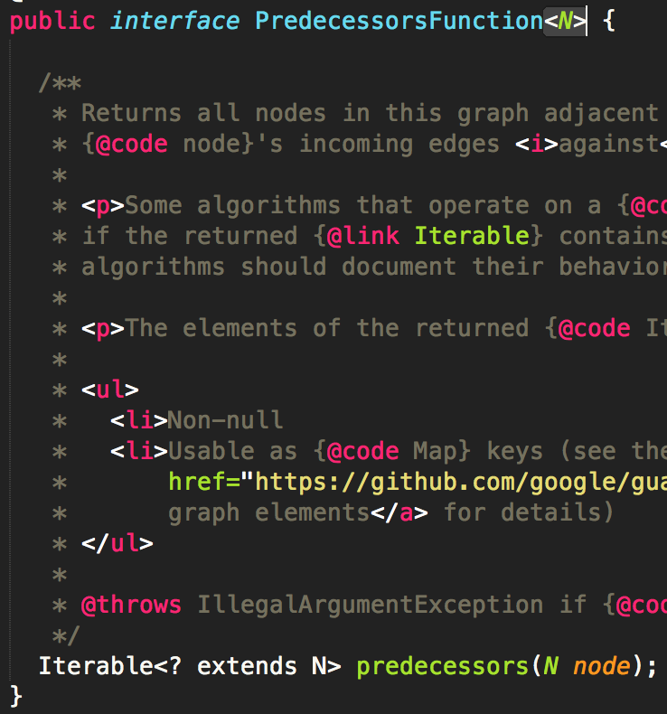
Notes:
Duplicate code ? No! it can let the developer more flexible when design predecessor or successor functions

Slide 12
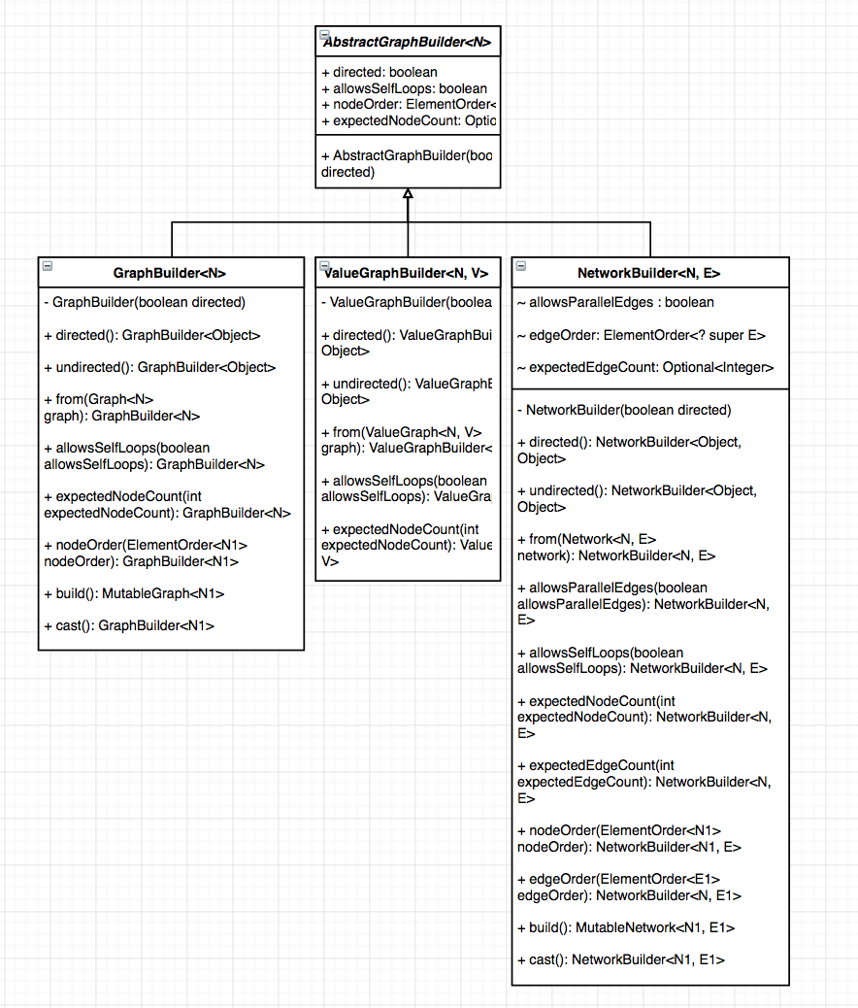
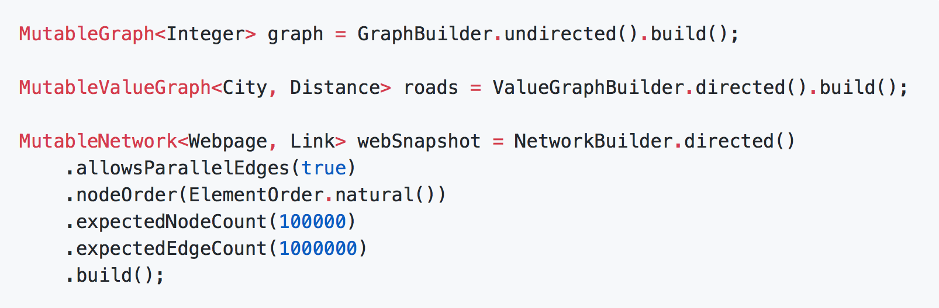
Notes:
Builder Pattern

Slide 13
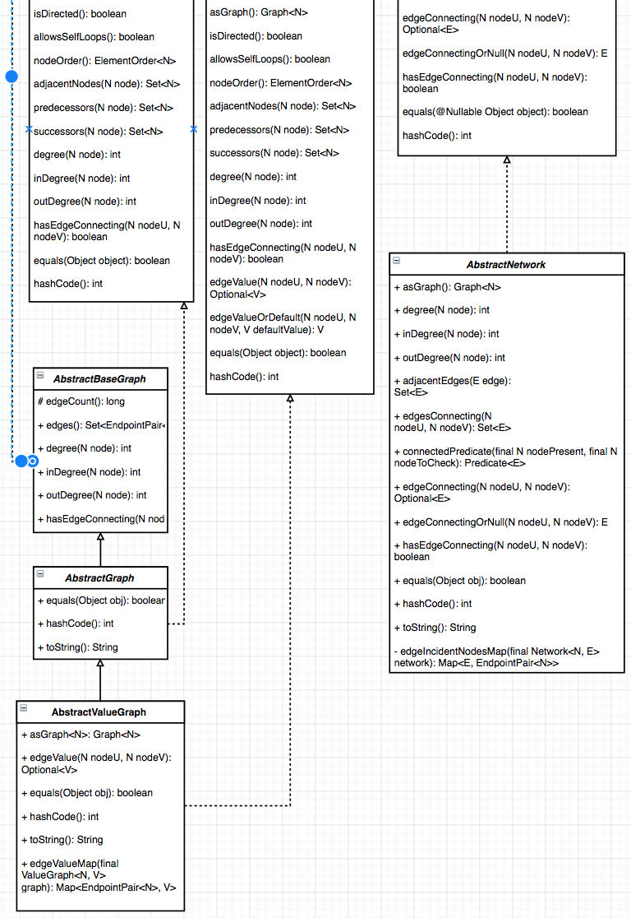
Inherit the most important class and delegate the rest.

Slide 14
Cache
BiMap
Graph
Cache

Slide 15
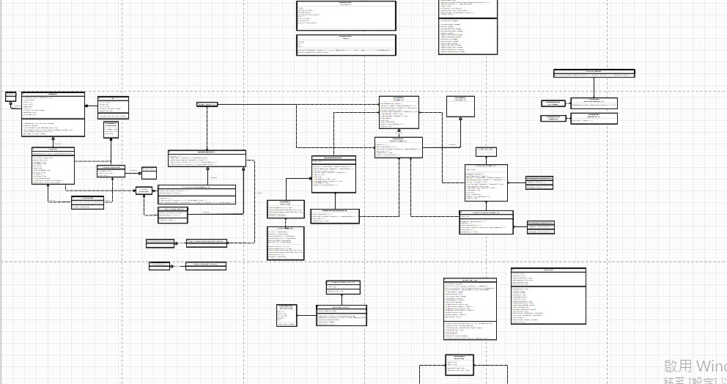
Overview

Slide 16
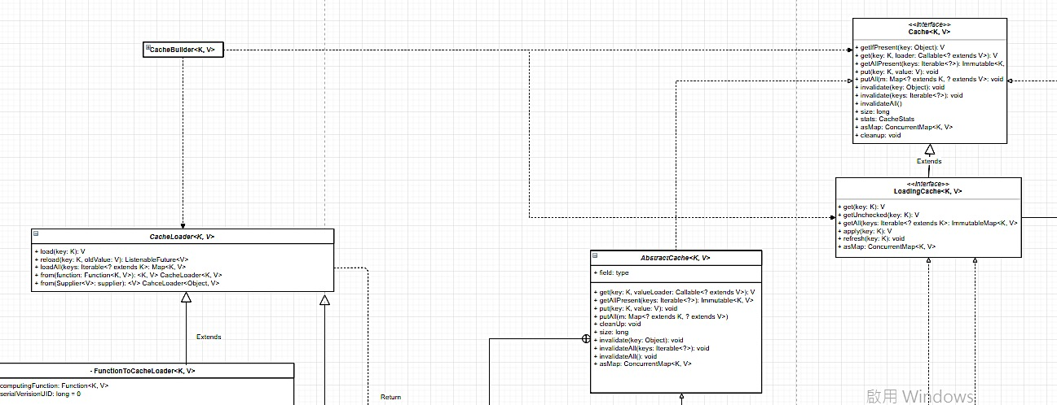

Slide 17
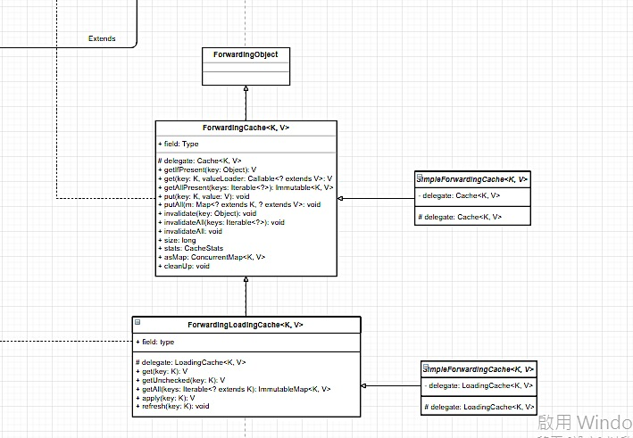

Slide 18
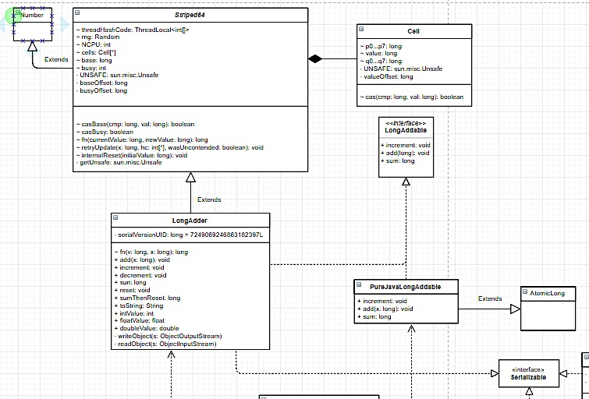

Slide 19
Thanks!
Any questions?

