Slide 1
Progress Report
106 – 1 Group 1 11/9

Slide 2
Immutable Set

Slide 3
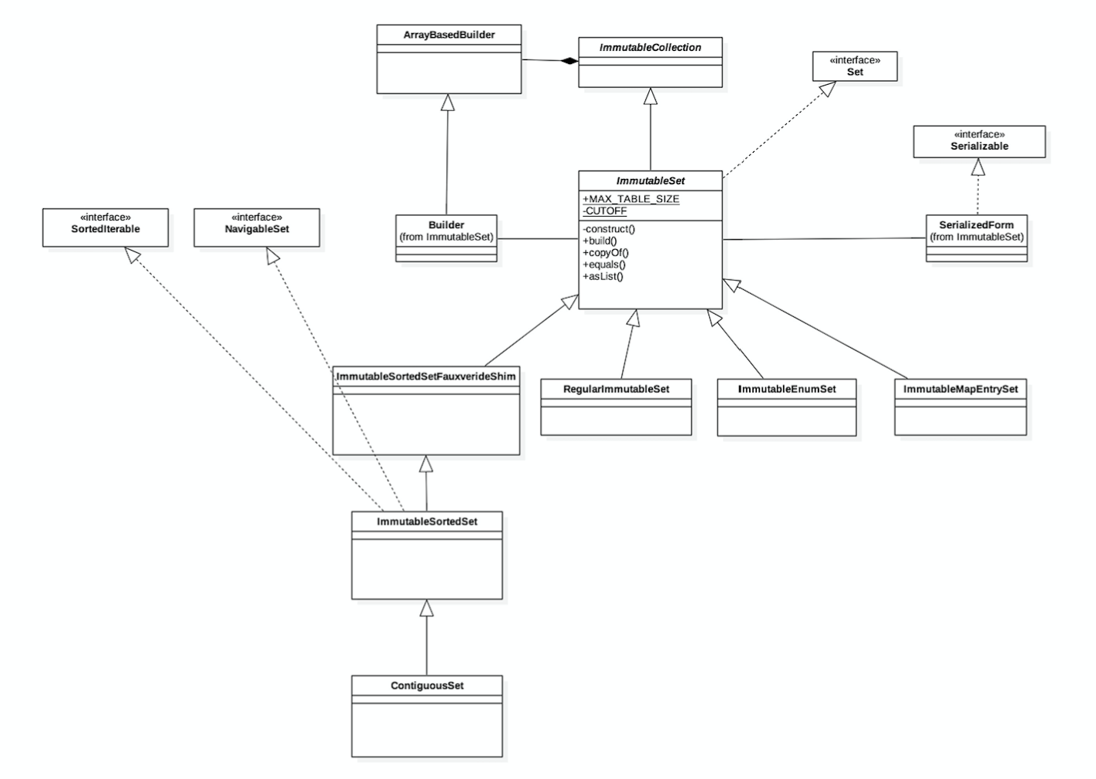

Slide 4
Graph

Slide 5
Iterator Pattern
Intent:
Provide a way to access the elements of an aggregate object sequentially without exposing its underlying representation.
Iterator Pattern Class Diagram

Slide 6
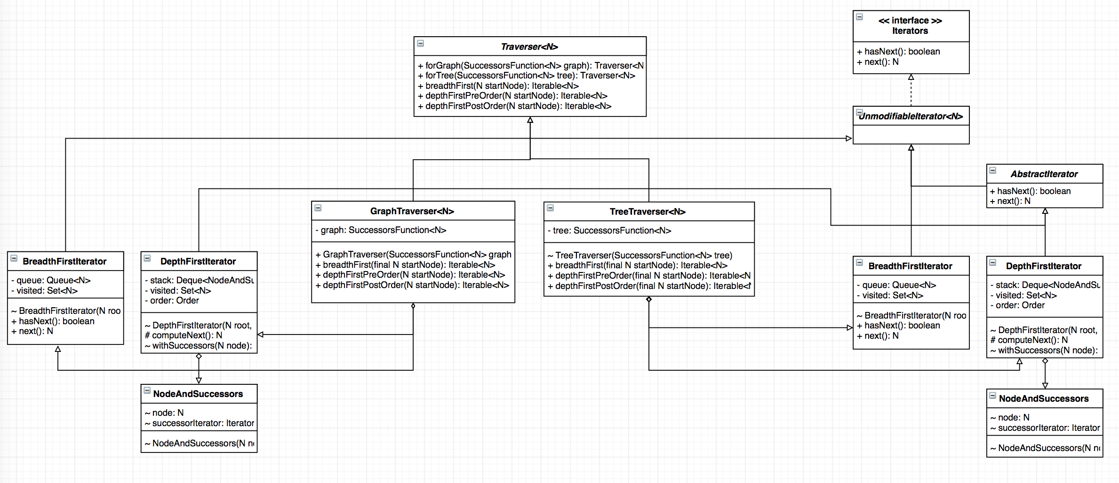
Graph Traverse Iterator
Notes:
Traverser: container
Iterators: Iterator
common.graph does not (at this time) include explicit support for the following graph variants, although they can be modeled using the existing types:
trees, forests
graphs with elements of the same kind (nodes or edges) that have different types (for example: bipartite/k-partite graphs, multimodal graphs)
hypergraphs
common.graph does not allow graphs with both directed and undirected edges.

Slide 7
Escaper

Slide 8
TXT
HTML
<
>
&lt;
&gt;
Escaper

Slide 9
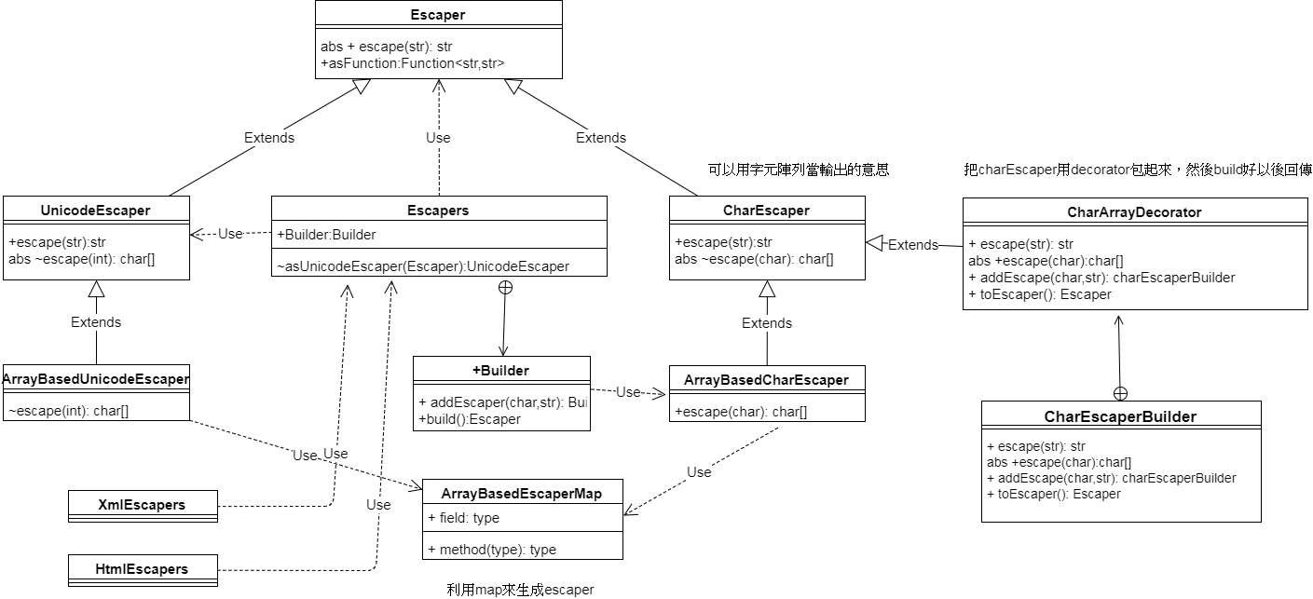
2
static
3
非arraybased
map
1
Notes:
decorator是要包什麼 包chararray
charEscaperBuilder和Escaper build有什麼差
escapers不thread safe 可以重複利用，建出來的是ArrayBasedCharEscaper和unicodeEscaper，但是uinicodeEscaper會被加上arrabased的功能
CharEscaperBuilder建出來的是CharEscaper
上層的class畫上面
位和右邊用map左邊不用:CharEscaperBuilder是只接受Add，然後在內部轉為map再建escaper
arraybased那些事一開始輸入就是ㄧ個map
asFunction把class的功能用asFunction跑出來

Slide 10
Multiset

Slide 11
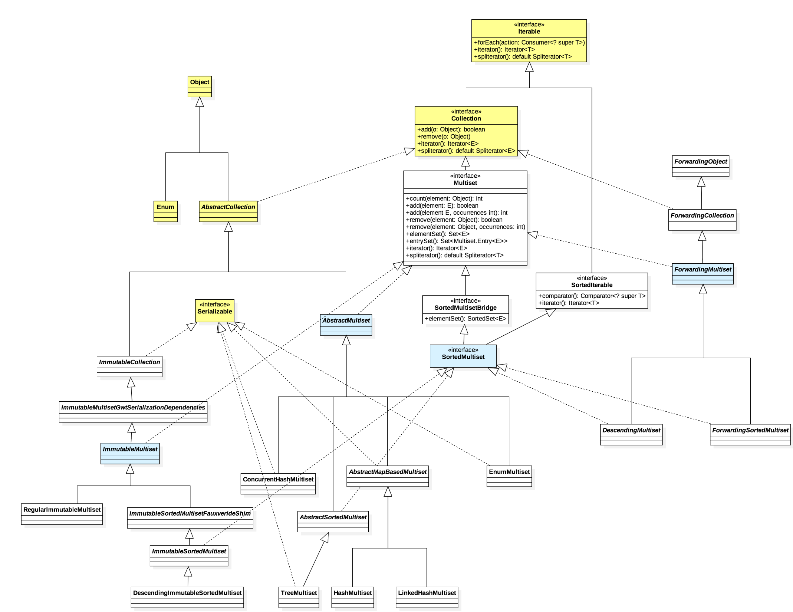

Slide 12


Slide 15


