Slide 1
An object oriented model for IPv4/IPv6 network management
Armand Pieterse, 12167844
Kgomotso Sito, 12243273
Jimmy Peleha, 12230830
Azhar Mohungoo, 12239799
Ndivhuwo Nthambeleni, 10001183

Slide 2
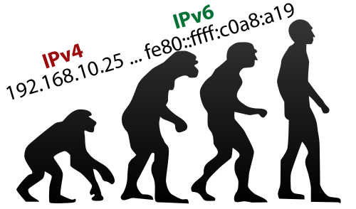
The Problem
Centralized network management.
IPv4 and IPv6 coexistence.
Monitoring resources
Object and Relational Mapping.

Slide 3
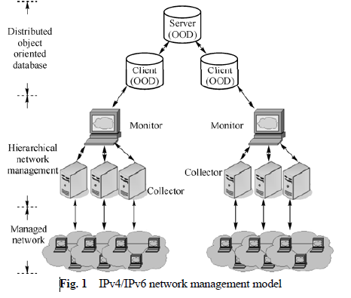
The Solution
Proposed hierarchal network management model
3 Basic Components
OOD (Distributed Object Oriented Database)
Monitor
Collector

Slide 4
Opinion on Advantages and Disadvantages
Hierarchical and Distributed Architectures
Availability, reliability, scalability, flexibility
Centralized Architecture
Maintenance
Modules
Performance Module, SHH channel module, User interface, Twisted
OODB
Data object, complex data type, algorithms
Relational DB’s
Mature, Data in this formant, and fast retrieval

Slide 5
Relevance to 326 and Organisations
Object-Oriented Databases (OODB)
Stores, not data, but objects
Encapsulates combinations of data structures together with associated functions
Object-Oriented Database Management System (OODBMS)

Slide 6
Conclusion
Transition introduced complexity issue
Solved!
Coexistence created the need for uniform network management
Solved!
Management System is
Flexible
Scalable
Reliable

