Slide 1
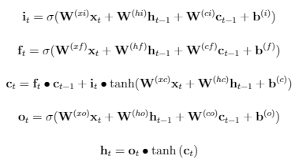













$$x_{t}$$
$$h_{t}$$
$$x_{t}$$
$$h_{t}$$
Input Gate
$$i_{t}$$
Output Gate
$$i_{t}$$
LSTM CELL
$$h_{t}$$
$$c_{t}$$
$$h_{t}$$
$$x_{t}$$
Forget Gate
$$i_{t}$$
$$x_{t}$$
$$h_{t}$$

Slide 2

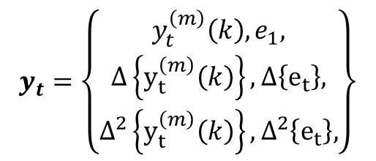

Pre-emphasis
x_{t}(n)
DFT
Mel filter banks
Log(| |²)
IDFT
MFCC
x(t)
x‘(n)
Window
Energy
$$e_{1}$$
$$y_{t}=\left\{\begin{matrix}y_{t}^{\left(m\right)}\left(k\right),e_{1}, \\ Δ\left\{y_{t}^{\left(m\right)}\left(k\right)\right\},Δ\left\{e_{t}\right\}, \\ Δ^{2}\left\{y_{t}^{\left(m\right)}\left(k\right)\right\},Δ^{2}\left\{e_{t}\right\},\end{matrix}\right\}$$
Derivatives
MFCC
$$y_{t}^{\left(m\right)}\left(k\right)$$

Slide 3

Speech
Signal
x(n)
DFT
X(k)
Log(| |)
log(|X(k)|)
IDFT
$${\hat{x}}_{r}(n)$$
Cepstrum

Slide 4
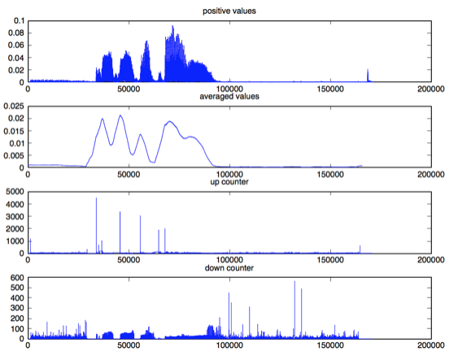
a
b
c
d

Slide 5
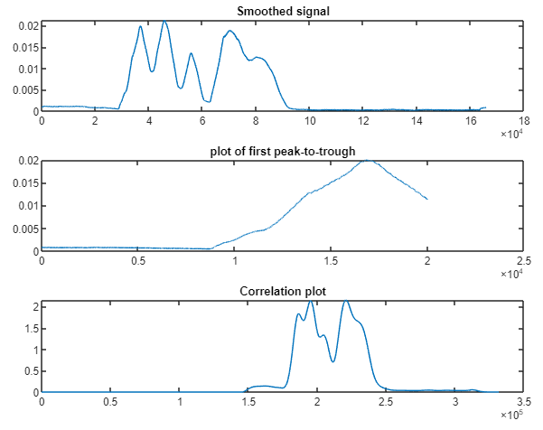
a
b
c

Slide 6




Training speech data
Acoustic models of speech units
Segmentation
and training
Feature Extraction
Speech Decoder
SPEECH SIGNAL
Acoustic features
SPEECH SIGNAL
$$W=w_{1}, …, w_{N}$$
$$O=o_{1}, …, o_{t}$$
$$W=w_{1}, …, w_{N}$$
Training text data
Statistical language model
Lexicon model (pronunciation dictionary)
Normalise
and analyse

Slide 7
$$U_{Δ_{1}}(k+b_{1})$$
𝑈_(Δ_1 ) (𝑘+𝑏_1)
$$U_{Δ_{2}}(k+b_{2})$$
𝑈_(Δ_2 ) (𝑘+𝑏_2)
…
$$X_{t}(k)$$
𝑋_𝑡 (𝑘)
$$U_{Δ_{24}}(k+b_{24})$$
𝑈_(Δ_24 ) (𝑘+𝑏_24)
Gain
0
8000 Hz
Gain
0
8000 Hz
Gain
0
8000 Hz

Slide 8
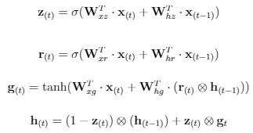
$$x_{t}$$
$$h_{t}$$
$$x_{t}$$
$$h_{t}$$
Input Gate
$$i_{t}$$
Output Gate
$$i_{t}$$
LSTM CELL
$$h_{t}$$
$$c_{t}$$
$$h_{t}$$
$$x_{t}$$
Forget Gate
$$i_{t}$$
$$x_{t}$$
$$h_{t}$$

Slide 9
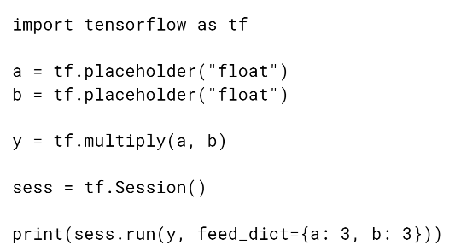
Import Tensorflow library
Define placeholder for input data
Build Graph stage
Add multiply to build graph
Run graph in session
Start a run session
Execute graph within session with data supplied

Slide 10
Language model evaluation pipeline
GRU LM train
GRU-Generated-Corpus 5-gram train
GRU-Generated-Corpus 5-gram evaluate perplexity
Held out data
5-gram LM train
5-gram LM evaluate perplexity

Slide 11

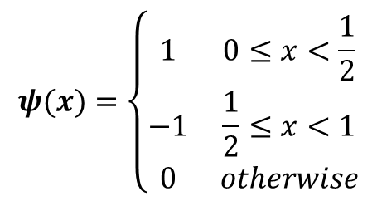

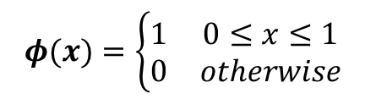





$$φ(x)$$
$$1$$
$$φ(x)=\left\{\begin{matrix}1 & 0≤x≤1 \\ 0 & otherwise\end{matrix}\right.$$
$$1$$
$$ψ(x)=\left\{\begin{matrix}1 & 0≤x<\frac{1}{2} \\ −1 & \frac{1}{2}≤x<1 \\ 0 & otherwise\end{matrix}\right.$$
$$ψ(x)$$
$$1$$
$$1$$
-$1$

Slide 12
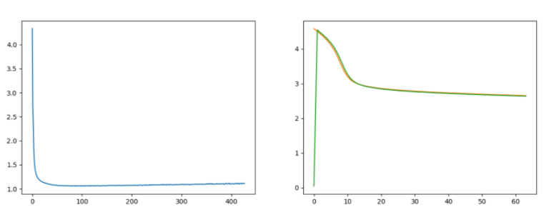

Slide 13
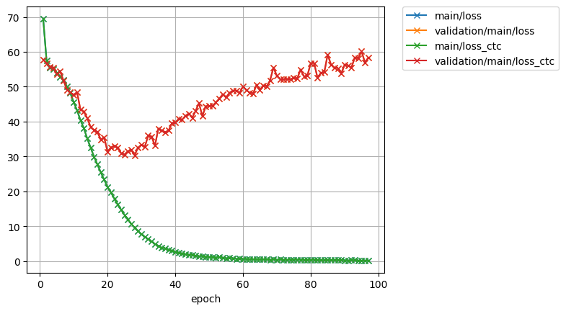
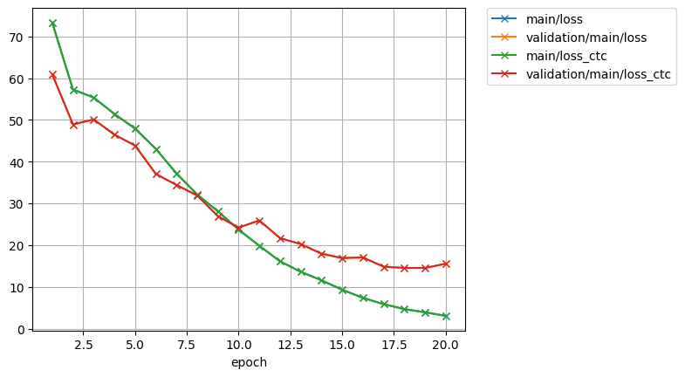
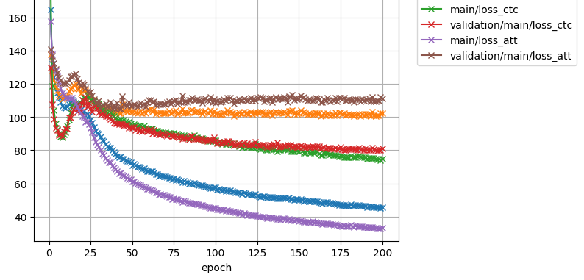
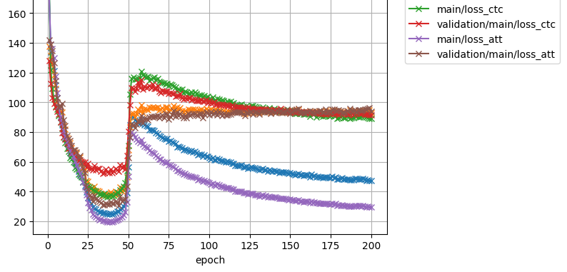

Slide 14





“du” “lait”
y’(0)
y’(1)
y’(2)
+
h(2)
$$α_{(3,0)}$$
$$α_{(3,1)}$$
$$α_{(3,2)}$$
+
SoftMax
Decoder
$$α_{(3,0)}$$
$$α_{(3,2)}$$
y(0)
y(1)
y(2)
e_{(3,0)}
e_{(3,1)}
e_{(3,2)}
Time Distributed (Dense)
h(2)
x(0)
x(1)
x(2)
y(0)
y(1)
y(2)
Encoder
Alignment model
“I” “drink” “milk”

Slide 15
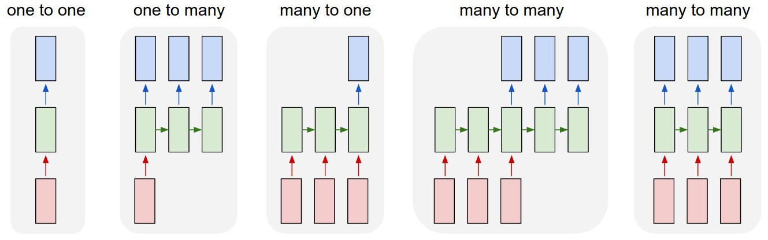
a b c d e

Slide 16
y
h(0)
h(1)
h(2)
x(0)
x(1)
x(2)
y(0)
y(1)
y(2)
h(2)
h(0)
h(2)
x(0)
x(1)
x(2)
x(1)
x(2)
x(3)
h(0)
h(1)
x(0)
x(1)
x(2)

