Slide 1

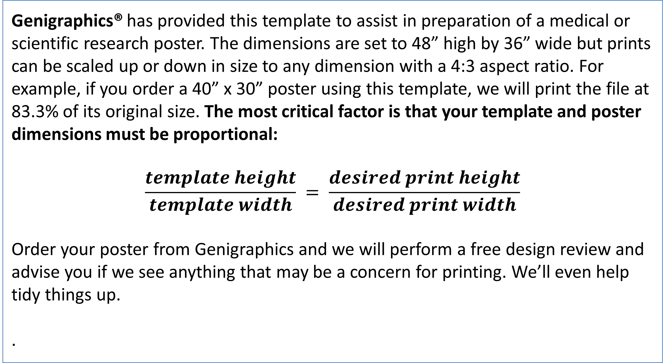
Deep Scattering End-to-End Speech Recognition
John Alamina¹; David Wilson, PhD¹; Andrew Crampton, PhD¹
¹University of Huddersfield
Abstract
Results
This work explores the prospects of deep recurrent end-to-end architectures applied to speech recognition. Complementary aspects of developing speech recognition systems are eliminated by focusing on end-to-end speech units as a two-step process requiring a Connectionist Temporal Character Classification (CTCC) model and Language Model (LM) rather than a three-step process requiring an Acoustic model(AM), LM and phonetic dictionary. A two-step process rather than a three-step process is particularly desirable for low resource languages as resources are required to build only two models instead of three models.
Our Bi-directional Recurrent neural network (Bi-RNN) end-to-end system, is augmented by features derived from a deep scattering network as opposed to the standard Mel Cepstral (MFCC) features used in state of the art acoustic models. These specialised deep scattering features, consumed by the Bi-RNN, model a light-weight convolution network. This work shows that it is possible to build a speech model from a combination of deep scattering features and a Bi-RNN. There has been no record of deep scattering features being used in end-to-end bi-RNN speech models as far as we are aware.
GPU training of the speech model architecture developed above was done using Mozilla deepspeech \cite{mdeepspeech} implementation along with the accompanying Mozilla Common voice dataset \cite{mcvd}. The Common Voice Dataset project consists of voice samples in short recordings approximately 4 seconds each. The complete dataset is about 250 hours of recording divided into training, test and development subsets.
A total of four experiments were carried out on two different GPU configurations. The set of experiments was on a Two-GPU configuration having a total of 10 gigabytes of memory. While the second set of experiments was carried out on a 5-GPU set configuration having a total of 15 gigabytes of memory. For each configuration two experiments were carried out on a small subset of the dataset then on a larger subset of the common voice dataset being used. The various GPU configurations along with the training times is shown in table \ref{table06a_gputraining}..
Table 1. Label in 24pt Calibri.
Introduction
 | Heading | Heading | Heading
Item | 800 | 790 | 4001
Item | 356 | 856 | 290
Item | 228 | 134 | 238
Genigraphics® has provided this template to assist in preparation of a medical or scientific research poster. The dimensions are set to 48” high by 36” wide but prints can be scaled up or down in size to any dimension with a 4:3 aspect ratio. For example, if you order a 40” x 30” poster using this template, we will print the file at 83.3% of its original size. The most critical factor is that your template and poster dimensions must be proportional:
$$\frac{template height}{template width} = \frac{desired print height}{desired print width}$$
Order your poster from Genigraphics and we will perform a free design review and advise you if we see anything that may be a concern for printing. We’ll even help tidy things up.
.
Methods and Materials
Chart 1. Label in 24pt Calibri.
Click here to insert your Methods and Materials text. Type it in or copy and paste from your Word document or other source.
This text box will automatically re-size to your text. To turn off that feature, right click inside this box and go to Format Shape, Text Box, Autofit, and select the “Do Not Autofit” radio button.
To change the font style of this text box: Click on the border once to highlight the entire text box, then select a different font or font size that suits you. This text is Calibri 32pt and is easily read up to 4 feet away on a 48x36 poster.
Zoom out to 100% to preview what this will look like on your printed poster.
Funding
Click here to insert your Discussion text. Type it in or copy and paste from your Word document or other source.
This text box will automatically re-size to your text. To turn off that feature, right click inside this box and go to Format Shape, Text Box, Autofit, and select the “Do Not Autofit” radio button.
To change the font style of this text box: Click on the border once to highlight the entire text box, then select a different font or font size that suits you. This text is Calibri 32pt and is easily read up to 4 feet away on a 48x36 poster.
Zoom out to 100% to preview what this will look like on your printed poster.
Conclusions
Click here to insert your Conclusions text. Type it in or copy and paste from your Word document or other source.
This text box will automatically re-size to your text. To turn off that feature, right click inside this box and go to Format Shape, Text Box, Autofit, and select the “Do Not Autofit” radio button.
Contact
References
<your name>
<your organization>
Email:
Website:
Phone:

