Slide 1
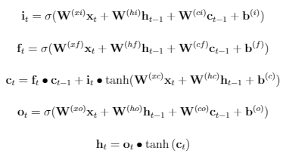













$$x_{t}$$
$$h_{t}$$
$$x_{t}$$
$$h_{t}$$
Input Gate
$$i_{t}$$
Output Gate
$$i_{t}$$
LSTM CELL
$$h_{t}$$
$$c_{t}$$
$$h_{t}$$
$$x_{t}$$
Forget Gate
$$i_{t}$$
$$x_{t}$$
$$h_{t}$$

Slide 2

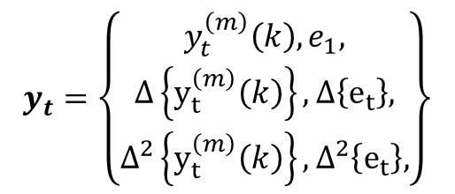

Pre-emphasis
x_{t}(n)
DFT
Mel filter banks
Log(| |²)
IDFT
MFCC
x(t)
x‘(n)
Window
Energy
$$e_{1}$$
$$y_{t}=\left\{\begin{matrix}y_{t}^{\left(m\right)}\left(k\right),e_{1}, \\ Δ\left\{y_{t}^{\left(m\right)}\left(k\right)\right\},Δ\left\{e_{t}\right\}, \\ Δ^{2}\left\{y_{t}^{\left(m\right)}\left(k\right)\right\},Δ^{2}\left\{e_{t}\right\},\end{matrix}\right\}$$
Derivatives
MFCC
$$y_{t}^{\left(m\right)}\left(k\right)$$

Slide 3

Speech
Signal
x(n)
DFT
X(k)
Log(| |)
log(|X(k)|)
IDFT
$${\hat{x}}_{r}(n)$$
Cepstrum

Slide 4
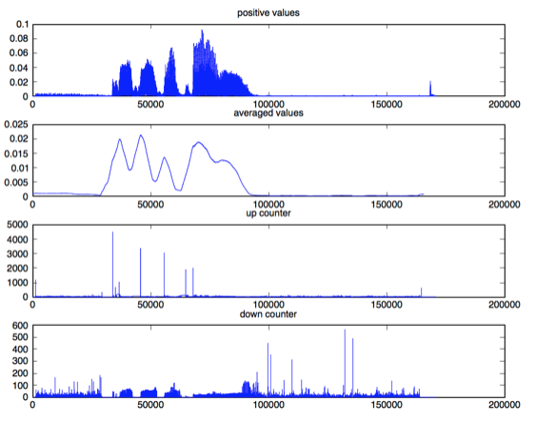
a
b
c
d

Slide 5
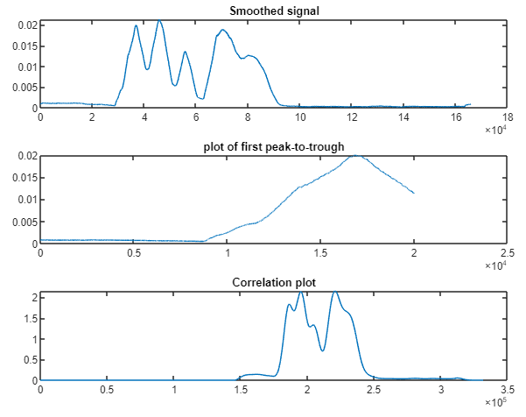
a
b
c

Slide 6




Training speech data
Acoustic models of speech units
Segmentation
and training
Feature Extraction
Speech Decoder
SPEECH SIGNAL
Acoustic features
SPEECH SIGNAL
$$W=w_{1}, …, w_{N}$$
$$O=o_{1}, …, o_{t}$$
$$W=w_{1}, …, w_{N}$$
Training text data
Statistical language model
Lexicon model (pronunciation dictionary)
Normalise
and analyse

Slide 7
$$U_{Δ_{1}}(k+b_{1})$$
𝑈_(Δ_1 ) (𝑘+𝑏_1)
$$U_{Δ_{2}}(k+b_{2})$$
𝑈_(Δ_2 ) (𝑘+𝑏_2)
…
$$X_{t}(k)$$
𝑋_𝑡 (𝑘)
$$U_{Δ_{24}}(k+b_{24})$$
𝑈_(Δ_24 ) (𝑘+𝑏_24)
Gain
0
8000 Hz
Gain
0
8000 Hz
Gain
0
8000 Hz

Slide 8
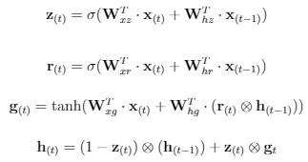
$$x_{t}$$
$$h_{t}$$
$$x_{t}$$
$$h_{t}$$
Input Gate
$$i_{t}$$
Output Gate
$$i_{t}$$
LSTM CELL
$$h_{t}$$
$$c_{t}$$
$$h_{t}$$
$$x_{t}$$
Forget Gate
$$i_{t}$$
$$x_{t}$$
$$h_{t}$$

Slide 9
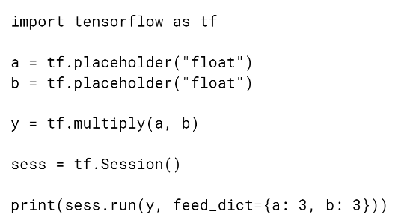
Import Tensorflow library
Define placeholder for input data
Build Graph stage
Add multiply to build graph
Run graph in session
Start a run session
Execute graph within session with data supplied

Slide 10
Language model evaluation pipeline
GRU LM train
GRU-Generated-Corpus 5-gram train
GRU-Generated-Corpus 5-gram evaluate perplexity
Held out data
5-gram LM train
5-gram LM evaluate perplexity

Slide 11

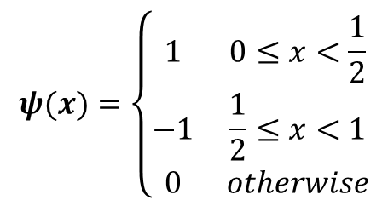

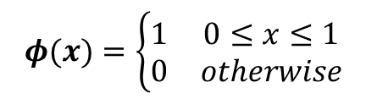





$$φ(x)$$
$$1$$
$$φ(x)=\left\{\begin{matrix}1 & 0≤x≤1 \\ 0 & otherwise\end{matrix}\right.$$
$$1$$
$$ψ(x)=\left\{\begin{matrix}1 & 0≤x<\frac{1}{2} \\ −1 & \frac{1}{2}≤x<1 \\ 0 & otherwise\end{matrix}\right.$$
$$ψ(x)$$
$$1$$
$$1$$
-$1$

Slide 12
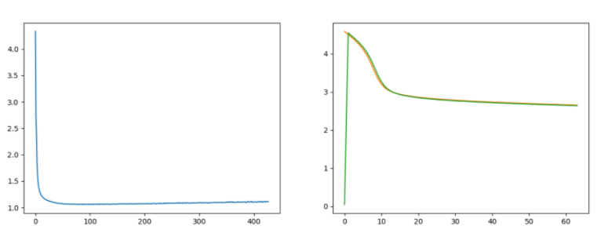

Slide 13
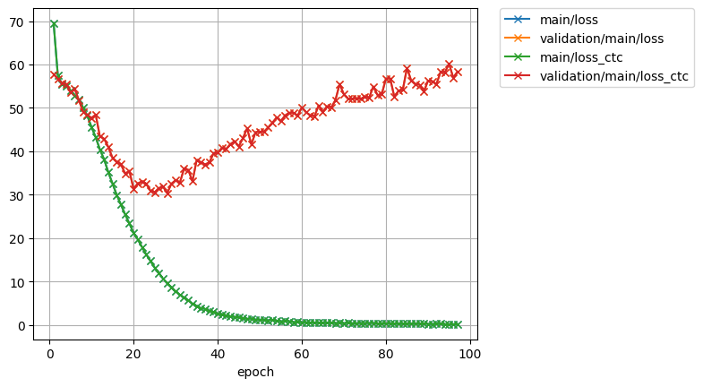
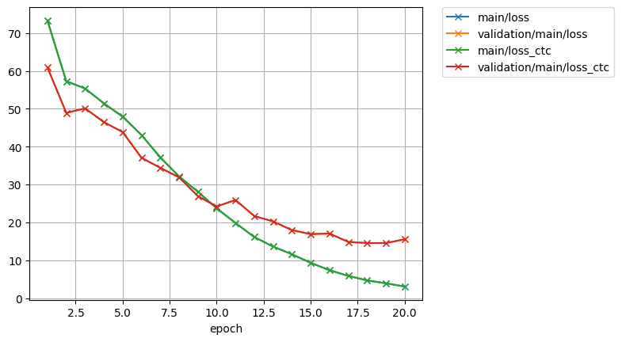
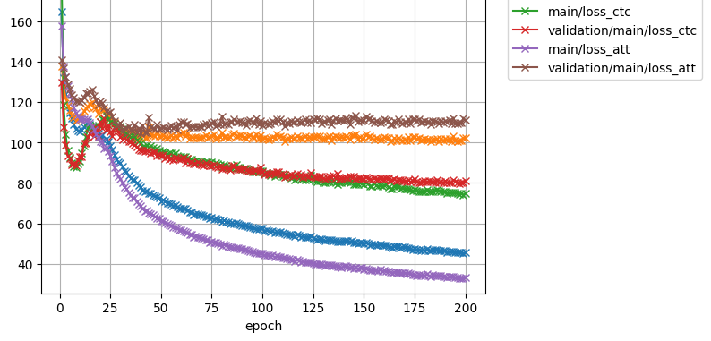
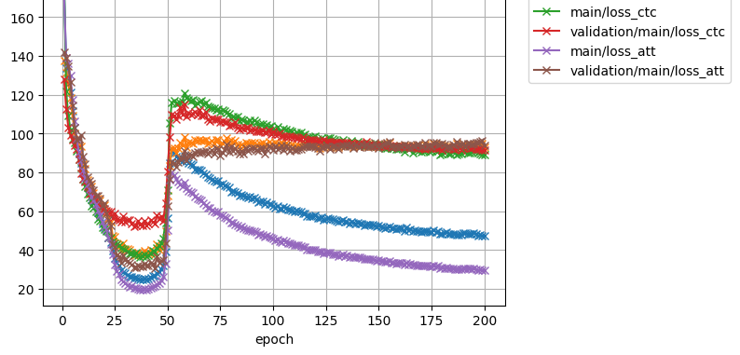
a
b
c
d

Slide 14





“du” “lait”
y’(0)
y’(1)
y’(2)
+
h(2)
$$α_{(3,0)}$$
$$α_{(3,1)}$$
$$α_{(3,2)}$$
+
SoftMax
Decoder
$$α_{(3,0)}$$
$$α_{(3,2)}$$
y(0)
y(1)
y(2)
e_{(3,0)}
e_{(3,1)}
e_{(3,2)}
Time Distributed (Dense)
h(2)
x(0)
x(1)
x(2)
y(0)
y(1)
y(2)
Encoder
Alignment model
“I” “drink” “milk”

Slide 15
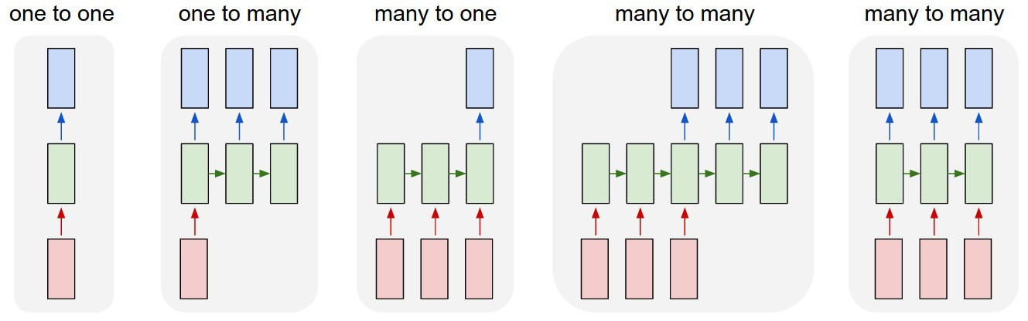
(a) SISO (b) SIMO (c) MISO (d) Asynchronous (e) Synchronous
MIMO MIMO

Slide 16
y
h(0)
h(1)
h(2)
x(0)
x(1)
x(2)
y(0)
y(1)
y(2)
h(2)
h(0)
h(2)
x(0)
x(1)
x(2)
x(1)
x(2)
x(3)
h(0)
h(1)
x(0)
x(1)
x(2)

