Slide 1
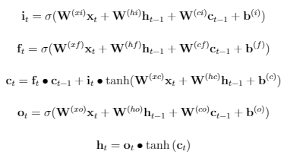













$$x_{t}$$
$$h_{t}$$
$$x_{t}$$
$$h_{t}$$
Input Gate
$$i_{t}$$
Output Gate
$$i_{t}$$
LSTM CELL
$$h_{t}$$
$$c_{t}$$
$$h_{t}$$
$$x_{t}$$
Forget Gate
$$i_{t}$$
$$x_{t}$$
$$h_{t}$$

Slide 3
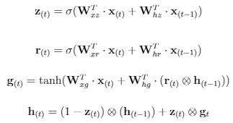
$$x_{t}$$
$$h_{t}$$
$$x_{t}$$
$$h_{t}$$
Input Gate
$$i_{t}$$
Output Gate
$$i_{t}$$
LSTM CELL
$$h_{t}$$
$$c_{t}$$
$$h_{t}$$
$$x_{t}$$
Forget Gate
$$i_{t}$$
$$x_{t}$$
$$h_{t}$$

Slide 4
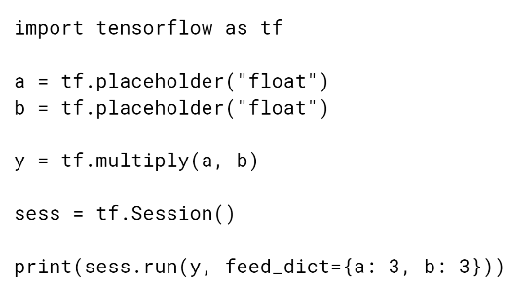
Import Tensorflow library
Define placeholder for input data
Build Graph stage
Add multiply to build graph
Run graph in session
Start a run session
Execute graph within session with data supplied

Slide 5
Language model evaluation pipeline
GRU LM train
GRU-Generated-Corpus 5-gram train
GRU-Generated-Corpus 5-gram evaluate perplexity
Held out data
5-gram LM train
5-gram LM evaluate perplexity

