Slide 1
Not Like This
Amazon Web Services
Network visualizer
Demo 2

Slide 2
Let's Review this holiday
Scrum! Sprint! Sleep!
Twice a week
Friday show client
Peer Programming
Pair programming in two groups
Graphics vs API

Slide 3
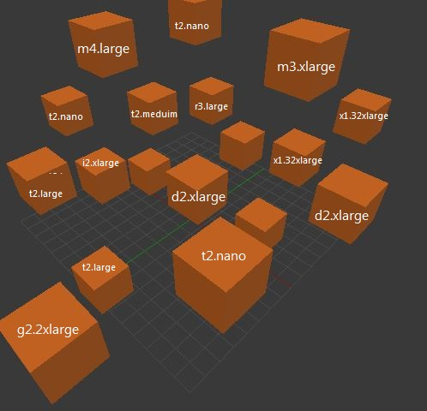
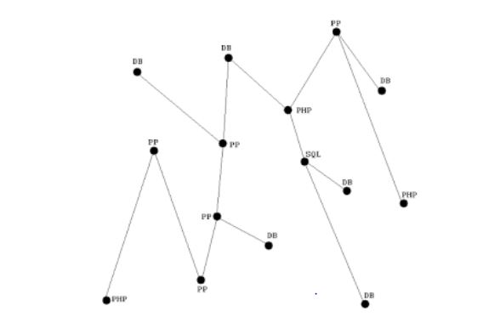
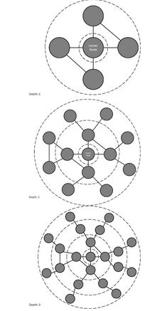
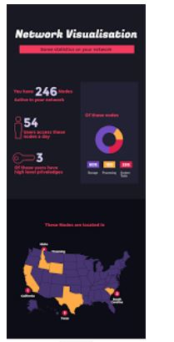
What we accomplished: Phase 1
Discussed his vision of the project and some potential implementations of the system

Slide 4
What we accomplished: Phase 2
Hierarchical representation
We have completed an early version of the Scanner, used to scan the network for information needed to be presented by the visualiser
We have completed an early version of the Visualiser, in which this information is displayed as a graph
We have an adapter, mock objects and unit tests

Slide 5
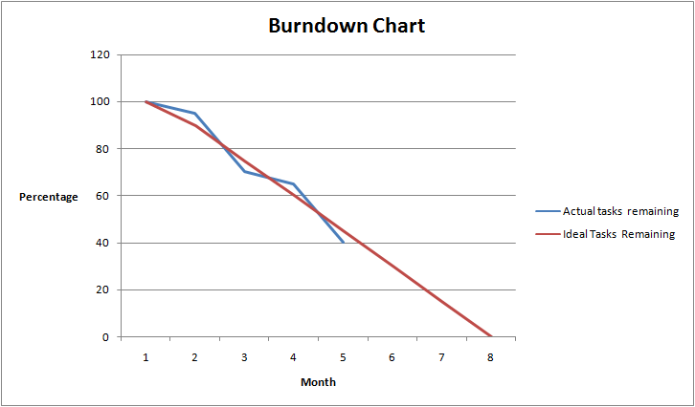
Problems

Slide 6
Architecture

Slide 7

Onions have layers!
We like onions

Slide 8
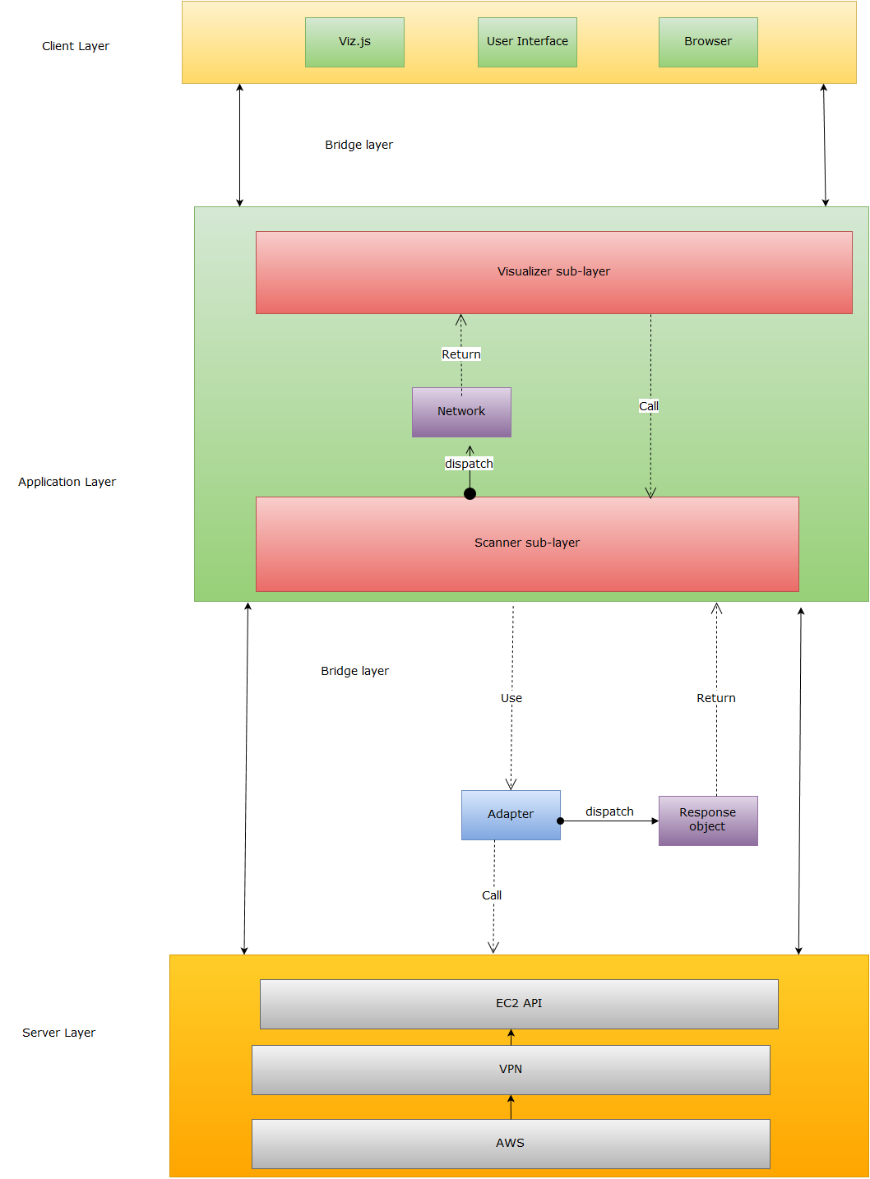

Slide 9
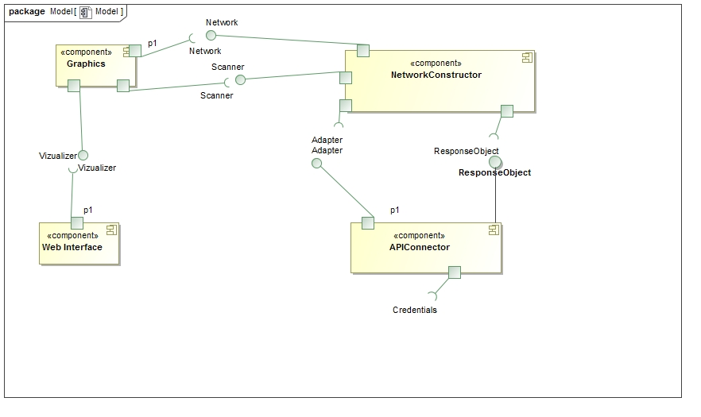

Slide 10
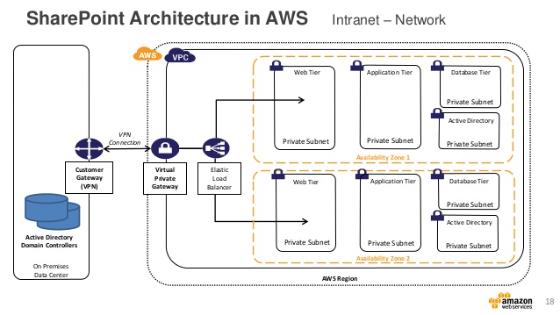
Knowledge for all

Slide 11
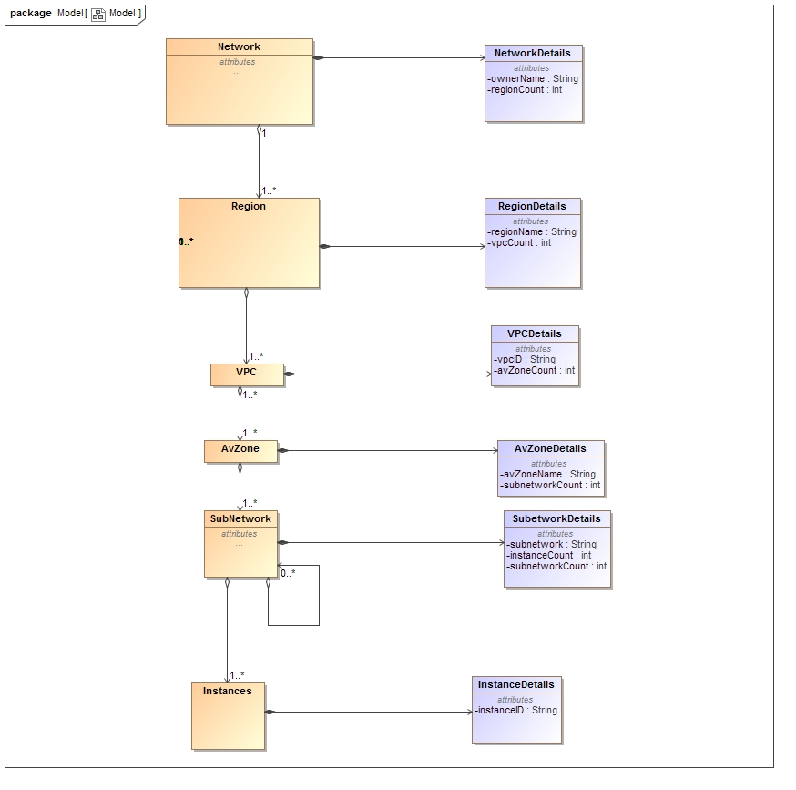

Slide 13
Why Not Composite?
121 was along time ago
Completely forgot
What is nice is interfaces
So stay tuned!

Slide 14
Questions?

