Slide 1
AWS Network Scanner
Team Not Like This
Muller Potgieter
Jedd Shneier
Daniel King

Slide 2

The briefest of explanations
We magically turn wishes into Trees

Slide 3
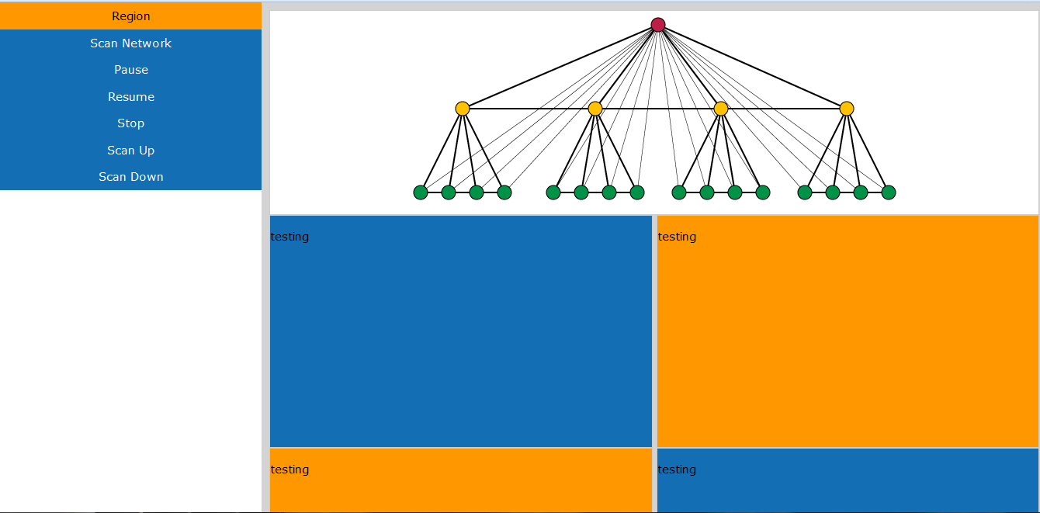
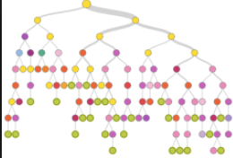


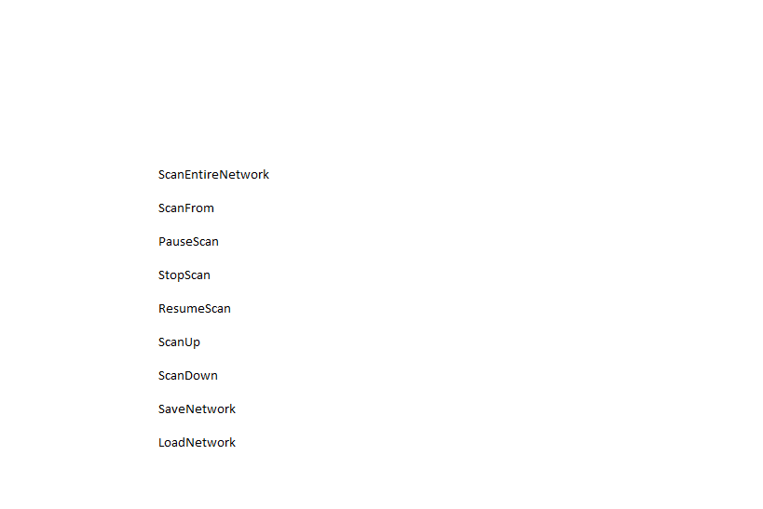
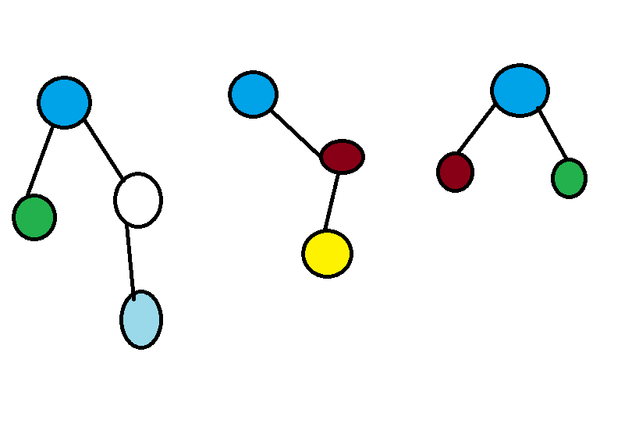
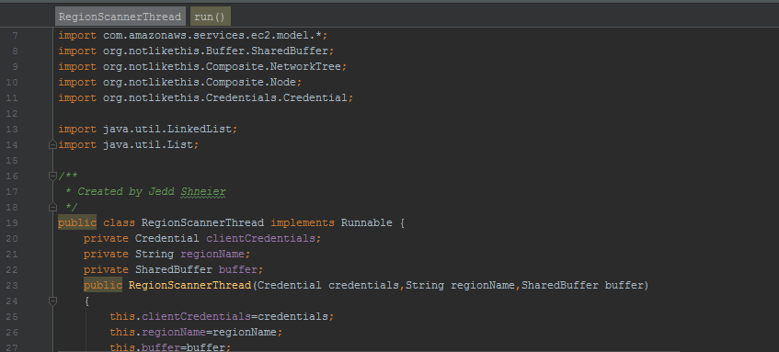

A bit more of an explanation
On our interface different scans are selected
Our own API handles the requests
The requests are mapped onto different scanners
Scanners thread off and start making calls from Amazons API
Each threads scans 100 nodes from Amazon and constructs a tree from each. Repeat until finished
A beautiful Tree is created for the user. With information, and Links!
The visualizer routinely checks the buffer and grabs the most current tree
Each tree is placed into the smart buffer which puts the disjoint subtrees into the correct order
User weeps with joy to finally be able to see his massive network clearly for the first time

Slide 4
What have we been up too
We stayed in school and said no to drugs

Slide 5
Oh you want more?
Scalability and Performance
That translates to architecture and algorithms
For Scalability :
- The Smart buffer constructs disjoint trees
- No matter what order they arrive in the tree will be correct
-Makes use of a thread safe queue, intelligent tree combining and our simple yet efficient composition
For performance:
-We thread on different criteria
-Depending on scan conditions we use architectural tactics to dynamically thread differently
-In theory..
-But so far static threading is working brilliantly

Slide 6
But wait there is more
We worked on our own API,
We spent weeks on our REST server
We are still working on that server
I don’t know why this is so hard
Like I mean come on now
I don’t like Java EE anymore
Our interface finally has nice pallet
EVERYTHING IS FINE

Slide 7
Now ladies please brace yourself

Slide 8
It’s time for

Slide 9
The WOW

Slide 10
The WOW
WE WORK WITH DATA
BIG DATA
LIKE YOU CAN’T EVEN COMPREHEND THE MAGNITUDE OF THE DATA WE WORKING WITH
Millions of instances each with their own collection of raw data
AND WE ARE PROCESSING AND VISUALIZING THIS AT RIDCULOUS SPEEDS
WHAT TAKES HOURS TO LIST FROM THE API WE FULLY VISUALIZE IN MINUTES
Within seconds you can see the information, you can explore it and you can get value from it
Our trees make it easy to fully explore your network
Our custom scans make it almost instantaneous to perform scans around parts of your network
Large scale companies like UBER, and Netflix can actually see IN REAL TIME what is happening on their entire massive…and I mean massive network
Our wow factor is that we bring you the information you need, faster then any other product, on a scale reserved for the largest companies in the world. And we display it beautifully, elegantly and intuitively
We have taken the virtual from cloud and created a tangible object to play with
AM I HYPING THIS ENOUGH!!!!
Like someone call the data mining students and let them learn a thing or two

Slide 11
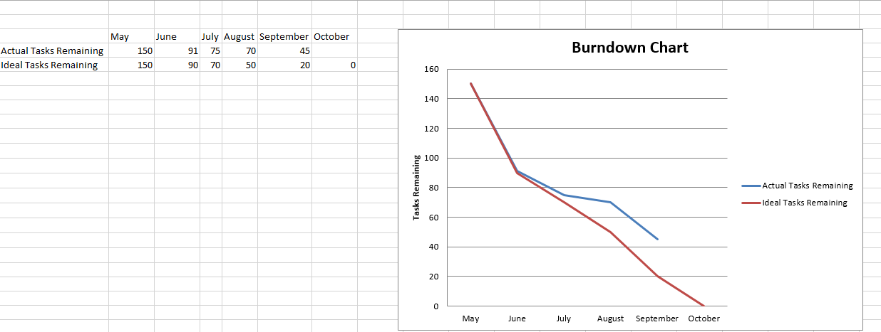
Burndown for what

